Slide 1
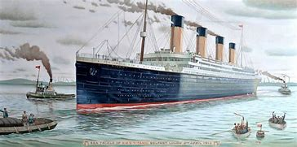
The Titanic
A Royal Mail Ship
Notes:
1. https://www.bluediamondtours.com/novascotiatours/halifax/titanictour.php

Slide 2
The Rotary Club of Canterbury “Let’s Stay Connected Project” has been developed as a response to an identified need within the Aged Care sector.
At times when it’s difficult to connect in person with family and friends, the Rotary Club of Canterbury has pleasure in offering you this booklet, designed to promote conversation, recollection and engagement for those who are in isolation and without their usual social activities.
The booklets have been designed for people in an aged care residence, village or at home to read by themselves, or to have a family or staff member share the booklet with them.
You can download this and other booklets from the Rotary Club of Canterbury website (www.canterburyrotary.org).
Source references for this book are held at the Rotary Club of Canterbury. Contact president@caterburyrotary.org for further details.
Material in this book was reproduced in accordance with Section 113F of the Copyright Act (1968).

Slide 3
Hello!
My name is Rosemary and I live in Melbourne Victoria, Australia.
I am a member of the Rotary Club of Canterbury.
I have been lucky to travel to places that were significant to the Titanic.
I wrote this book about the Titanic to share my travels with you.
I hope you enjoy the story of my Titanic experience as much as I enjoyed writing it.
Rosemary

Slide 4
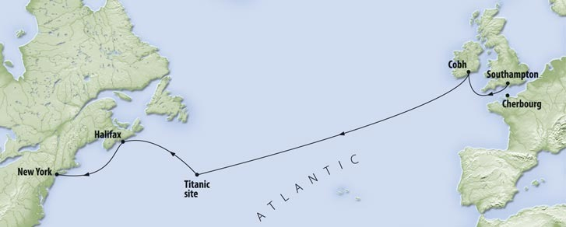
Itinerary
I have been lucky to travel to several places significant to the Titanic:
Belfast - Titanic was built and the Titanic Experience Museum;
Halifax - Nova Scotia, Canada, cemetery and Maritime Museum;
Cherbourg, France - where ferries took passengers out to the Titanic; and
New York – Titanic’s destination and where survivors were taken.

Slide 5
A Mail Ship
The Titanic was not only a passenger ship – it was also a Royal Mail Ship for the British Royal Mail Service.
Over 7 million items of mail were lost when it sank.
Notes:
1. https://www.slideserve.com/fiona-mcleod/rms-titanic

Slide 6
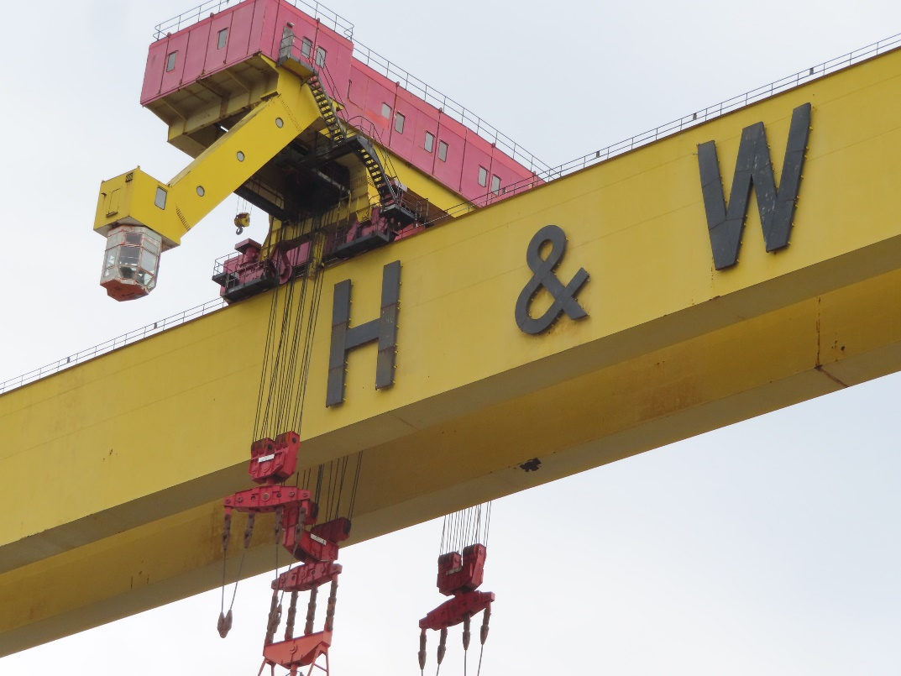
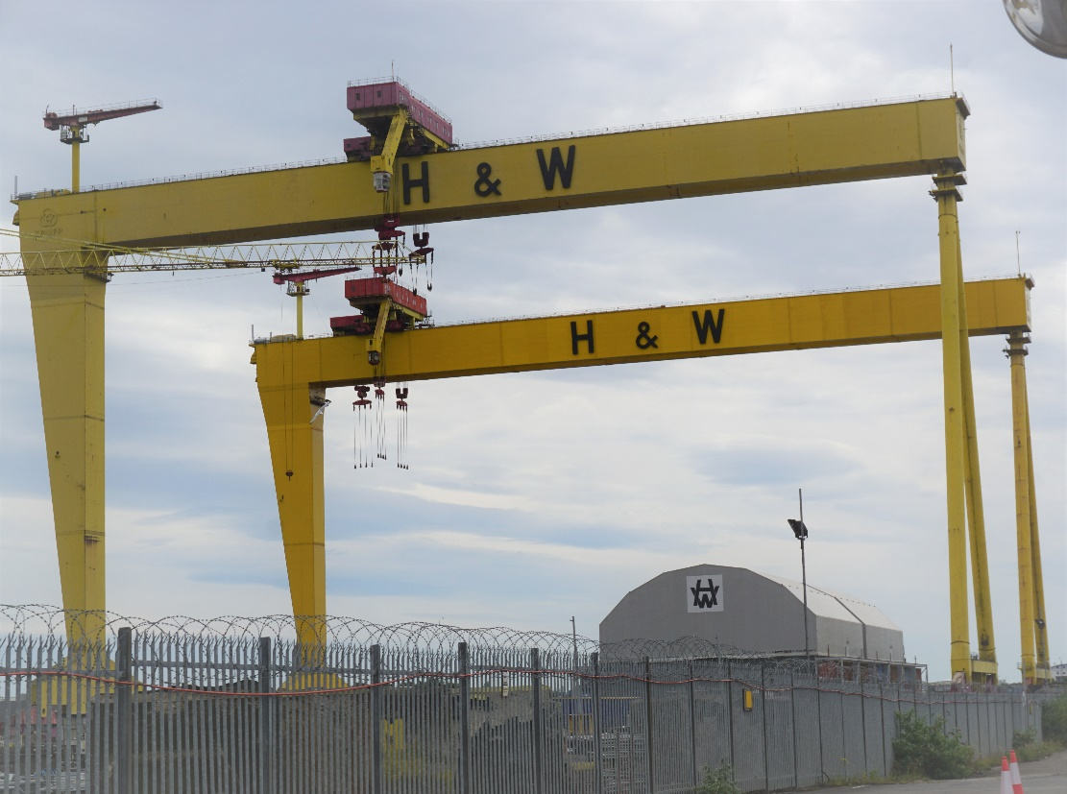
Building The Titanic
Titanic was built by Harland and Wolff Company.
The two cranes used to build the Titanic are still in use – called Goliath and Samson. They are 100m wide and 150m high.
The Arrol Gantry stands 228 feet (69 m) high, is 270 feet (82 m) wide and 840 feet (260 m) long.
Notes:
Photo supplied by the author
Photo supplied by the author

Slide 7
Building The Titanic
The Titanic’s keel was laid on 31 March 1909 and it took about 26 months to build.
There were 2,000 hull plates single pieces of rolled steel plate. These were mostly up to 6 feet (1.8m) wide and 30 feet (9.1m) long. They each weighed between 2.5 and 3 tons.
Notes:
1. https://www.deviantart.com/cjca915/art/RMS-Olympic-244113154

Slide 8
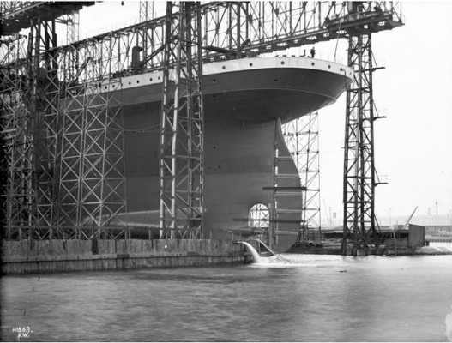
The stern and one of the steam engines built by Harland & Wolff’s Engine Works, Belfast, May 1911.
Building The Titanic
Notes:
https://www.thevintagenews.com/2018/02/25/titanic-2/
https://www.thevintagenews.com/2018/02/25/titanic-2/

Slide 9
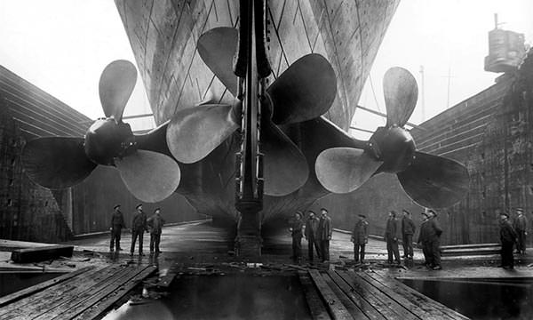
Rudder Facts
Height of Titanic’s rudder – 78 feet 8 inches (23.8m).
Weight of rudder – 100 tons
Span of central propeller – 17 feet (5.2m).
Span of each outer propeller – 23 feet 6 inches (7 m).
Notes:
https://www.theactivetimes.com/adventure/titanic-20-differences-between-movie-and-real-story/slide-17

Slide 10
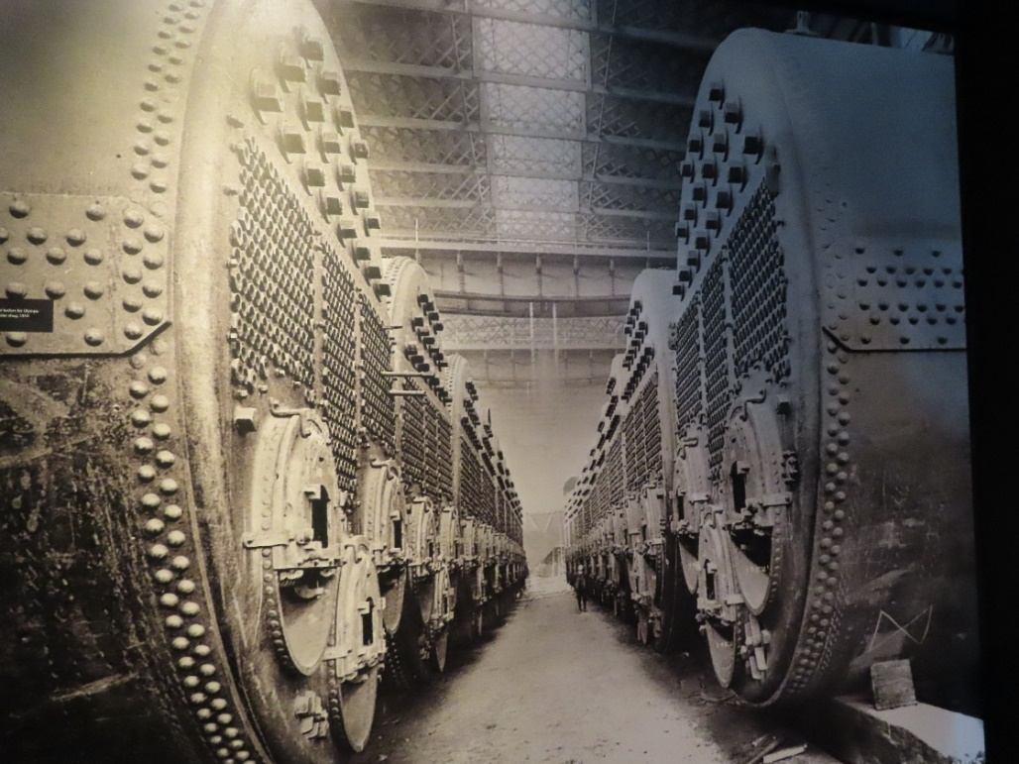
The Biggest Ship
At the time she was built, Titanic was one of the biggest ships ever built. You can see from the size of her boilers that she was a huge ship.
Can you see the man at the back?
Notes:
1. https://www.ultimatetitanic.com/construction

Slide 11
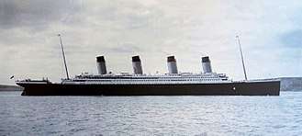
Construction Facts and Figures
The Titanic was one of three Olympic-class ships constructed on Queen's Island, now known as the Titanic Quarter, in Belfast Harbour.
Titanic was 882 feet 9 inches (269m) long with a maximum breadth of 92 feet 6 inches (28m). Her total height, measured from the base of the keel to the top of
the bridge, was 104 feet (32m).
There were ten decks (excluding the top of the officers' quarters) eight for passenger use.

Slide 12
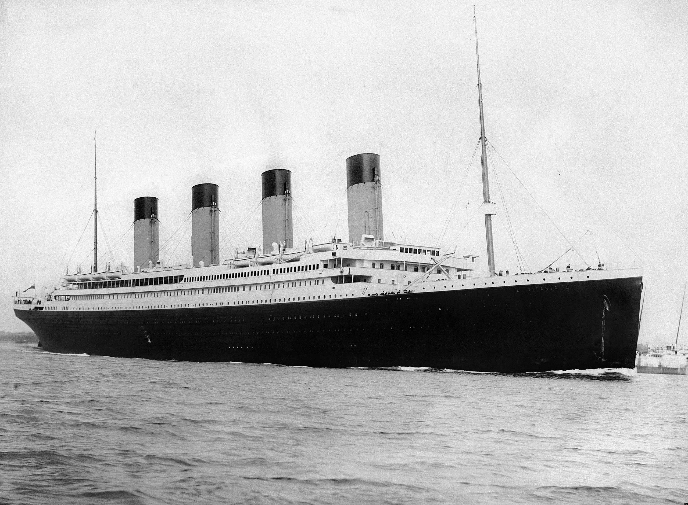
Construction Costs
The Titanic cost 1.5 million British pounds to build in 1911 and took just over two years to build.
The average wage then was about 2 British pounds per week.
Over 15,000 people helped build the ship.
The fourth funnel on the Titanic was a fake but it made the ship look grander
Notes:
1. https://en.wikipedia.org/wiki/Titanic#/media/File:RMS_Titanic_3.jpg

Slide 13
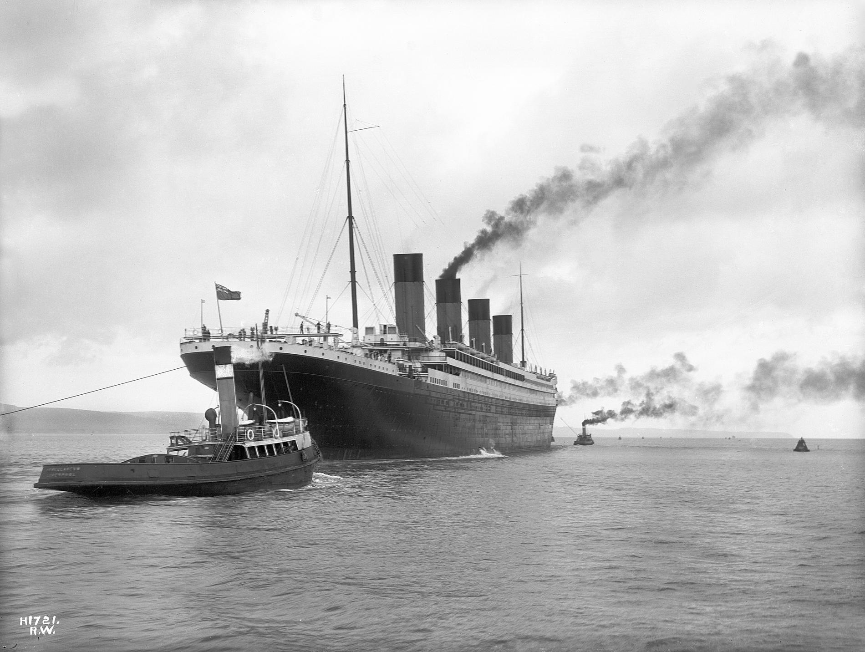
Launch
Titanic was launched at 12:15 pm on 31 May 1911 in front of around 100,000 onlookers.
Twenty-two tons of soap and tallow were spread on the slipway to lubricate the ship's passage into the River Lagan.
RMS Titanic leaving Belfast for sea trials on 2 April 1912.
Notes:
https://en.wikipedia.org/wiki/Titanic#/media/File:RMS_Titanic_2.jpg

Slide 14
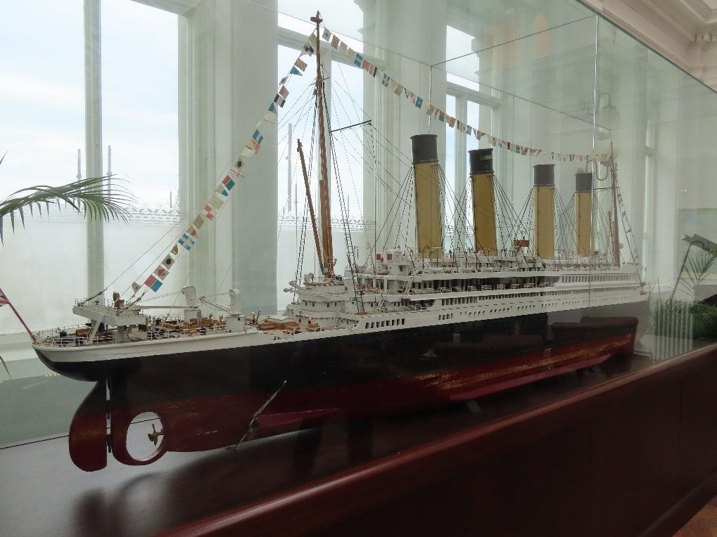
Mementos and Monuments
What was once the Harland and Wolff drafting room is now the bar of the Titanic Hotel.
There is a 3.8 metre model of Titanic in the bar.
Notes:
1. Photo supplied by the author

Slide 15
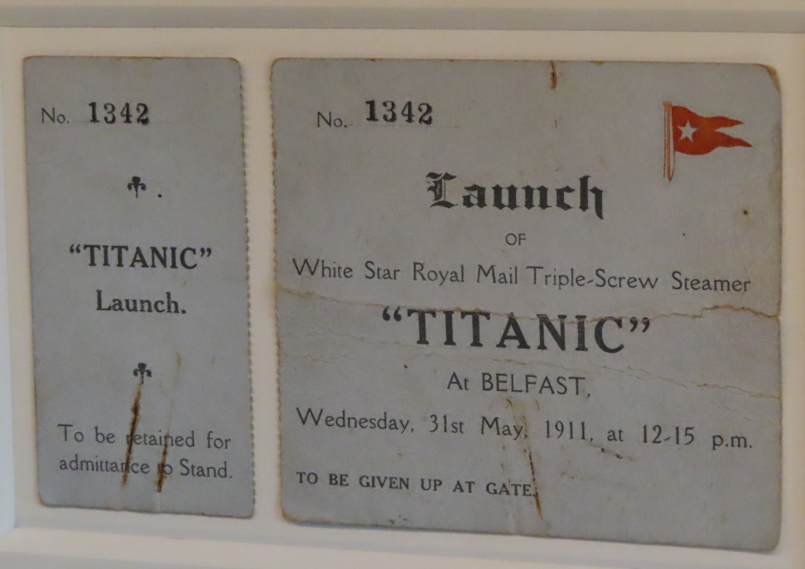
Mementos and Monuments
One Harland and Wolff staff member kept her ticket to see the launch as a memento.
Notes:
1. Photo supplied by the author

Slide 16
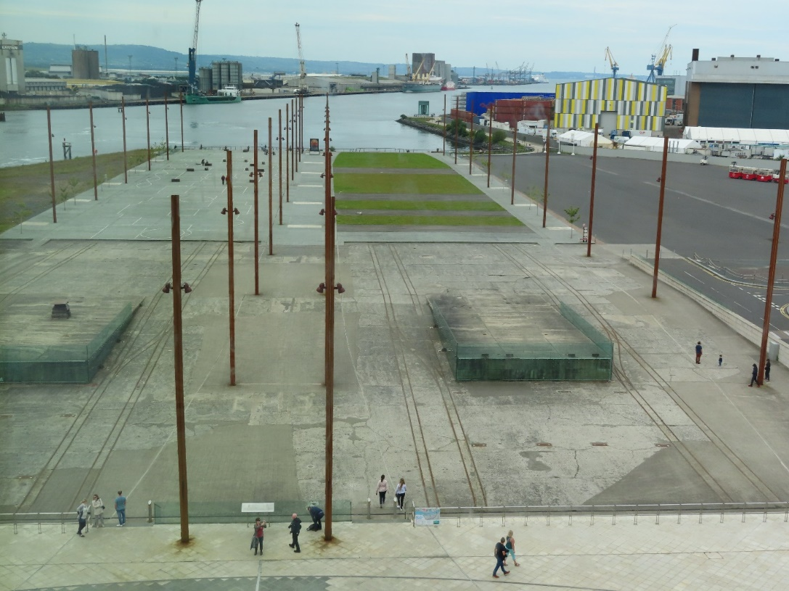
Mementos and Monuments
The slipway where Titanic was launched is now a memorial.
The poles were there to support the ship.
Three docks were demolished to accommodate the new Olympic-class ship.
Notes:
1. Photo supplied by the author

Slide 17
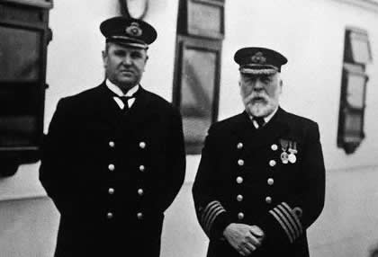
Facts on the Crew
The Titanic had 908 crew members, of whom only 23 were women. The youngest crew were only 14. The crew included:
2 doctors
2 window cleaners
6 lookouts
25 engineers
165 firemen
8 musicians
First Officer William Murdoch and Captain Edward Smith
Notes:
https://thehistoricalnovel.files.wordpress.com/2013/05/titanic-crew-list.jpg

Slide 18
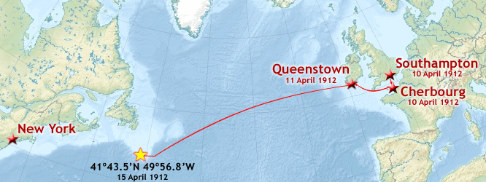
Maiden Voyage
Titanic left for her maiden voyage on 10 April 1912. She was to go to New York, via Southampton, Cherbourg (France), and Queenstown (Ireland). The map shows the route with the coordinates of her sinking.
Notes:
1. Photo supplied by the author
2. https://en.wikipedia.org/wiki/Titanic#/media/File:Titanic_voyage_map.png

Slide 19
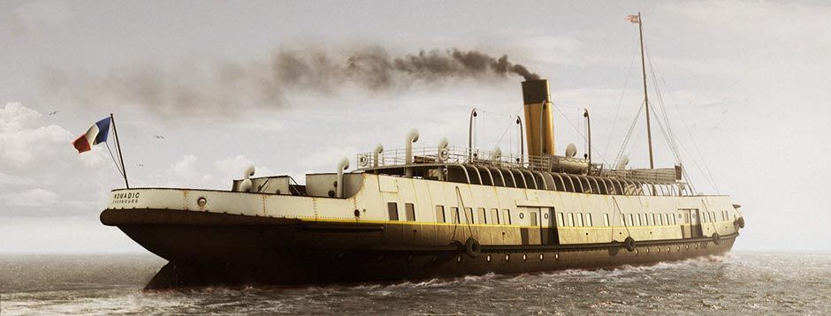
Getting to The Titanic
Special trains were scheduled from London and Paris to convey passengers to Southampton and Cherbourg respectively.
Nomadic ferried passengers between the dock and Titanic at Cherbourg.
Notes:
1. https://www.encyclopedia-titanica.org/nomadic.html

Slide 20
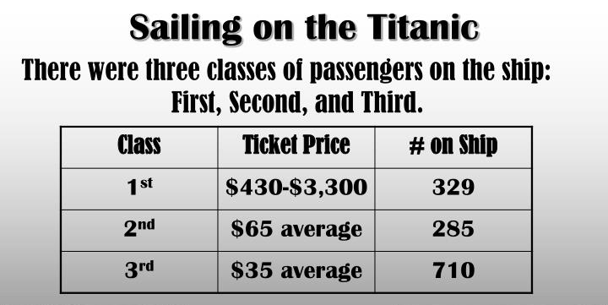
Passenger Facts
Most of the passengers boarded the ship at Southampton:
179 First Class
247 Second Class and
494 Third Class – including many who were migrating to America.
By the time all passengers had boarded from all ports, there were a total of 1325 passengers aboard of whom 112 were children. The ship could carry 2435 passengers, so fortunately was under capacity considering the disaster about to occur.
Notes:
1. https://www.slideserve.com/fiona-mcleod/rms-titanic

Slide 21
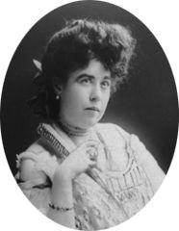
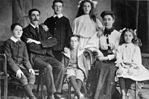
Class Distinction
Stewards showed Second and Third Class passengers to their cabins, while First Class passengers were personally greeted by Captain Smith.
Third Class passengers were inspected for ailments and physical impairments to ensure their entry into America.
Second and Third Class passengers were not to mingle with the First Class passengers.
First Class passenger Margaret (Molly) Brown survived.
Third Class passengers Mr & Mrs Goodwin & children all perished.

Slide 22
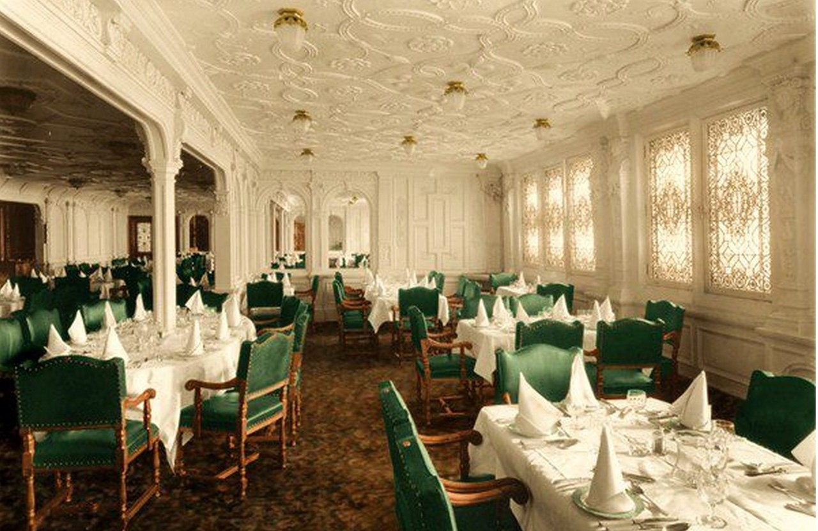
First Class – Grand Style
Titanic was a luxury ship with many famous and wealthy people on board.
This is the Grand Central staircase (above) and the First Class dining room (right).
Notes:
Photo: https://luxurylinerrow.com/online-museum/olympic-titanic-staircase/
https://www.deviantart.com/rms-olympic/art/Titanic-Honour-and-Glory-554698448

Slide 23
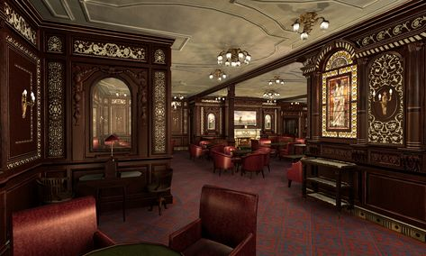
First Class – Luxurious Amenities
The first-class accommodation was designed to be the pinnacle of comfort and luxury, with a gymnasium, swimming pool, libraries, high-class restaurants, and opulent cabins.
This smoking room was for First Class gentlemen only.
Notes:
1. https://www.moddb.com/mods/mafia-titanic-mod/images/smoking-room-completed3

Slide 24
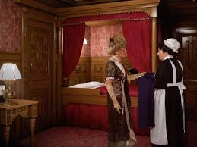
First Class Accommodation
Titanic had 39 private suites located at the top of the ship. Each had two large bedrooms, two walk-in wardrobes and a bathroom.
There was also a spacious sitting room to entertain guests and servants quarters.
Suites cost up to £870 which is the equivalent of £79,000 today!
Notes:
https://en.wikipedia.org/wiki/First-class_facilities_of_the_Titanic#/media/File:Titanic's_B_59_stateroom.jpg
https://www.businessinsider.com.au/titanic-ll-compare-to-the-original-2018-11?r=US&IR=T

Slide 25
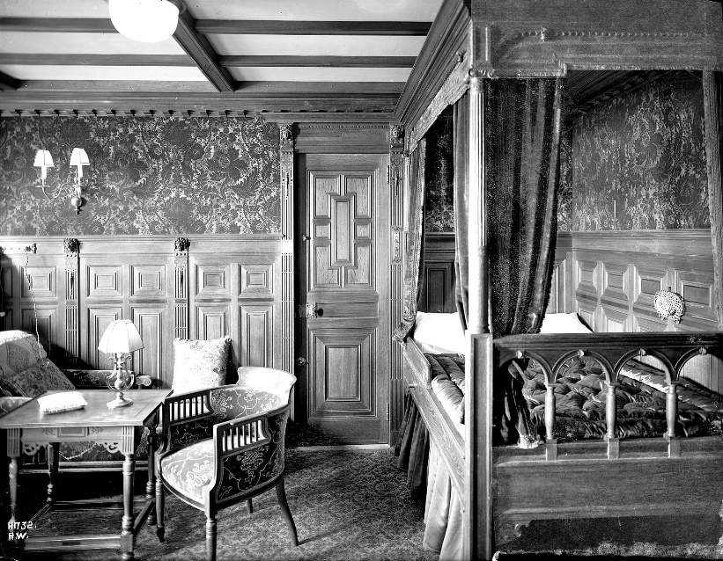
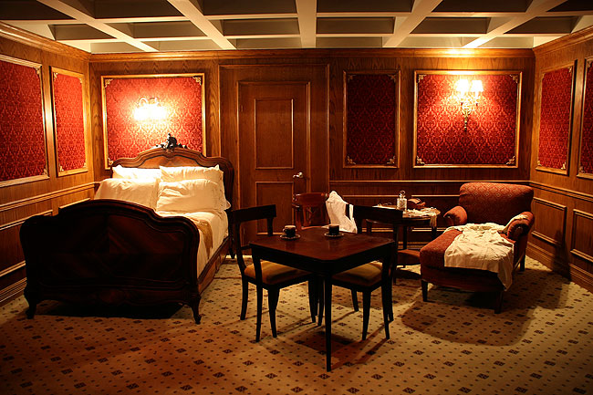
First Class Accommodation
The First Class cabins were luxurious.
Notes:
https://www.ultimatetitanic.com/interior-fittings

Slide 26
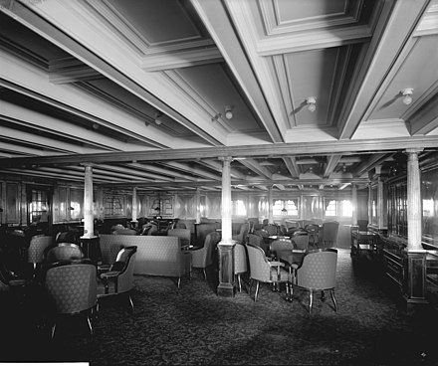
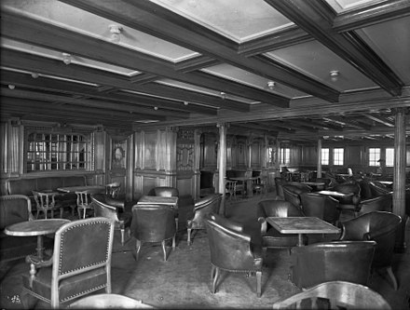
Second Class Amenities
Passengers in second class had facilities such as a spacious outdoor promenade, a smoking room, a library and dining room. Afternoon tea and coffee was served in the library.
Notes:
https://en.wikipedia.org/wiki/Second-_and_third-class_facilities_on_the_Titanic
https://en.wikipedia.org/wiki/Second-_and_third-class_facilities_on_the_Titanic

Slide 27
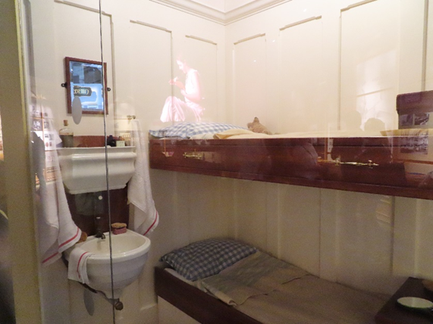
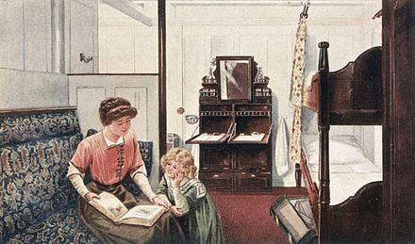
Second Class Accommodation
Most of the Second Class accommodation on Titanic consisted of cabins with bunk-beds.
These cabins didn’t have private bathrooms, but inside there were sinks and mirrors and the bed linen was changed every day.
Notes:
1. https://en.wikipedia.org/wiki/Second-_and_third-class_facilities_on_the_Titanic
2. https://upload.wikimedia.org/wikipedia/commons/3/33/2nd-Class_Library_on_the_RMS_Olympic.jpg

Slide 28
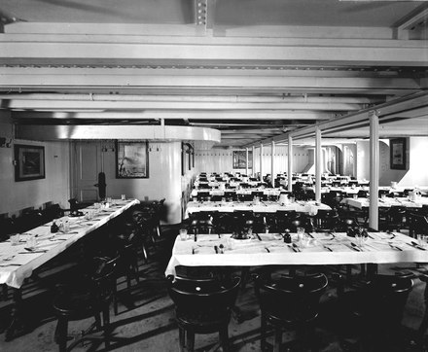
Third Class
The passengers in third class were mainly immigrants heading for a new life in America. They came from a variety of locations across Europe such as Ireland, England, Scandinavia and a significant number also came from the Middle East as well as some Jewish migrants.
Single men and women were split up at the front and back with families in the middle.
There were only two baths for everyone in third class!
Third class dining room
Notes:
1. https://www.lovefood.com/gallerylist/69139/the-titanics-incredible-menu-revealed-for-every-class

Slide 29
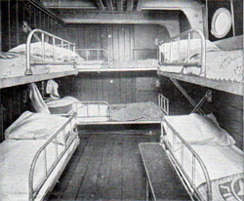
Third Class
The general room was where most passengers gathered, talked and socialised.
There was a piano for passengers to make their own music in the evenings.
The food was simple but plentiful consisting of rice, soup, biscuits, roast beef and fruit.
Cabins slept up to 10 people and were located at the noisy bottom part of the ship close to the engines.
Third class cabin
Notes:
1. http://www.titanicuniverse.com/wp-content/uploads/2018/01/thirdclass.jpg

Slide 30
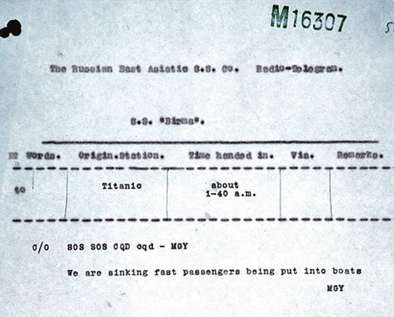
Disaster Strikes
Only 4 days into her voyage, Titanic struck an iceberg at 11.45pm on 14 April.
Titanic sent out a distress signal, CQD, which was the international distress signal at the time.
The last call from Titanic at 2.10am was CQ…… then silence.
Notes:
https://en.wikipedia.org/wiki/Sinking_of_the_Titanic#/media/File:Titanic_signal.jpg
https://www.google.com/search?q=iceberg&rlz=1C5CHFA_enAU906AU906&sxsrf=ALeKk01Er5Zf0R8M1C7jpxAKfvwNo8YQDA:1601008361261&tbm=isch&source=iu&ictx=1&fir=Z4jkPQP_dcf0jM%252Cb6A5NHT2e59Y_M%252C%252Fm%252F012mqx&vet=1&usg=AI4_-kSMg-Fg8JTUJ8G_cXcRJC888p0nvQ&sa=X&ved=2ahUKEwiU2J71vIPsAhUJzTgGHZGJDoMQ_B16BAgHEAM#imgrc=Z4jkPQP_dcf0jM

Slide 31
The Titanic Sinks
The starboard side of the ship hit an iceberg, making five widely separated holes in the hull of the ship.
Two hours and 40 minutes later, the Titanic sank.
Over 1,500 people died when Titanic sank at 2.20am on 15 April 1912. There were not sufficient lifeboats available.
Notes:
https://www.deviantart.com/filipeps/art/Titanic-190912742

Slide 32
Help Arrives
The Carpathia was fifty-eight miles away from the sinking Titanic when they received the CQD / SOS message.
Carpathia in Halifax Harbour 1912.
Notes:
Picture: The National Archives/Heritage-Images/Imagestate

Slide 33
The Carpathia
Over an hour after the sinking, at 4am, RMS Carpathia arrived and rescued about 705 people from the lifeboats.
All of the Titanic survivors were on the Carpathia by 9am that morning.
Notes:
1. http://alookthrutime.com/carpathia-arrives-titanic-survivors-are-rescued/

Slide 34
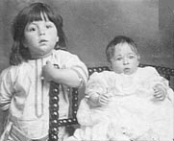
The Youngest Survivor
Eliza (Malvina) Dean was the youngest survivor of Titanic. She was just 2 months old.
She and her brother survived with their mother, Etta
Eliza lived to the age of 97.
Malvina (right) and her brother Bertram (on the left).
Notes:
1. https://en.wikipedia.org/wiki/Sinking_of_the_Titanic#/media/File:Titanic_signal.jpg

Slide 35
New Maritime Regulations
After the disaster, recommendations were made by both the British and American Boards of Inquiry stating that ships should:
carry enough lifeboats for all aboard
lifeboat drills would be implemented
lifeboat inspections would be conducted
In Britain, new "Rules for Life Saving Appliances" was passed by the Board of Trade on 8 May 1914.

Slide 36
New Maritime Radio Regulations
The United States government passed the Radio Act of 1912. This Act stated that radio communications on passenger ships would be operated 24 hours a day, along with a secondary power supply, so as not to miss distress calls.
The Act required ships to maintain contact with vessels in their vicinity as well as coastal onshore radio stations.
It was agreed that the firing of red rockets from a ship must be interpreted as a sign of need for help.

Slide 37
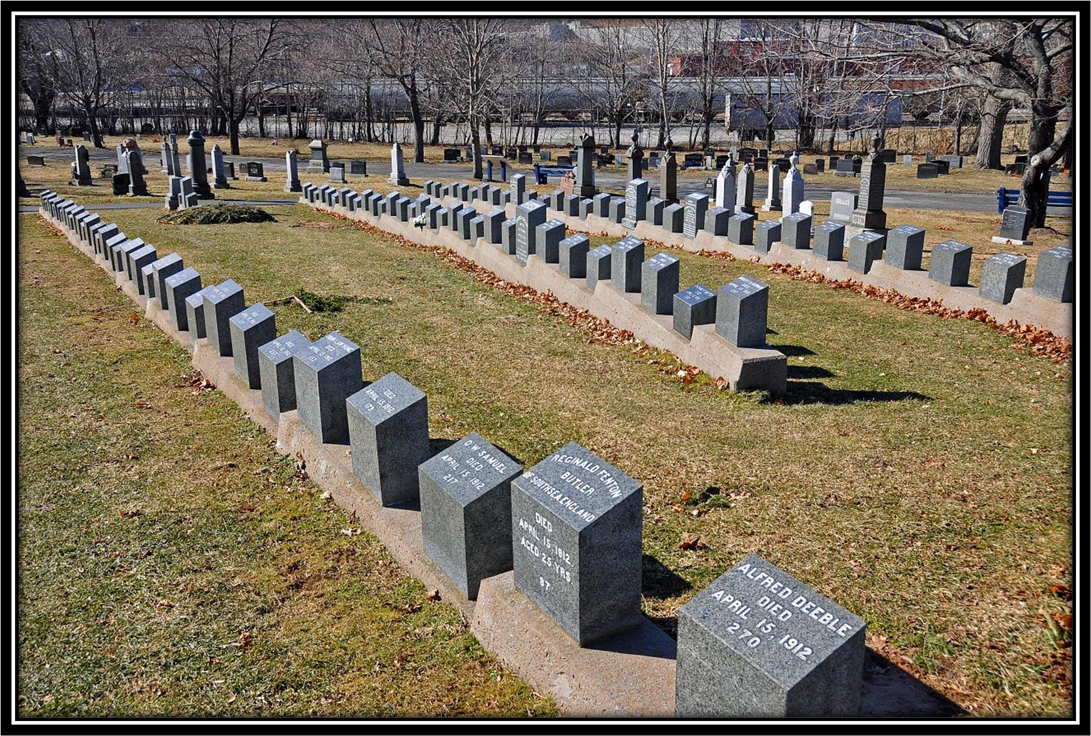
Memorials
A memorial and headstones for those who perished on the Titanic can be found at the Fairview Lawn Cemetery in Halifax, Canada.

Slide 38
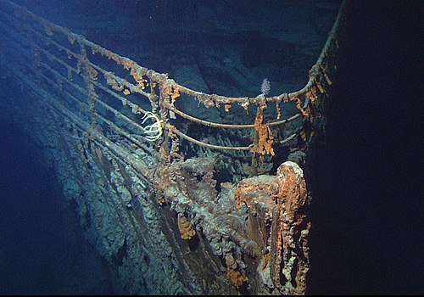
Finding The Wreck
The wreck of Titanic continues to fascinate people more than 100 years after she sank.
The Titanic wreck was discovered in 1985 (73 years after the disaster).
Recovered artifacts are in various museums around the world.
Many films have been made about Titanic.
The bow of the wrecked RMS Titanic, photographed in June 2004
Notes:
https://en.wikipedia.org/wiki/Titanic#Building_and_preparing_the_ship

Slide 39
Titanic Experience Museum
The Titanic Experience Museum is on the site where the Titanic was built.
The wings of the building are the same size as the bows of Titanic and her sister ship, Britannic.
The colours of the building represent the cold grey sea, the stars and the icebergs.
The building is 5 storeys high.
Notes:
1. https://www.buzz.ie/news/titanic-belfast-to-reopen-from-tomorrow-onwards-381406

Slide 40
I hope you enjoyed my version of the Titanic experience as much as I have in putting it together.
Rosemary Waghorne
September 2020
Notes:
1. https://www.buzz.ie/news/titanic-belfast-to-reopen-from-tomorrow-onwards-381406

