Slide 1

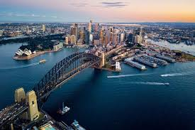

A HOLIDAY IN SYDNEY
Hello, My name is Val and I invite you to join me on two trips to Sydney.
One was taken by my Grandmother in 1950 and the other was taken by me just last year.
Let’s compare the differences…. And discuss your experiences of visiting Sydney.
Vall
Notes:
https://www.10best.com/interests/explore/sydney-australia-virtual-photo-tour/

Slide 2
The Rotary Club of Canterbury “Connecting in Isolation Project” has been specifically developed to support residents in aged care accommodation during the Covid-19 pandemic.
In times when it’s difficult to connect in person with family and friends, the Rotary Club of Canterbury has pleasure in offering you this booklet, designed to promote conversation, recollection and engagement to those who are in isolation and without their usual social activities.
The booklets have been designed for people in an aged care residence to read by themselves, or to colour in the pictures, or to have a family member at the other end of the phone read the booklet to them.
You can download this and other booklets from the Rotary Club of Canterbury website (www.canterburyrotary.org).
Source references for this book are held at the Rotary Club of Canterbury. Contact president@caterburyrotary.com.au for further details. Material in this book was reproduced in accordance with Section 113F of the Copyright Act (1968).

Slide 3
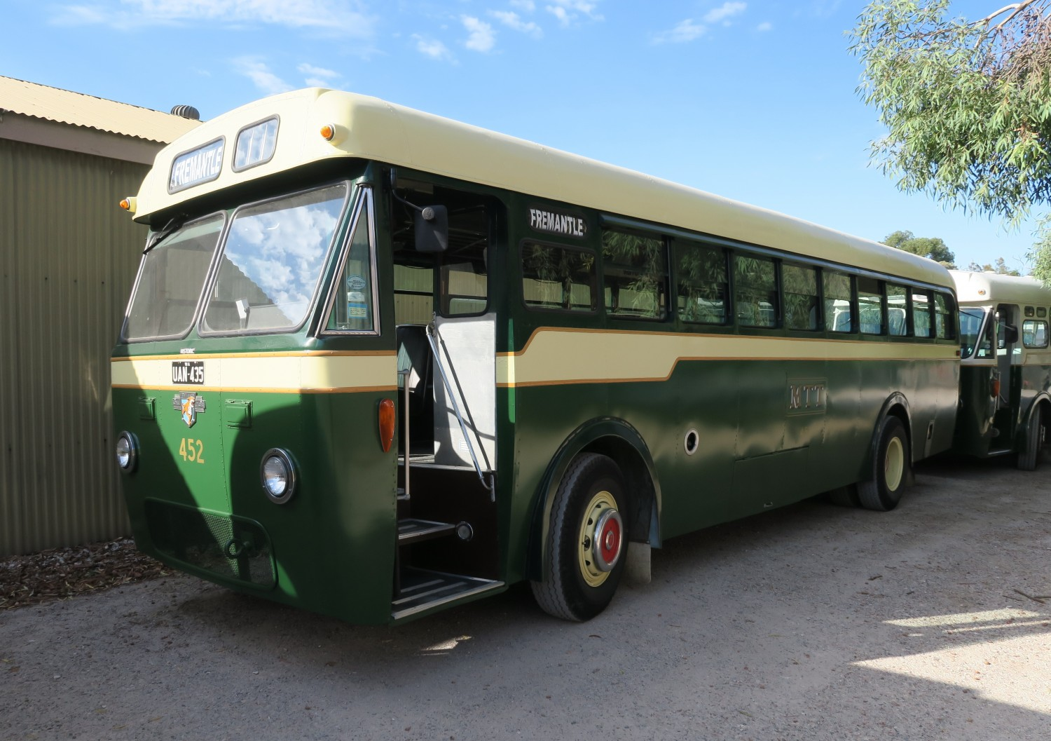
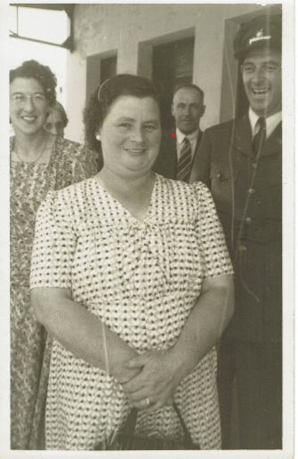
Travelling to Sydney 1950
My grandmother, Nanna Cook, would have travelled in a coach like this, leaving from Spencer Street Station.
Nanna: ready for the long trip up the Hume Highway. Note the smiling bus driver in his snappy suit and cap.
My guess is that it would have been a two-day trip.
Where do you think they would have stopped?
Notes:
https://assets.shannons.com.au/images/UGU4DK7CEA50C0V/TDP17824IB2F2EG2/2048x2048x3/sp0hs75sglhdga92.jpg
Author’s own photo

Slide 4
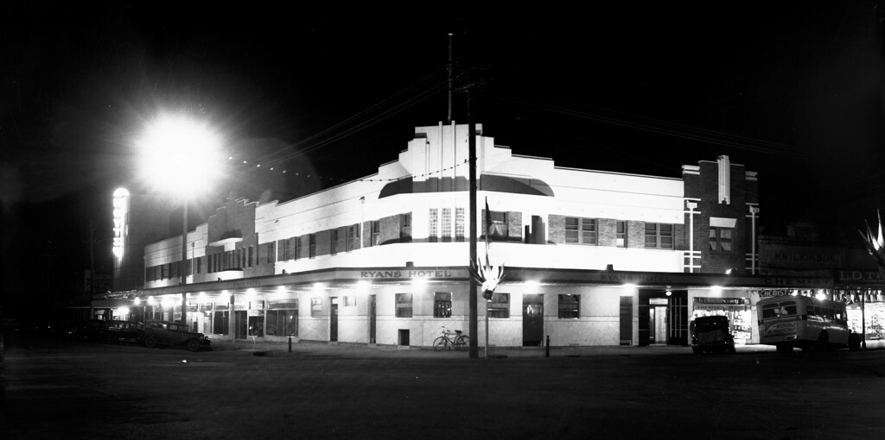
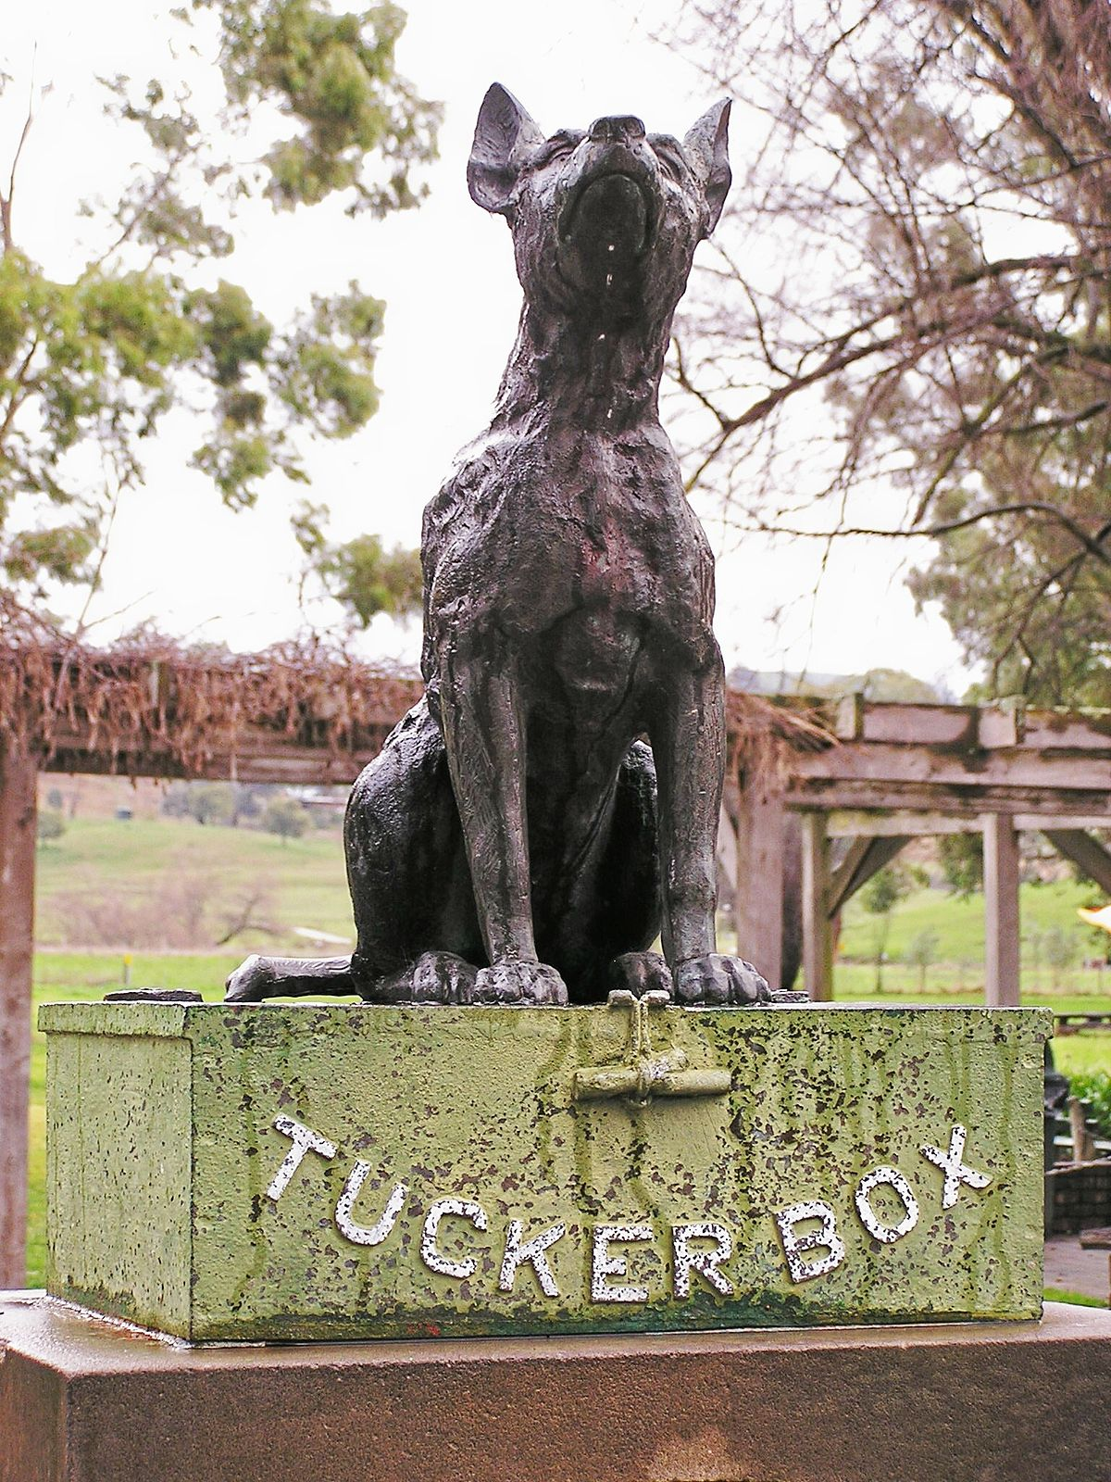
Travelling to Sydney 1950
I know they stopped overnight somewhere along the way
Maybe here… Ryans Hotel Dean Street Albury 1950s
But they most certainly would have stopped for a cuppa here…
Where does the dog sit on the tuckerbox?
Can you remember the song?
“My Mabel waits for me ….
Notes:
https://www.flickr.com/photos/oakleystudios/243013691
https://en.wikipedia.org/wiki/Dog_on_the_Tuckerbox

Slide 5
Travelling to Sydney 1950
Lyrics to song Where the Dog Sits On the Tucker Box by Slim Dusty
My Mabel waits for me underneath the bright blue sky,
Where the dog sits on the tucker box nine miles from Gundagai.
I meet her ev'ry day and I know she's dinky di,
Where the dog sits on the tucker box nine miles from Gundagai.
I think she's bonzer and she reckons I'm good O.
She's such a trimmer that I've entered her for the local show;
And my Mabel waits for me underneath the bright blue sky,
Where the dog sits on the tucker box nine miles from Gundagai.
Notes:
https://www.thedogonthetuckerbox.com/yahoo_site_admin/assets/images/384.204101737.jpg
https://www.krakenlyrics.com/slimdusty/wherethedogsitsonthetuckerbox-93d130c4.html

Slide 6
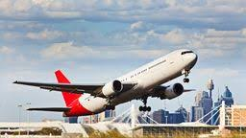
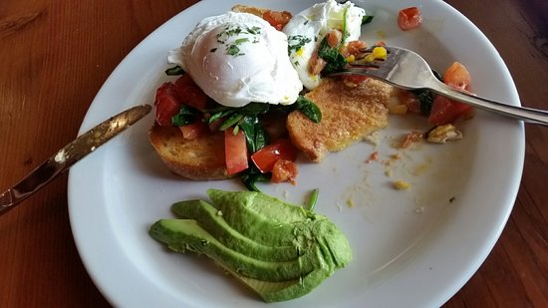
Travelling to Sydney 2020
Most people now travel from Melbourne to Sydney by plane.
Did you know that Melbourne to Sydney was listed as the second busiest
domestic route in
the world?
There are almost 150 flights each day!
We sometimes fly, but often journey by car. It only takes 10 hours these days. The dog still sits on the tuckerbox, but with a somewhat tacky café beside it.
So we choose to stop at a Gourmet Café in Holbrook. Food stops along the way have vastly improved.
Notes:
https://www.google.com/imgres?imgurl=https%3A%2F%2Fwww.kayak.com.au%2Frimg%2Fdimg%2F44%2F45%2F2e9c11d2-ap-SYD-1705ddf1bca.jpg%3Fcrop%3Dtrue%26width%3D256%26height%3D144&imgrefurl=https%3A%2F%2Fwww.kayak.com.au%2Fflight-routes%2FAustralia-AU0%2FSydney-Kingsford-Smith-SYD&tbnid=88-sx0LgYnF-mM&vet=12ahUKEwiq76iE6brrAhW55nMBHW3kBnsQMygJegUIARC2AQ..i&docid=0Gu_-OJOp5orRM&w=256&h=144&q=cheap%20flights%20to%20sydney&ved=2ahUKEwiq76iE6brrAhW55nMBHW3kBnsQMygJegUIARC2AQ
https://media-cdn.tripadvisor.com/media/photo-s/0d/50/b3/30/20161016-104437-largejpg.jpg

Slide 7
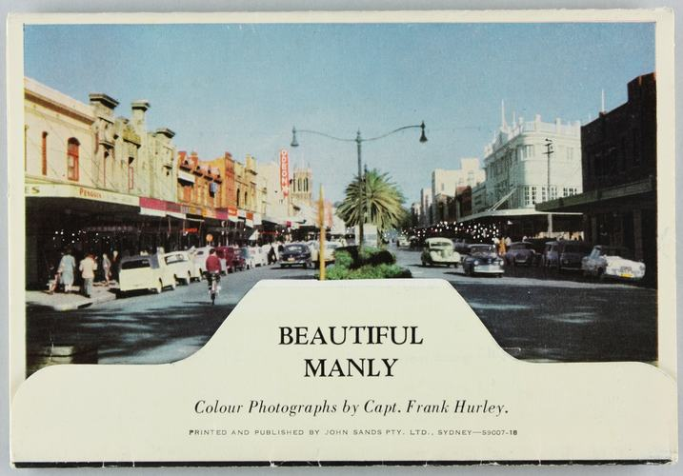
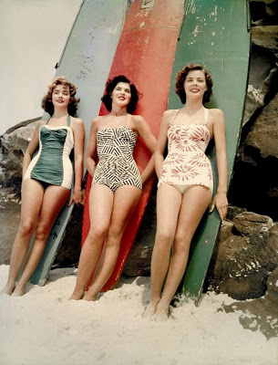
Where to stay in Sydney 1950
In my Grandmother’s time, it was popular to stay in a Bed and Breakfast or take the Full Board option at a Boarding House.
Or head to accommodation in sexy and youthful Bondi Beach.
Where did you stay when you went to Sydney?
Notes:
https://collections.museumsvictoria.com.au/content/media/42/686042-small.jpg
http://1.bp.blogspot.com/-7Epnz__3f4E/T1e03ETL0AI/AAAAAAAAIPA/XO5dvmLyJsE/s1600/miss%2Bpacific%2Bfinalists%2B%252752%2Bbondi.jpg

Slide 8
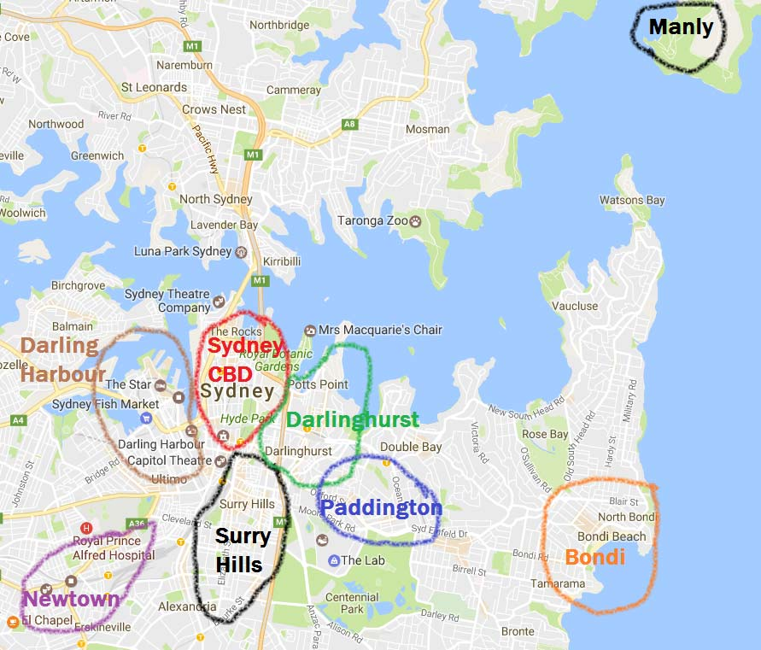
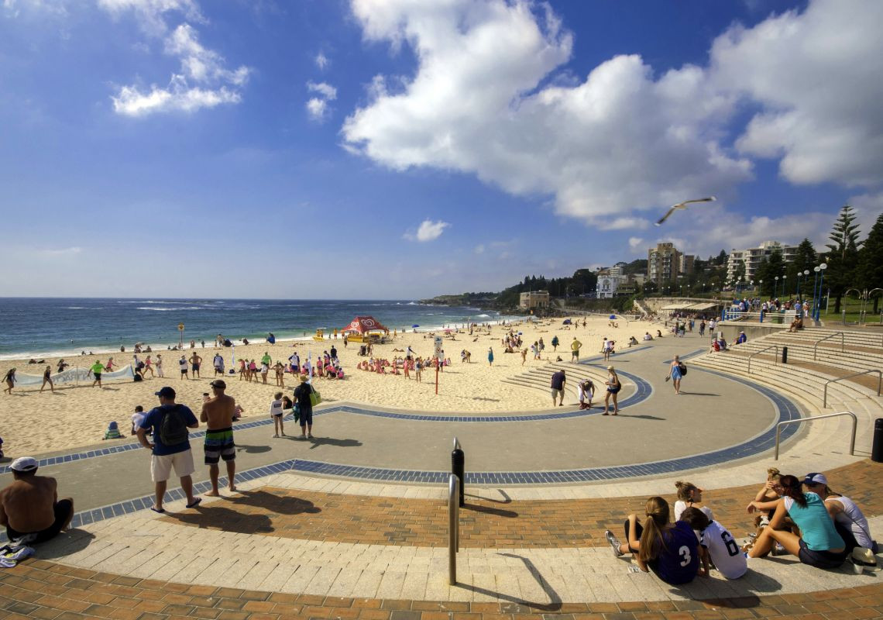
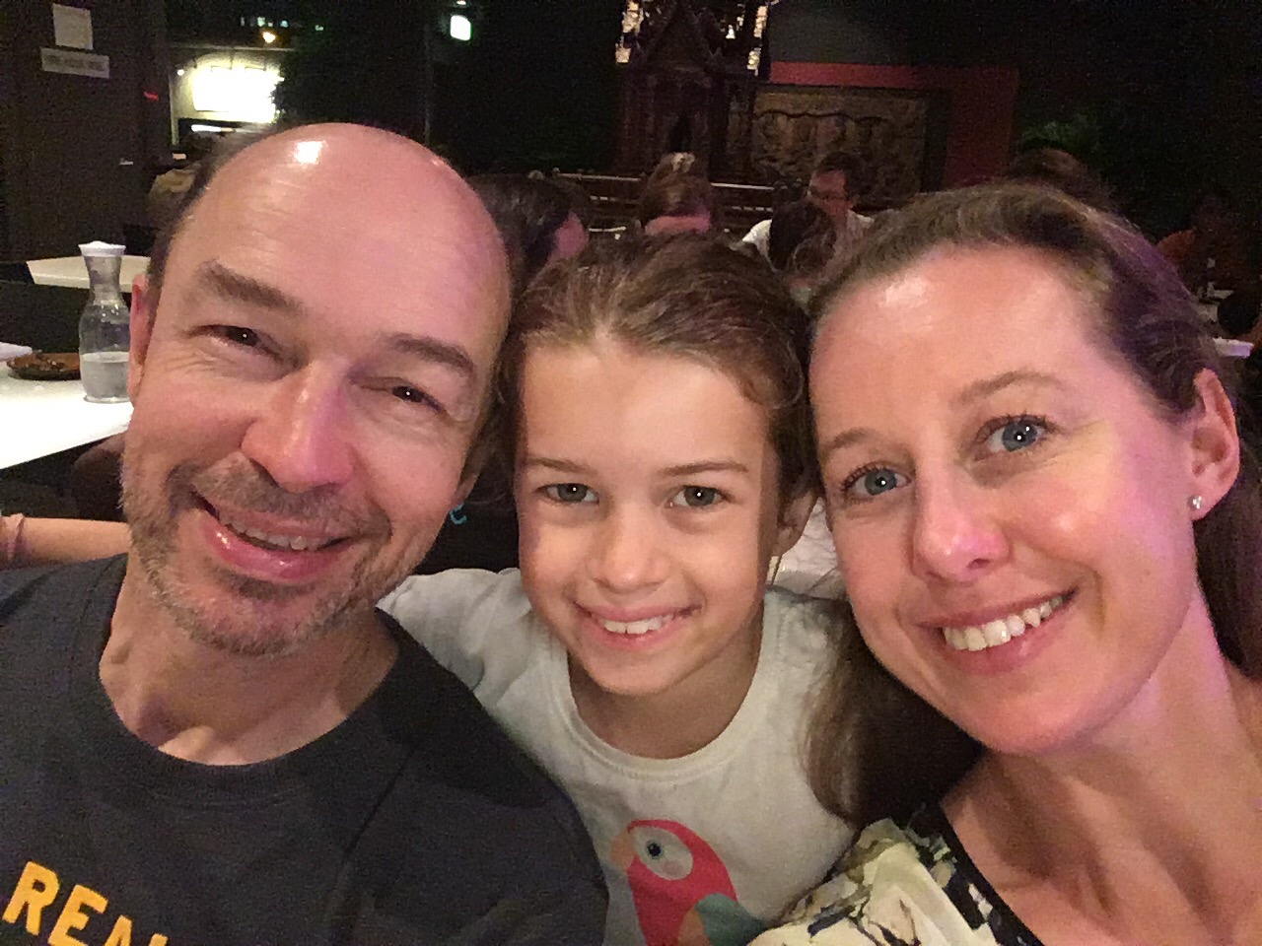
Where to stay in Sydney 2020
Today there are so many options !!!!
It is estimated there are nearly 20,000 hotel rooms within Sydney. Prices range from $40 to $2,000 per night.
My daughter lives in Sydney in Coogee, so we never have to choose.
We always stay
in Coogee.
Notes:
https://mel365.com/wp-content/uploads/2017/02/8-areas-to-stay-in-Sydney.jpg
https://www.sydney.com/destinations/sydney/sydney-east/coogee

Slide 9
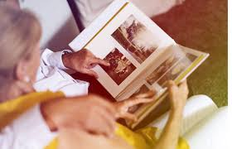
Thinking back
Do you have memories of visiting Sydney?
Where did you stay?
How did you get there?
Notes:
https://encrypted-tbn0.gstatic.com/images?q=tbn%3AANd9GcQyu3c7rOEPDP5QVupnC78otG0K6s4Z_vMdmA&usqp=CAU

Slide 10
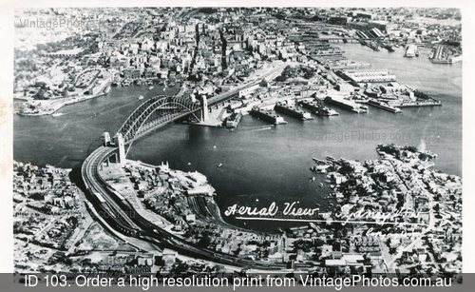
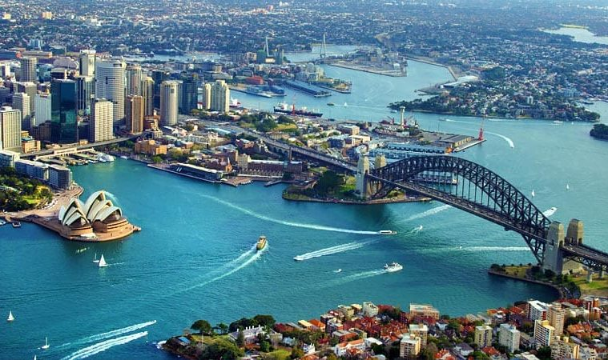
Sydney has changed… spot the differences
Notes:
http://vintagephotos.com.au/images/aerial_view_of_sydney_harbour_1.jpg
https://cruisepassenger.com.au/sydney-harbour-virus-scare-could-damage-australian-cruising/

Slide 11
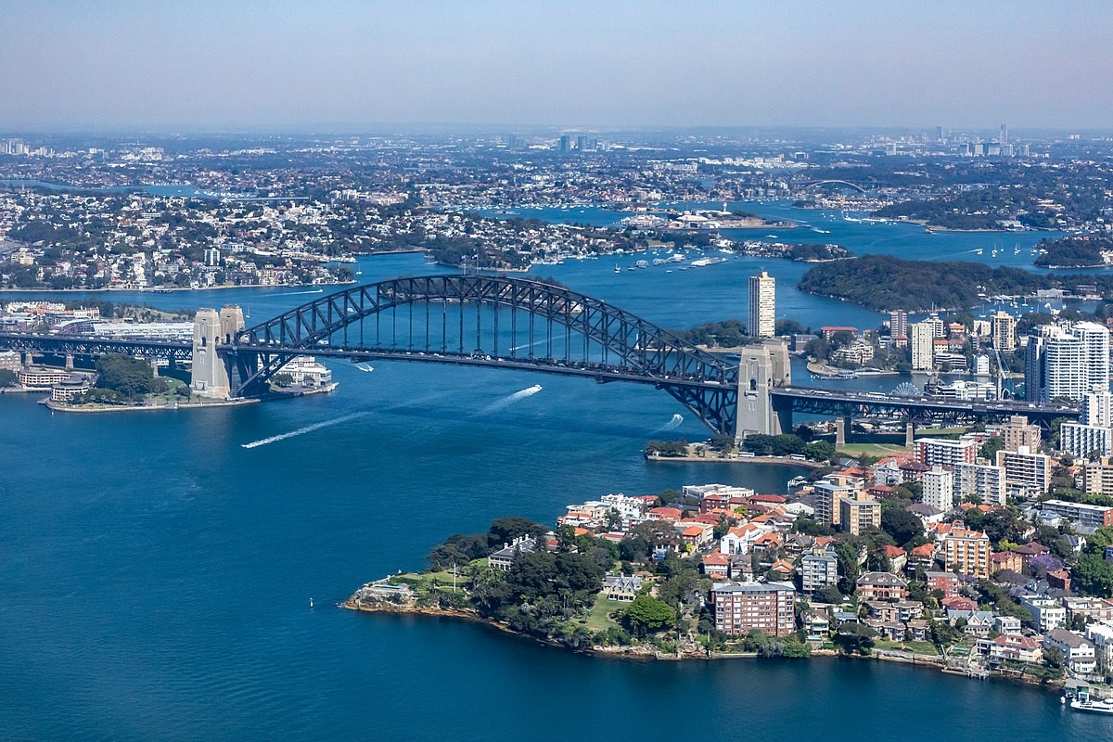
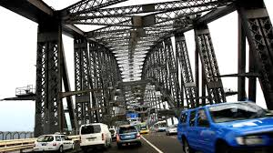
Things to do in Sydney 1950
No trip to Sydney would be complete without a drive over the Harbour Bridge.
When the Harbour Bridge opened, it was the epitome of modern bridge design and engineering ingenuity.
Thousands of workers toiled on it through the Great Depression.
Notes:
https://commons.wikimedia.org/wiki/File:Sydney_(AU),_Harbour_Bridge_--_2019_--_2881.jpg
https://www.kidsnews.com.au/history/team-of-robots-and-people-working-to-keep-sydney-harbour-bridge-as-good-as-new/news-story/be755b5465ca6942ead17f502e39f055
THIS REFERENCE NOT USED FOR IMAGES
https://dictionaryofsydney.org/sites/default/files/media/6c103664dfdef80e1a412b92023c285818780359.jpghttps://www.google.com/url?sa=i&url=https%3A%2F%2Fdictionaryofsydney.org%2Fmedia%2F1558&psig=AOvVaw2M-_WQEfkawDNkYiV52UvA&ust=1598602156152000&source=images&cd=vfe&ved=0CAIQjRxqFwoTCID69p_3uusCFQAAAAAdAAAAABAD

Slide 12
Thinking back
What year was the Bridge opened?
Can you remember what shocked everyone at the official opening?
Notes:
Answer The official opening of the bridge took place on 19 March 1932. By that time 52,000 school children had already crossed the bridge in a series of 'school days'. More than 750,000 people gathered around the harbour for the official opening event. The bridge was to be opened by the New South Wales Premier, Jack Lang.
Before Lang could cut the ribbon and declare the bridge open, Francis De Groot, a member of the ultra-right-wing New Guard group, rode a borrowed horse out of the crowd and slashed the ribbon with his cavalry sword. De Groot was arrested.Ap

Slide 13
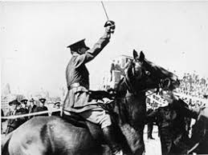
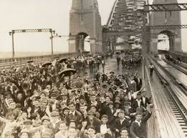
The Opening of the
Sydney Harbour Bridge
The official opening of the bridge took place on 19 March 1932. By that time 52,000 school children had already crossed the bridge in a series of “school days”.
More than 750,000 people gathered around the Harbour for the official opening event.
The bridge was to be opened by the New South Wales Premier, Jack Lang. Before Lang could cut the ribbon and declare the bridge open, Francis De Groot, a member of the ultra-right-wing New Guard group, rode a borrowed horse out of the crowd and slashed the ribbon with his cavalry sword.
De Groot was arrested. Lang cut a new ribbon, the bridge was declared open, and a public bridge walk took place. De Groot was fined £5.
Notes:
Answer The official opening of the bridge took place on 19 March 1932. By that time 52,000 school children had already crossed the bridge in a series of 'school days'. More than 750,000 people gathered around the harbour for the official opening event. The bridge was to be opened by the New South Wales Premier, Jack Lang.
Before Lang could cut the ribbon and declare the bridge open, Francis De Groot, a member of the ultra-right-wing New Guard group, rode a borrowed horse out of the crowd and slashed the ribbon with his cavalry sword. De Groot was arrested.Ap
https://en.wikipedia.org/wiki/Francis_de_Groot
https://www.nma.gov.au/learn/kspace/sydney-harbour-bridge-1930/kids

Slide 14
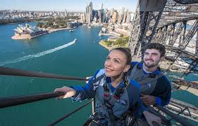
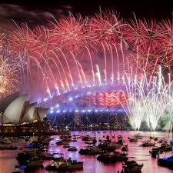
Sydney Harbour Bridge 2020
Today a trip to Sydney often involves climbing the Bridge.
Prices start at $143 for child and $168 for an adult, ranging through to $388 for an adult dawn bridge climb.
But we can all share the joy of watching the fireworks each year on New Years Eve.
And it’s free.
Notes:
https://www.bridgeclimb.com/
https://www.theguardian.com/australia-news/2019/dec/30/sydney-new-years-eve-fireworks-debate-rages-as-nsw-deputy-premier-calls-for-event-to-be-cancelled

Slide 15
Thinking back
Can you remember what you were doing on New Year’s Eve 2000?

Slide 16
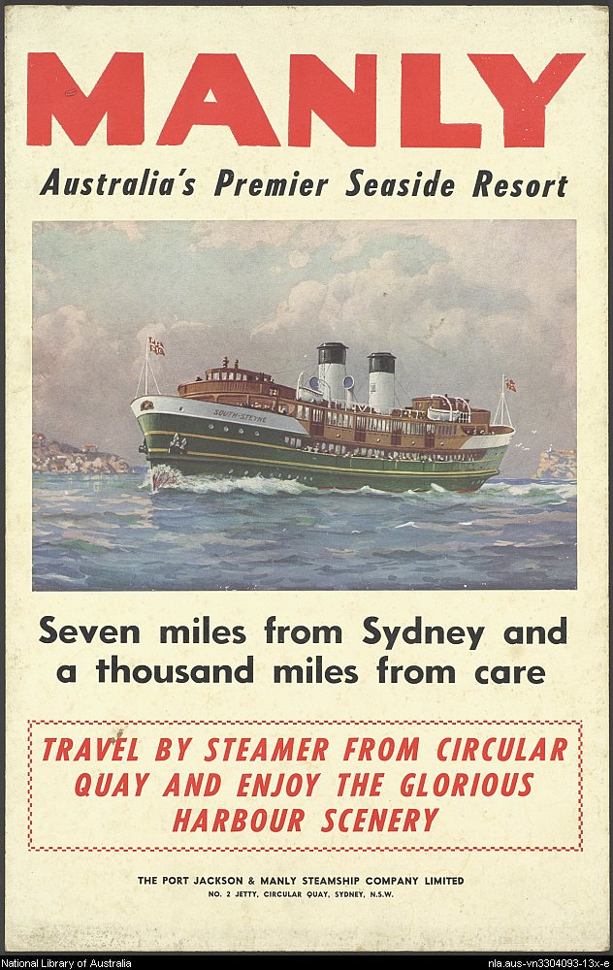
Back to Sydney in 1950
In the early 1950s one of the great pleasures available to Sydneysiders of all ages was a trip on the Manly Ferry.
At about 30 minutes, the Manly trip was the longest and the most relaxing. It gave views of remnant bushland and glimpses of waterfront mansions. It even passed nearby ‘The Heads’, the wide break in the cliffs which provides access to the Pacific Ocean.
Notes:
http://www.thecud.com/live/sites/default/files/tonysmithoct3.jpg
The ‘Floating Concert Hall’: Music on the Manly Ferry
Tony Smith

Slide 17
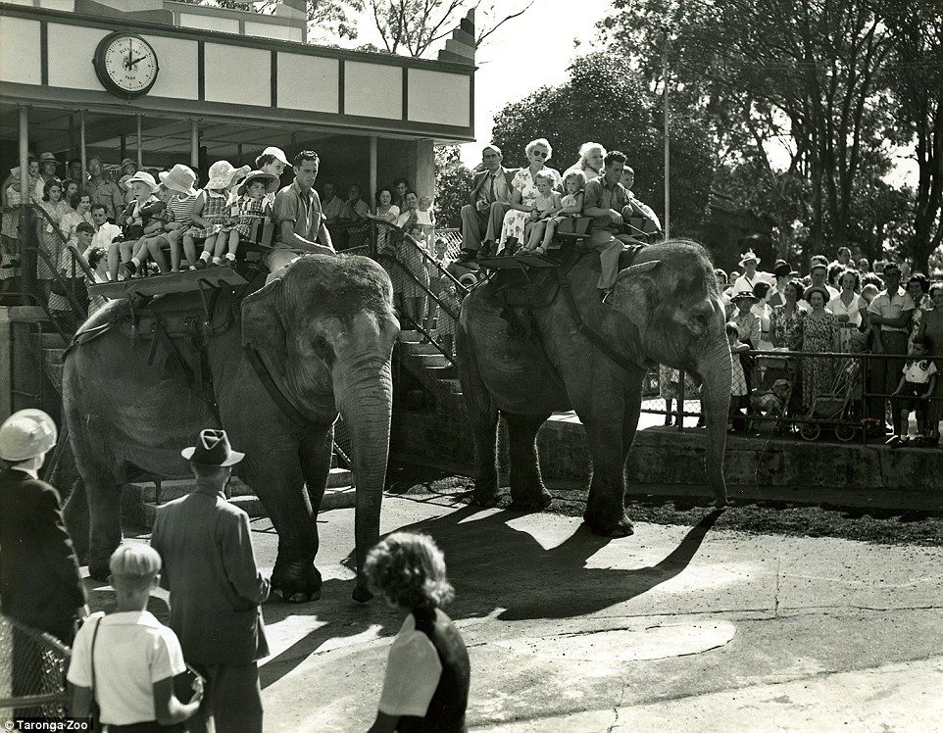
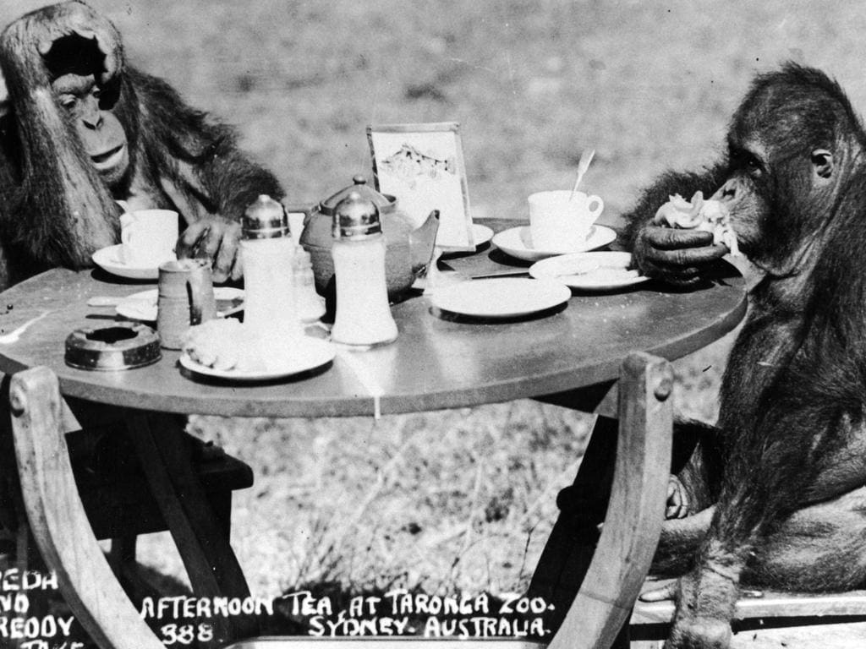
Things to do at Taronga Zoo 1950
In the 1950s, attractions such as elephant rides, miniature trains, a monkey circus and merry-go-round were popular.
After a critical review in 1967, a new era in the style and philosophy for the operation of Taronga began which reflected the new emphasis on scientific research, conservation and education.
Notes:
https://i.dailymail.co.uk/i/pix/2016/09/15/07/386131C000000578-3790407-image-a-52_1473921080707.jpg
https://cdn.newsapi.com.au/image/v1/b260343d93f897d30a3ed2fef9bcf724?width=1024

Slide 18
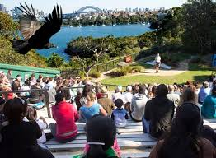
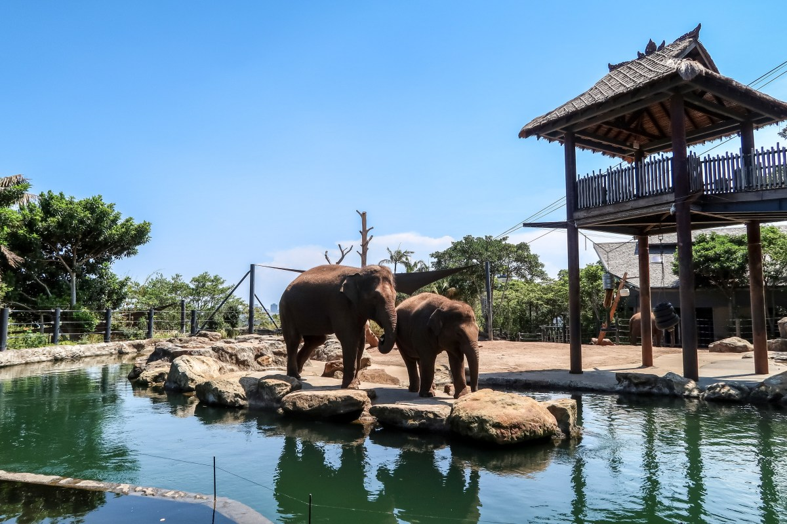
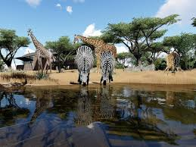
Things to do at Taronga Zoo 2020
Now, rather than a focus on animal entertainment, Taronga cares for over 5,000 animals from over 350 species, many of which are threatened.
The zoo says, “Find out how we're contributing to global efforts to save species from the brink of extinction.”
Taronga Zoo Sydney has over 20 shows and keeper talks every day. And the best part, the animals are shown great respect.
Notes:
https://www.qbe.com/au/about/sponsorship-community/sponsorship/taronga-zoo
https://wanderlustyle.com/taronga-zoo/
https://wanderlustyle.com/taronga-zoo/

Slide 19
Thinking back
Have you been to Taronga Zoo?
What your favourite zoo experience?
Our family stayed overnight at Melbourne Zoo a few years ago. The noise kept us awake all night.

Slide 20
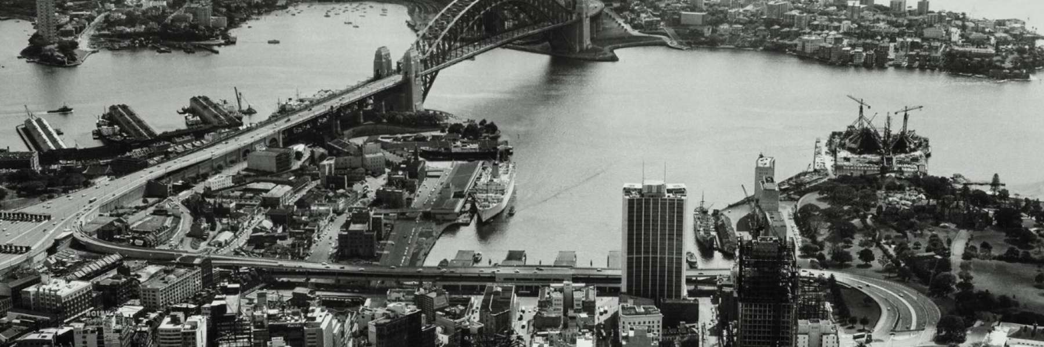
Sydney Opera House 1950
It’s hard to imagine Sydney without the Opera House, but here it is.
Besides lacking the iconic Opera House, what else looks different?
The architect of the Sydney Opera House, Jørn Utzon, was a relatively unknown 38-year old Dane when, in January 1957, his entry was announced winner of the international competition to design a ‘national opera house’ for Sydney’s Bennelong Point.
Construction of the Sydney Opera House began on 2 March 1959.
In 1965 the Minister of Works began questioning Utzon's designs, schedules and cost estimates. He eventually stopped payments to Utzon who was forced to withdraw as chief architect in February 1966.
Notes:
https://www.sydneyoperahouse.com/content/dam/soh/our-story/house_history/Construction%20%20looking%20north_SLNSW3_1600x53.jpg.image.1800.600.high.jpg

Slide 21
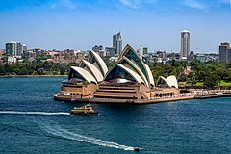
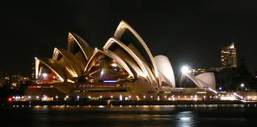
Sydney Opera House 2020
Today the Sydney Opera House is included on the UNESCO World Heritage List, placing it alongside the Taj Mahal, the ancient Pyramids of Egypt and the Great Wall of China as one of the most outstanding places on Earth.
Exciting by day and by night.
When it was opened?
Who opened the Opera House?
Notes:
https://en.wikipedia.org/wiki/Sydney_Opera_House
https://en.wikipedia.org/wiki/Sydney_Opera_House
Answer : Construction started on 2 March 1959. Opera House was opened on 23 October 1973

Slide 22
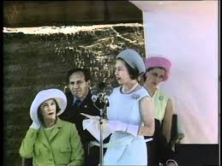
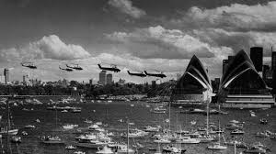
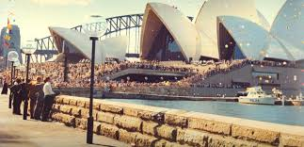
Opening of the Opera House
23 October, 1973
Queen Elizabeth II
Notes:
Video Clip of the Queen opening the Sydney Opera House: https://www.google.com/url?sa=i&url=https%3A%2F%2Fwww.youtube.com%2Fwatch%3Fv%3D0tecBKSQIJ4&psig=AOvVaw3D4bT7IYcmnt_f9_2yEfhD&ust=1598610162747000&source=images&cd=vfe&ved=0CAIQjRxqFwoTCMDpiKqVu-sCFQAAAAAdAAAAABAD
https://www.google.com/imgres?imgurl=https%3A%2F%2Fi.ytimg.com%2Fvi%2F0tecBKSQIJ4%2Fsddefault.jpg&imgrefurl=https%3A%2F%2Fwww.youtube.com%2Fwatch%3Fv%3D0tecBKSQIJ4&tbnid=FROhEYJi27_s3M&vet=12ahUKEwiG1KyIlbvrAhUDXXwKHWOVCcAQMygPegUIARDQAQ..i&docid=fNRqZtaOkQZQOM&w=640&h=480&q=opening%20of%20the%20sydney%20opera%20house&ved=2ahUKEwiG1KyIlbvrAhUDXXwKHWOVCcAQMygPegUIARDQAQ
https://www.news.com.au/lifestyle/real-life/news-life/today-in-history-september-28-first-performance-at-the-sydney-opera-house/news-story/d5f0d829ebe2dfc0b891236f0c8e994c
https://www.nfsa.gov.au/sites/default/files/styles/img480x270/public/collection/hero_image09-2017/sydney_opera_house_collection_cover.jpg?itok=x-cMhc-J&timestamp=1504241248

Slide 23
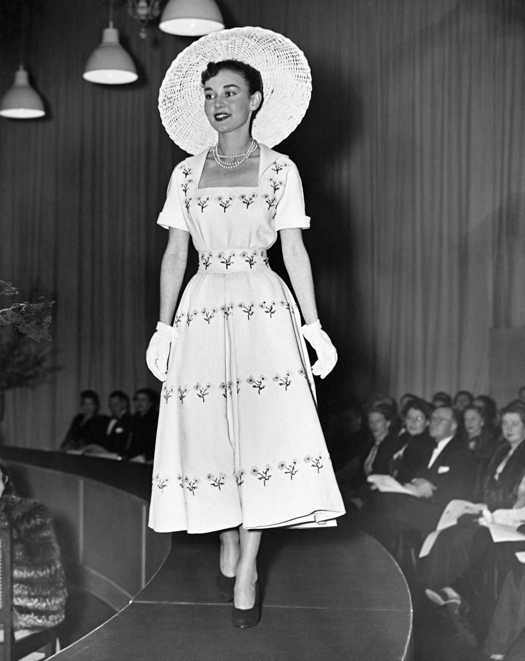
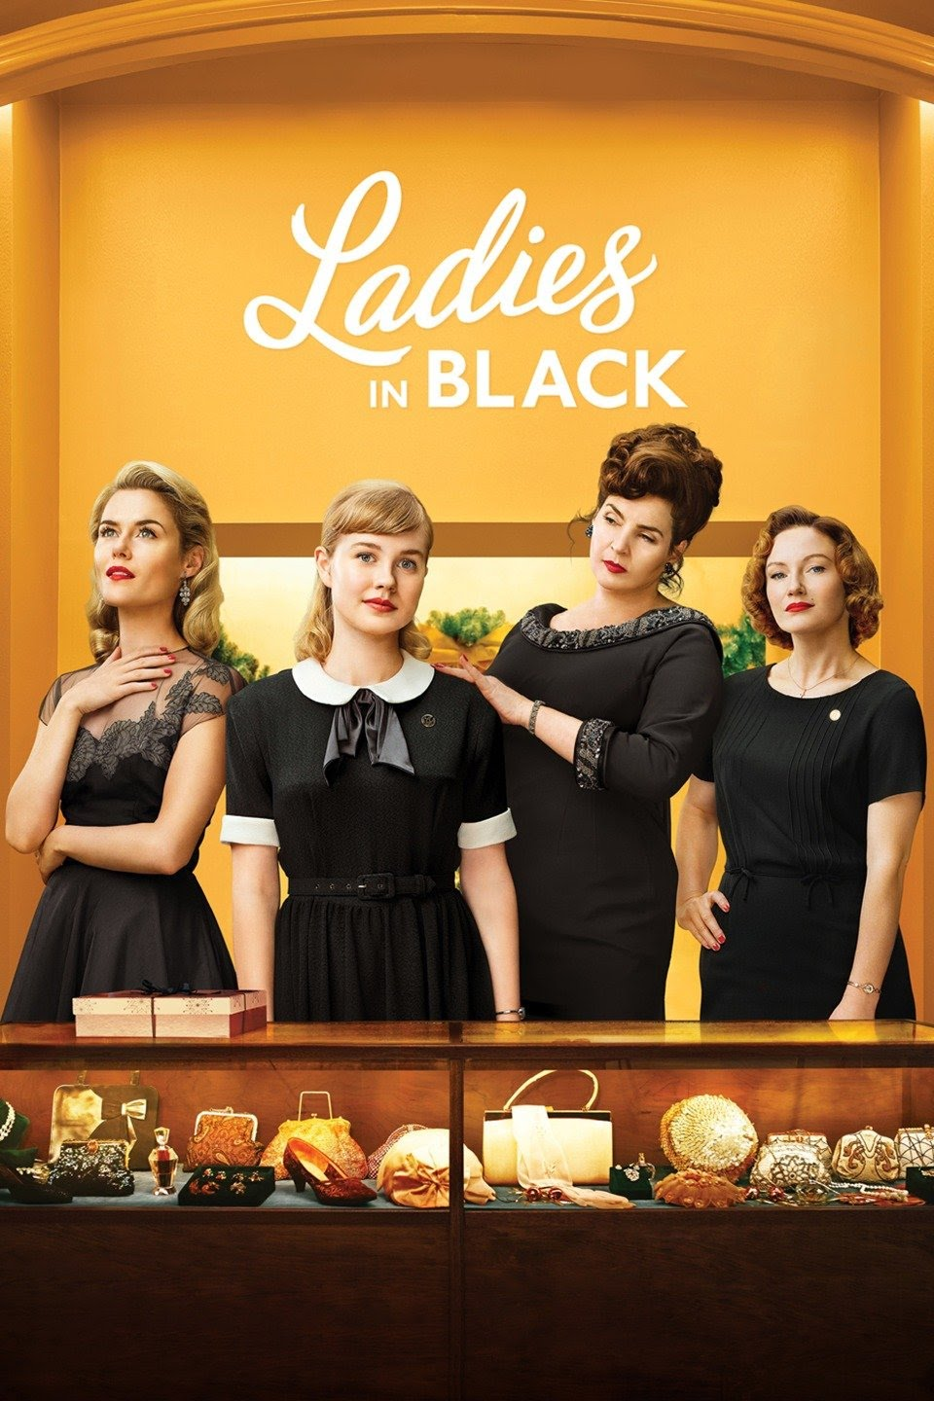
Shopping in Sydney 1950
The David Jones department store brought Sydney out of the post-war doldrums with Paris-style fashion parades in 1947.
So a trip to DJs would certainly be on the agenda.
One year later David Jones brought the collection of Christian Dior’s famous ‘New Look’ to Sydney, the first time Dior had ever shown outside Paris.
The film Ladies in Black is a superb depiction of life and times of Sydney in that era.
A must-see movie!!
Notes:
https://www.ngv.vic.gov.au/exhibition/the-house-of-dior/
https://encrypted-tbn3.gstatic.com/images?q=tbn:ANd9GcR7LYUHfmNzVLToSTqjDZT2AP3uXEtNzKsEidB2TpY24lchqkIE

Slide 24
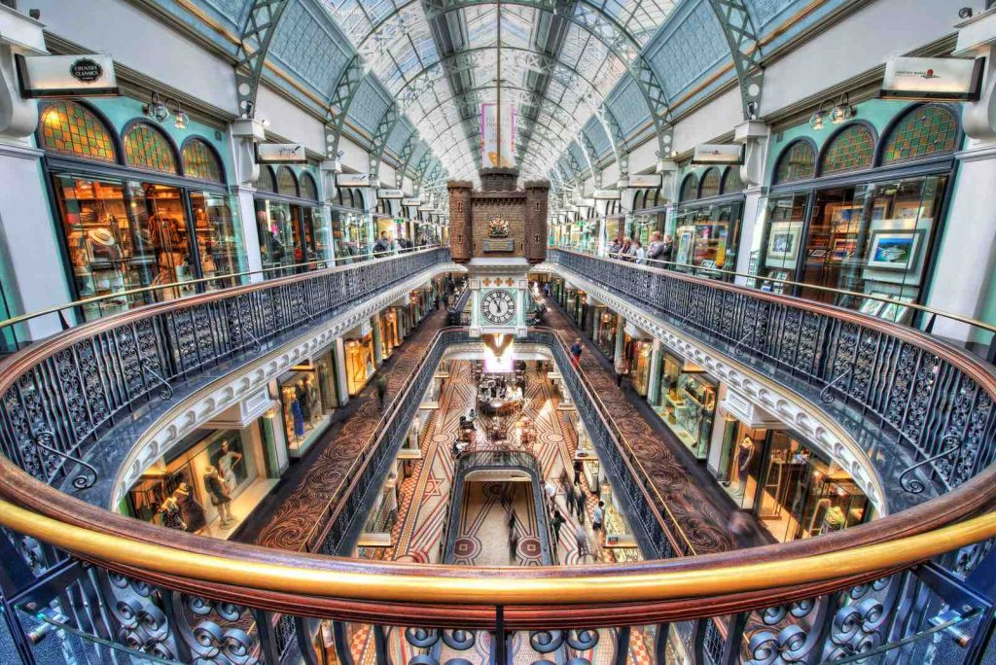
Shopping in Sydney 2020
For me a shopping highlight when visiting Sydney is a meander through the Queen Victoria Building.
Architecturally splendid, the Queen Victoria Building (QVB) occupies an entire block on Sydney's George Street, and has over 180 of Sydney's finest fashion boutiques, jewellery shops and homewares, accompanied by delightful cafes and restaurants.
Built in the 1890s it was erected as a Municipal Market on the scale of a Cathedral, but by the 1950s it was very shabby and was almost demolished. Luckily, it was restored in 2006 with a renovation cost of $48 million.
Notes:
https://www.propertyhq.com.au/news-blog-and-research/makeover-sydneys-queen-victoria-building/

Slide 25
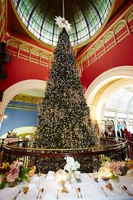
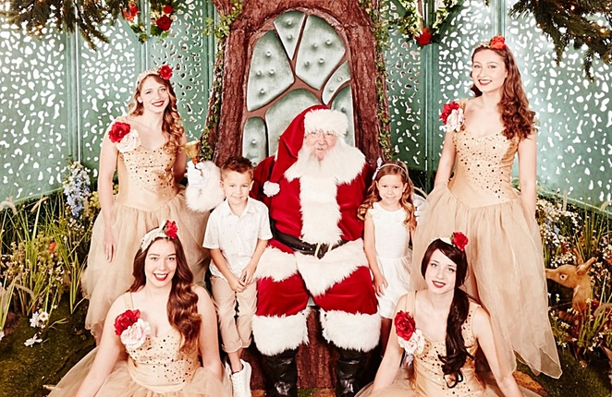
Shopping in Sydney 2020
The QVB at Christmas time
Is a place of splendour for young and old.
But keep hold of your credit card; it can be an expensive outing.
Notes:
https://www.vogue.com.au/culture/lifestyle/the-qvb-swarovski-christmas-tree-by-numbers/news-story/47576a1d52d6c86c6980db6cfbb5d5ea
https://www.weekendnotes.com/im/000/06/santa-the-enchanted-garden-qvb-sydney1.jpg

Slide 26
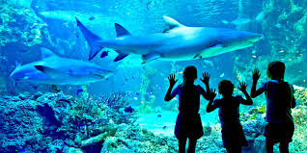
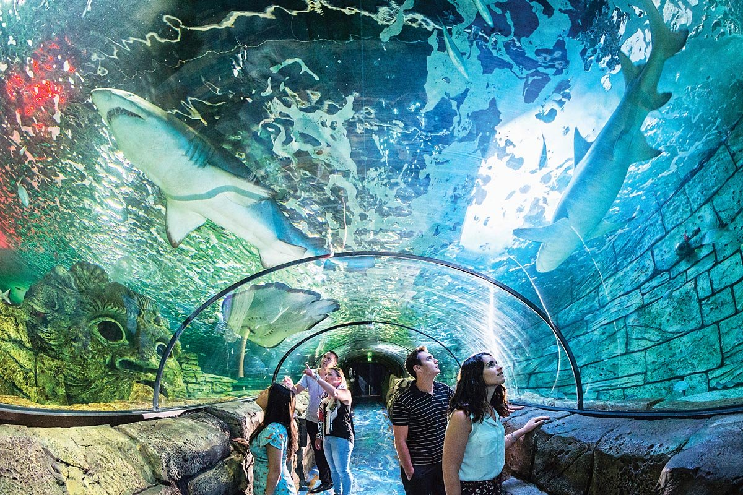
A trip to the Aquarium 2020
No such excitement in 1950, but in 1988, Sea Life Sydney Aquarium opened, featuring 700 species and comprising more than 13,000 individual fish. A new “must see” in Sydney.
Notes:
https://thebigbus.com.au/product/sea-life-sydney-aquarium/
https://www.wheretraveler.com/sydney/sea-life-sydney-aquarium

Slide 27
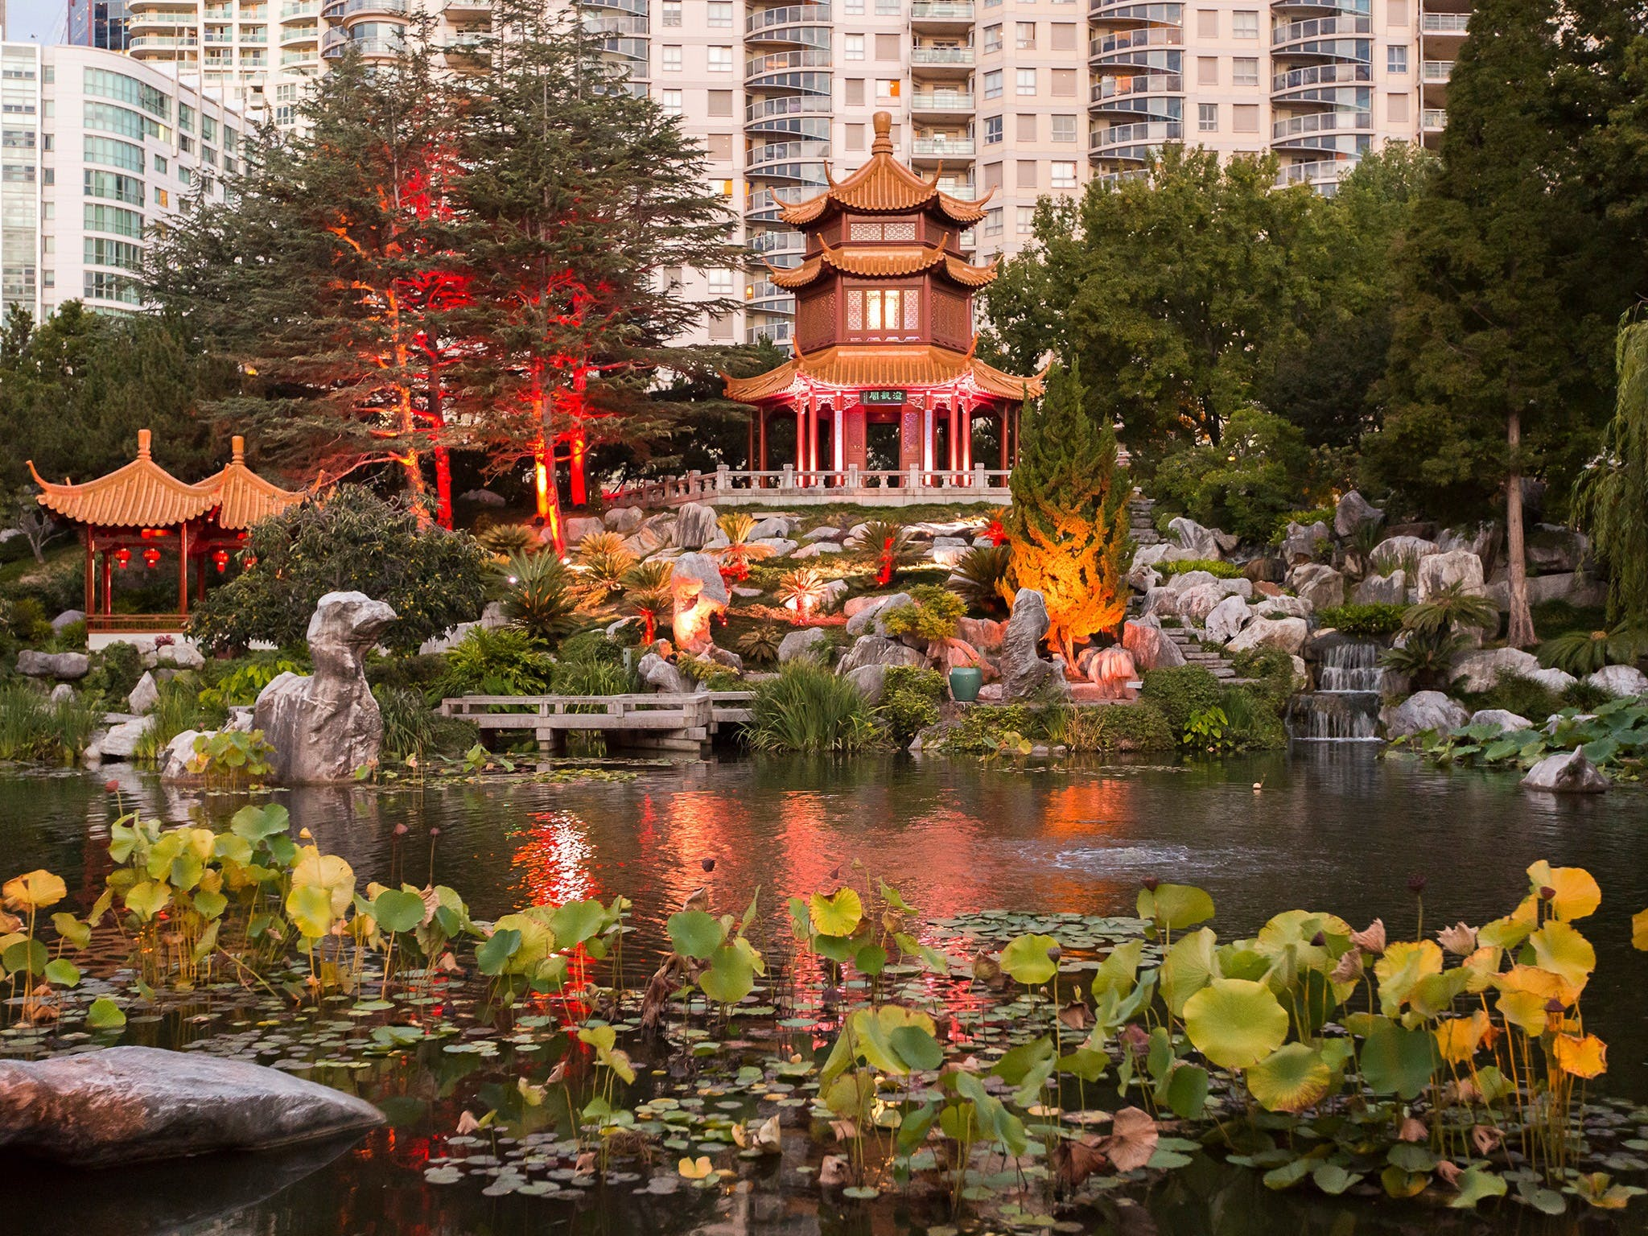
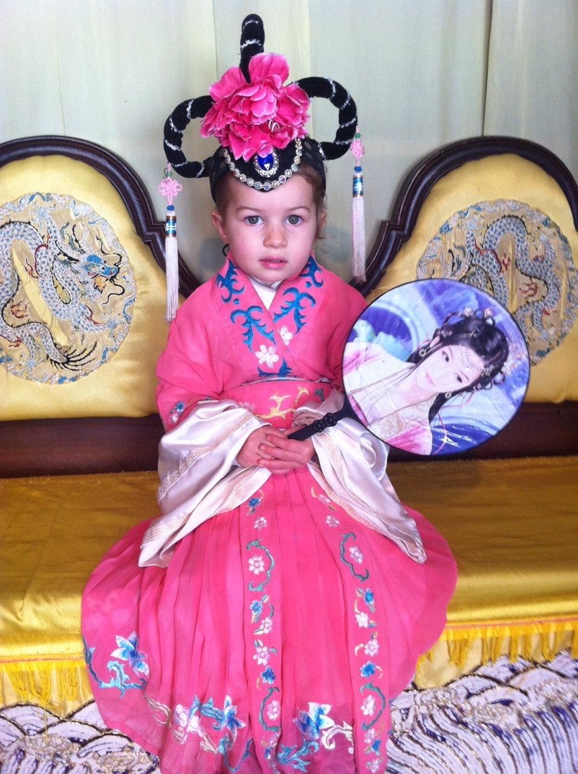
Before we leave Sydney in 2020
A visit to the Chinese Friendship Garden in the heart of the city is delightful. Once a light industrial site, it was transformed in 1988.
A short walk from Chinatown, entering the garden is like walking backwards in time into the quiet solitude of ancient Chinese architecture and its relationship with nature. The garden combines the elements of water, plants, stone and architecture.
You can also hire costumes for the day to engross yourself in the atmosphere of the gardens.
My lovely granddaughter, Keira.
Notes:
https://www.google.com/url?sa=i&url=https%3A%2F%2Fwww.sydney.com%2Fdestinations%2Fsydney%2Fsydney-city%2Fdarling-harbour%2Fattractions%2Fchinese-garden-friendship&psig=AOvVaw1tdhKMNTRMJMThsy-PRcUi&ust=1598750863343000&source=images&cd=vfe&ved=0CAIQjRxqFwoTCODG3qChv-sCFQAAAAAdAAAAABAD

Slide 28
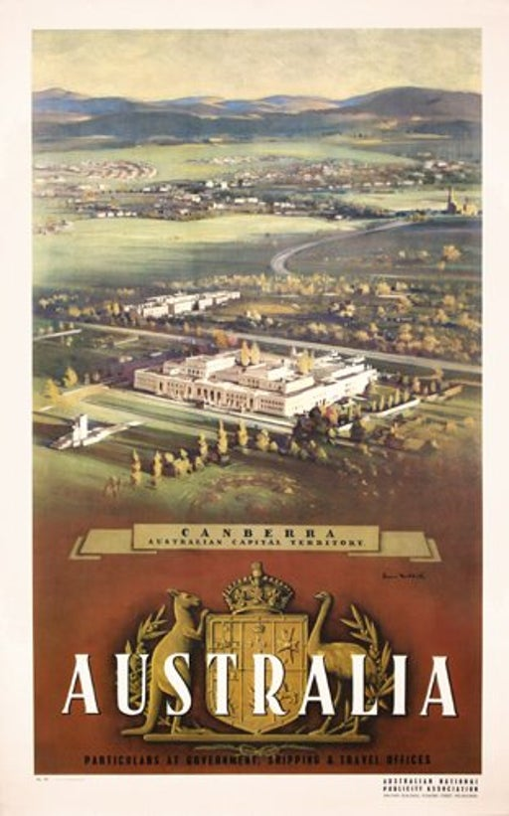
Heading for home 1950
I remember my grandmother telling me that they came home via Canberra, so we will too.
Canberra was chosen as the site of the national capital in 1908.
After very slow beginnings, Parliament House was opened in 1927, (now known as the "Old Parliament House").
Not much else there… not even Lake Burley Griffin (not completed until 1963).
Notes:
https://p1.liveauctioneers.com/119/12336/3380930_1_x.jpg?auto=webp&format=pjpg&version=1175300070

Slide 29
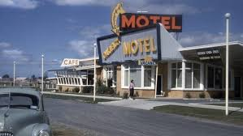
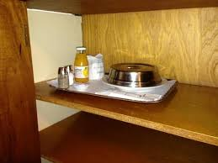
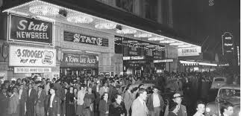
Places to stay in 1950
They probably stayed in the latest travel accommodation option of the time…
The Motel with a breakfast hatch. Such a modern invention….
And so exciting to wake up to.
Not a lot of night life in Canberra, but the cinema was always full.
Notes:
https://www.traveller.com.au/road-trips-in-australia-the-great-aussie-motel-is-set-to-make-a-comeback-h1o87d
https://www.tripadvisor.com.au/LocationPhotoDirectLink-g255347-d1845375-i75788682-Bendigo_s_Allara_Motor_Lodge-Bendigo_Greater_Bendigo_Victoria.html
https://www.nfsa.gov.au/collection/curated/australian-vintage-cinemas-and-theatres

Slide 30
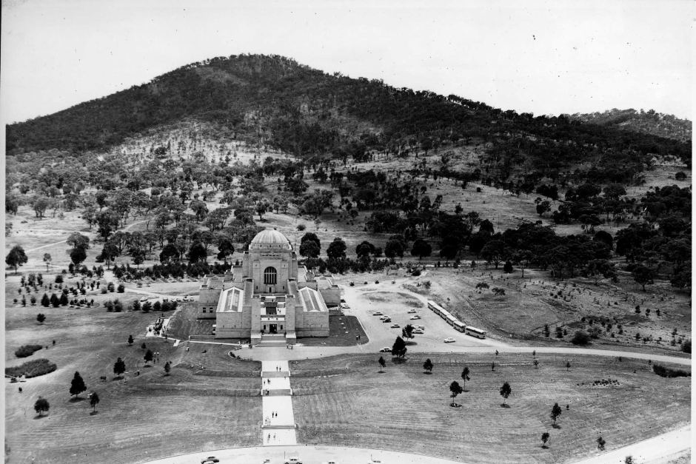
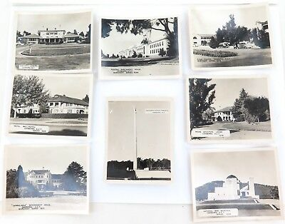
Not a lot to see in 1950
When this photo was taken in the 1950s, the Australian War Memorial had been open for around a decade and the population of Canberra was just less than 20,000 people.
A popular drive was Embassy Circuit and, of course, a visit to Parliament House.
Notes:
https://scontent.fmel5-1.fna.fbcdn.net/v/t1.0-9/102261489_4167668489940613_8074441355372434695_n.jpg?_nc_cat=106&_nc_sid=8024bb&_nc_ohc=8jO1q52Er3gAX88fEvv&_nc_ht=scontent.fmel5-1.fna&oh=5a70a946c148281631586fe8e30f23bb&oe=5F6EE6AA
https://picclick.co.uk/8-x-c1940-50%E2%80%99s-CANBERRA-ACT-REAL-PHOTO-SOUVENIR-142618054520.html#&gid=1&pid=1

Slide 31
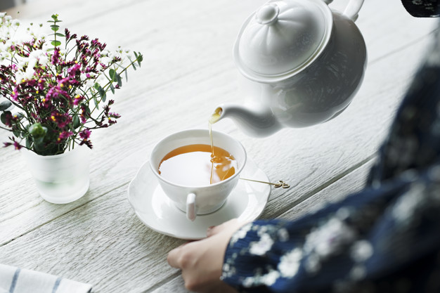
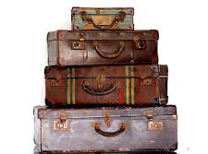

Back home in Melbourne
After a long drive home from Canberra, it was time for Nanna to sit back, relax and tell us all about her adventure.
Perhaps it is time for us to do the same. Why don’t we take some time for a cup of tea and exchange holiday tales with friends and family.
Enjoy ….
Best wishes from Val
Notes:
https://vogueweddingsandevents.com.au/e-hire/hire-vintage-suitcases-set-4/
https://www.freepik.com/free-photo/aerial-view-woman-pouring-hot-tea-drink_3214151.htm#page=1&query=women%20drinking%20tea&position=11
https://bakingamoment.com/irish-scones/

