Slide 1

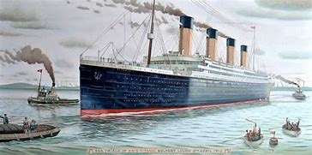
The Titanic
A Royal Mail Ship
Notes:
1. https://www.bluediamondtours.com/novascotiatours/halifax/titanictour.php

Slide 2

Hello!
My name is Rosemary and I live in Melbourne Victoria, Australia.
I am a member of the Rotary Club of Canterbury.
I have been lucky to travel to places that were significant to the Titanic. I wrote this book about the Titanic to share my travels with you. I hope you enjoy the story of my Titanic experience as much as I enjoyed writing it.
Rosemary

Slide 3
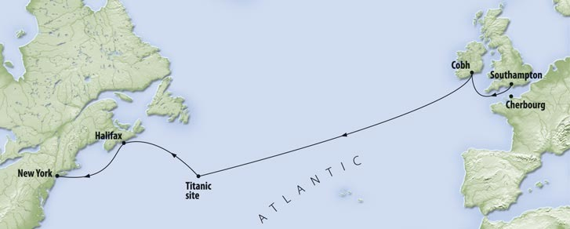
Itinerary
I have been lucky to travel to several places significant to the Titanic.
Belfast – where Titanic was built;
Halifax, Nova Scotia, Canada - cemetery and Maritime Museum;
Cherbourg, France – where passengers were ferried to the Titanic;
New York – Titanic’s destination and where survivors were taken.

Slide 4
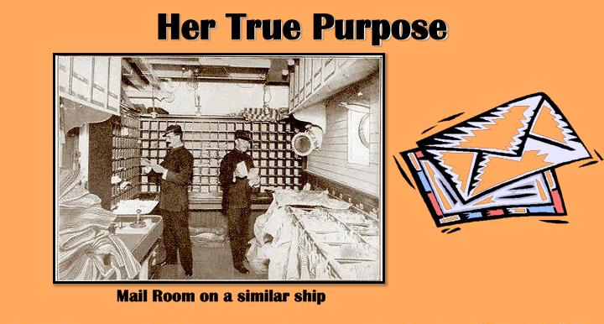
A Mail Ship
The Titanic was not only a passenger ship – it was also a Royal Mail Ship for the British Royal Mail Service.
Over 7 million items of mail were lost when Titanic sank.
Notes:
1. https://www.slideserve.com/fiona-mcleod/rms-titanic

Slide 5
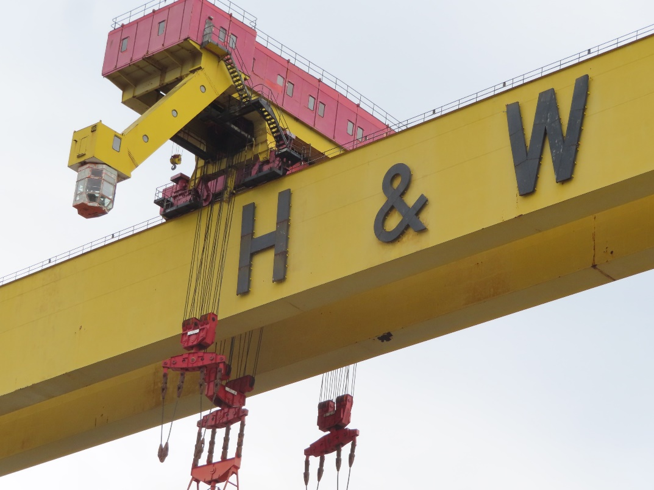
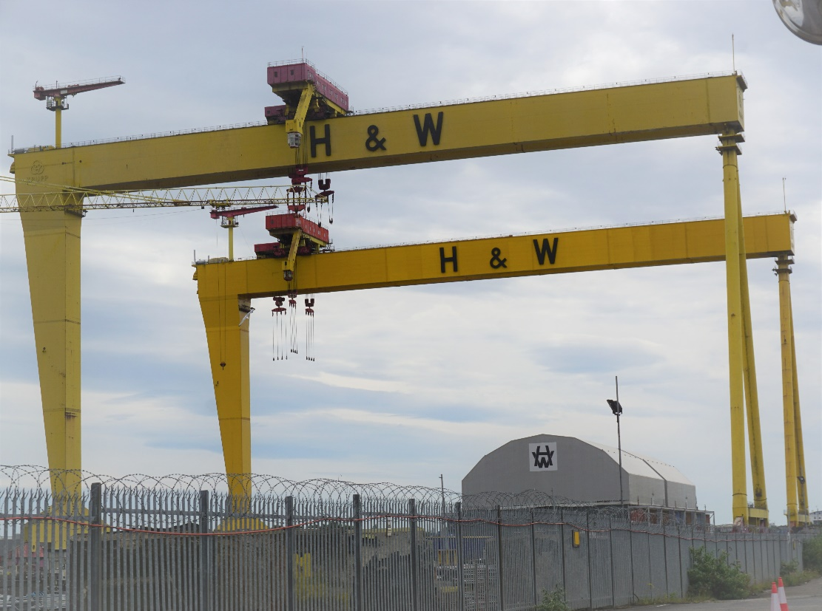
Building The Titanic
Titanic was built by Harland and Wolff Company.
The two cranes used to build the Titanic are still in use – Goliath and Samson. They are 100m wide and 150m high.
Notes:
Photo supplied by the author
Photo supplied by the author

Slide 6
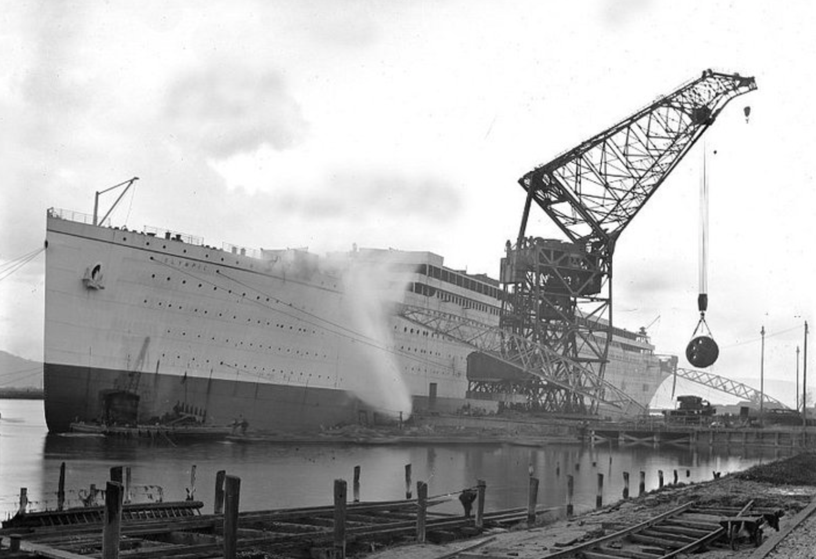
Building The Titanic
The Titanic’s keel was laid on 31 March 1909 and took about 26 months to build.
They used 2,000 steel hull plates, up to 6 feet (1.8m) wide and 30 feet (9.1m) long, weighing 2.5 to 3 tons.
Notes:
1. https://www.deviantart.com/cjca915/art/RMS-Olympic-244113154

Slide 7
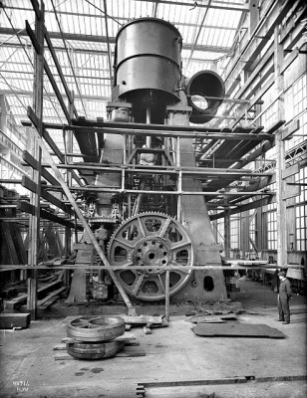
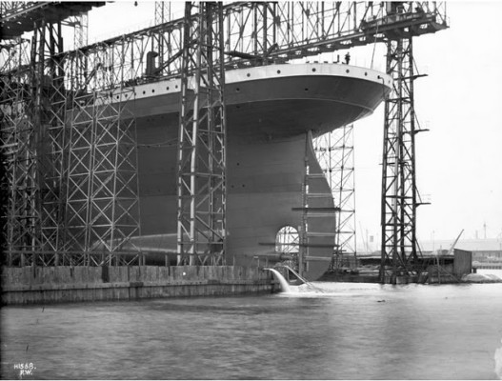
The stern and one of the steam engines built by Harland & Wolff’s Engine Works, Belfast, May 1911.
Building The Titanic
Notes:
https://www.thevintagenews.com/2018/02/25/titanic-2/
https://www.thevintagenews.com/2018/02/25/titanic-2/

Slide 8
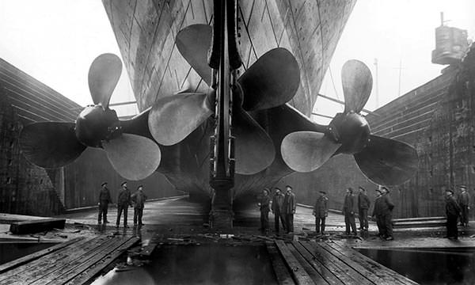
Rudder Facts
Height of Titanic’s rudder – 78 feet 8 inches (23.8m).
Weight of rudder – 100 tons
Span of central propeller – 17 feet (5.2m).
Span of each outer propeller – 23 feet 6 inches (7 m).
Notes:
https://www.theactivetimes.com/adventure/titanic-20-differences-between-movie-and-real-story/slide-17

Slide 9
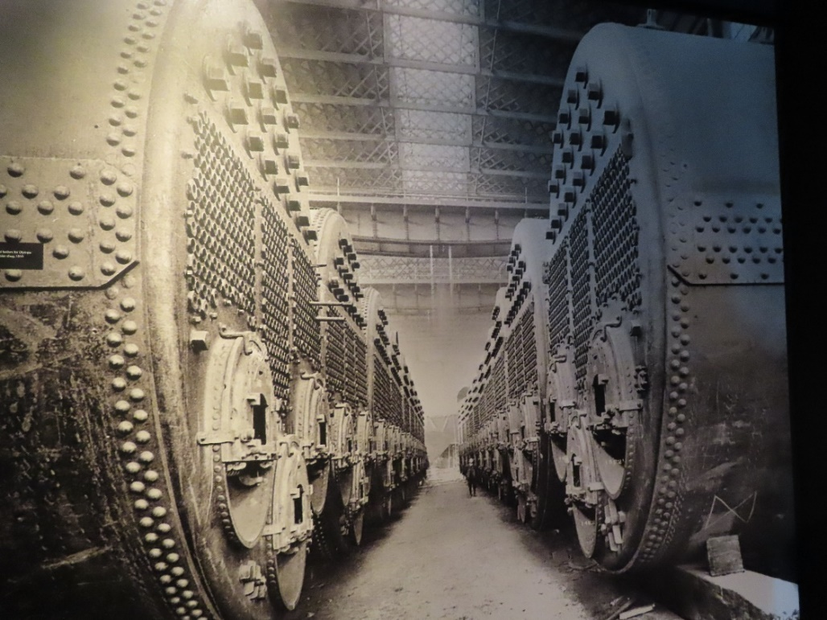
The Biggest Ship
Titanic was one of the biggest ships ever built. You can see from the size of these boilers.
Can you see the man at the back?
Notes:
1. https://www.ultimatetitanic.com/construction

Slide 10
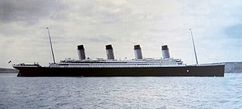
Construction Facts and Figures
The Titanic was one of three luxury ships constructed in Belfast.
She was 882 feet 9 inches (269m) long and 92 feet 6 inches (28m) wide with a total height of 104 feet (32m) and had ten decks.

Slide 11
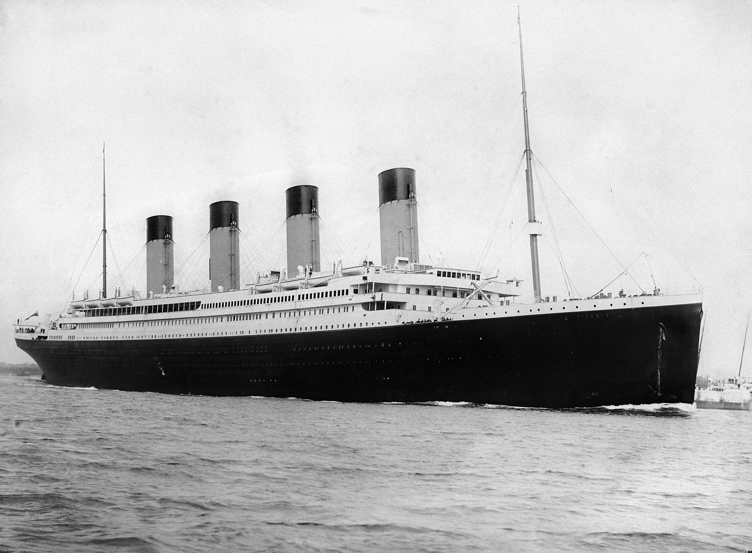
Construction Facts and Figures
Over 15,000 people helped build the Titanic over a period 3 years from construction to final fit out.
The fourth funnel on the Titanic was a fake but it made the ship look grander.
Notes:
1. https://en.wikipedia.org/wiki/Titanic#/media/File:RMS_Titanic_3.jpg

Slide 12
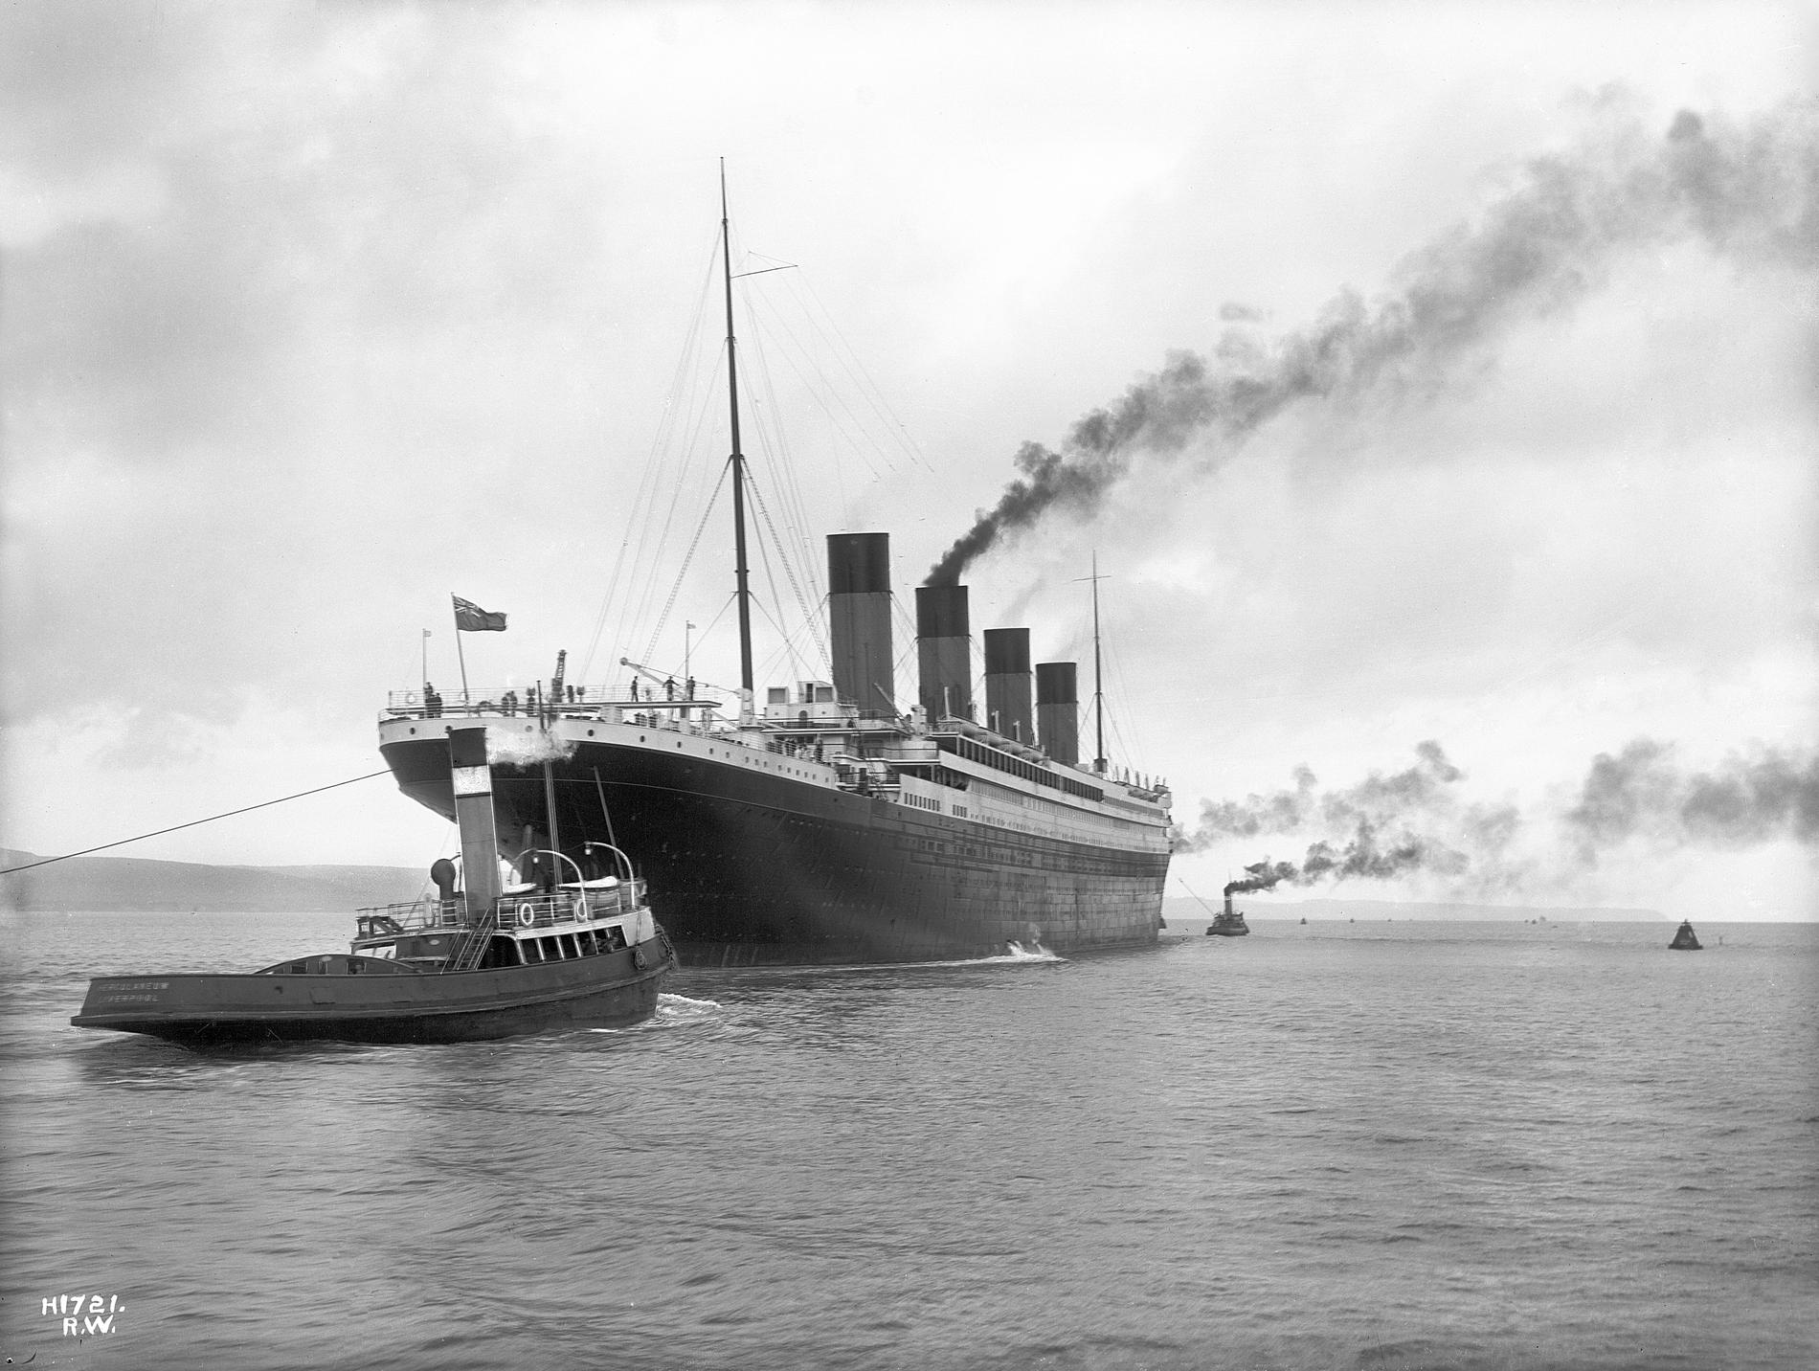
Launch
Titanic was launched on 31 May 1911 in front of around 100,000 onlookers.
This photo shows the RMS Titanic leaving Belfast for sea trials on 2 April 1912.
Notes:
https://en.wikipedia.org/wiki/Titanic#/media/File:RMS_Titanic_2.jpg

Slide 13
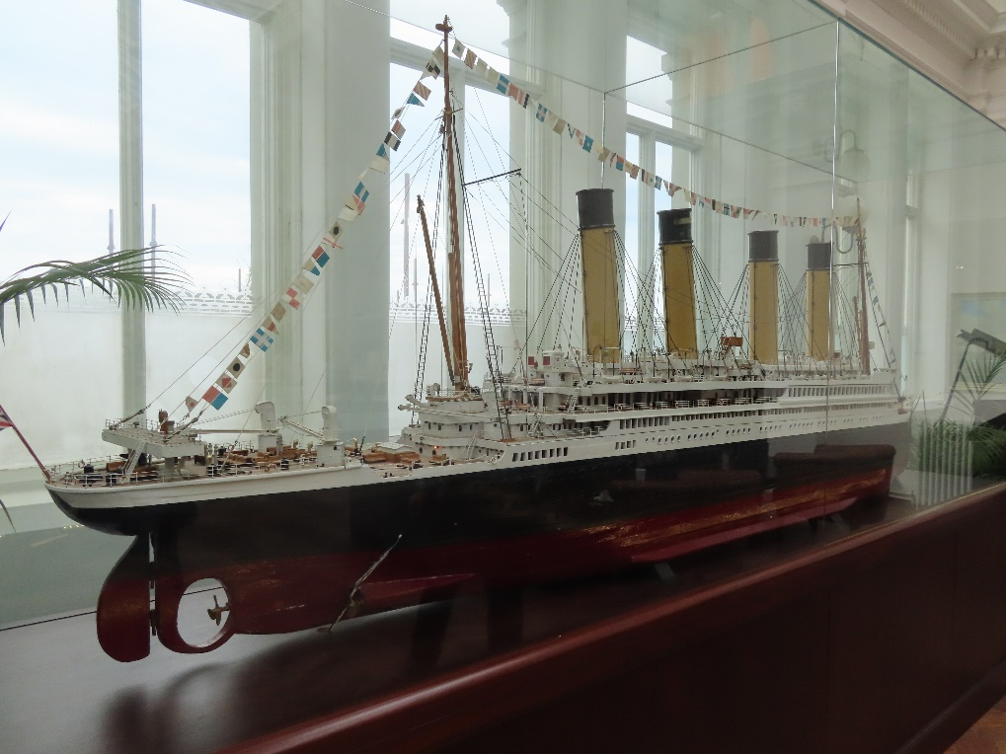
Mementos and Monuments
What was once the Harland and Wolff drafting room is now the bar of the Titanic Hotel.
There is a 3.8 metre model of Titanic in the bar.
Notes:
1. Photo supplied by the author

Slide 14
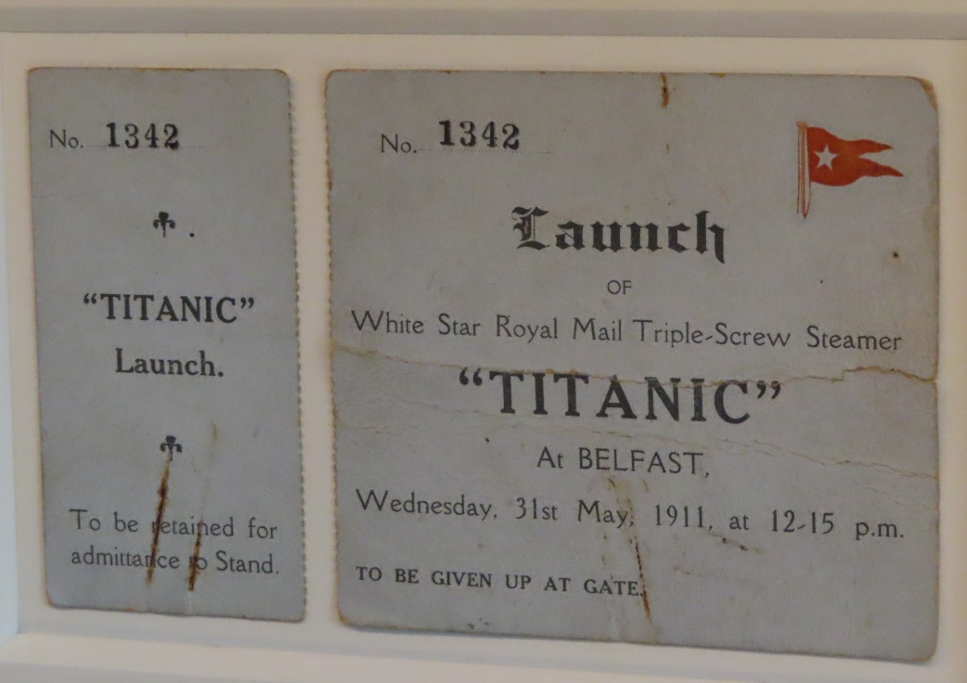
Mementos and Monuments
One Harland and Wolff staff member kept her ticket to see the launch as a memento.
Notes:
1. Photo supplied by the author

Slide 15
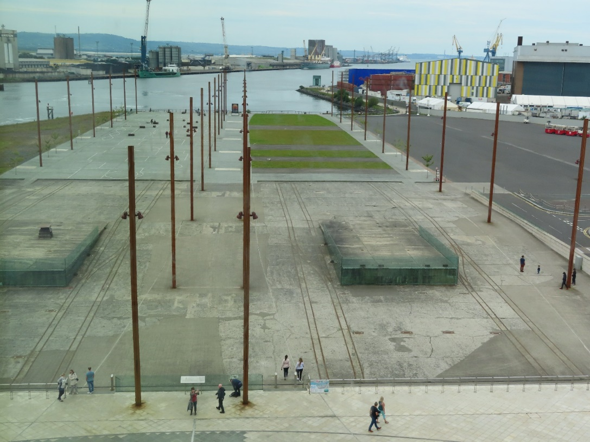
Mementos and Monuments
The slipway where Titanic was launched is now a memorial.
The poles were there to support the ship.
Notes:
1. Photo supplied by the author

Slide 16
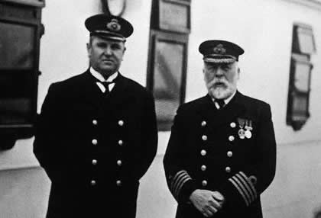
Facts on the Crew
The Titanic had 908 crew members, of whom only 23 were women. The youngest crew members were only 14 years old.
First Officer William Murdoch and Captain Edward Smith
Notes:
https://thehistoricalnovel.files.wordpress.com/2013/05/titanic-crew-list.jpg

Slide 17
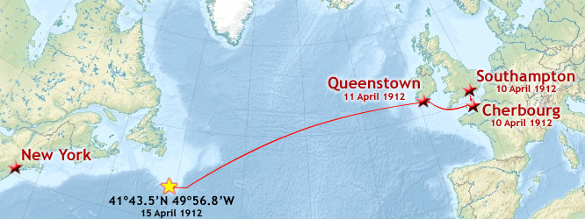
Maiden Voyage
Titanic left for her maiden voyage on 10 April 1912. She was to go to New York, via Southampton, Cherbourg (France), and Queenstown (Ireland).
Notes:
1. Photo supplied by the author
2. https://en.wikipedia.org/wiki/Titanic#/media/File:Titanic_voyage_map.png

Slide 18
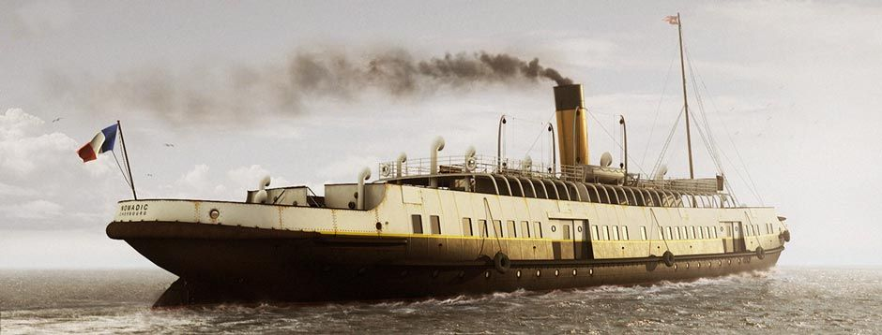
Getting to The Titanic
Special trains were scheduled from London and Paris to convey passengers to Southampton and Cherbourg respectively.
The Nomadic ferried passengers between the dock and Titanic at Cherbourg.
Notes:
1. https://www.encyclopedia-titanica.org/nomadic.html

Slide 19
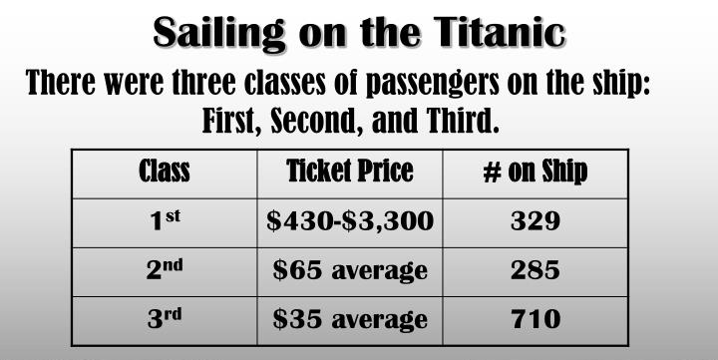
Passenger Facts
When the Titanic left Queenstown, there were 1325 passengers aboard, 112 of whom were children.
Notes:
1. https://www.slideserve.com/fiona-mcleod/rms-titanic

Slide 20
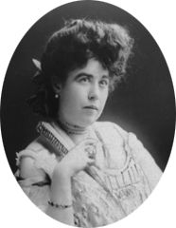
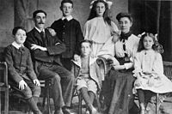
Class Distinction
Stewards showed Second and Third Class passengers to their cabins, while First Class passengers were personally greeted by Captain Smith.
First Class passenger Margaret (Molly) Brown survived.
Third Class passengers Mr & Mrs Goodwin & children all perished.

Slide 21
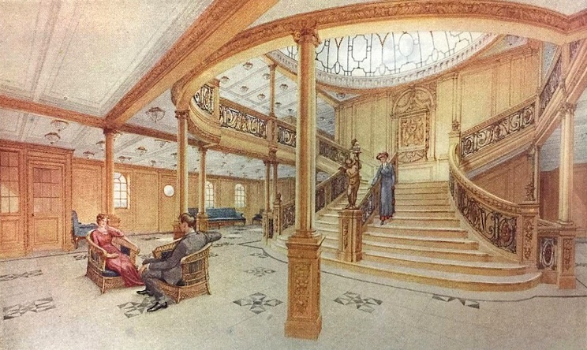
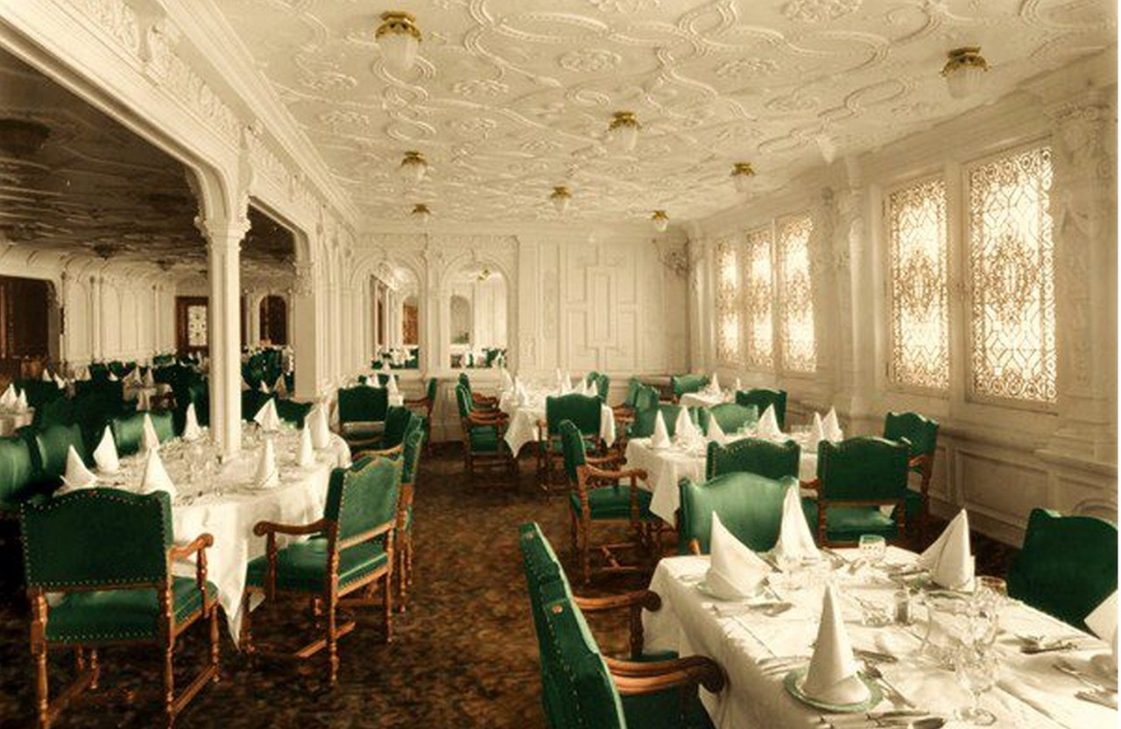
First Class – Grand Style
Titanic was a luxury ship with many famous and wealthy people on board.
This is the Grand Central staircase (above) and the First Class dining room (right).
Notes:
Photo: https://luxurylinerrow.com/online-museum/olympic-titanic-staircase/
https://www.deviantart.com/rms-olympic/art/Titanic-Honour-and-Glory-554698448

Slide 22
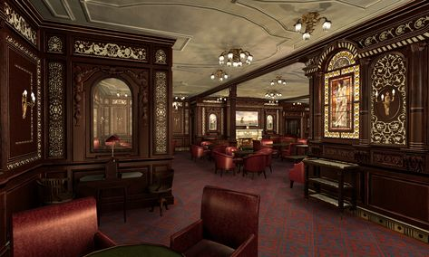
First Class – Luxurious Amenities
The First Class accommodation was designed to be the pinnacle of comfort and luxury.
This smoking room was for First Class gentlemen only.
Notes:
1. https://www.moddb.com/mods/mafia-titanic-mod/images/smoking-room-completed3

Slide 23
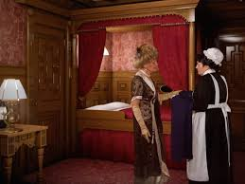
First Class Accommodation
Titanic had 39 private suites located at the top of the ship. Each had two large bedrooms, two walk-in wardrobes and a bathroom.
There was also a spacious sitting room to entertain guests, plus servants’ quarters.
Notes:
https://en.wikipedia.org/wiki/First-class_facilities_of_the_Titanic#/media/File:Titanic's_B_59_stateroom.jpg
https://www.businessinsider.com.au/titanic-ll-compare-to-the-original-2018-11?r=US&IR=T

Slide 24
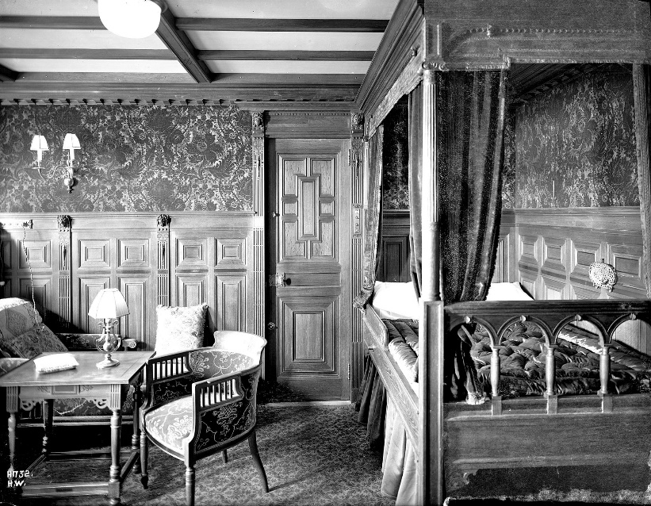
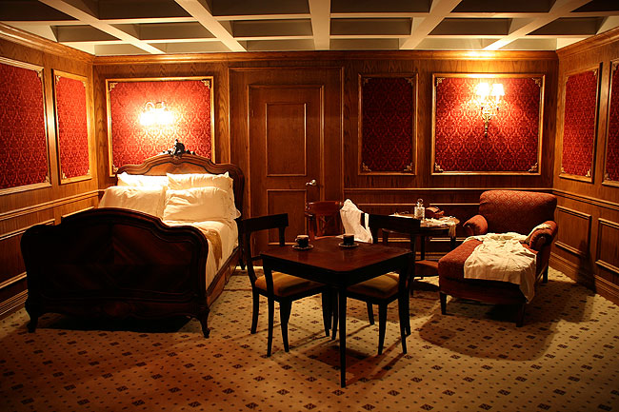
First Class Accommodation
The First Class cabins were luxurious.
Notes:
https://www.ultimatetitanic.com/interior-fittings

Slide 25
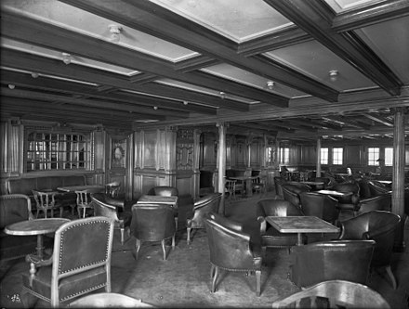
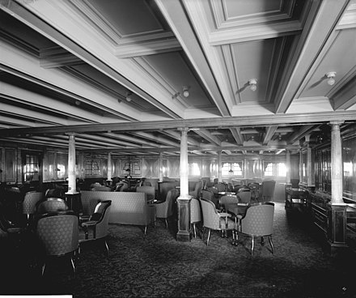
Second Class Amenities
Passengers in Second Class had facilities such as a spacious outdoor promenade. Afternoon tea and coffee was served in the library.
Notes:
https://en.wikipedia.org/wiki/Second-_and_third-class_facilities_on_the_Titanic
https://en.wikipedia.org/wiki/Second-_and_third-class_facilities_on_the_Titanic

Slide 26
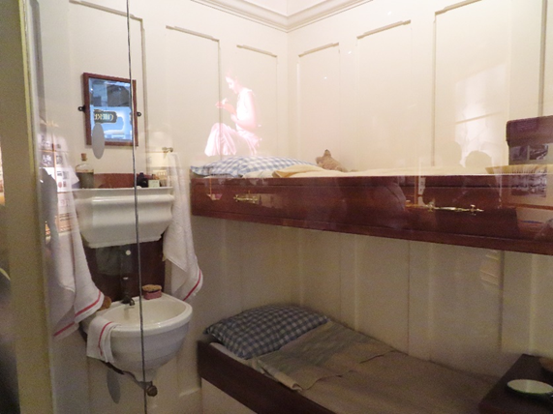
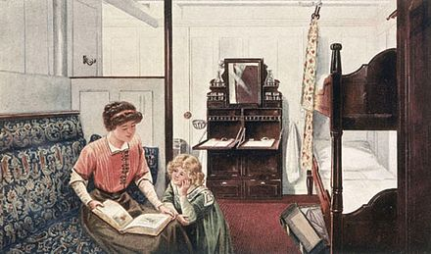
Second Class Accommodation
Most of the Second Class accommodation on Titanic consisted of cabins with bunk-beds.
These cabins had sinks and mirrors and the bed linen was changed every day.
Notes:
1. https://en.wikipedia.org/wiki/Second-_and_third-class_facilities_on_the_Titanic
2. https://upload.wikimedia.org/wikipedia/commons/3/33/2nd-Class_Library_on_the_RMS_Olympic.jpg

Slide 27
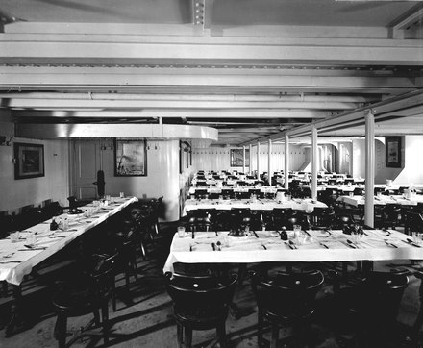
Third Class
The passengers in Third Class were mainly immigrants heading for a new life in America.
Single men and women were split up at the front and back with families in the middle.
There were only two baths for everyone in third class!
Third class dining room
Notes:
1. https://www.lovefood.com/gallerylist/69139/the-titanics-incredible-menu-revealed-for-every-class

Slide 28
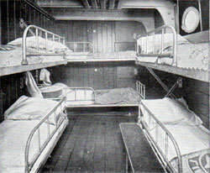
Third Class
Cabins slept up to 10 people and were located at the noisy bottom part of the ship close to the engines.
The food was simple but plentiful consisting of rice, soup, biscuits, roast beef and fruit.
Notes:
1. http://www.titanicuniverse.com/wp-content/uploads/2018/01/thirdclass.jpg

Slide 29
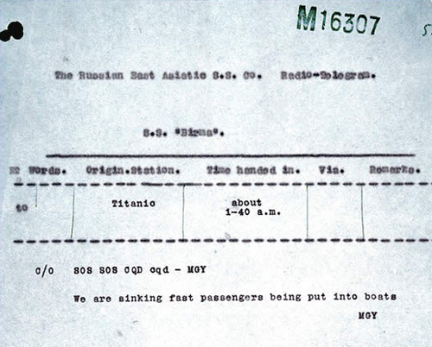
Disaster Strikes
Four days into her voyage, Titanic struck an iceberg at 11.45pm on 14 April.
The distress signal “CQD” (equivalent of SOS) was sent out.
The last call from Titanic at 2.10am was CQ…… then silence.
Notes:
https://en.wikipedia.org/wiki/Sinking_of_the_Titanic#/media/File:Titanic_signal.jpg
https://www.google.com/search?q=iceberg&rlz=1C5CHFA_enAU906AU906&sxsrf=ALeKk01Er5Zf0R8M1C7jpxAKfvwNo8YQDA:1601008361261&tbm=isch&source=iu&ictx=1&fir=Z4jkPQP_dcf0jM%252Cb6A5NHT2e59Y_M%252C%252Fm%252F012mqx&vet=1&usg=AI4_-kSMg-Fg8JTUJ8G_cXcRJC888p0nvQ&sa=X&ved=2ahUKEwiU2J71vIPsAhUJzTgGHZGJDoMQ_B16BAgHEAM#imgrc=Z4jkPQP_dcf0jM

Slide 30
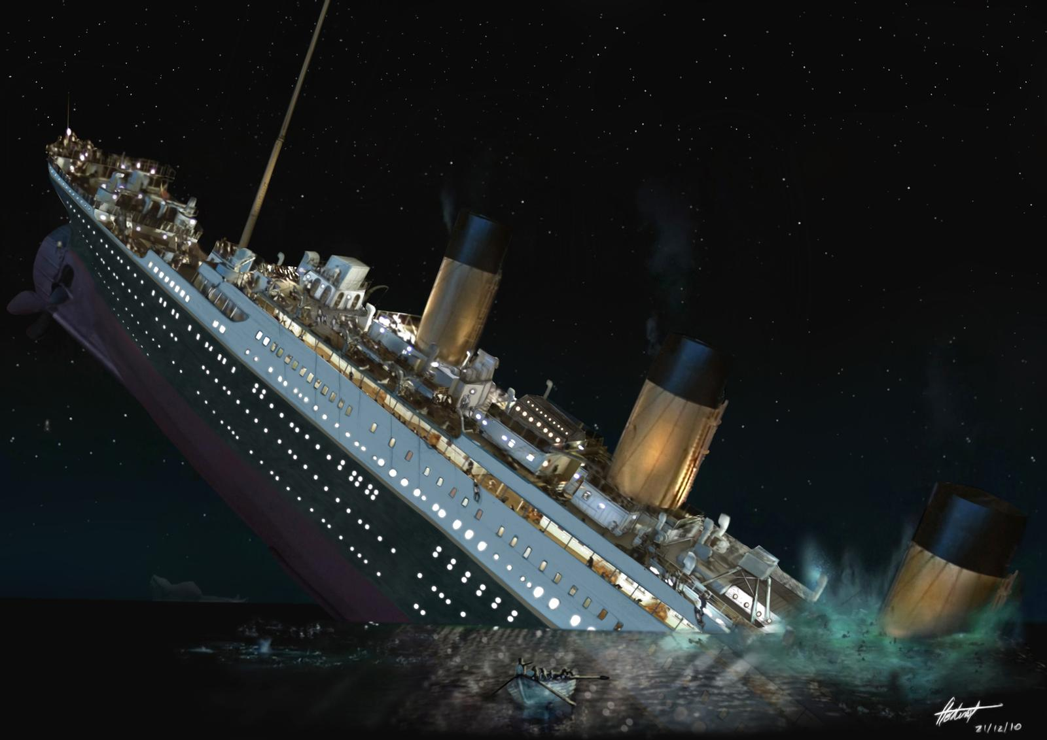
The Titanic Sinks
The starboard side of the ship hit an iceberg, leaving five widely separated holes in the hull.
Two hours and forty minutes later, at 2.20am, the Titanic sank, taking with it over 1,500 lives.
Notes:
https://www.deviantart.com/filipeps/art/Titanic-190912742

Slide 31
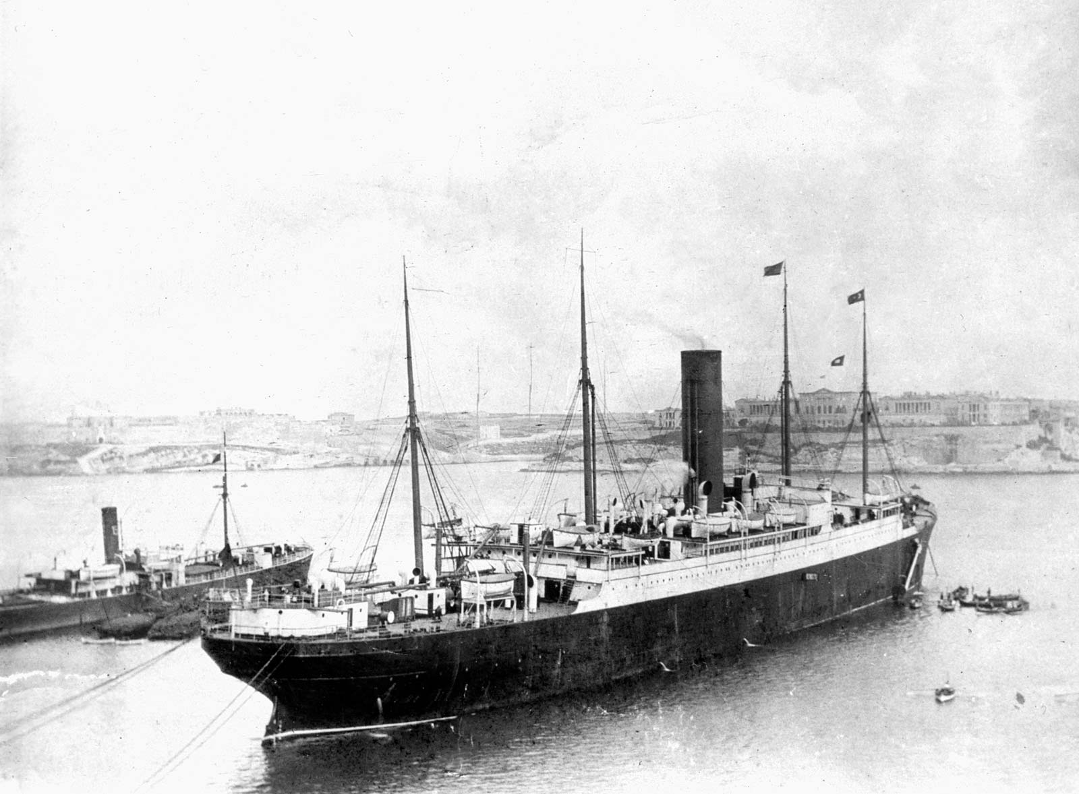
Help Arrives
The Carpathia was fifty-eight miles away from the sinking Titanic when they received the CQD / SOS message.
Carpathia in Halifax Harbour 1912.
Notes:
Picture: The National Archives/Heritage-Images/Imagestate

Slide 32
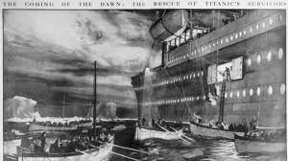
The Carpathia
Over an hour after the sinking, at 4am, RMS Carpathia arrived and rescued about 705 people from the lifeboats.
Notes:
1. http://alookthrutime.com/carpathia-arrives-titanic-survivors-are-rescued/

Slide 33
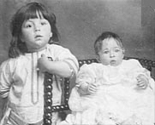
The Youngest Survivor
Eliza (Malvina) Dean was the youngest survivor of Titanic. She was just 2 months old.
She and her brother survived with their mother, Etta.
Malvina (right) and her brother Bertram (on the left).
Notes:
1. https://en.wikipedia.org/wiki/Sinking_of_the_Titanic#/media/File:Titanic_signal.jpg

Slide 34
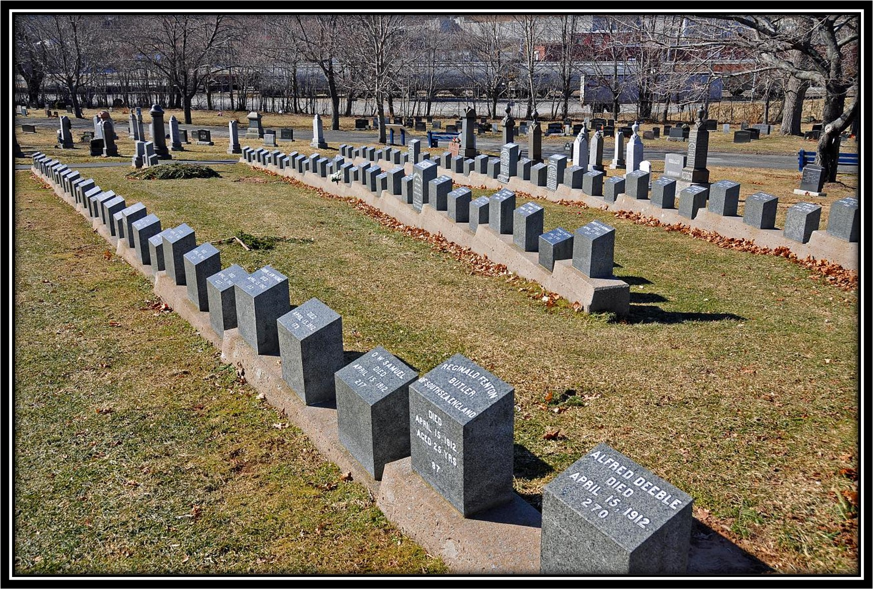
Memorials
A memorial and headstones for those who perished on the Titanic can be found at the Fairview Lawn Cemetery in Halifax, Canada.

Slide 35
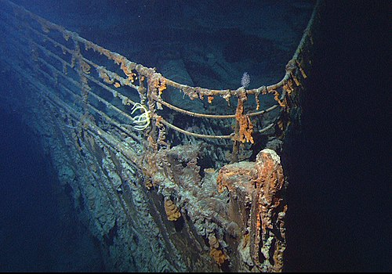
Finding The Wreck
The Titanic wreck was discovered in 1985 (73 years after the disaster).
Recovered artifacts are in various museums around the world.
Notes:
https://en.wikipedia.org/wiki/Titanic#Building_and_preparing_the_ship

Slide 36
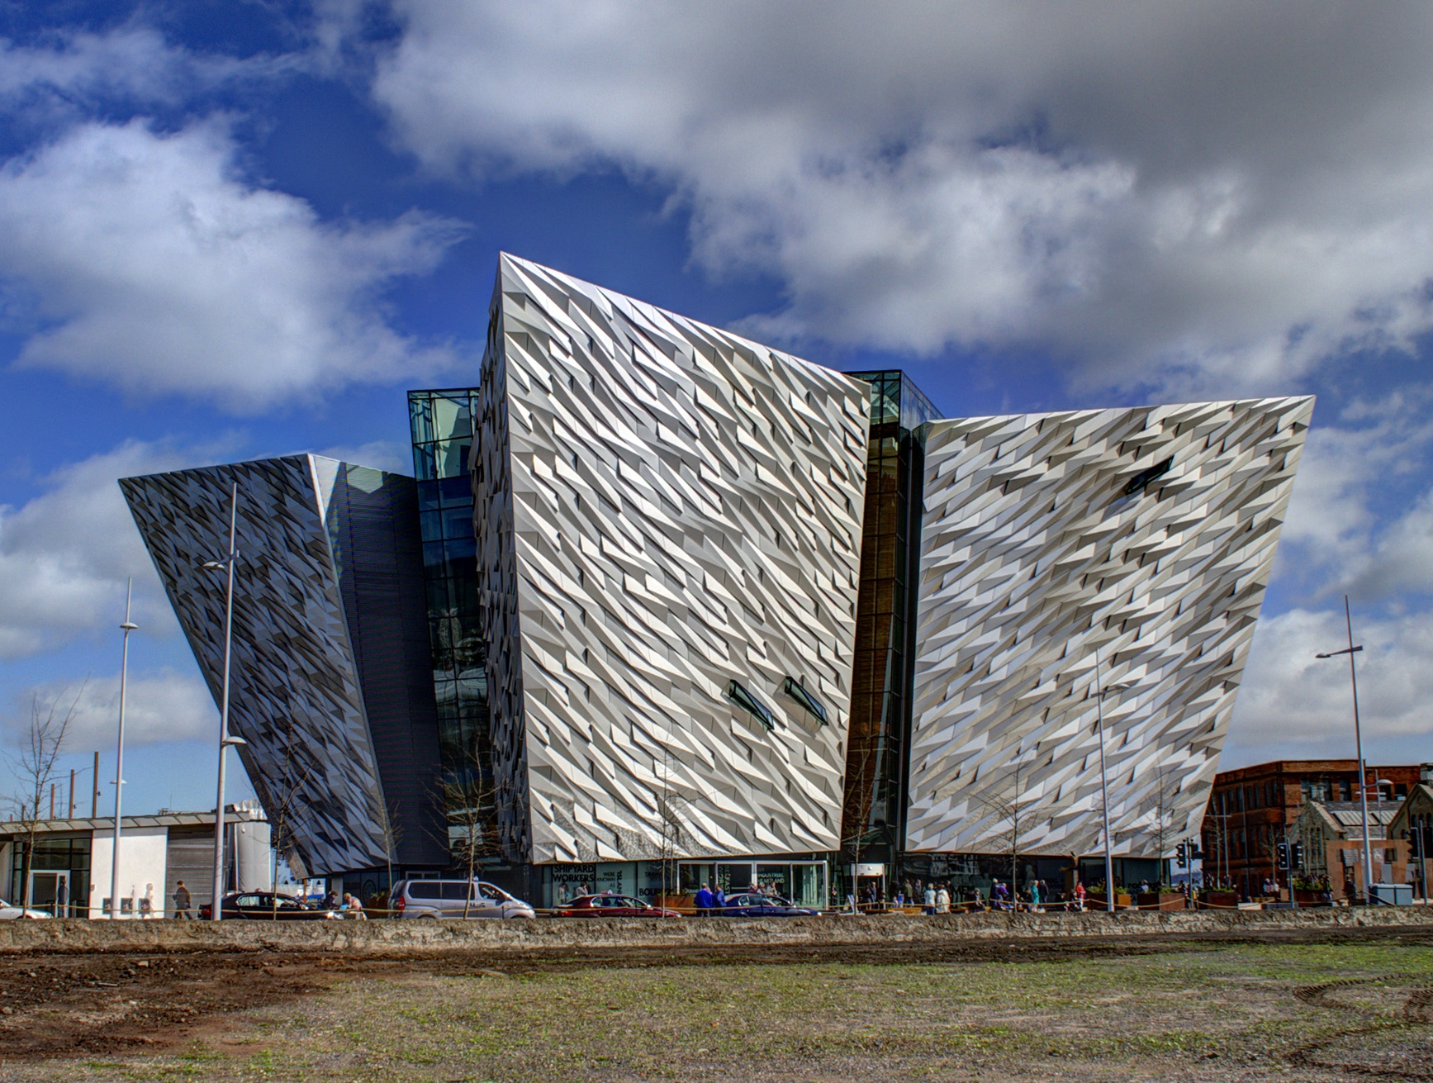
Titanic Experience Museum
The Museum is on the site where the Titanic was built.
The wings of the building are the same size as the bows of Titanic.
The colours of the building represent the cold grey sea, the stars and the icebergs.
Notes:
1. https://www.buzz.ie/news/titanic-belfast-to-reopen-from-tomorrow-onwards-381406

Slide 37
I hope you enjoyed my version of the Titanic experience as much as I have in putting it together.
Rosemary Waghorne
September 2020
Notes:
1. https://www.buzz.ie/news/titanic-belfast-to-reopen-from-tomorrow-onwards-381406

Slide 38
The Rotary Club of Canterbury “Let’s Stay Connected Project” has been developed as a response to an identified need within the Aged Care sector.
At times when it’s difficult to connect in person with family and friends, the Rotary Club of Canterbury has pleasure in offering you this booklet, designed to promote conversation, recollection and engagement for those who are in isolation and without their usual social activities.
The booklets have been designed for people in an aged care residence, village or at home to read by themselves, or to have a family or staff member share the booklet with them.
You can download this and other booklets from the Rotary Club of Canterbury website (www.canterburyrotary.org).
Source references for this book are held at the Rotary Club of Canterbury. Contact president@caterburyrotary.org for further details.
Material in this book was reproduced in accordance with Section 113F of the Copyright Act (1968).

