Slide 1

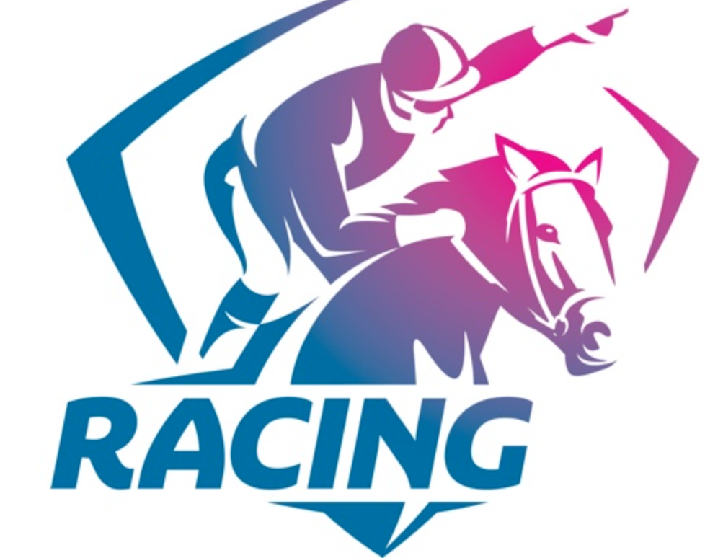
Horse Racing in Victoria
Following the Nags

Slide 2
The Rotary Club of Canterbury “Connecting in Isolation Project” has been specifically developed to support residents in aged care accommodation during the Covid-19 pandemic.
In times when it’s difficult to connect in person with family and friends, the Rotary Club of Canterbury has pleasure in offering you this booklet, designed to promote conversation, recollection and engagement to those who are in isolation and without their usual social activities.
The booklets have been designed for people in an aged care residence to read by themselves, or to colour in the pictures, or to have a family member at the other end of the phone read the booklet to them.
You can download this and other booklets from the Rotary Club of Canterbury website (www.canterburyrotary.org).
Source references for this book are held at the Rotary Club of Canterbury. Contact president@caterburyrotary.com.au for further details. Material in this book was reproduced in accordance with Section 113F of the Copyright Act (1968).

Slide 3
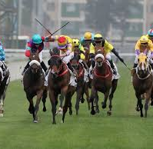
Horses and Jockeys - a partnership

Slide 4
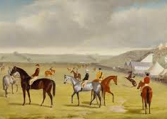
Early Days
Horse racing in Australia began in
Victoria in 1848.

Slide 5
Tracks were not as well designed or professionally prepared as they are today.
Races took place in paddocks or any other open, flat space.

Slide 6
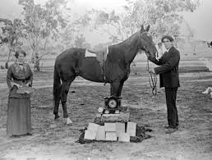
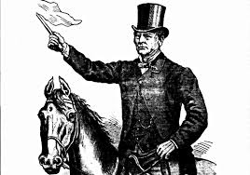
Conditions were not as sophisticated as they are now, but they still loved the prizemoney.

Slide 7
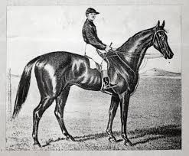
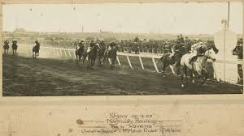
Archer
(1856–1872) won the first and the second Melbourne Cups in 1861 and 1862.
Horses have been bred to win over centuries. Most are traceable back to English ‘taproot’ mares identified in the first General Stud book in 1793.

Slide 8

Thinking back
Have you ever been to the races?
Did you pick a winner?
Which race meet did you go to?

Slide 9
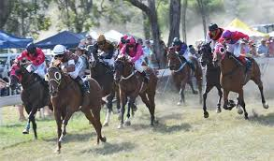
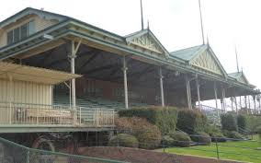
By the late 19th century most major towns had proper racetracks.
Melbourne’s first racecourse was on Batman’s Hill on the site now occupied by Southern Cross railway station and the rail yard west of the CBD.
Its first meeting in March 1838 predated Flemington by two years. The starting post was near present-day North Melbourne railway station.

Slide 10
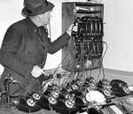
SP bookies were a feature of local neighbourhoods in the early and middle 1900’s – some just operating from the kitchen table and using young boys as runners to collect and deliver bets and money.

Slide 11
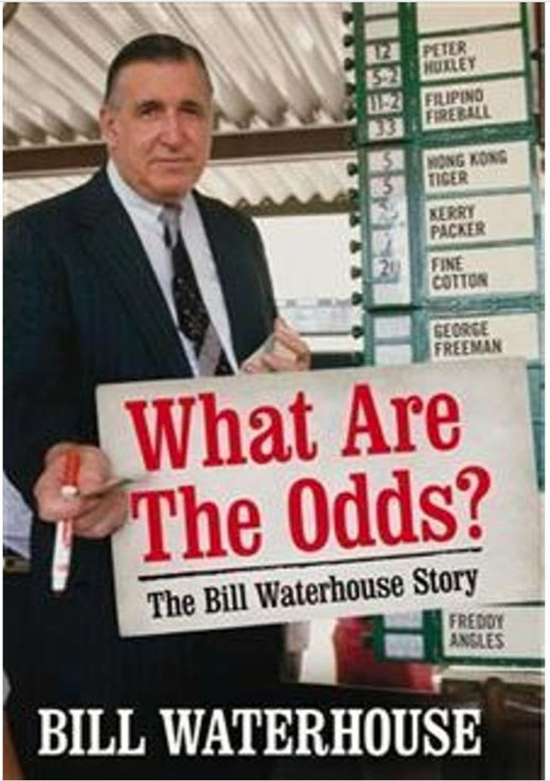
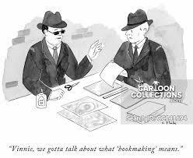
Face-to-face interaction in the betting ring, the ultimate battleground between bookie and punter, is no longer as relevant in horse racing with the advent of betting agencies.

Slide 12
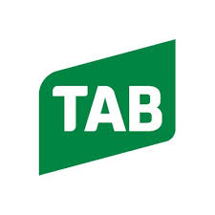
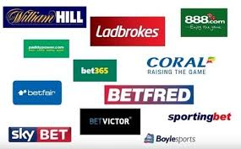
Betting began being more regulated in 1961 with the advent of the TAB, then a state-owned monopoly betting organization.
Today the TAB has been privatized and there are a multitude of corporate betting agencies. The majority of betting is now done online.

Slide 13
Thinking back
Have you ever placed a bet on a horse race?
What about a trifecta?
Have you ever won a sweep in the Cup?

Slide 14
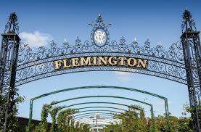
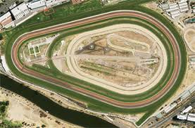
The First Racecourses
The first races were held on land west of Spencer Street in 1938. The first race-course was established in 1848 at Flemington.

Slide 15
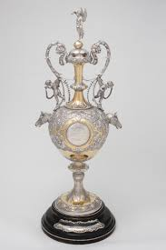
The Melbourne Cup
The first Melbourne Cup was in 1861. Today it is the richest handicap race in Australia. The prizemoney and trophies make it among the richest in the world. It is a 3200 metre race (2 miles) in distance.

Slide 16
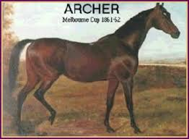
The Beginning of a Horse Racing Legend
Archer (1856–1872) was an Australian Thoroughbred racehorse who won
the first and the second Melbourne Cups in 1861 and 1862. He won both Cups easily and is one of only five horses to win the Melbourne Cup twice or more; he is one of only four horses to win two successive Cups.

Slide 17
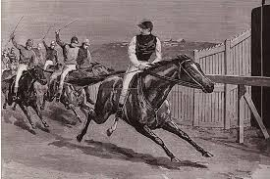
Carbine Won
The Melbourne Cup In 1890
Carbine was a New Zealand thoroughbred. “Five to one bar one” was the bookies cry when taking odds on Carbine races.

Slide 18
Thinking back
Have you been to the Melbourne Cup?
Did you pick a winner?
How many Melbourne Cup winners can you name?

Slide 19
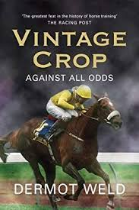
The First International Melbourne Cup Winner
Horses from all over the world now travel to race in the Melbourne cup on the first Tuesday in November. Vintage Crop was the first international horse to win in 1993.

Slide 20
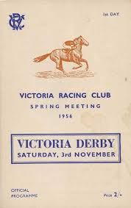
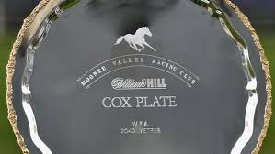
Victoria’s Famous Horse Races
Here is the Racebook for the 1956 Victoria Derby that included the famous triple dead heat in the Hotham Handicap.
The Cox Plate is run at Moonee Valley over 2040 metres.

Slide 21
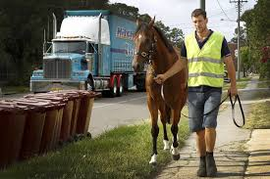
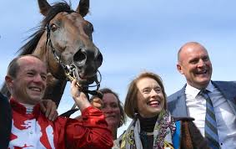
$$$$
The horse racing industry is worth $3.2 billion to the Victorian economy. It has the equivalent of 25,000 full time jobs. Other states like NSW, Queensland & WA have equally large racing industries.

Slide 22
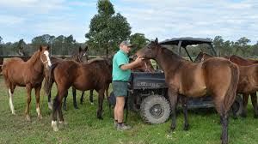
Thoroughbred Racing
Participants In Victoria
Breeders 2,100
Breeders’ Staff 2,200
Owners & Syndicate Members 70,000
Trainers 950
Jockeys 250
Stable Employees 3000
Full-time Racing Club Staff 860
Racing Club Staff 4,800
Wagering Provider Staff 2,000
Bookmakers & Staff 950
,

Slide 23
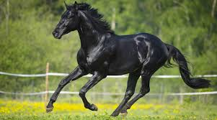
Thinking back
Why do you love horseracing?
Who in your lifetime do you think has been the best jockey?
Do you have a favourite racetrack?
3.

Slide 24
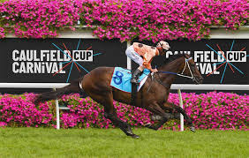
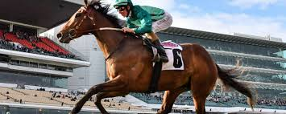
Caulfield Racecourse
CAULFIELD RACECOURSE, commonly known as "The Heath" by local racegoers, is on Crown Land in Melbourne’s south eastern suburbs. The Melbourne Racing Club has a license to operate the course also owning adjoining land.

Slide 25
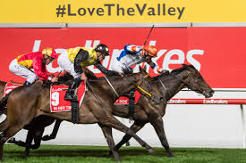
Moonee Valley Hosts
The Cox Plate
Moonee Valley Racecourse was established in 1883 by William Samuel (W.S.) Cox, who purchased a farm the previous year belonging to John F. Feehan to establish a racetrack.
Expansion of the racecourse occurred in the 1960s, funded through compensation for land acquired for construction of the adjacent
Tullamarine Freeway. In the 1970s, harness racing moved to the Valley, when night trotting relocated from the Royal Melbourne Showgrounds.

Slide 26
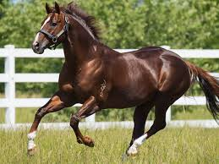
Horse Birthdays
All thoroughbred horses celebrate their birthday on the same date: January 1 in the Northern hemisphere and August 1 in the Southern hemisphere.
After the first time a horse is alive, on August 1st it is considered a yearling. This makes it easier to keep track of thoroughbred horses' bloodlines.

Slide 27
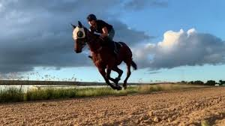
RACING PARLANCE
RACING PARLANCE
Barriers: The gates the horses come out of at the start of a race.
Birdcage: The area where the horses are walked before being taken to the Mounting Yard.
Blinkers: The hood horses wear with cups around their eyes.
Bookmakers/Bookies: The people licensed to place your bet. Can be on-course or off-course.
Box Trifecta: Usually four or five horses are "boxed" in a trifecta. If three of the horses selected all finish in the first three placings, the punter collects for a winning trifecta.
Colt: A male horse under three years old, that hasn't been gelded yet.
Dead Heat: A tie at the finish line between two or more horses.

Slide 28
RACING PARLANCE CONT….
Each way: This is when you have an equal amount of money on the horse for a win and for a place.
Exacta: Picking the first two horses in a race in the finishing order.
Extended: How to describe a horse running at top speed.
Favourite: The most popular horse in betting by weight of money and therefore the one who starts at the shortest odds ie the one that will pay the least.
Filly: A female horse three years old or under.
Late Scratching: A horse that is withdrawn from the race after 8 am on race day.
Lay: When a bookmaker offers better odds on a horse they think won't win.

Slide 29
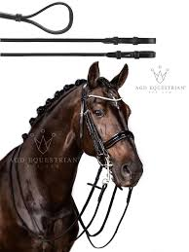
RACING PARLANCE CONT….
Maiden: A horse which has not won a race.
Mare: Adult female horse 4 years of age or older.
Mounting Yard: The area where the horses are paraded before a race and jockeys get on.
Mudlark: A horse that does well on wet tracks.
Mug Punter: Someone who's bad at betting.
Head/half head: Winning margin equated to the length of a horse’s head or part thereof.
Nose: The smallest measuring margin between horses. If a horse wins by a nose, it was an incredibly close race.
Odds-Against: The prices in the betting ring are longer than even money (eg $4 for $1 invested).
Odds On: Odds of less than even money.

Slide 30
RACING PARLANCE CONT….
Photo Finish: A result so close they need to look at the pictures taken by the finish-line camera to determine the winner.
Place: When your horse comes either first, second or third and you receive a dividend (No third-place dividend unless at least 8 starters.)
Punter: Person placing a bet.
Quadrella: When you select the winner of four pre-nominated races on the card eg Early Quaddie and main Quaddie.
Quinella: Select the first two horses in a race in any order.
Runner: What you call a horse in the race.
Scratching: A runner that has been be taken out of the race after being listed as a runner.

Slide 31
Thinking back
Who is the best WFA runner in your lifetime?
What makes for a good trainer?
Do you think prizemoney is too much now?

