Slide 1

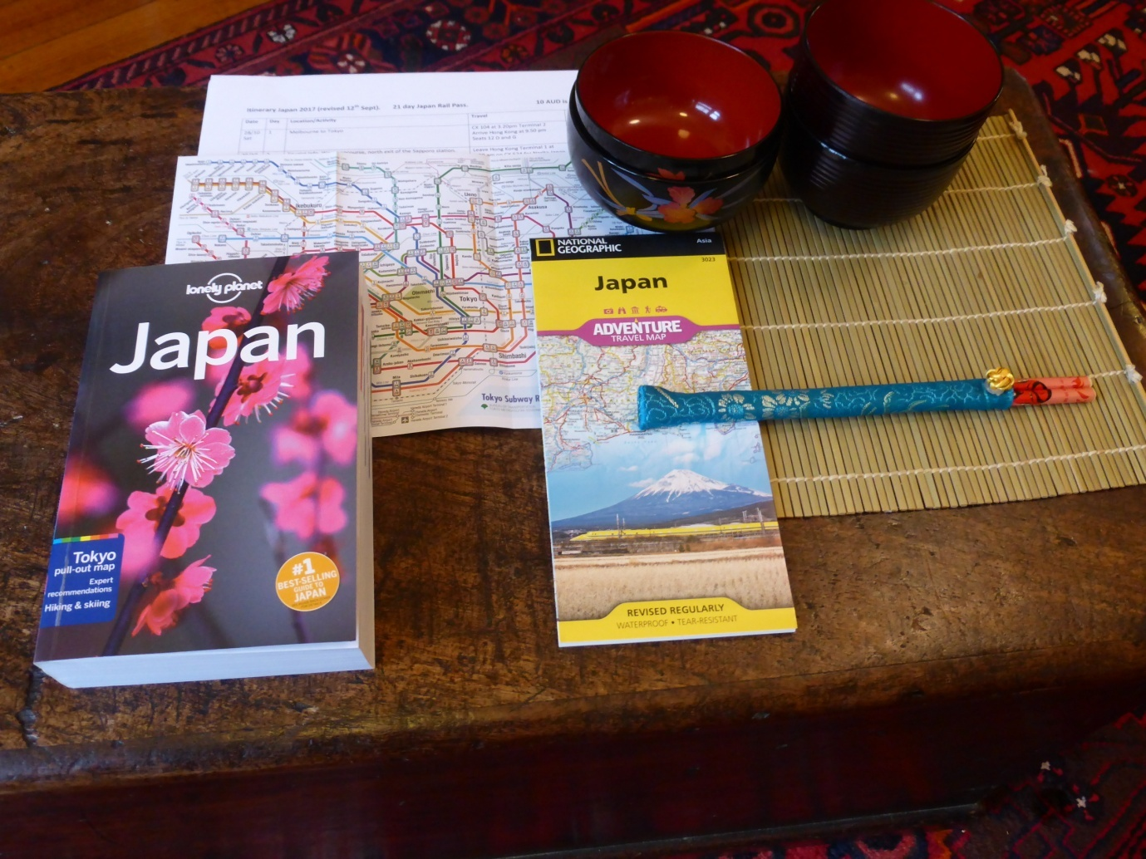
Travelling by Train Through Japan
Rotary Club of Canterbury Let’s Stay Connected Project
Notes:
Photo supplied by the Author

Slide 2
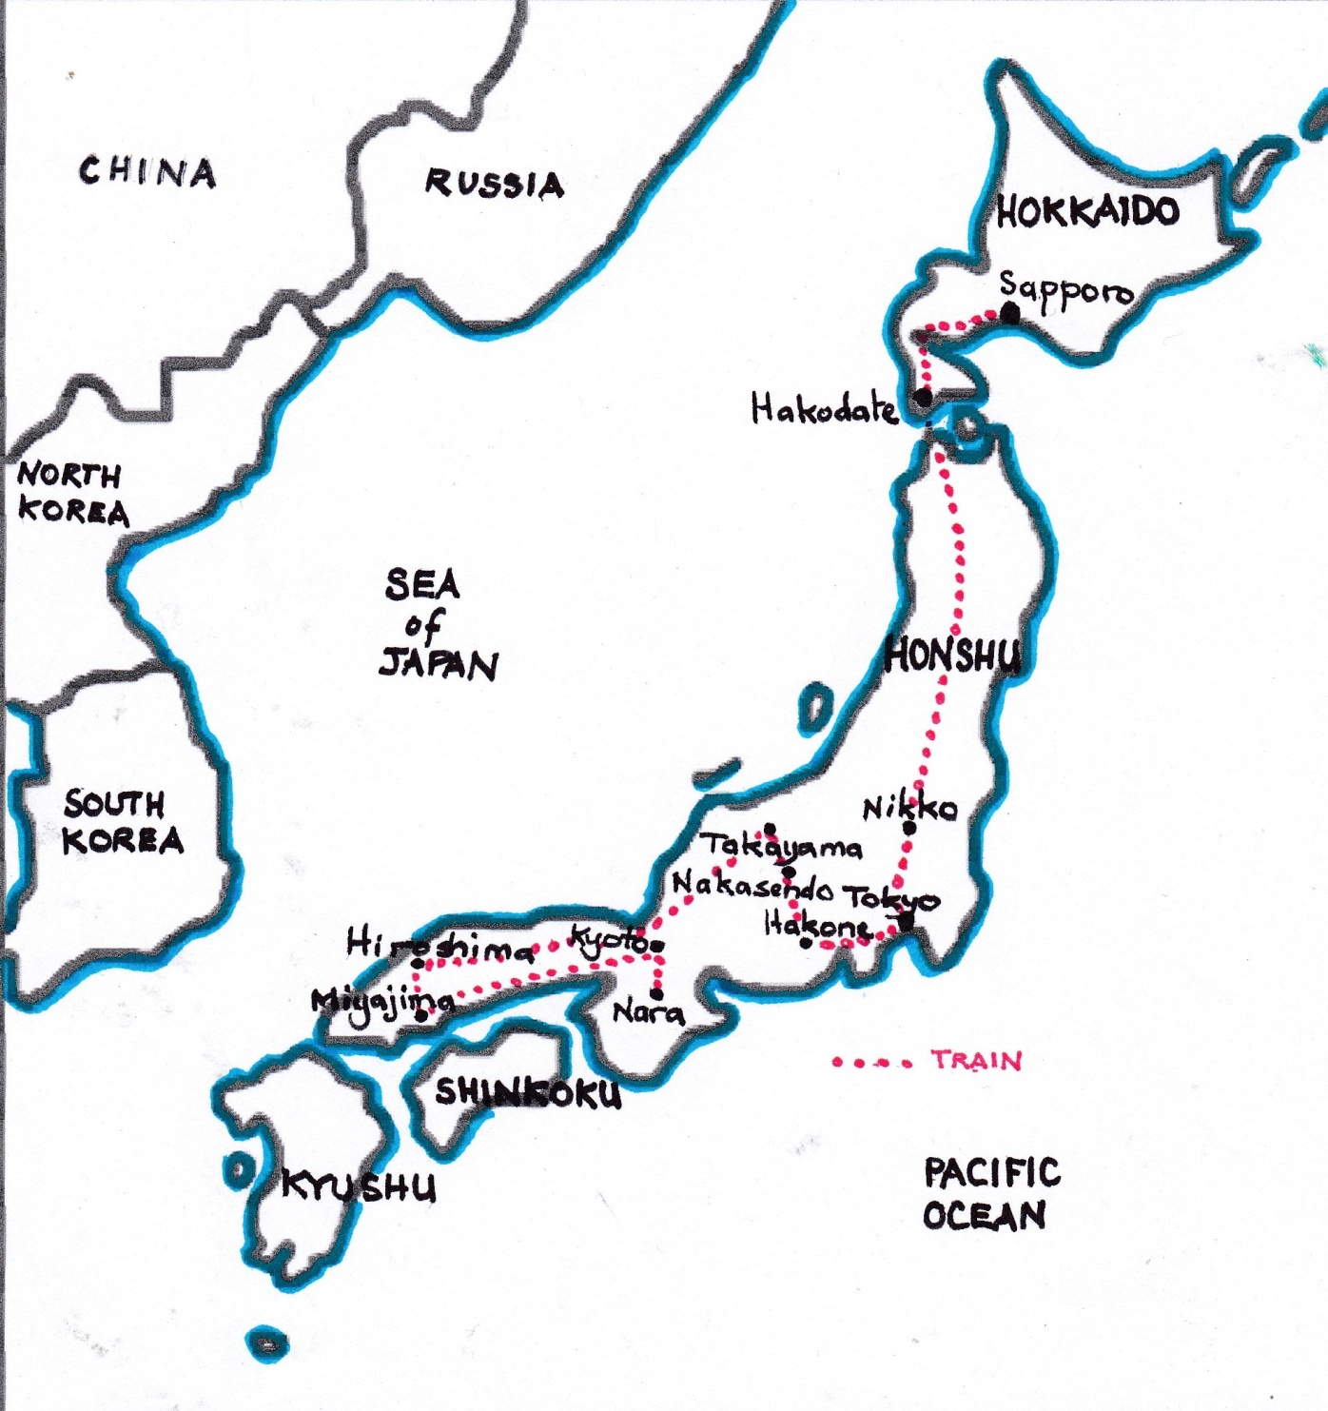
HELLO OR KONNICHIWA
In 2017, my husband and I travelled by train throughout Japan.
We travelled from Sapporo in the north to Hiroshima in the south.
We only speak a few words of Japanese. However, we managed with sign language and pointing and with people offering help!
Notes:
Map supplied by the author

Slide 3
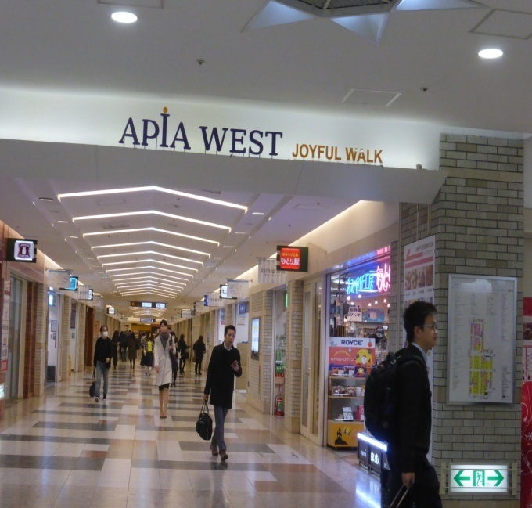
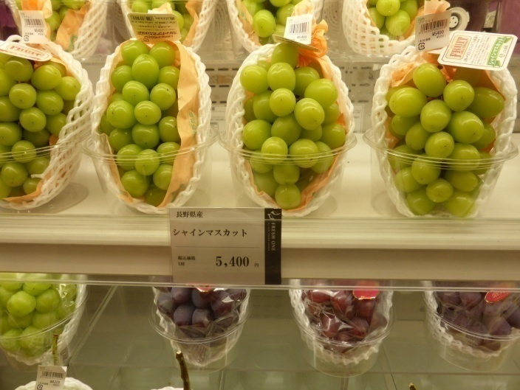
UNDERGROUND MALLS
Our first stop was Sapporo on the northern island of Hokkaido.
These underground malls have shops, train stations, cinemas, hotels and markets.
The grapes were very expensive – about AUD $65.00
Notes:
Photos supplied by the author

Slide 4
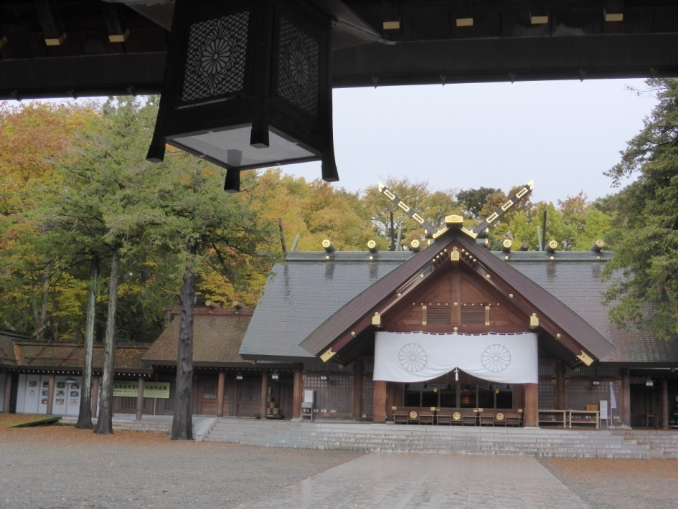
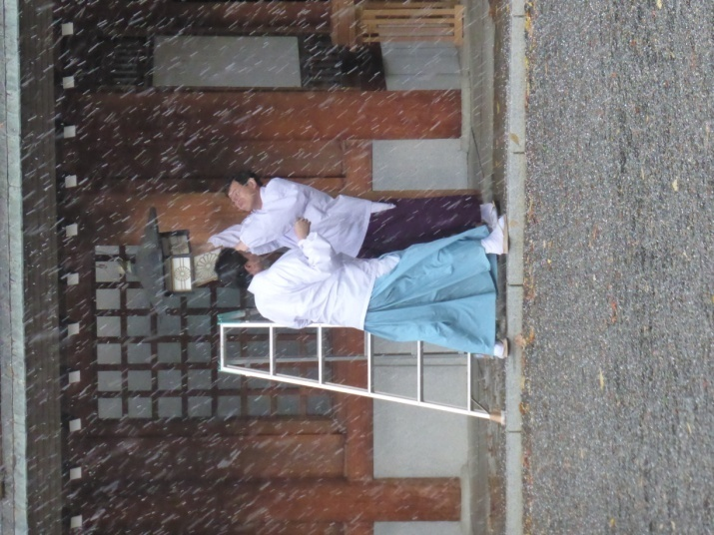
Our first train adventure took us to a temple in a village. It was snowing!
These men were trying to fix a lantern while it was snowing.
Notes:
Photos supplied by the author

Slide 5
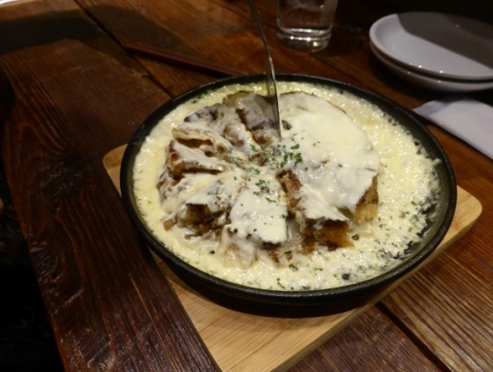
Okonomiyaki
This dish is like a pancake stuffed with vegetables. Ours also had cheese sauce. It was delicious.
Notes:
Photo provided by the author

Slide 6
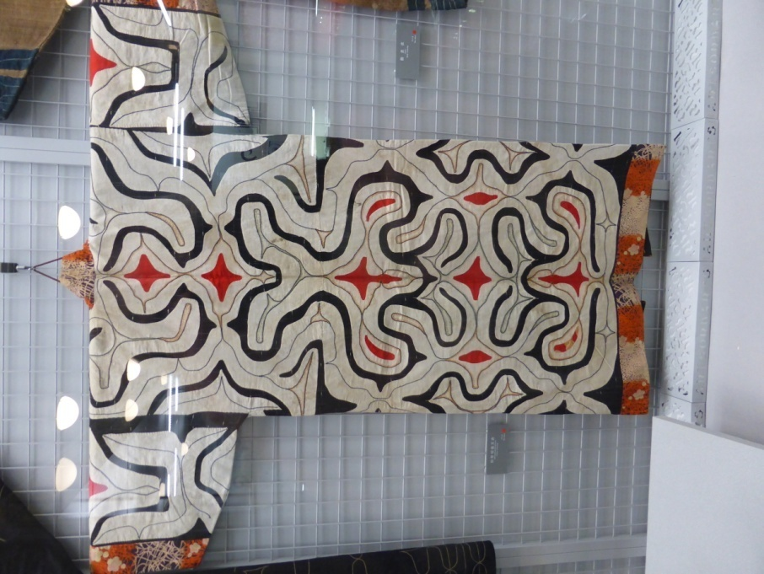
The next stop on our trip was Hakodate. It lies on the southern tip of the island of Hokkaido.
This kimono was designed by the Ainu people. The Ainu are Japan’s first indigenous people.
Notes:
Photo supplied by the author

Slide 7
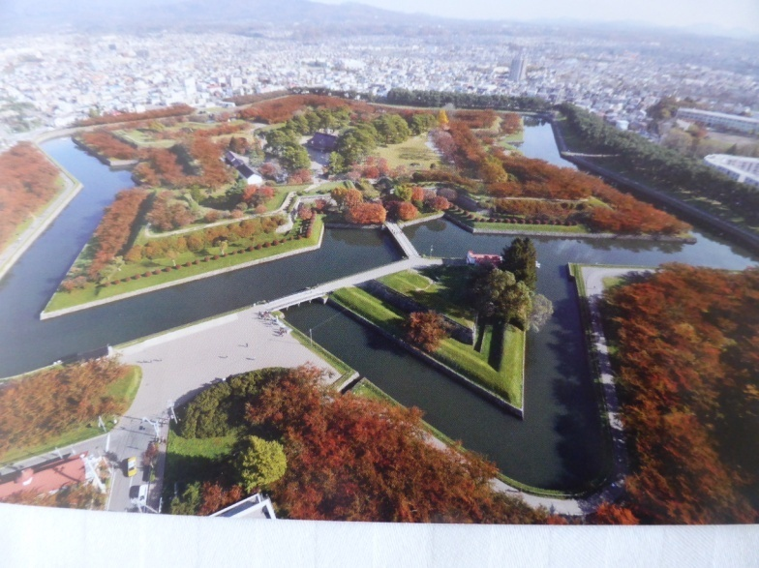
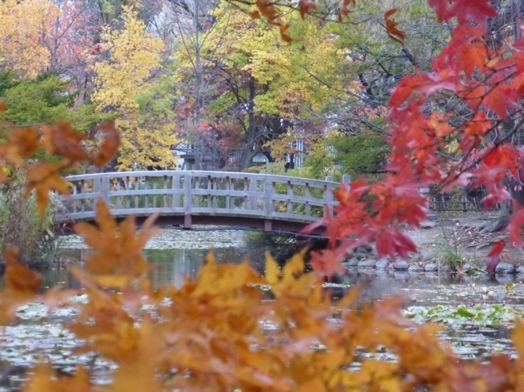
AUTUMN IN JAPAN
Next, we travelled to a fort. It was built in 1850 and was the scene of the last battle of the Shoguns.
It was autumn and everywhere the trees were showing bright autumn colour.
Notes:
Photos supplied by the author

Slide 8
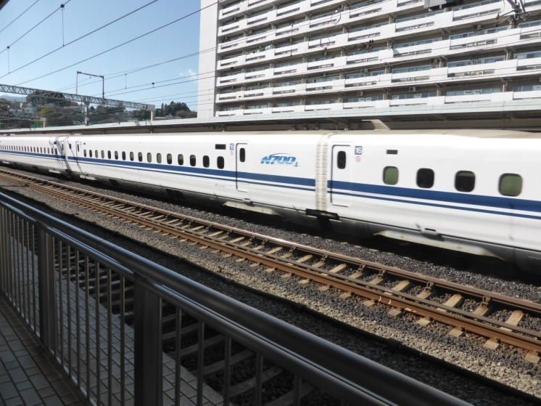
SHINKASEN – FAST TRAINS
After travelling on 3 trains including one Shinkansen or bullet train, we arrived in the capital of Japan, Tokyo. In the Shinkansen we were travelling at 250 kph!
Notes:
Photo supplied by the Author

Slide 9
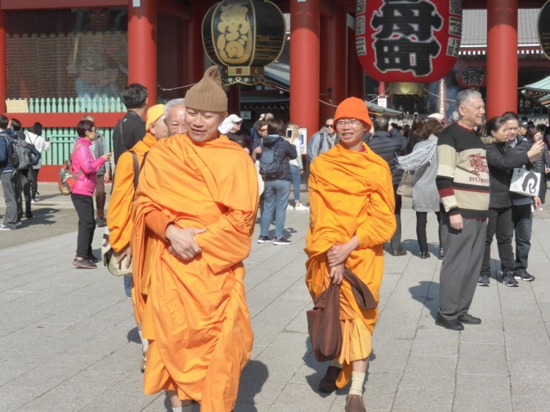
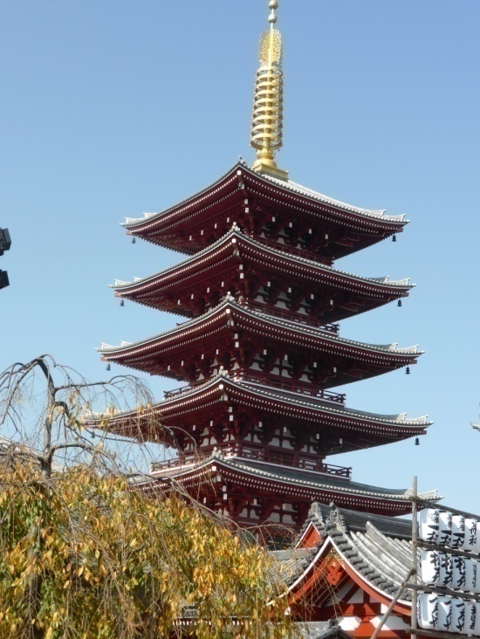
ASAKUSA SHRINES
One of our favourite places in Tokyo is the Asakusa shrines and temple complex.
People pray, burn incense, receive blessings and eat snacks. We love steamed buns.
Notes:
Photos supplied by the author

Slide 10
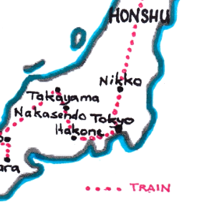
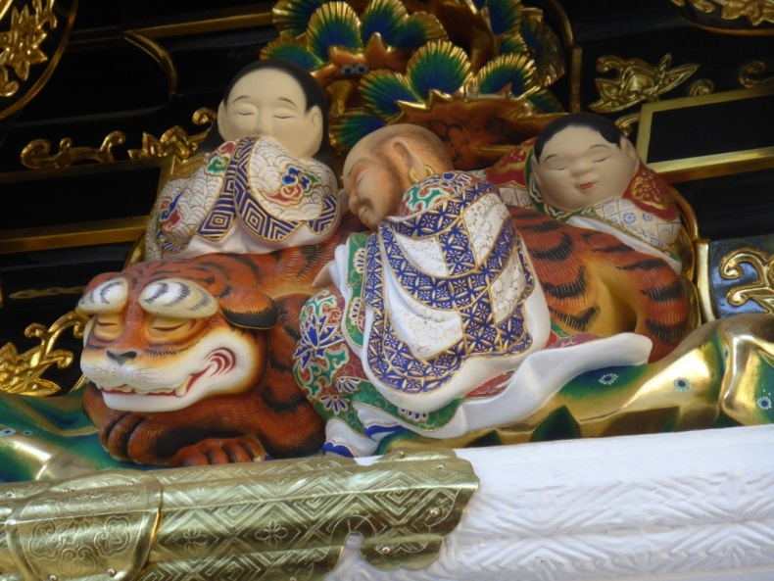
NIKKO
Nikko is a Shinto Shrine complex in a stunning mountain setting.
Some of the beautiful porcelain decorations at the Shrine
Notes:
Photos supplied by the author

Slide 11
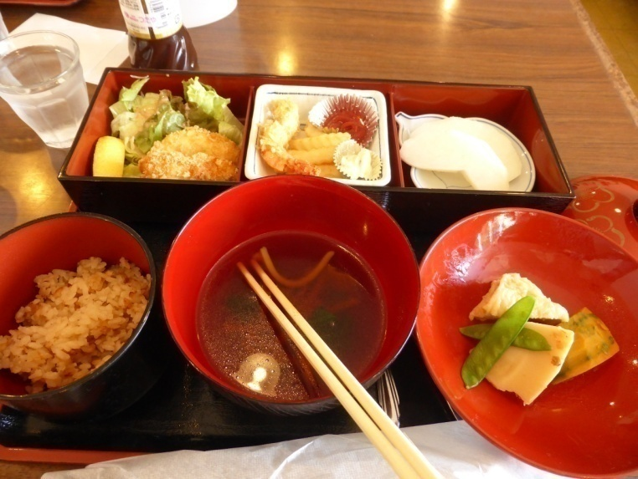
TYPICAL JAPANESE LUNCH
Our lunch at Nikko was typically Japanese with rice, chicken, prawns, vegetables, a soy bean curd roll, noodle soup, a salad and a nashi pear.
Notes:
Photos supplied by the author

Slide 12
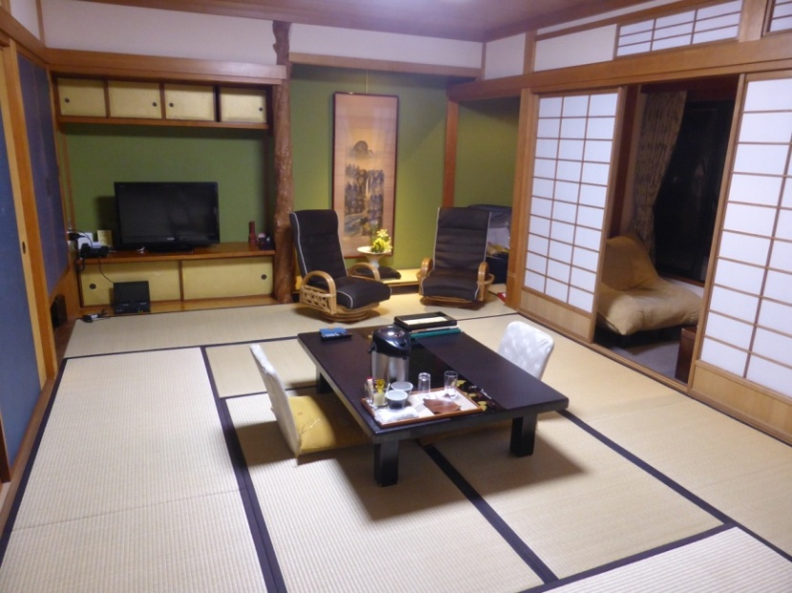
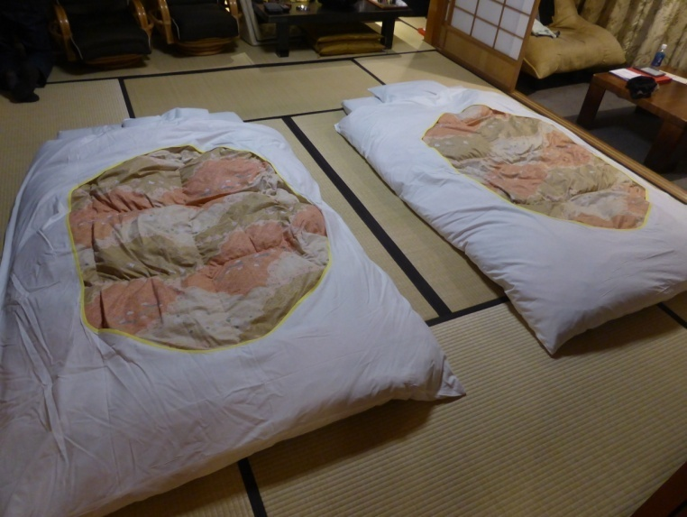
AN ONSEN – HOT SPRINGS DAY SPA
An onsen is a guesthouse with natural hot springs. This one was in Hakone.
We slept on futons laid upon Japanese tatami, or rolled straw mats.
Notes:
Photos supplied by the author

Slide 13
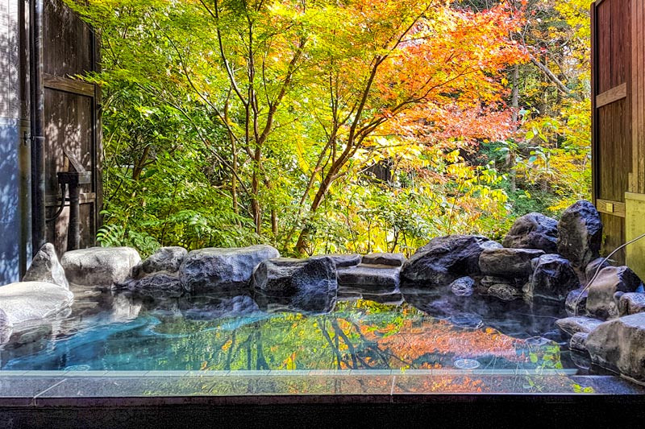
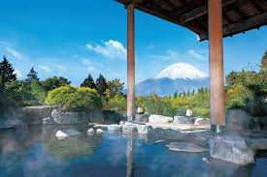
HAKONE DAY SPA
The spas are segregated. There are indoor and outdoor spas.
The scenery is stunningly beautiful.
Notes:
https://www.2aussietravellers.com/hakone-onsen/
https://www.tripzilla.com/top-10-onsens-hakone/94379

Slide 14
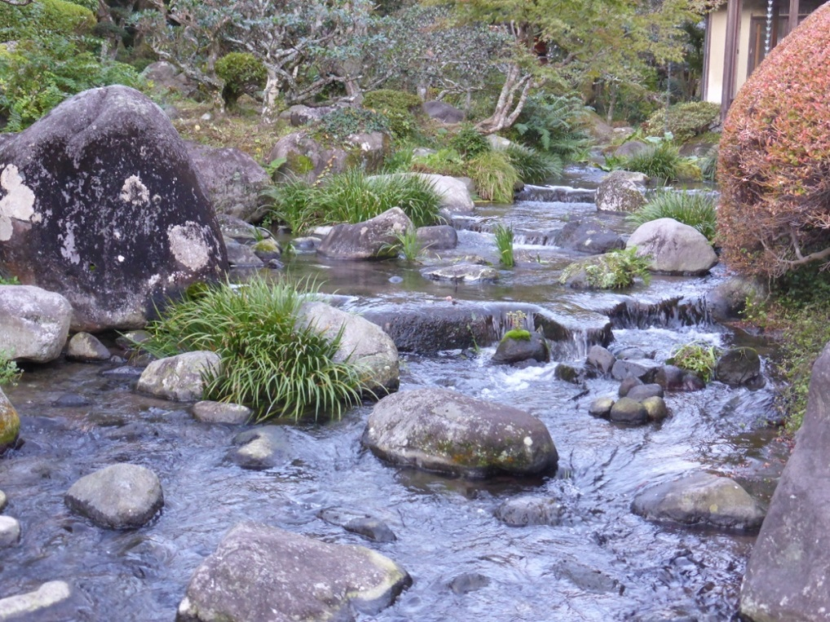
AROUND HAKONE
We went on a tour over the volcanic ground of Hakone.
First we went by cable train, then a gondola and ‘flew‘over the active volcanic area with billowing sulphuric steam.
The smell of sulphur was overpowering.
Notes:
Photos supplied by the author

Slide 15
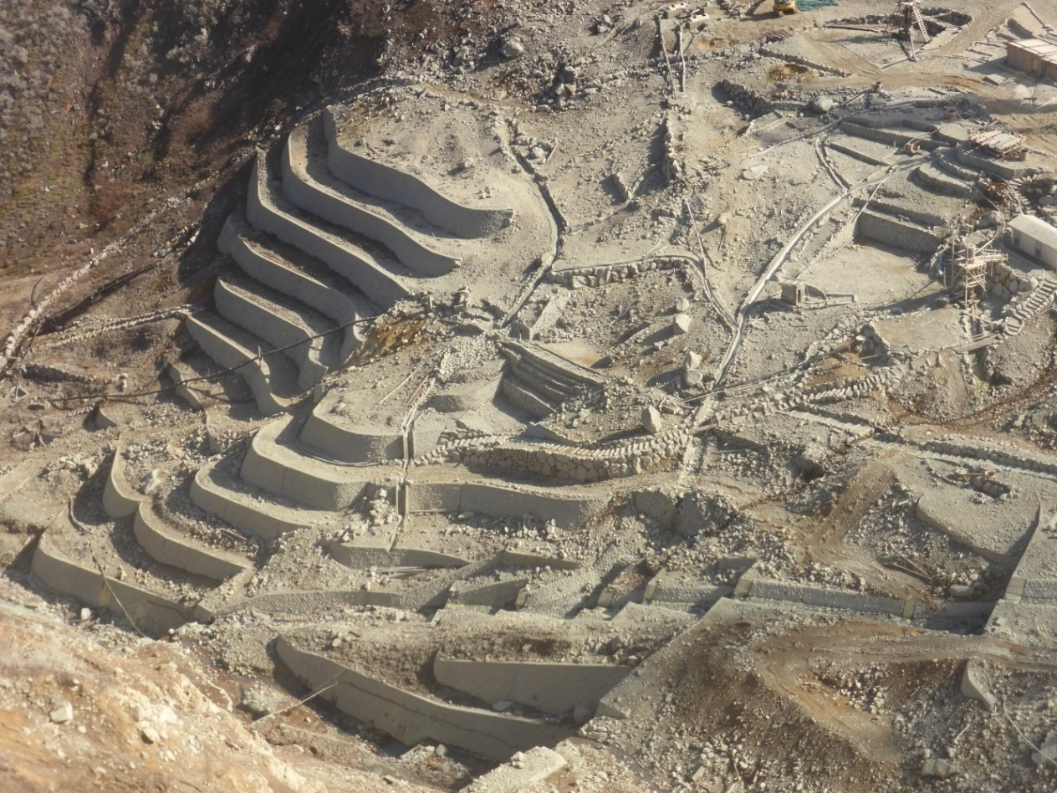
SULPHUR MINE
This photo below is of a sulphur mine we passed over on our gondola ride.
I can still smell the sulphur stench.
Notes:
Photos supplied by the author

Slide 16
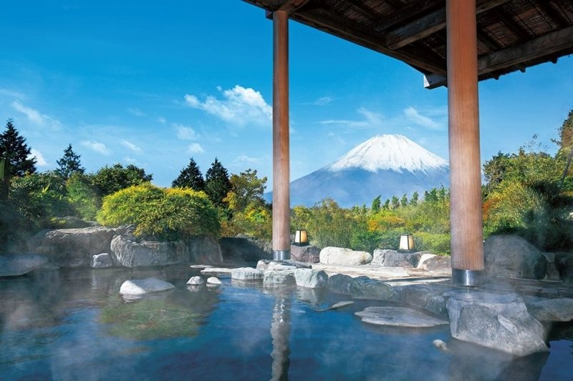
MOUNT FUJI
We could see Mount Fuji from the spa.
Notes:
1. https://www.tripzilla.com/top-10-onsens-hakone/94379

Slide 17
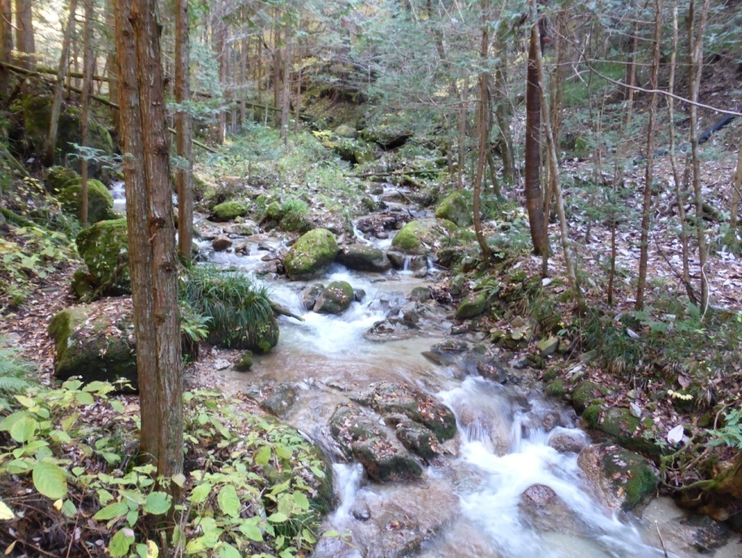
KISA VALLEY – NAKASENDO TRAIL
This trail is part of the original trading route between Kyoto and Tokyo.
We walked from the 42nd to the 43rd trading villages – about 8 kms.
Notes:
Photos supplied by the author

Slide 18
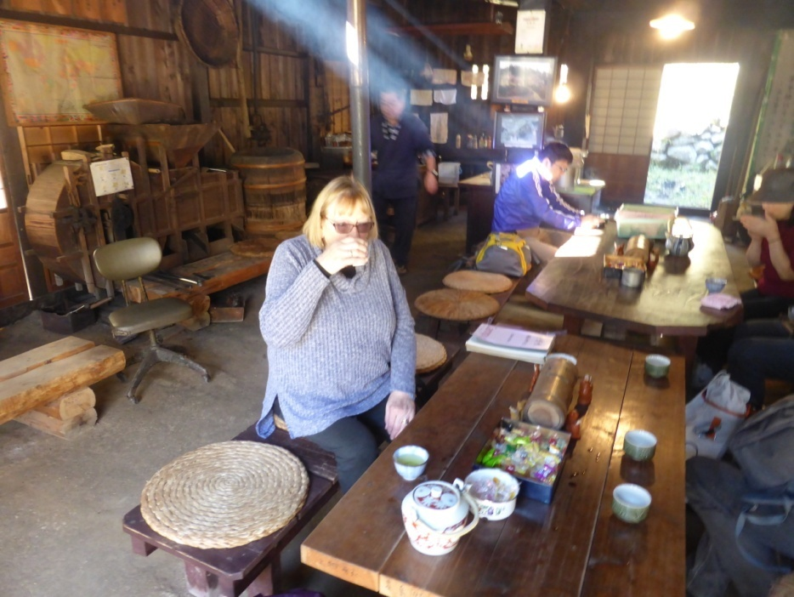
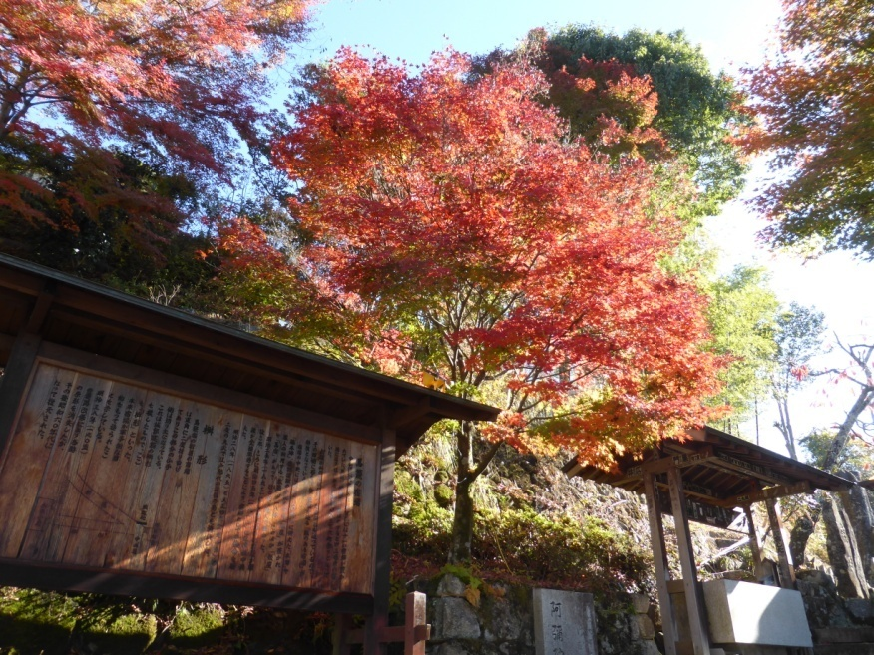
NAKASENDO WAY
The houses were made of cedar and were blackened with age.
We stopped at a tea house on the way.
Notes:
Photos supplied by the author

Slide 19
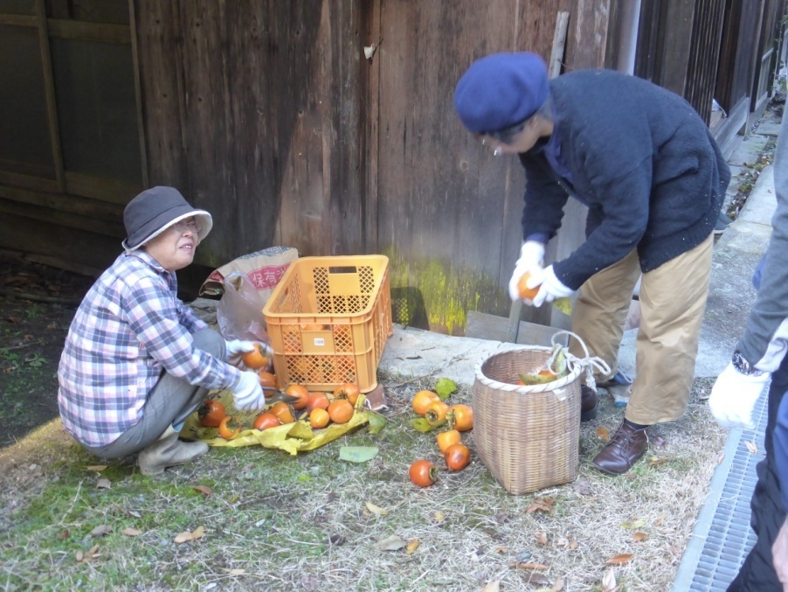
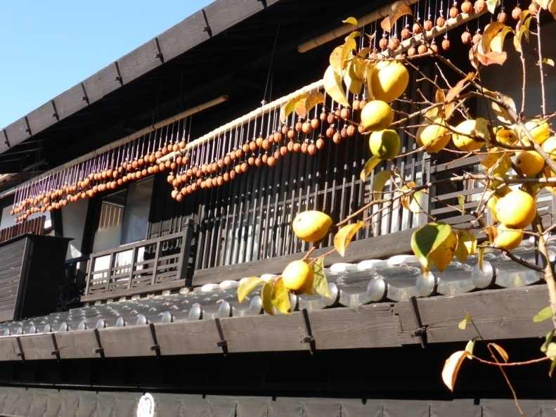
VILLAGE HOUSES
On the houses, fruit, chillis & vegetables were hung out to dry.
The ladies are preparing persimmons for drying.
Notes:
Photos supplied by the author

Slide 20
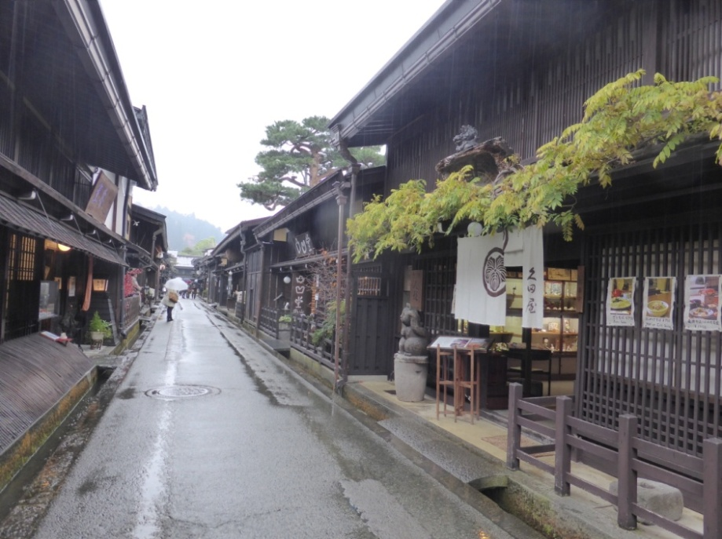
TAKAYAMA
Takayama is a heritage-listed town.
It has beautiful cedar house and shops which were well-preserved.
Notes:
Photos supplied by the author

Slide 21
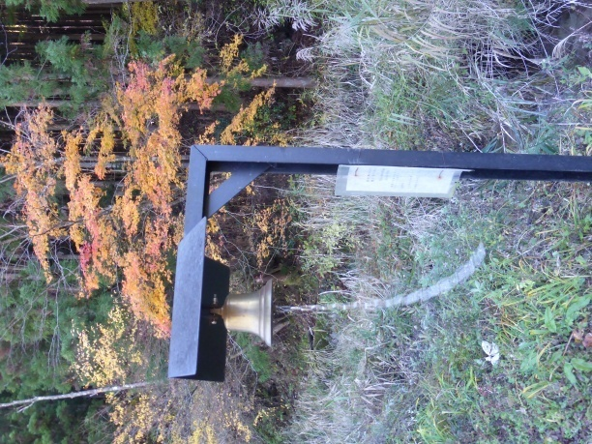
BEARS!
Walkers were advised to ring the bells periodically to scare away bears. The last bear seen on the trail had been over 20 years ago.
Despite this, we rang the bells, loudly, just in case!
Notes:
Photos supplied by the author

Slide 22
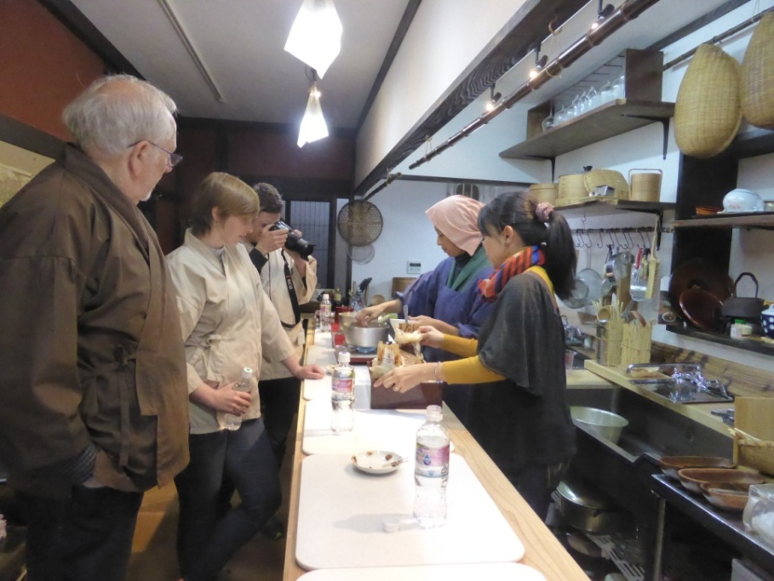
COOKING CLASS
We made fresh tuna sushi, egg roll, and a chicken, mushroom and tofu hot pot.
Notes:
Photos supplied by the author

Slide 23
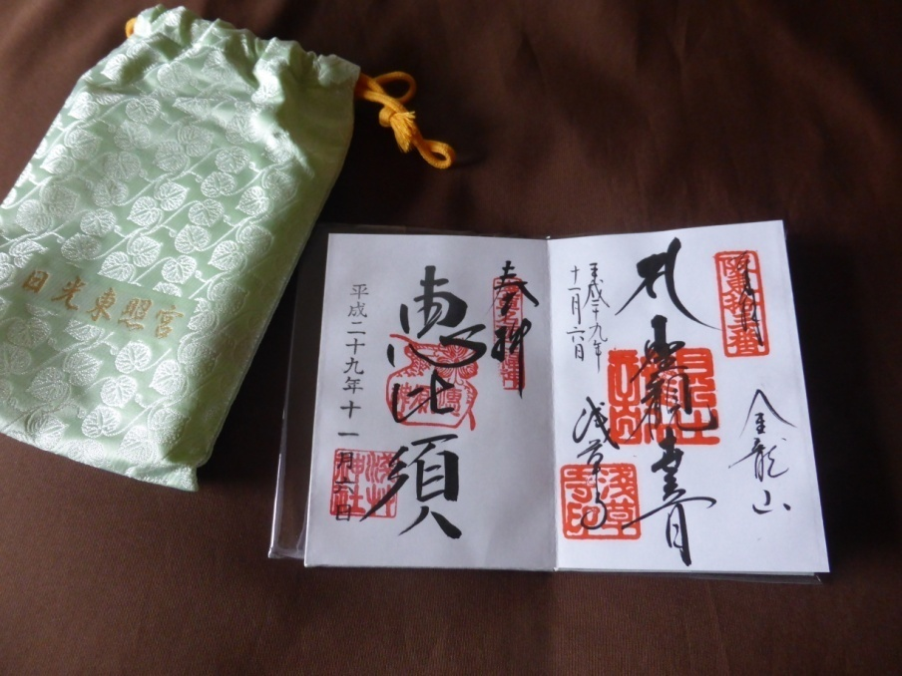
TEMPLE STAMPS
During our trip, I collected temple stamps.
At each temple we visited, a priest would write a blessing and stamp it with the temple’s red stamp.
Notes:
Photos supplied by the author

Slide 24
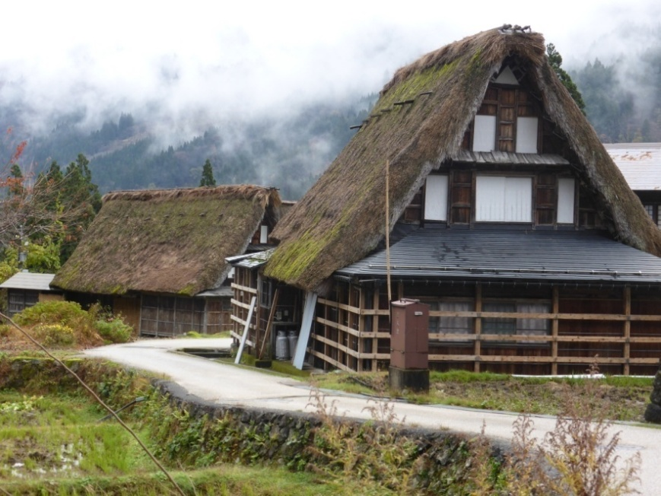
WORLD HERITAGE VILLAGE
From Takayama, we took a tour to a World Heritage Village.
Their houses are made from local materials and are thatched with grass.
The villagers live a traditional country life.
Notes:
Photos supplied by the author

Slide 25
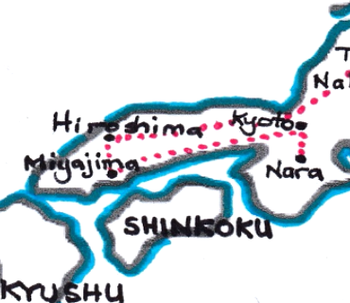
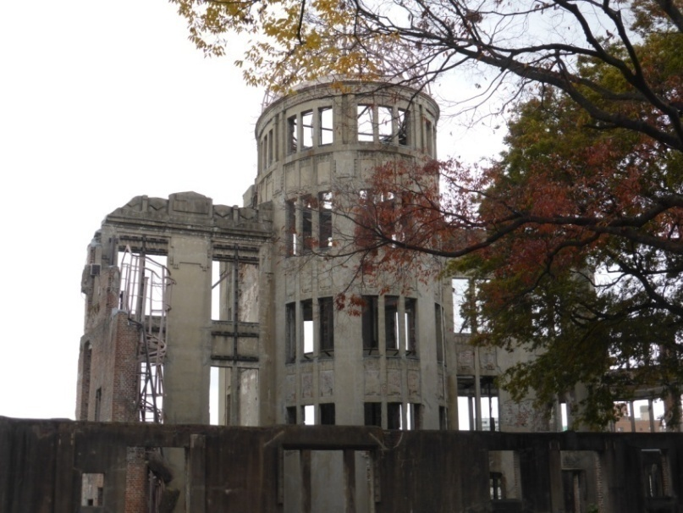
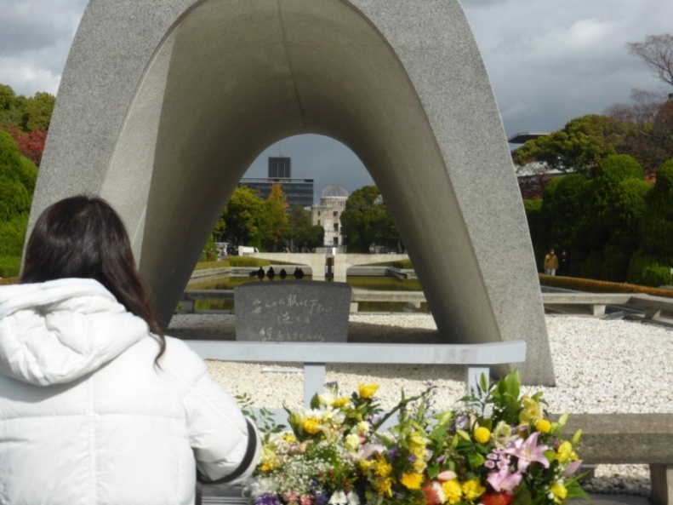
HIROSHIMA
We visited the Memorial Park. And saw the cenotaph and eternal flame.
Notes:
Photos supplied by the author

Slide 26
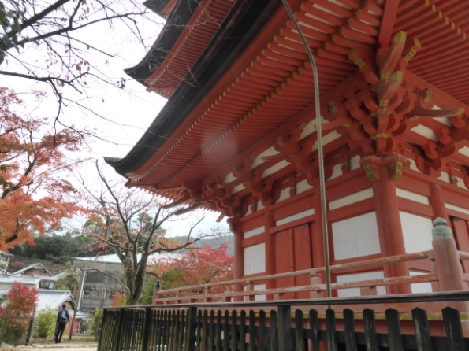
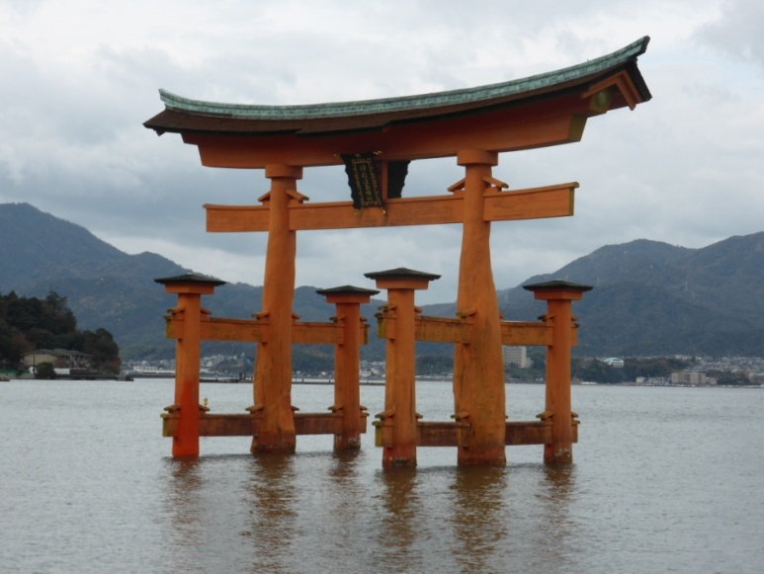
MIYAJAMA
Miyajama is a holy place of shrines and temples.
We climbed lots of steps to an orange pagoda and another shrine dedicated to rice gods.
Notes:
Photos supplied by the author

Slide 27
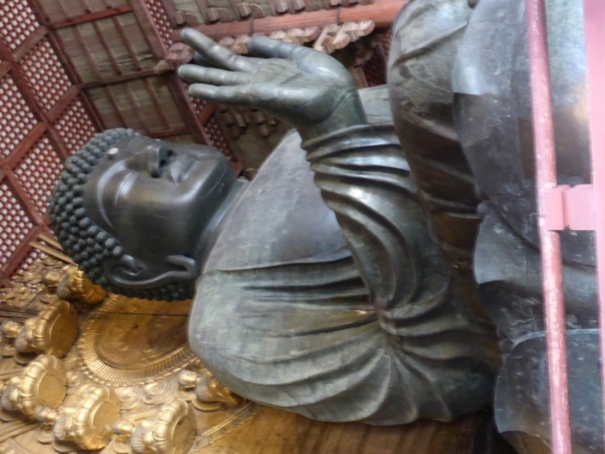
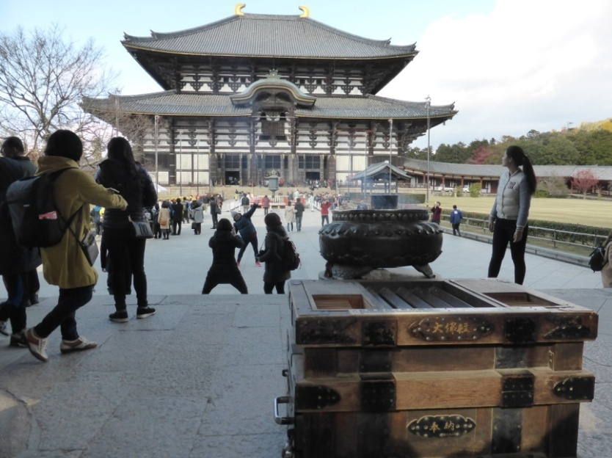
NARA
Nara was the first capital of Japan.
The Kasuga-Taisha Shrine was built in 768 BC and is UNESCO listed.
Notes:
Photos supplied by the author

Slide 28
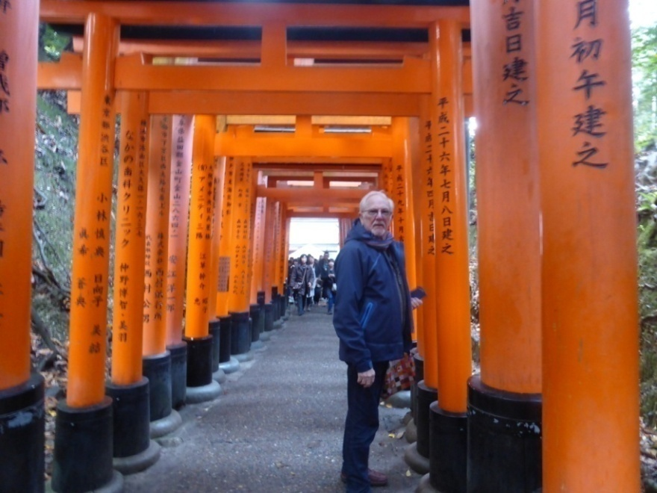
KYOTO
Kyoto was the imperial capital until 1868.
We visited the Inari Shrine. It consists of 10,000 vermillion gates leading up the mountain to the shrine.
Notes:
Photos supplied by the author

Slide 29
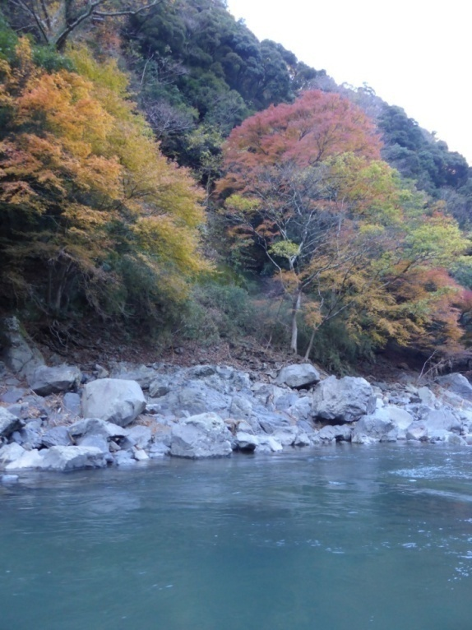
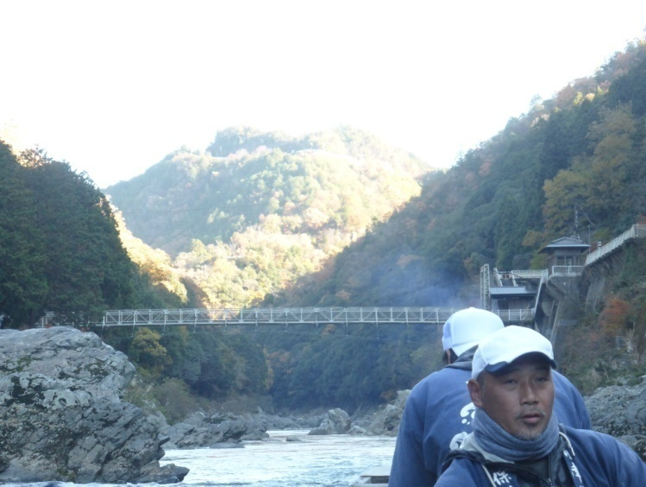
RIVER RAFTING
We decided to go rafting on the Yoshino River.
We went through small rapids and beautiful ravines.
Mostly the ride was about admiring the towering mountains & the tree- covered ravines.
Notes:
Photos supplied by the author

Slide 30
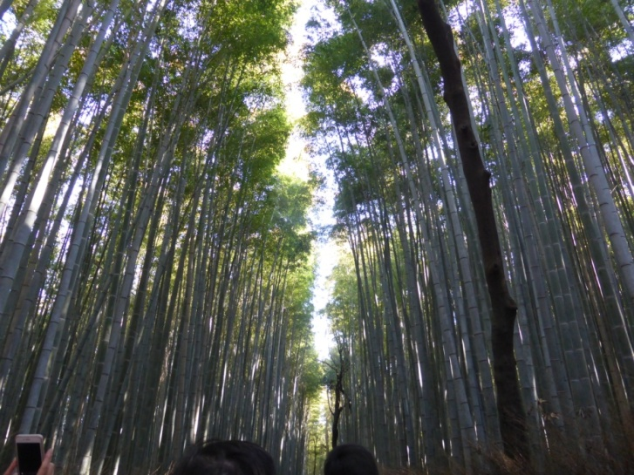
BAMBOO GROVE
At the end of the boat ride we arrived at a giant bamboo grove. This grove was a very imposing and majestic sight.
I didn’t know bamboo could grow so tall!
Notes:
Photos supplied by the author

Slide 31
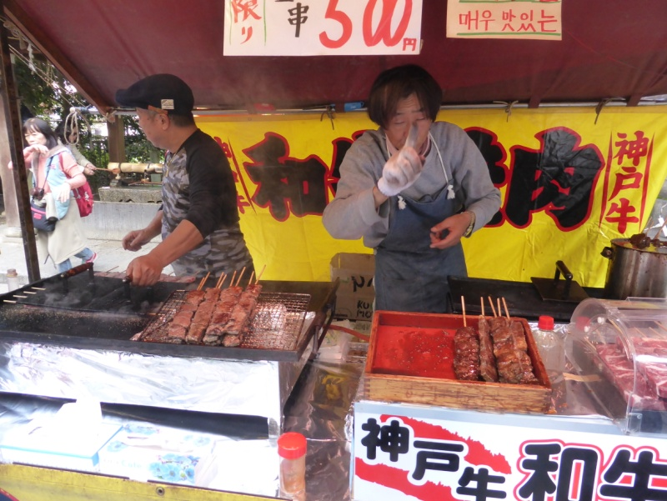
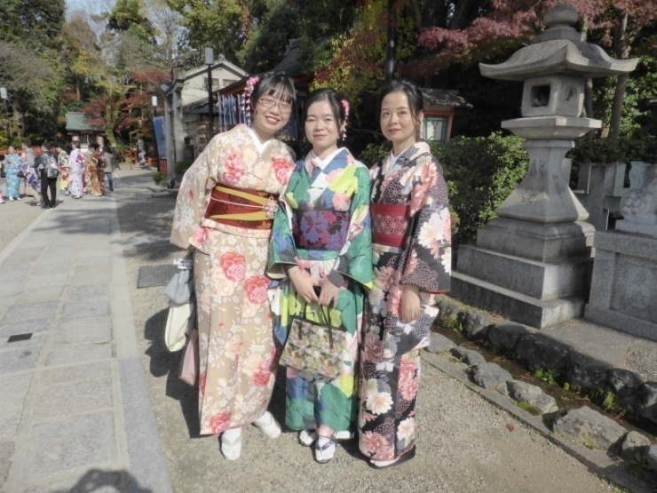
MARKET VISIT
Our final day was spent in a market, held in the large gardens of a temple complex.
Many of the ladies and girls were dressed in traditional dress.
Notes:
Photos supplied by the author

Slide 32
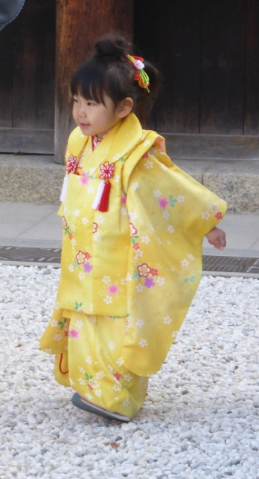
I hope you have enjoyed seeing some of the sights of Japan that we enjoyed on our train trip in 2017.
Sayonara!
Notes:
Photos supplied by the author

