Slide 1
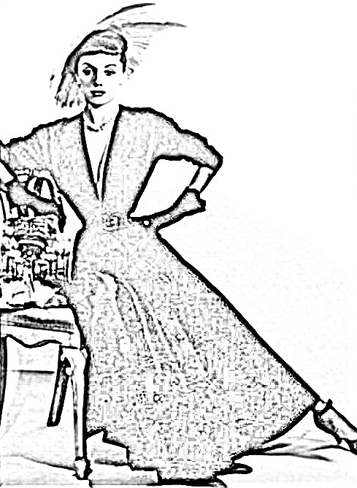
Melbourne City of Fashion
Notes:
https://cv.vic.gov.au/stories/creative-life/athol-shmith/no-title-fashion-illustration-model-patricia-tuckwell/
NB: this image was put through a photo to sketch application to produce this

Slide 2
Hi, My name is Val Cunniffe and I am a member of the Rotary Club of Canterbury, in Melbourne, Australia.
I wrote "Melbourne: City of Fashion" because as a small child I remember visits to the city with my mother. They were always so exciting and we always ended up in Collins Street, looking at the shops and going for a special afternoon tea. It all felt so glamorous and I felt so special! It was fun to remember and to share memories.
Val
Notes:
Author’s own photo

Slide 3
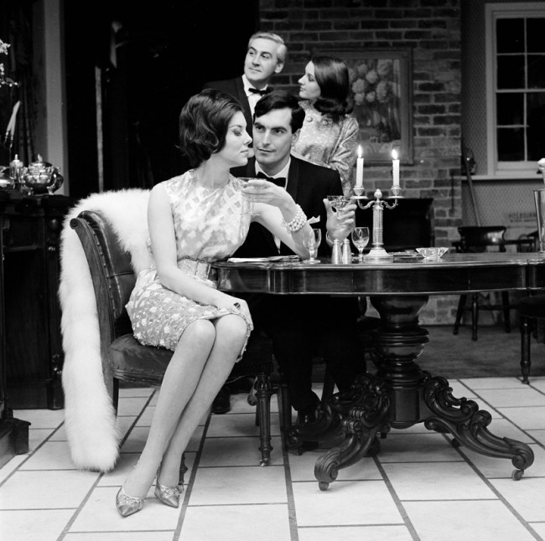
The City of Fashion
Melbourne has long been touted as the fashion capital of Australia; known for its sophistication and culture.
Notes:
https://www.slv.vic.gov.au/sites/default/files/styles/gallery_large/public/31.%20Photograph%20for%20Holeproof%20advertisement%2C%20Henry%20Talbot.jpg?itok=VwjUwHTJ

Slide 4
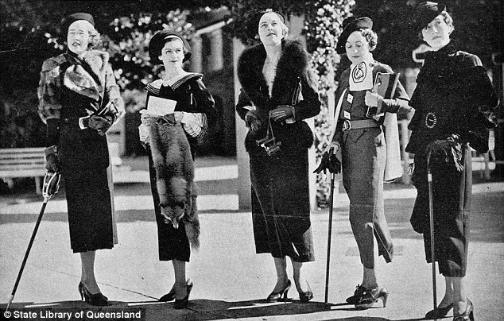
Melbourne Fashions in the 30s
Notes:
https://commons.wikimedia.org/w/index.php?search=race+day+fashions&title=Special%3ASearch&go=Go&ns0=1&ns6=1&ns12=1&ns14=1&ns100=1&ns106=1#/media/File:StateLibQld_2_206817_Mannequins_modelling_race_day_fashions_at_Ascot,_Brisbane,_1935.jpg
https://i.dailymail.co.uk/i/pix/2015/05/08/04/2853EA7300000578-3071525-A_day_at_the_races_Women_gossiping_in_their_finest_at_the_Melbou-a-117_1431057525806.jpg

Slide 5
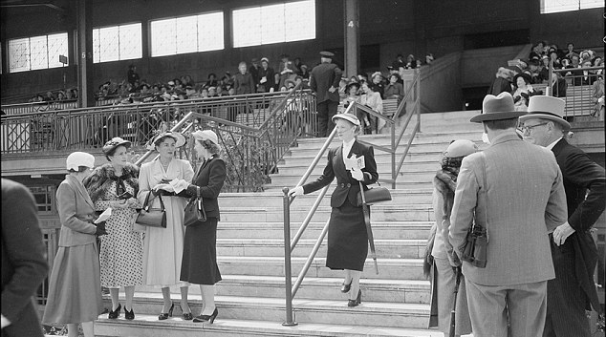
Melbourne Fashions in the 50s – At The Cup
Notes:
https://commons.wikimedia.org/w/index.php?search=race+day+fashions&title=Special%3ASearch&go=Go&ns0=1&ns6=1&ns12=1&ns14=1&ns100=1&ns106=1#/media/File:StateLibQld_2_206817_Mannequins_modelling_race_day_fashions_at_Ascot,_Brisbane,_1935.jpg
https://i.dailymail.co.uk/i/pix/2015/05/08/04/2853EA7300000578-3071525-A_day_at_the_races_Women_gossiping_in_their_finest_at_the_Melbou-a-117_1431057525806.jpg

Slide 6
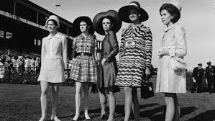
In 1962, the Victoria Racing Club introduced the “Fashions on the Field” competition to attract more women.
Melbourne Fashions in the 60s – At The Cup
Notes:
https://commons.wikimedia.org/w/index.php?search=race+day+fashions&title=Special%3ASearch&go=Go&ns0=1&ns6=1&ns12=1&ns14=1&ns100=1&ns106=1#/media/File:StateLibQld_2_206817_Mannequins_modelling_race_day_fashions_at_Ascot,_Brisbane,_1935.jpg
https://i.dailymail.co.uk/i/pix/2015/05/08/04/2853EA7300000578-3071525-A_day_at_the_races_Women_gossiping_in_their_finest_at_the_Melbou-a-117_1431057525806.jpg

Slide 7
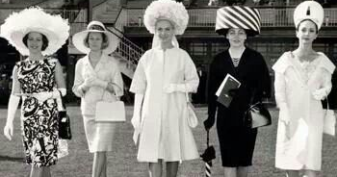
Melbourne Fashions in the 60s – At The Cup
In 1962, the Victoria Racing Club introduced the “Fashions on the Field” competition to attract more women.
Notes:
https://commons.wikimedia.org/w/index.php?search=race+day+fashions&title=Special%3ASearch&go=Go&ns0=1&ns6=1&ns12=1&ns14=1&ns100=1&ns106=1#/media/File:StateLibQld_2_206817_Mannequins_modelling_race_day_fashions_at_Ascot,_Brisbane,_1935.jpg
https://i.dailymail.co.uk/i/pix/2015/05/08/04/2853EA7300000578-3071525-A_day_at_the_races_Women_gossiping_in_their_finest_at_the_Melbou-a-117_1431057525806.jpg

Slide 8
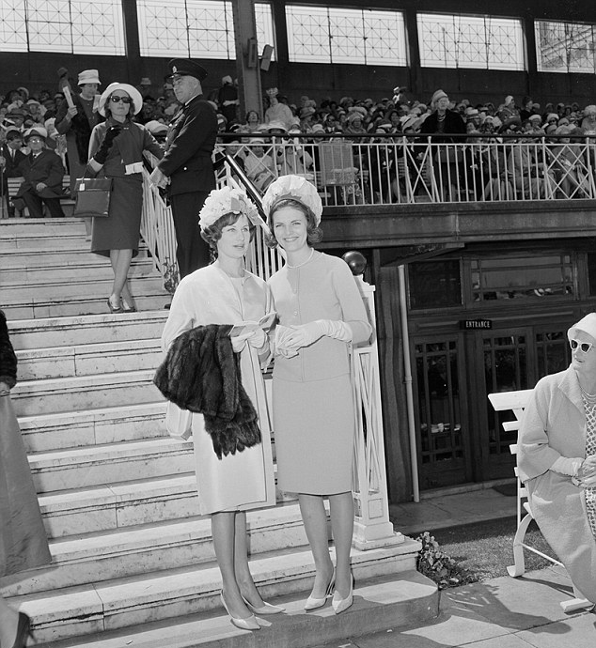
The Place to be Seen: The Melbourne Cup
Jan Taylor, Miss Australia 1961 at the Melbourne Cup.
Notes:
https://www.dailymail.co.uk/femail/article-3071525/The-evolution-Australian-Race-Day-fashion-Black-white-pictures-archives-reveal-glory-days-fashions-field.html
https://en.wikipedia.org/wiki/White_shift_dress_of_Jean_Shrimpton

Slide 9
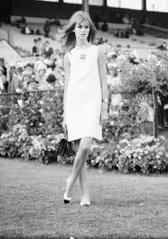
The Place to be Seen: The Melbourne Cup
Jean Shrimpton, UK model in the “Dress that shocked the Nation”
5 inches above the knee
No stockings
No gloves
“I fear that Melbourne is not ready for me yet.”
Notes:
https://www.dailymail.co.uk/femail/article-3071525/The-evolution-Australian-Race-Day-fashion-Black-white-pictures-archives-reveal-glory-days-fashions-field.html
https://en.wikipedia.org/wiki/White_shift_dress_of_Jean_Shrimpton

Slide 10
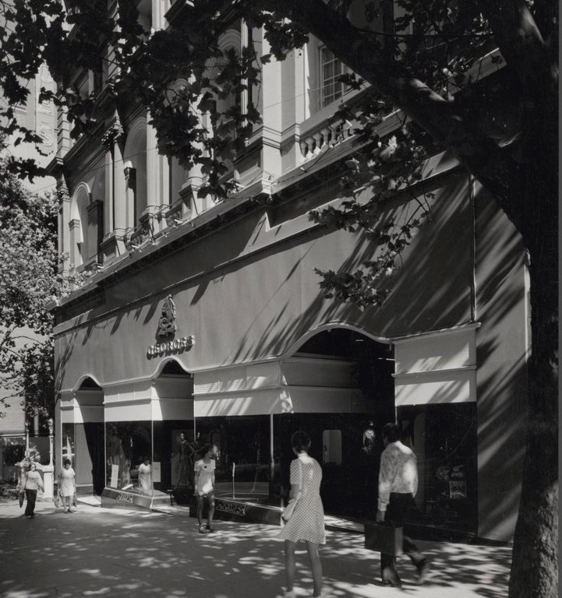
Other Places to be Seen – Georges
Georges was established in 1880 and moved to the ‘Paris end of Collins Street’ in 1889. It was one of the most exclusive department stores in Melbourne.
Notes:
https://blogs.slv.vic.gov.au/our-stories/melbournes-lost-department-stores/
https://blogs.slv.vic.gov.au/our-stories/melbournes-lost-department-stores/

Slide 11
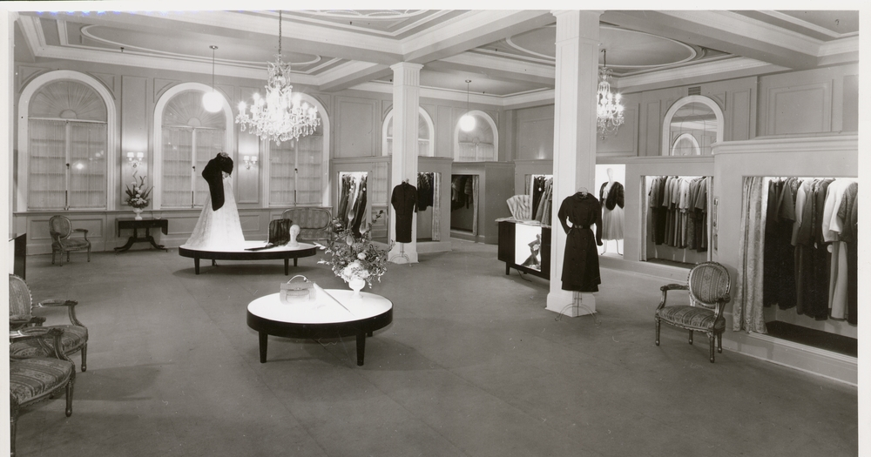
Other Places to be Seen – Georges
In the 1950s and 60s there were other department stores, but only Georges represented international fashion and style in Melbourne.
Notes:
https://blogs.slv.vic.gov.au/our-stories/melbournes-lost-department-stores/
https://blogs.slv.vic.gov.au/our-stories/melbournes-lost-department-stores/

Slide 12
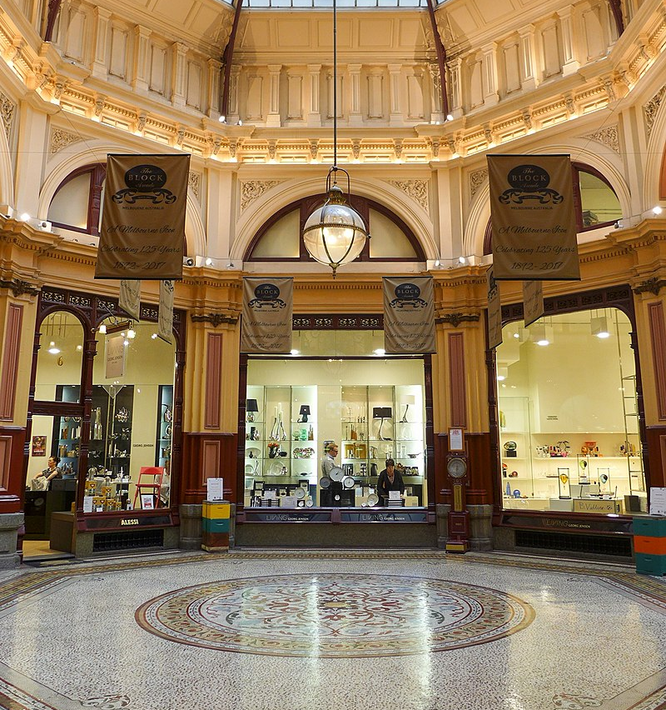
Other Places to be Seen – Block Arcade
Melbourne's impressive Block Arcade was constructed in 1891. It was modelled after the Galleria Vittorio Emanuele in Milan.
Notes:
https://en.wikipedia.org/wiki/Block_Arcade,_Melbourne#/media/File:The_Block_Arcade_interior,_Melbourne.jpg
https://en.wikipedia.org/wiki/Block_Arcade,_Melbourne#/media/File:The_Block_Arcade_Central_atrium_201708.jpg

Slide 13
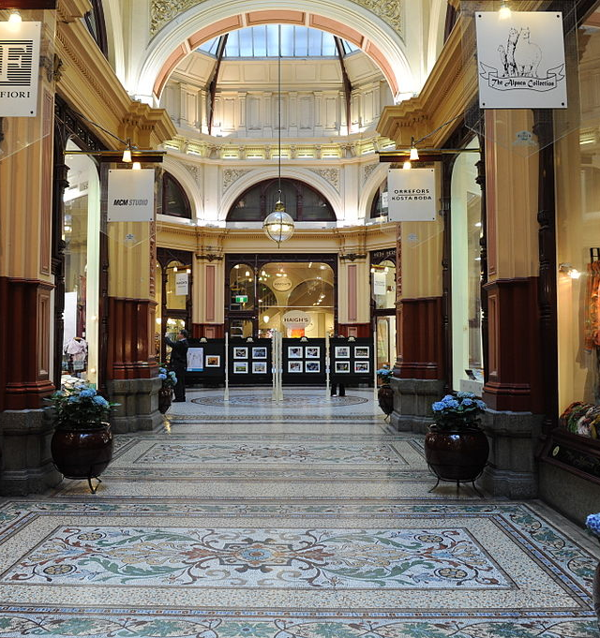
Other Places to be Seen – Block Arcade
When the Block Arcade opened It had 15 milliners, three lace shops, a photographer and Hopetoun Tea Rooms. Only the Tea Room remains open today.
Notes:
https://en.wikipedia.org/wiki/Block_Arcade,_Melbourne#/media/File:The_Block_Arcade_interior,_Melbourne.jpg
https://en.wikipedia.org/wiki/Block_Arcade,_Melbourne#/media/File:The_Block_Arcade_Central_atrium_201708.jpg

Slide 14
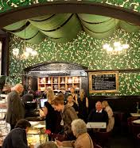
Other Places to be Seen – Block Arcade
A trip to the Block Arcade is never complete without the decadence of High Tea at the Hopetoun Tea Rooms.
Notes:
https://www.broadsheet.com.au/melbourne/food-and-drink/article/128-year-old-melbourne-institution-hopetoun-tea-rooms-sale
https://en.wikipedia.org/wiki/Block_Arcade,_Melbourne#/media/File:Tea_rooms_store_front_in_Collins_Street,_Melbourne.jpg

Slide 15
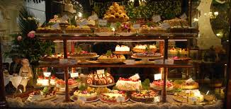
Other Places to be Seen – Block Arcade
The Hopetoun Tea Rooms is known for its extravagant window displays of cakes, tarts and muffins.
Notes:
https://commons.wikimedia.org/w/index.php?search=race+day+fashions&title=Special%3ASearch&go=Go&ns0=1&ns6=1&ns12=1&ns14=1&ns100=1&ns106=1#/media/File:StateLibQld_2_206817_Mannequins_modelling_race_day_fashions_at_Ascot,_Brisbane,_1935.jpg
https://i.dailymail.co.uk/i/pix/2015/05/08/04/2853EA7300000578-3071525-A_day_at_the_races_Women_gossiping_in_their_finest_at_the_Melbou-a-117_1431057525806.jpg

Slide 16
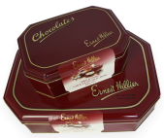
Other Places to be Seen – Hilliers
Ernest Hillier made Australia’s first chocolates in 1916.
Notes:
https://pbs.twimg.com/profile_images/2752471739/5b059b32a42a276aec33b5b5d15f27dc_400x400.jpeg
https://australianfoodtimeline.com.au/earnest-hillier/
https://australianfoodtimeline.com.au/earnest-hillier/
https://www.taste.com.au/recipes/banana-split/3b01b775-2be2-4a15-9326-0ca09178b1eb

Slide 17
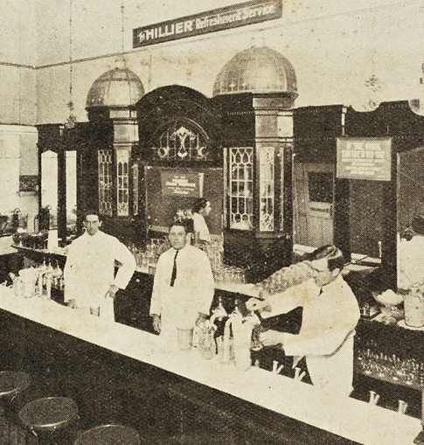
Other Places to be Seen – Hilliers
The highlight of a trip to the city with my mother was Ernest Hilliers Café, beside the Regent Theatre in Collins Street.
Notes:
https://pbs.twimg.com/profile_images/2752471739/5b059b32a42a276aec33b5b5d15f27dc_400x400.jpeg
https://australianfoodtimeline.com.au/earnest-hillier/
https://australianfoodtimeline.com.au/earnest-hillier/
https://www.taste.com.au/recipes/banana-split/3b01b775-2be2-4a15-9326-0ca09178b1eb

Slide 18
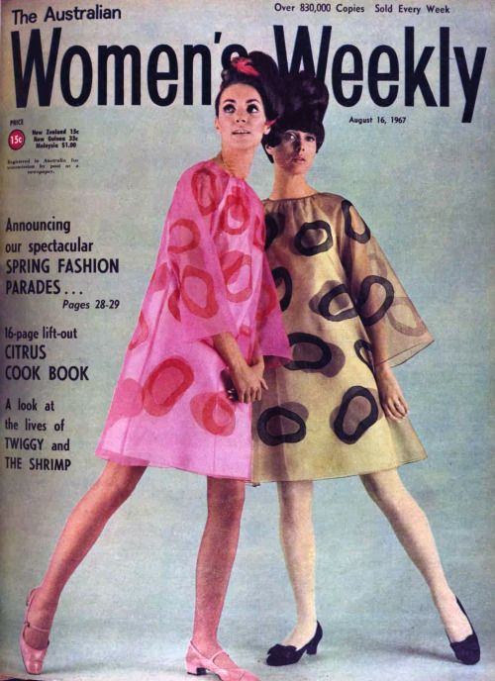
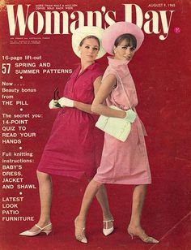
Popular Fashion Magazines
For many years, Women’s Weekly was the premier magazine in Australia. The Woman’s Day was its competitor.
Notes:
https://likesoldclothes.tumblr.com/post/79147047960/womans-day-australia-august-9-1965
https://theswinginsixties.tumblr.com/post/74370085678/designer-fashion-music-shopping-internet-clothes-beauty

Slide 19
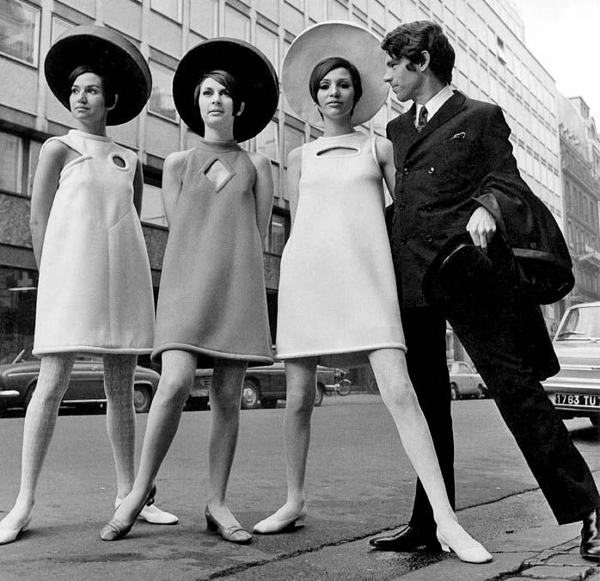
Iconic Designers
Pierre Cardin began his couture career at Christian Dior.
Here are some of his designer dresses from the 1960s.
Notes:
https://blog.colettehq.com/inspiration/pierre-cardin-geometric-guru
https://snapfashion.wordpress.com/tag/mondrian-dress-ysl/

Slide 20
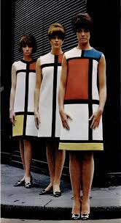
Iconic Designers
These dresses were designed by Yves St Laurent as a tribute to the Dutch artist Piet Mondrian’s geometric works.
They caused a sensation when shown at the fall/winter 1965 haute couture show.
Notes:
https://blog.colettehq.com/inspiration/pierre-cardin-geometric-guru
https://snapfashion.wordpress.com/tag/mondrian-dress-ysl/

Slide 21
In 1963, aged 21, Prue Acton established her fashion design business in Flinders Lane. She was a new wave designer who shaped the youth fashion industry.
Notes:
https://blog.colettehq.com/inspiration/pierre-cardin-geometric-guru
https://snapfashion.wordpress.com/tag/mondrian-dress-ysl/

Slide 22
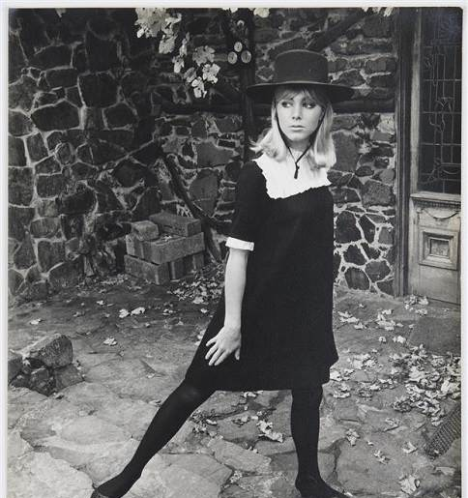
Prue Acton
She produced 350 designs a year selling 1,000 dresses a week through 80 outlets in Australia and New Zealand.
She also developed her own range of cosmetics.
Notes:
https://www.smh.com.au/entertainment/art-and-design/design-of-a-lifetime-prue-acton-exhibition-opens-at-bayside-arts-and-cultural-centre-20160212-gms88y.html
https://www.art-almanac.com.au/new-look-1960s-fashion-melbourne/prueacton-medium/

Slide 23
Australian models of the 60s
Maggie Tabberer’s name has been synonymous with fashion and style in this country for more than 60 years.
Notes:
https://nga.gov.au/exhibition/karshshmith/detail.cfm?IRN=66837&BioArtistIRN=12439&mystartrow=25&realstartrow=25
https://cdn.newsapi.com.au/image/v1/ccc640808b26aff4f0345d44d0db2b17?width=316

Slide 24
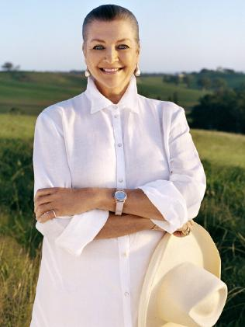
Australian models of the 60s
Maggie Tabberer went from model to editor, television host, fashion designer and retailer. She’s done the lot.
Notes:
https://nga.gov.au/exhibition/karshshmith/detail.cfm?IRN=66837&BioArtistIRN=12439&mystartrow=25&realstartrow=25
https://cdn.newsapi.com.au/image/v1/ccc640808b26aff4f0345d44d0db2b17?width=316

Slide 25
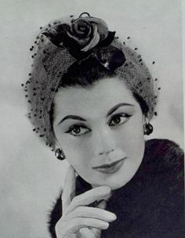
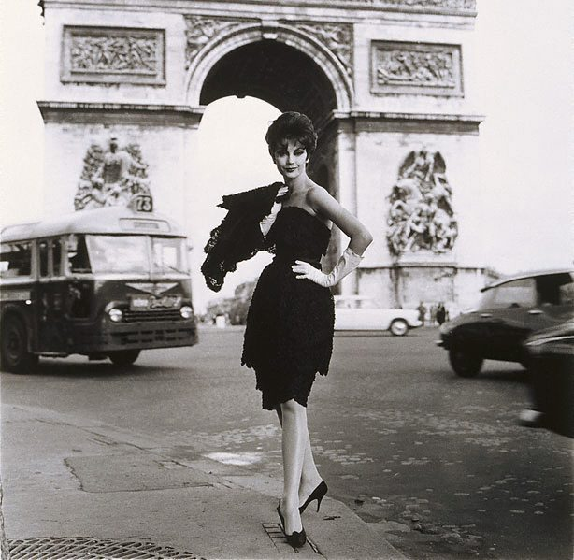
Australian models of the 60s
Jean Newington is seen here wearing a Nina Ricci design in Paris.
Notes:
https://likesoldclothes.tumblr.com/post/79147047960/womans-day-australia-august-9-1965
https://theswinginsixties.tumblr.com/post/74370085678/designer-fashion-music-shopping-internet-clothes-beauty

Slide 26
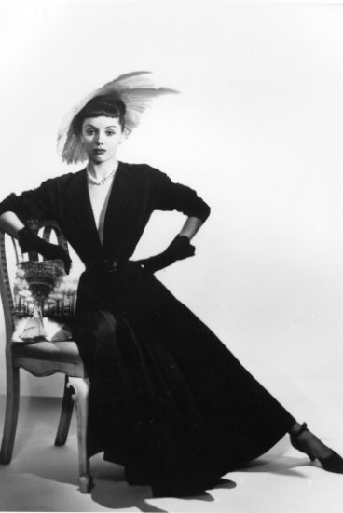
Australian models of the 60s
Bambi Smith photographed here by Athol Shmith in Melbourne in the 60s.
She later became the Countess of Harewood.
Notes:
https://cv.vic.gov.au/stories/creative-life/athol-shmith/no-title-fashion-illustration-model-patricia-tuckwell/
https://www.thetimes.co.uk/article/the-dowager-countess-of-harewood-obituary-9p2smq53s

Slide 27
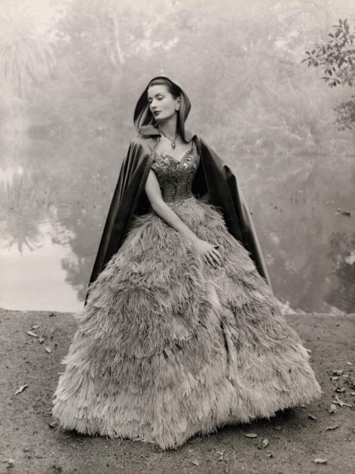
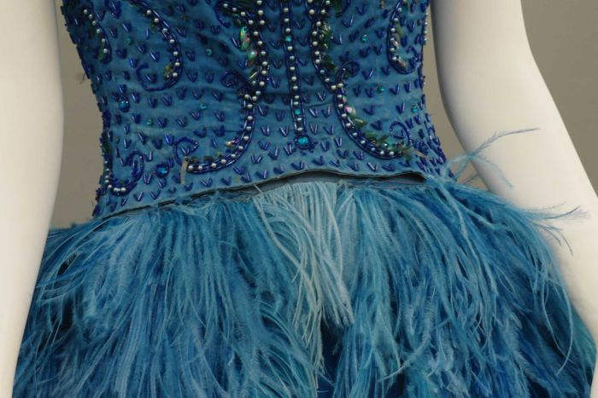
A royal blue hand-dyed ostrich feather dress, studded with sequins, beads and diamantes, bought from La Petite salon on Collins Street, Melbourne.
The Ostrich Feather Dress
Notes:
https://www.abc.net.au/news/2016-03-01/dress-in-glamorous-black-and-white-photograph-from-1960s-found/7177712?nw=0
https://www.abc.net.au/news/2016-03-01/dress-in-glamorous-black-and-white-photograph-from-1960s-found/7177712?nw=0

Slide 28
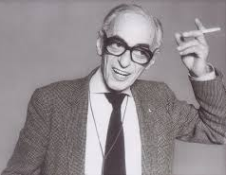
Fashion Photographer – Athol Shmith
Melbourne born Athol Shmith was a studio portrait and fashion photographer with an international reputation.
Notes:
https://www.portrait.gov.au/portraits/1999.57/athol-shmith
https://nga.gov.au/exhibition/karshshmith/detail.cfm?IRN=54204&BioArtistIRN=12439&mystartrow=13&realstartrow=13

Slide 29
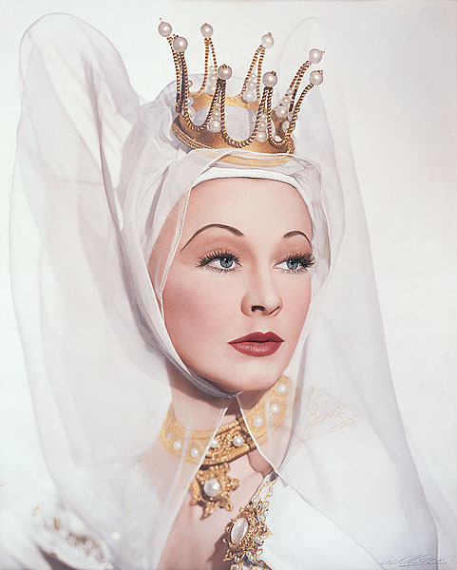
Fashion Photographer – Athol Shmith
Athol Shmith photographed many famous people, including Vivien Leigh.
He was charming and witty, and it is said that “he treated his models like princesses”.
Notes:
https://www.portrait.gov.au/portraits/1999.57/athol-shmith
https://nga.gov.au/exhibition/karshshmith/detail.cfm?IRN=54204&BioArtistIRN=12439&mystartrow=13&realstartrow=13

Slide 30
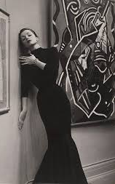
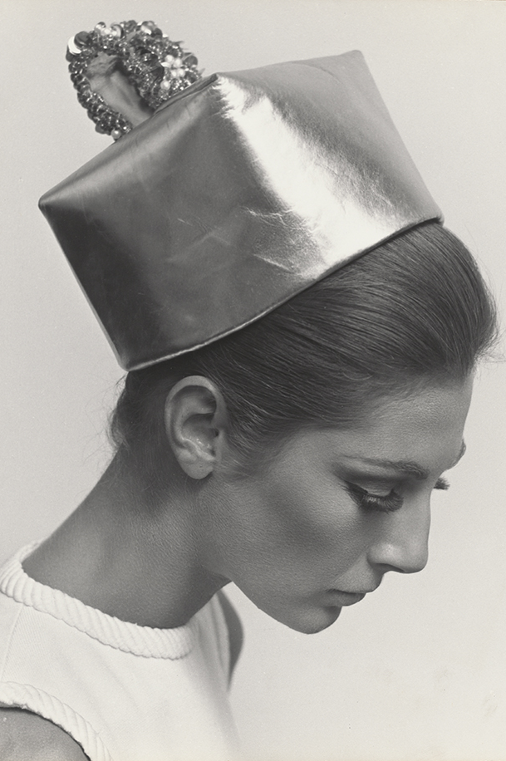
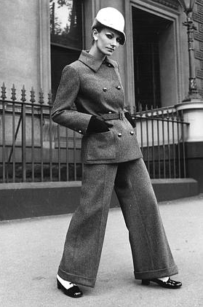
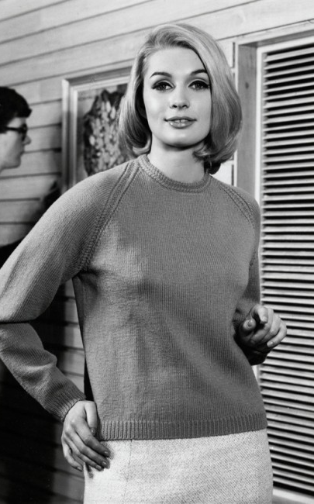
Fashion Photographer – Athol Shmith
He photographed high fashion, hats, trouser suits … and even Paton’s knitting patterns.
Notes:
https://www.abc.net.au/news/2016-12-12/athol-shmith-fashion-photographs-on-display-at-national-library/8099622?pfm=ms
https://www.artgallery.nsw.gov.au/collection/works/?artist_id=shmith-athol
http://melbournehub.blogspot.com/2014/06/photo-essay-take-look-back-at-everyday_9640.html
https://www.broadsheet.com.au/melbourne/art-and-design/entries-modern-tomorrow-closing-soon

Slide 31
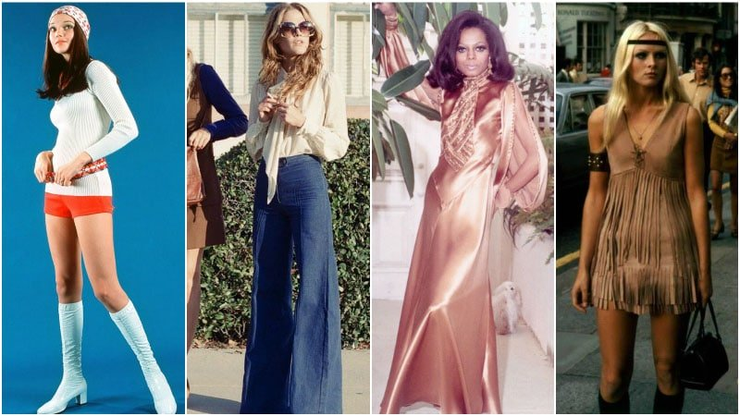
Fashion in the 70s
Fashion in the 1970s ran that gamut from hippy and glam rock to disco and bohemian with numerous iconic styles that are still wearable today.
Notes:
https://www.thetrendspotter.net/70s-fashion-trend/

Slide 32
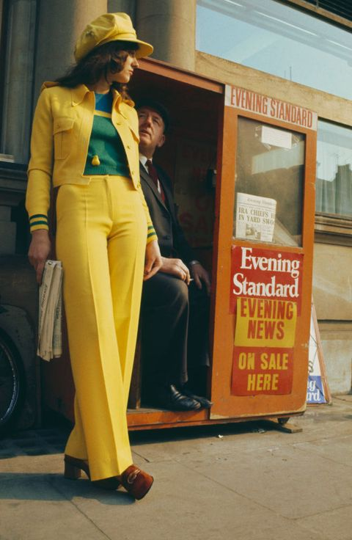
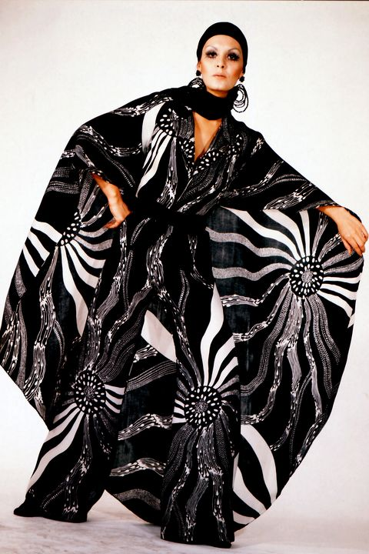
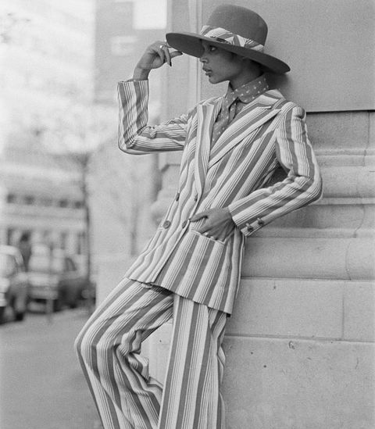
What were you wearing in the 70s?
Notes:
http://www.townandcountrymag.com/style/fashion-trends/news/g1760/70s-fashion-in-photos/
https://www.elle.com/fashion/trend-reports/g28520318/70s-fashion-style-trends/
https://www.harpersbazaar.com/fashion/trends/g6495/70s-fashion-in-photos/
https://www.harpersbazaar.com.sg/gallery/year-born-fashion-trends-90-80/

Slide 33
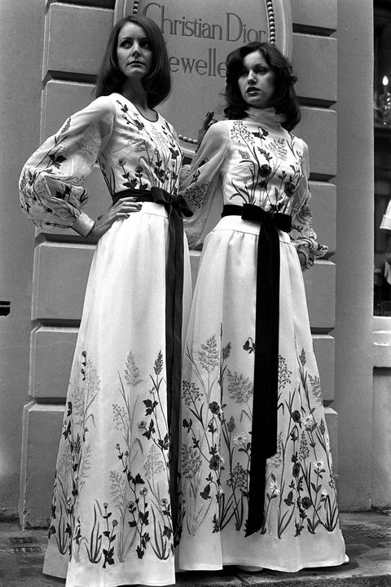
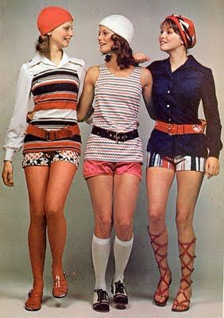
What were you wearing in the 70s?
Notes:
http://www.townandcountrymag.com/style/fashion-trends/news/g1760/70s-fashion-in-photos/
https://www.elle.com/fashion/trend-reports/g28520318/70s-fashion-style-trends/
https://www.harpersbazaar.com/fashion/trends/g6495/70s-fashion-in-photos/
https://www.harpersbazaar.com.sg/gallery/year-born-fashion-trends-90-80/

Slide 34
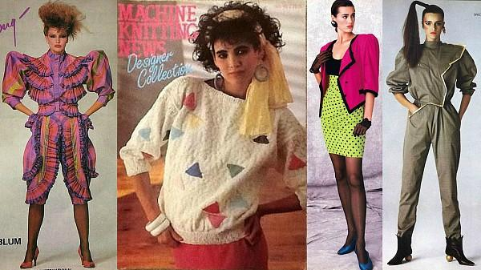
Fashion in the 80s
This was a decade of bold style, colours, and silhouettes – and heaps of permed hair. Trends spanned ripped tights and biker jackets to oversized blazers and poof skirts.
Notes:
https://www.thetrendspotter.net/70s-fashion-trend/

Slide 35
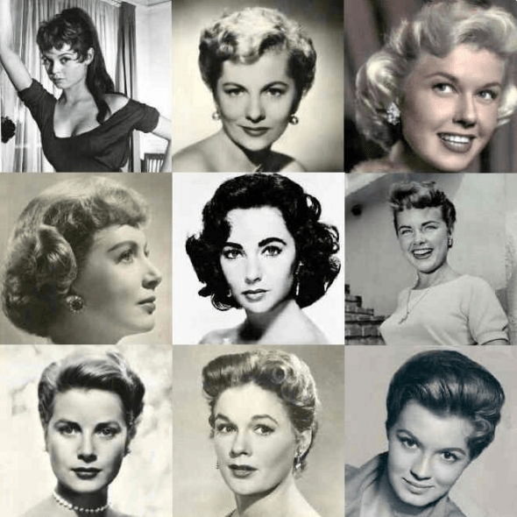
Changes in hair and makeup too!
Notes:
https://vintagedancer.com/1950s/1950s-hairstyles/
https://www.rebelsmarket.com/blog/posts/1950s-hairstyles-most-popular-hairstyles-of-the-1950s

Slide 36
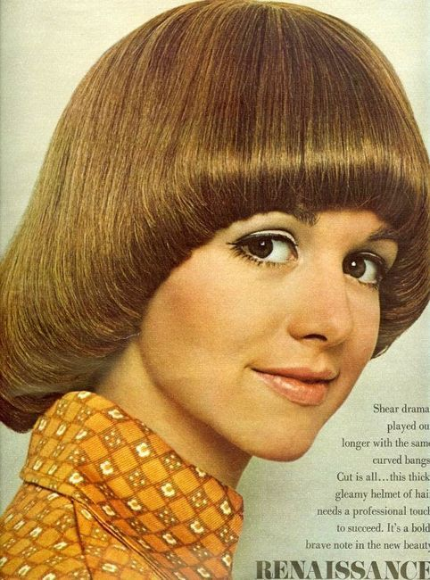
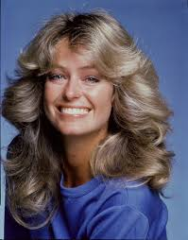
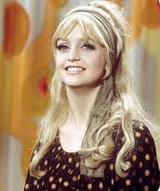
Hairstyles of the 70s?
Notes:
http://www.townandcountrymag.com/style/fashion-trends/news/g1760/70s-fashion-in-photos/
https://www.elle.com/fashion/trend-reports/g28520318/70s-fashion-style-trends/
https://www.harpersbazaar.com/fashion/trends/g6495/70s-fashion-in-photos/
https://www.harpersbazaar.com.sg/gallery/year-born-fashion-trends-90-80/

Slide 37
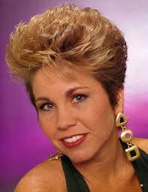
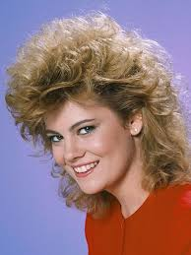
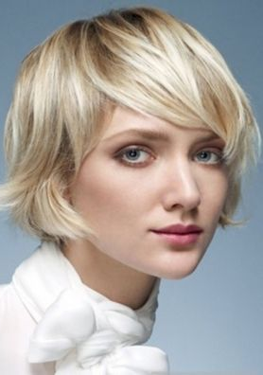
Then came the 80s
The perms! The wigs!!
The earrings!!!
And finally some sense.
Notes:
https://peruecken-online.com/GFW386-24AB17
https://www.allure.com/gallery/80s-hairstyles-trends
https://andrewbrentcall.blogspot.com/2018/12/80s-hairstyle-short-hair.html
https://www.short-haircut.com/best-stacked-short-hairstyles-pictures.html

Slide 38
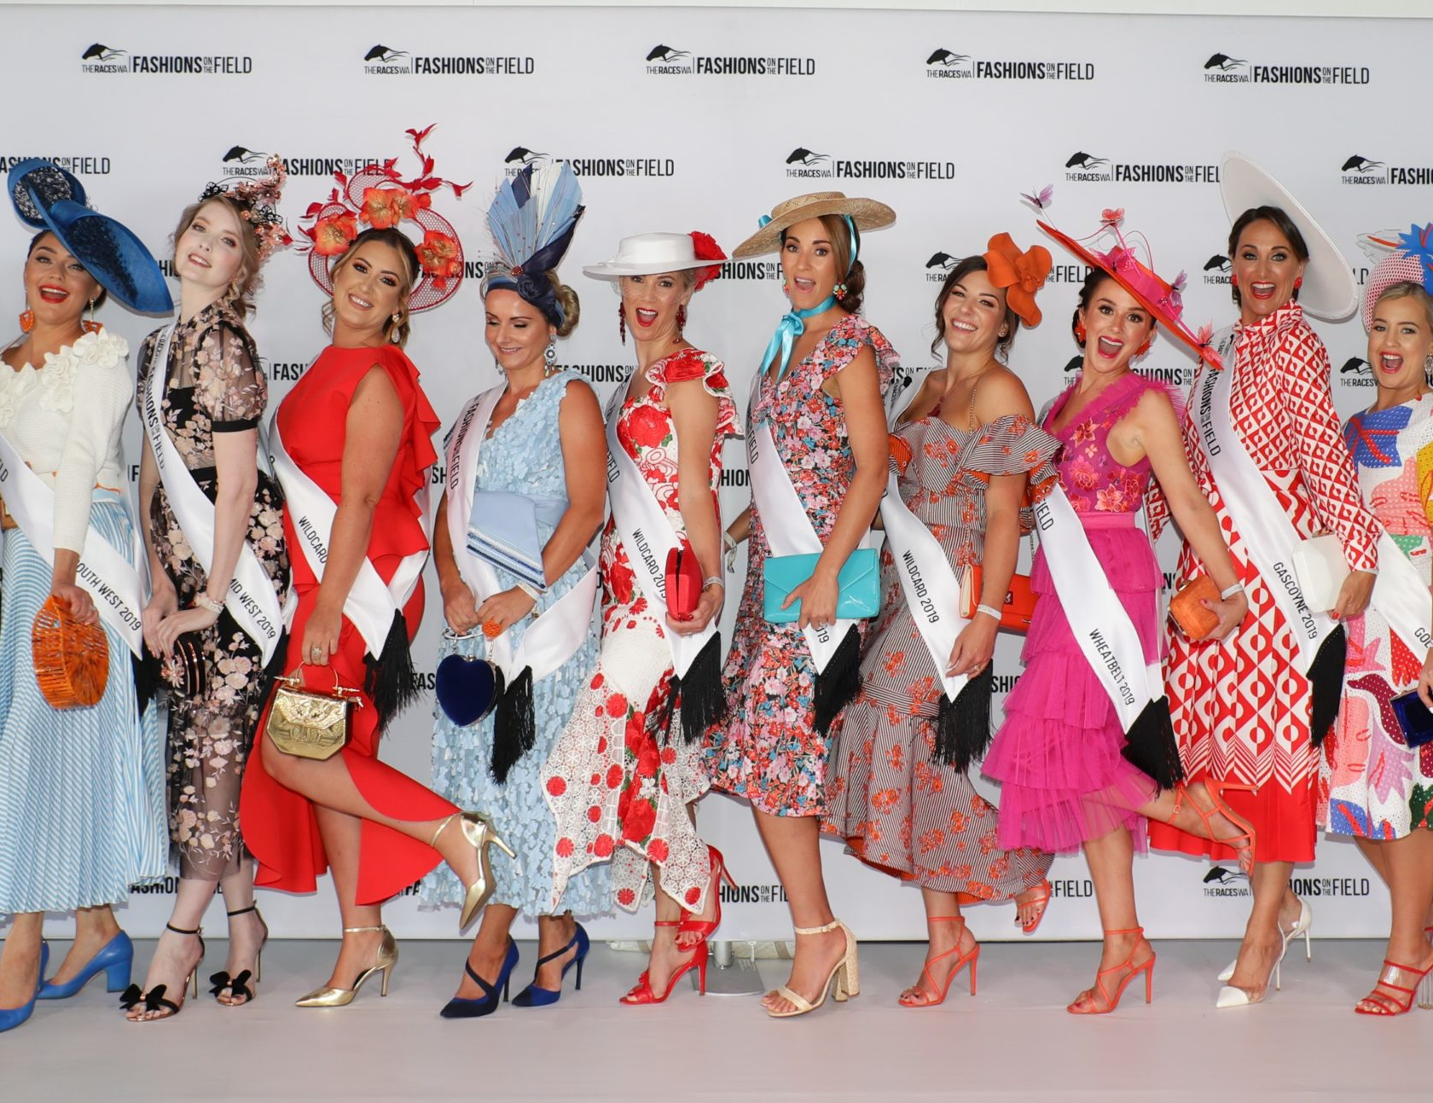
We’ve come a long way!
Notes:
https://upload.wikimedia.org/wikipedia/commons/thumb/b/be/StateLibQld_2_206817_Mannequins_modelling_race_day_fashions_at_Ascot%2C_Brisbane%2C_1935.jpg/120px-StateLibQld_2_206817_Mannequins_modelling_race_day_fashions_at_Ascot%2C_Brisbane%2C_1935.jpg
https://www.wafashionsonthefield.com.au/2019-20-calendar/

Slide 39
The Rotary Club of Canterbury “Let’s Stay Connected Project” has been developed as a response to an identified need within the Aged Care sector.
At times when it’s difficult to connect in person with family and friends, the Rotary Club of Canterbury has pleasure in offering you this booklet, designed to promote conversation, recollection and engagement for those who are in isolation and without their usual social activities.
The booklets have been designed for people in an aged care residence, village or at home to read by themselves, or to have a family or staff member share the booklet with them.
You can download this and other booklets from the Rotary Club of Canterbury website (www.canterburyrotary.org).
Source references for this book are held at the Rotary Club of Canterbury. Contact president@caterburyrotary.org for further details.
Material in this book was reproduced in accordance with Section 113F of the Copyright Act (1968).

