Slide 1
More of Bill’s Taxi Tales

Slide 2
The Rotary Club of Canterbury “Connecting in Isolation Project” has been specifically developed to support residents in aged care accommodation during the Covid-19 pandemic.
In times when it’s difficult to connect in person with family and friends, the Rotary Club of Canterbury has pleasure in offering you this booklet, designed to promote conversation, recollection and engagement to those who are in isolation and without their usual social activities.
The booklets have been designed for people in an aged care residence to read by themselves, or to colour in the pictures, or to have a family member at the other end of the phone read the booklet to them.
You can download this and other booklets from the Rotary Club of Canterbury website (www.canterburyrotary.org).
Source references for this book are held at the Rotary Club of Canterbury. Contact president@caterburyrotary.com.au for further details. Material in this book was reproduced in accordance with Section 113F of the Copyright Act (1968).

Slide 3
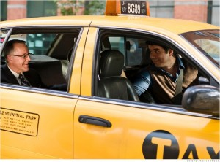
G’day, I’m Bill.
You may recall me from Bill’s Taxi Tales. I’m retired now, but I used to own and run taxis, 18 in all. For every taxi you need four drivers: day and night for weekdays, and the same for weekends. I drove the cars when I didn't have a driver for a shift.
The tales told really happened. Names and places have been changed to protect identities.
I hope you enjoy reading more of my tall, but true, tales. Regards, Bill

Slide 4
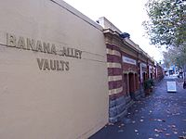
Banana Alley
Banana Alley is a night club area in Flinders Street. If you go there late at night you need to be very careful.
Very late at night, I once was called to pickup two young guys.

Slide 5
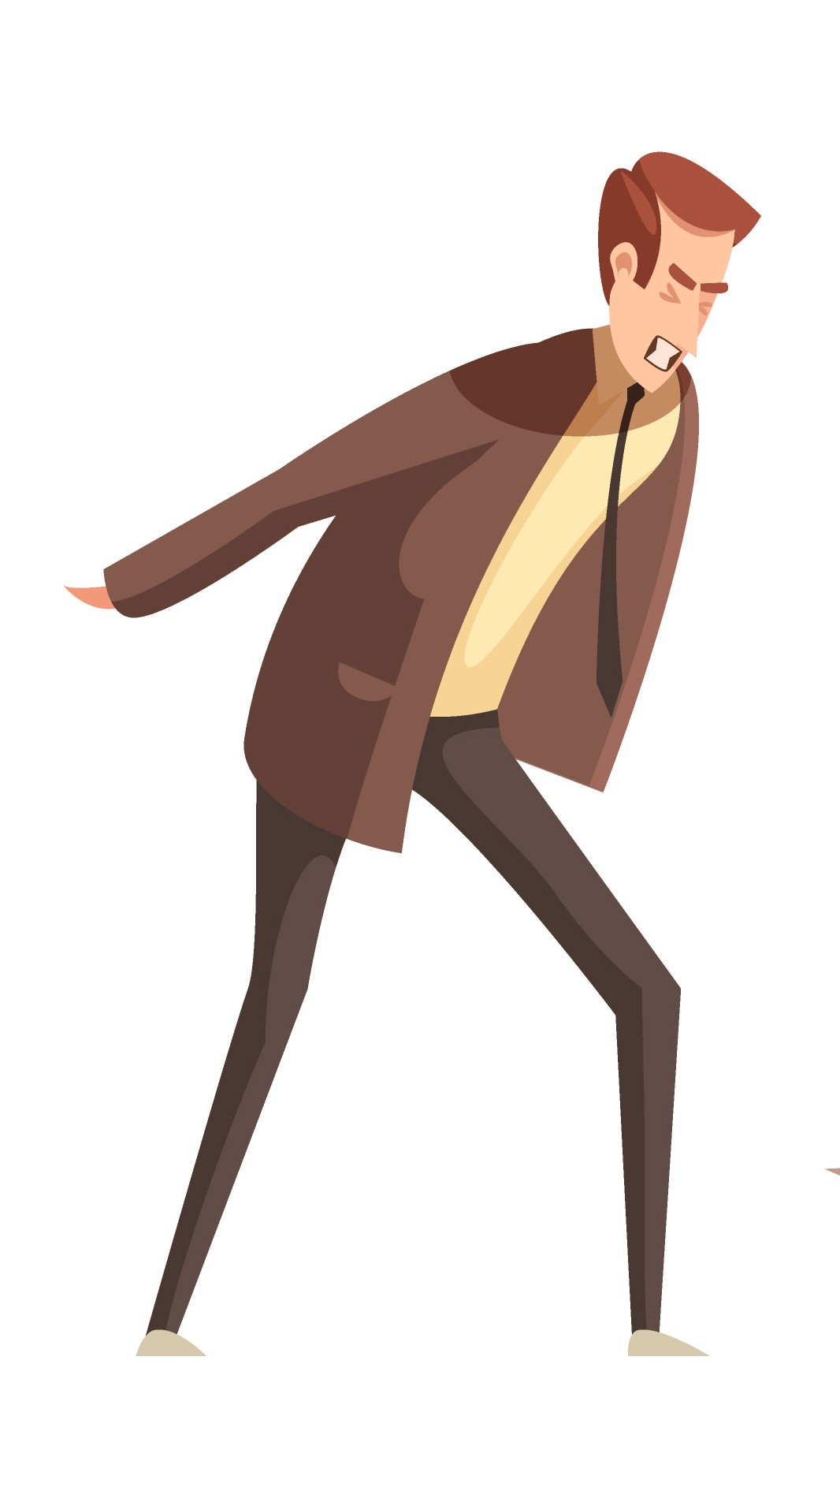
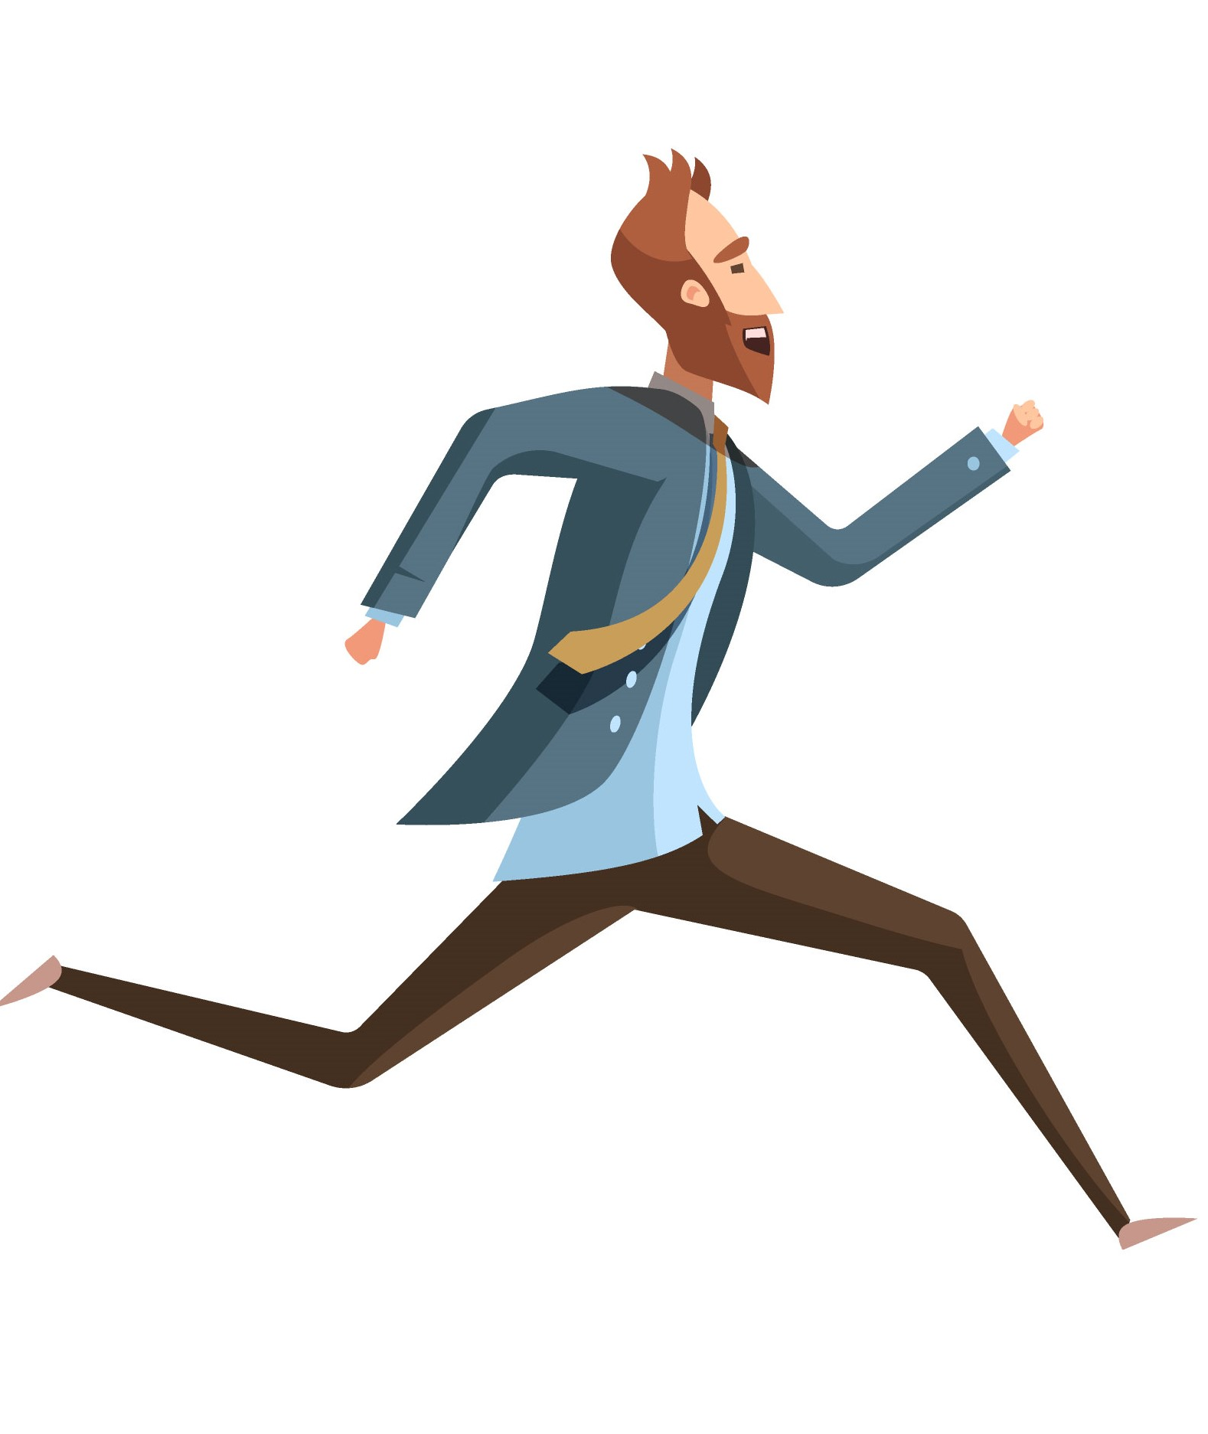
They wanted to go to Burke Road, Camberwell. They both got in the back seat.
When we got to Camberwell and stopped at a set of traffic lights, they both jumped out and ran across an oval.
I got out and chased them.

Slide 6
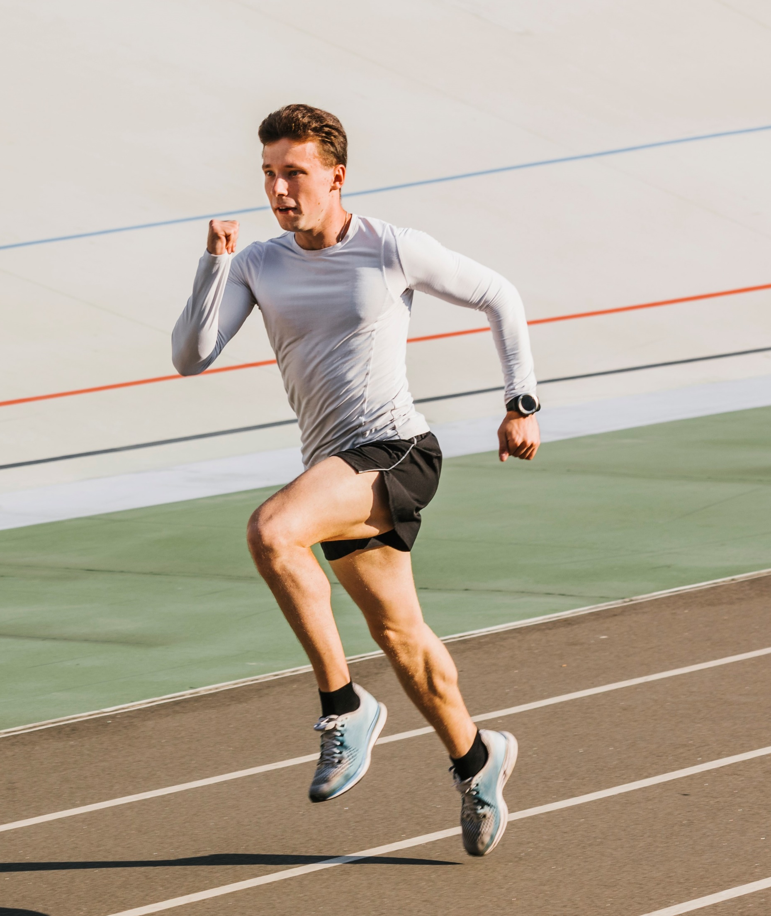
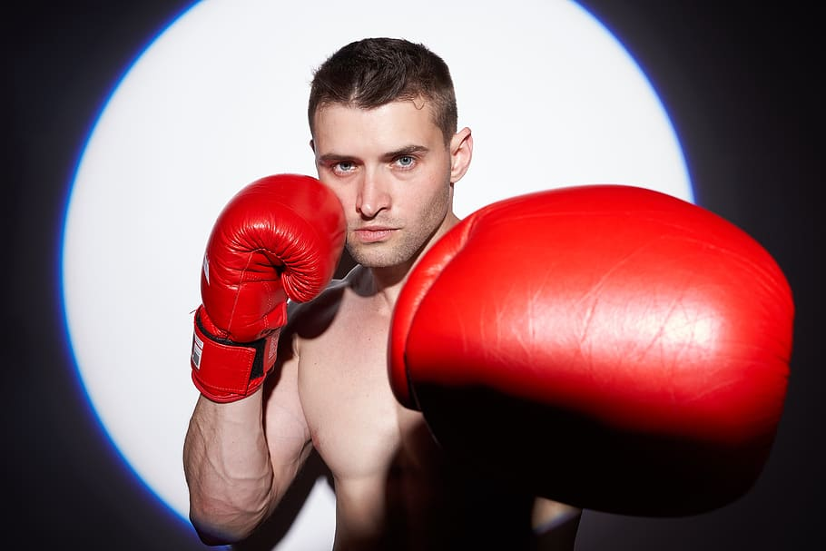
What they didn't know was that their driver
had been a professional runner and a professional boxer.
When I caught them, they asked me how much they owed me. I advised that the fare was $50. They handed me a $50 note. I gave them the right change and returned to my cab.

Slide 7
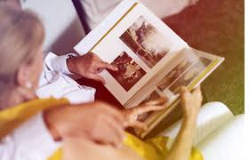
Thinking back
Were you good at sport?
When did you start playing sport?
What sporting activities did, or do, you like to do?

Slide 8
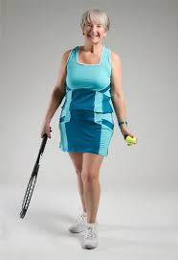
Anyone for Tennis?
I picked up Mary from a block of units in St. Kilda Rd.
A tall, elegant lady, dressed in tennis gear, she asked me to take her to Kooyong Lawn Tennis Club.
She told me she was 96 years old.

Slide 9
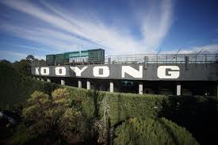
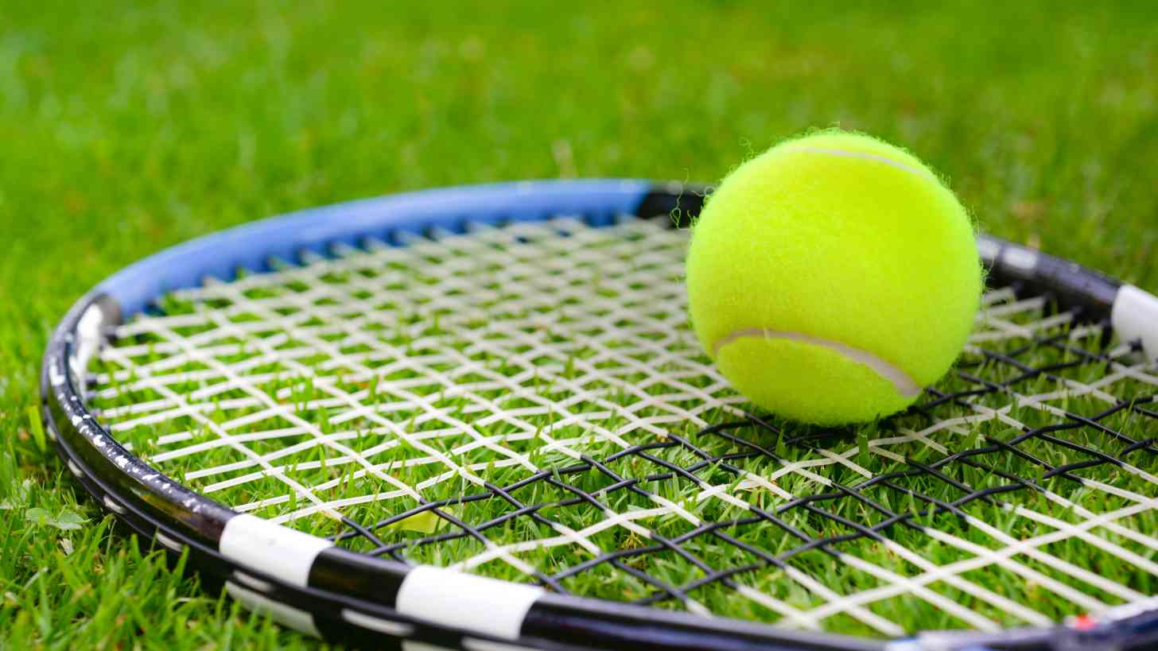
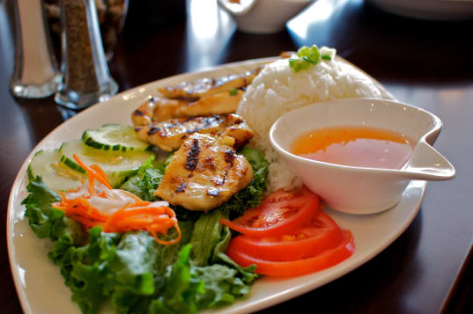
“I have to get away from my husband a couple of times a week,” she told me, ”so I go to Kooyong, play some tennis, have lunch with my friends and then come home.”

Slide 10
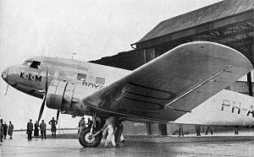
I asked her about her accent and she replied that she was from England.
“I had a friend in London during the war,” she reminisced. “She was a bit more adventurous than I was. She would get up in the morning and see her husband off to work. She would then take a plane to Paris.
There she would meet with some soldiers on R and R, have lunch and a good time, and
then back to London to put on the evening meal and await her husband's return.”
“I wouldn't have had the gumption to do that!”, she said.

Slide 11
Thinking back
What do, or did you wear to play tennis?
Can you tell me a story about when you went to a match?
Have you had friends with daring adventures?

Slide 12
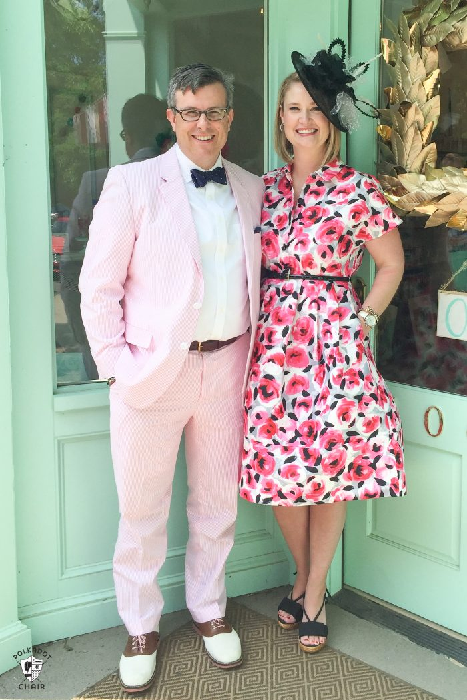
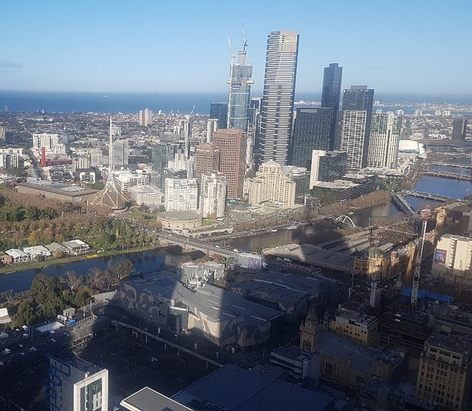
A Knight of the Realm
It was Caulfield Cup day, and mine was first car on the rank at the Sofitel Hotel. The concierge called me up as an immaculately dressed man approached with his wife.
He opened the rear door for his wife, then he sat in the front. I recognised him as a very prominent QC and politician.
.

Slide 13
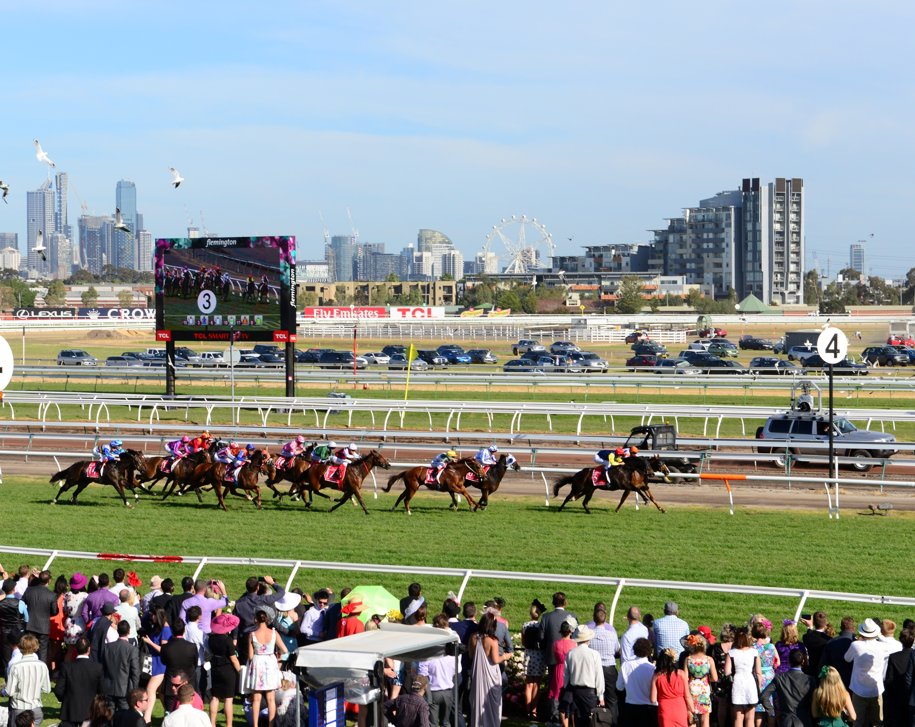
I felt quite comfortable saying to him, “Royal Caulfield, Sir”, and off we went. He was very happy to chat about the races, his fancies, some wins and some losses.
He paid the fare by Credit Card, and a tip by cash. He was one of only two people in many years to do that.

Slide 14
Thinking back
Have you visited any big hotels in Melbourne?
Did you stay at the hotel, or have a meal?
What is your favourite thing about going to the races?
Have you been to the Caulfield Cup?

Slide 15
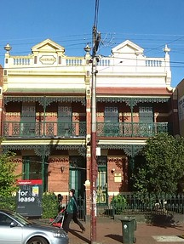
We’ll Never Know
The pick-up address was not in one of the better parts of Brunswick.
There was a thin, pale lady waiting on the front porch of the house when I arrived.

Slide 16
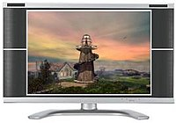
She had a television beside her and told me that she wished to take the television to Cash Converters. She asked that I carry it out to the taxi for her.
At Cash Converters in Sydney Road, I again did the carrying. The transaction completed, I took her back to the pick-up address.
As I drove off, the thought came to me. Was that her house and her television?

Slide 17
Thinking back
Do you often travel in a taxi?
What have been some of your journeys?
Where did you wait for people collecting you?

