Slide 1

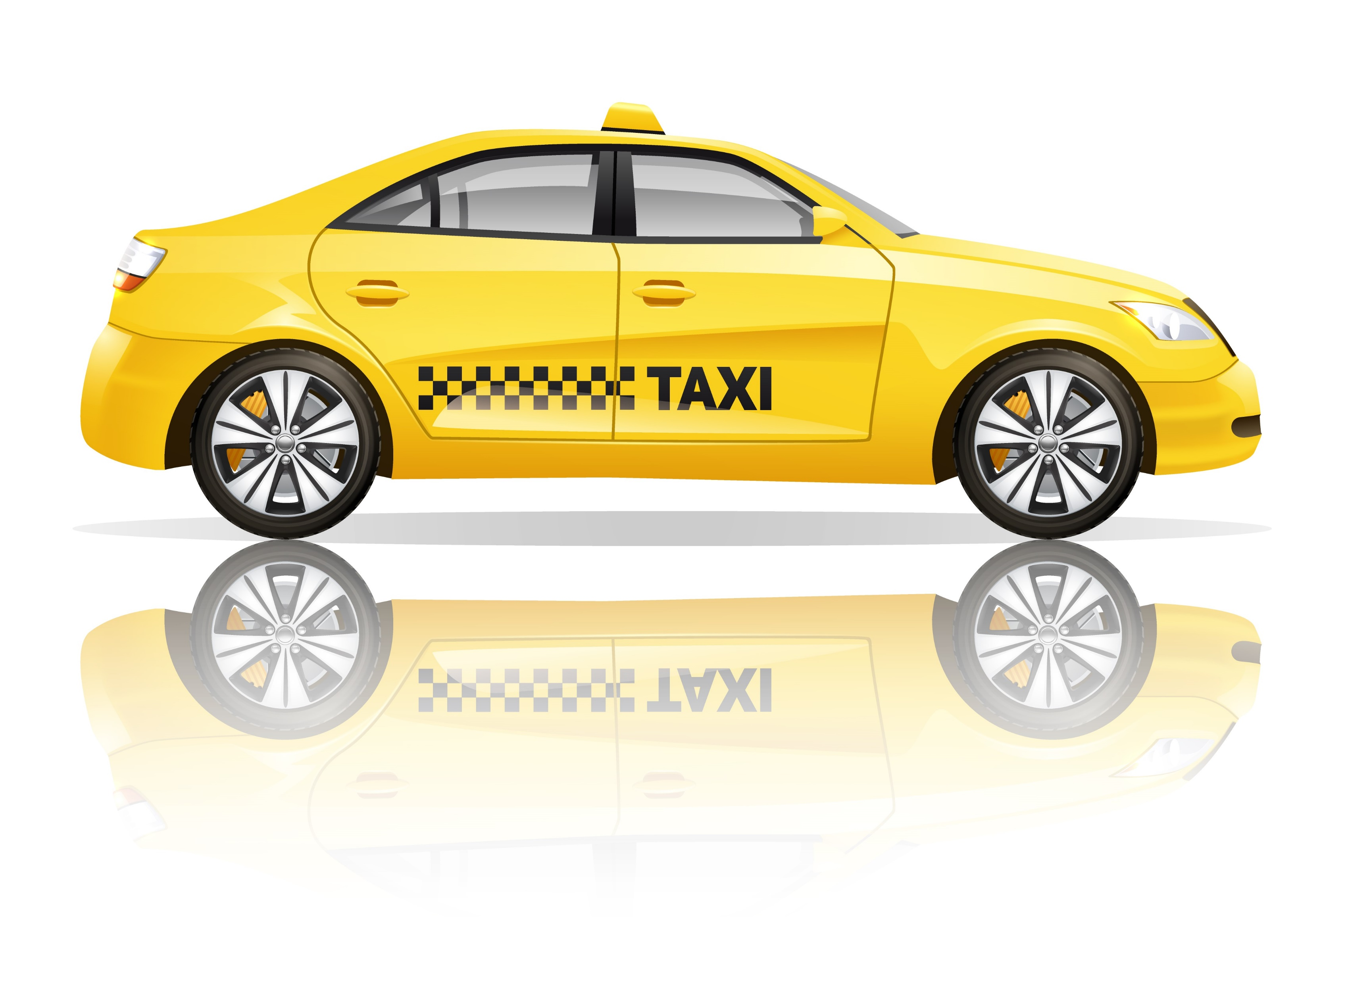
Bill’s Taxi Tales
Notes:
https://www.freepik.com/free-vector/taxi-poster-with-realistic-yellow-public-service-car-with-reflection_2868846.htm#page=1&query=taxi&position=0

Slide 2
The Rotary Club of Canterbury “Let’s Stay Connected Project” has been developed as a response to an identified need within the Aged Care sector.
At times when it’s difficult to connect in person with family and friends, the Rotary Club of Canterbury has pleasure in offering you this booklet, designed to promote conversation, recollection and engagement for those who are in isolation and without their usual social activities.
The booklets have been designed for people in an aged care residence, village or at home to read by themselves, or to have a family or staff member share the booklet with them.
You can download this and other booklets from the Rotary Club of Canterbury website (www.canterburyrotary.org).
Source references for this book are held at the Rotary Club of Canterbury. Contact president@caterburyrotary.org for further details.
Material in this book was reproduced in accordance with Section 113F of the Copyright Act (1968).

Slide 3
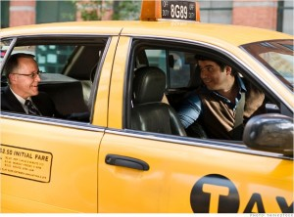
G’day, I’m Bill.
I’m retired now, but I used to own and run taxis, 18 in all. For every taxi you need four drivers: day and night for weekdays, and the same for weekends. I drove the cars when I didn't have a driver for a shift.
These tales really happened, though names and places have been changed to protect identities.
I hope you enjoy reading my tall tales, but true. Regards, Bill
Notes:
http://career.iresearchnet.com/career-information/taxi-driver-career/

Slide 4
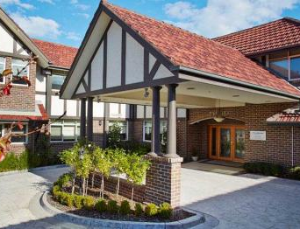
Lucy
I could see that Lucy was a mature lady when I arrived to pick her up at the Day Centre.
“Good Afternoon, Lucy”, I said. The nurse with her told me Lucy was blind and deaf.
I helped Lucy into the taxi and asked the nurse where I should take her. The nurse replied that Lucy would show me the address on a piece of paper when she got into in the taxi, and that is what happened. So off we went to Box Hill.
Notes:
https://www.agedcare101.com.au/aged-care/vic/north-east-melbourne/region

Slide 5
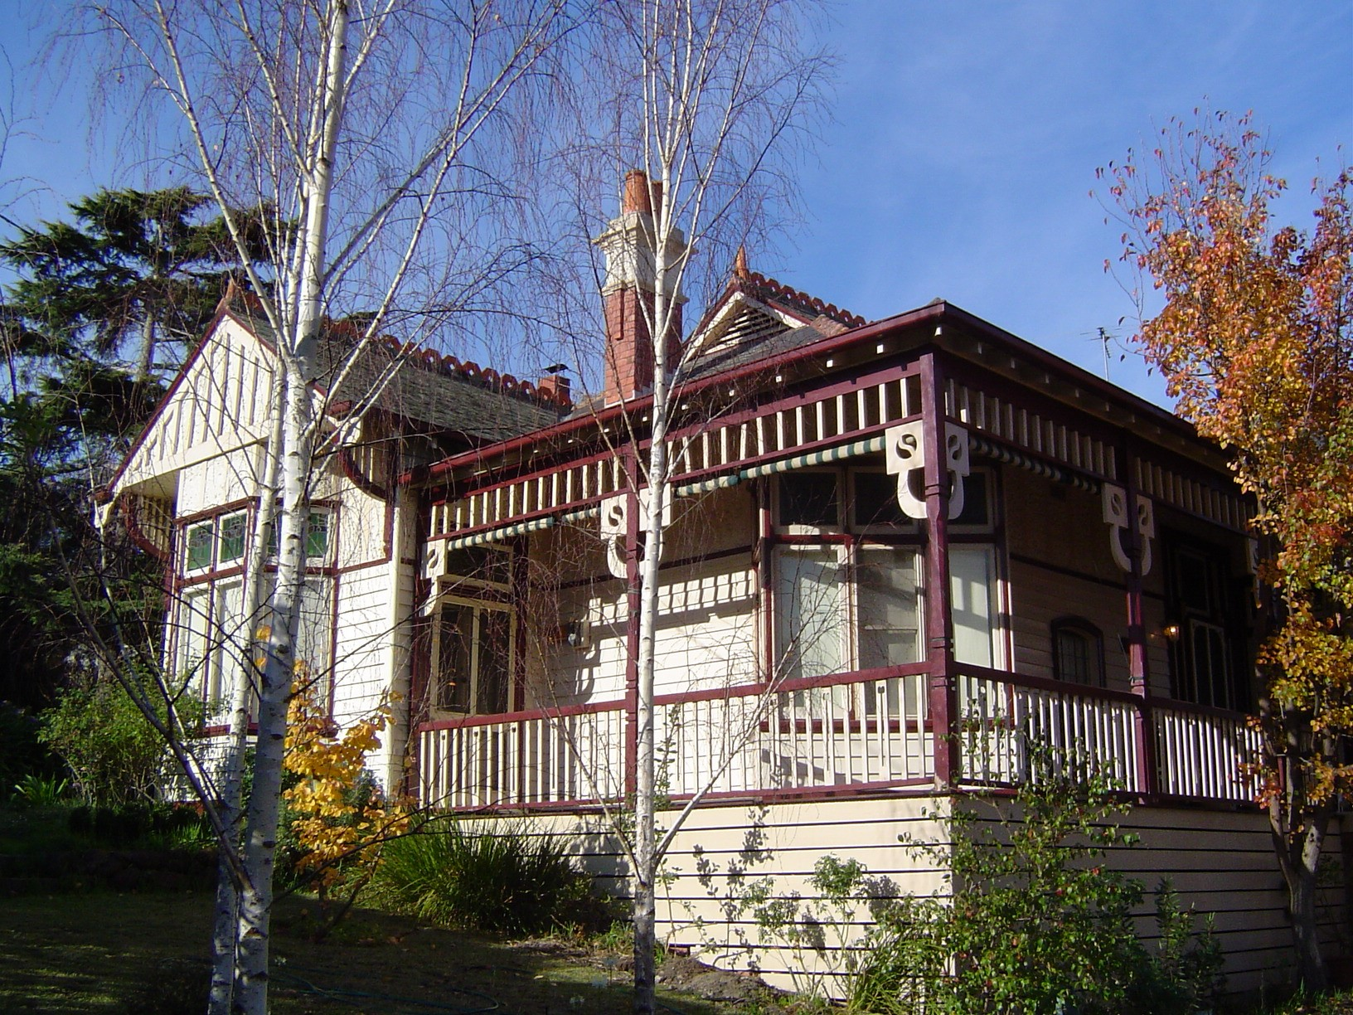
Lucy
But then I had the terrible thought: how was I to tell her the fare at the end of the trip? By the tell-tale movement of the car and the elapsed time, Lucy had a very good idea as to where we were as she must have done the trip many times.
As we neared her destination, she handed me a note which said, “Write the fare on my hand with your finger”. I did and she paid the fare.
I helped Lucy out of the taxi and onto the footpath which she felt carefully with her feet. She knew she was home and waved me away. My job was done.
Notes:
https://upload.wikimedia.org/wikipedia/commons/thumb/3/30/Edwardian_style_house_in_Heidelberg%2C_Victoria.jpg/800px-Edwardian_style_house_in_Heidelberg%2C_Victoria.jpg

Slide 6
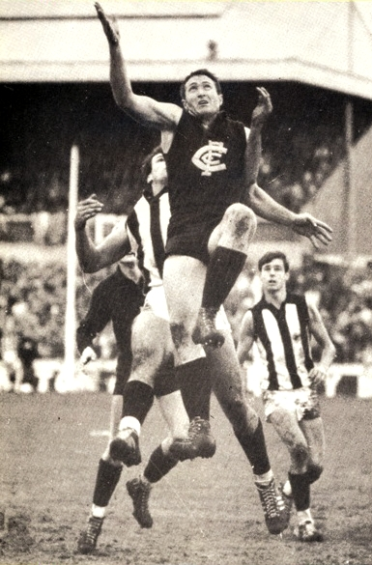
Big Bob
It was a wintry Saturday afternoon, about 4.30pm and I needed to knock off work soon.
One more little job would help to fill the day’s takings.
The Carlton versus Collingwood football game at Carlton was just about to finish.
“That should give me a fare” I thought as I drove to the Carlton ground in Royal Parade.
Notes:
https://www.blueseum.org/John+Nichollshttps://www.blueseum.org/John+Nicholls

Slide 7
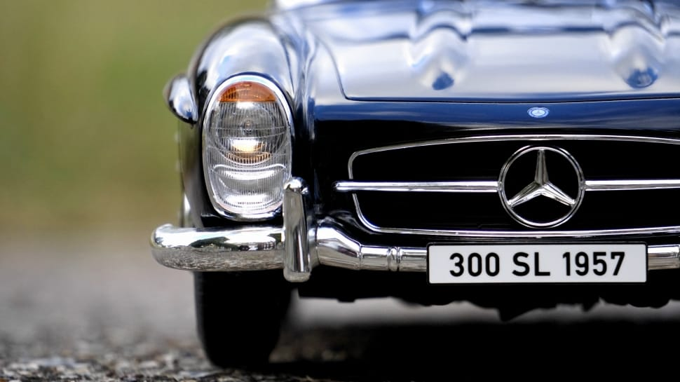
Big Bob
I stopped behind two late model Mercedes-Benz in the car park. Carlton lost, so there was no happiness among their supporters.
A big guy with a menacing face strode towards one of the Mercs. He looked at his car, then at my taxi and growled “Nick off” in threatening tone. I drove away quick smart. His next reaction could have cost me more than a fare!
Notes:
https://www.peakpx.com/566753/blue-classic-mercedes-benz

Slide 8
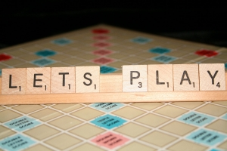

One hundred
It was one September and I picked up a lady from a residential aged care home.
She was going to an adjoining suburb to play Scrabble.
.
Notes:
http://escapetheclassroom.nl/portfolio-items/scrabble/
https://futurecentre.eu/close-up-letters-scrabble-278881-2/?lang=en

Slide 9
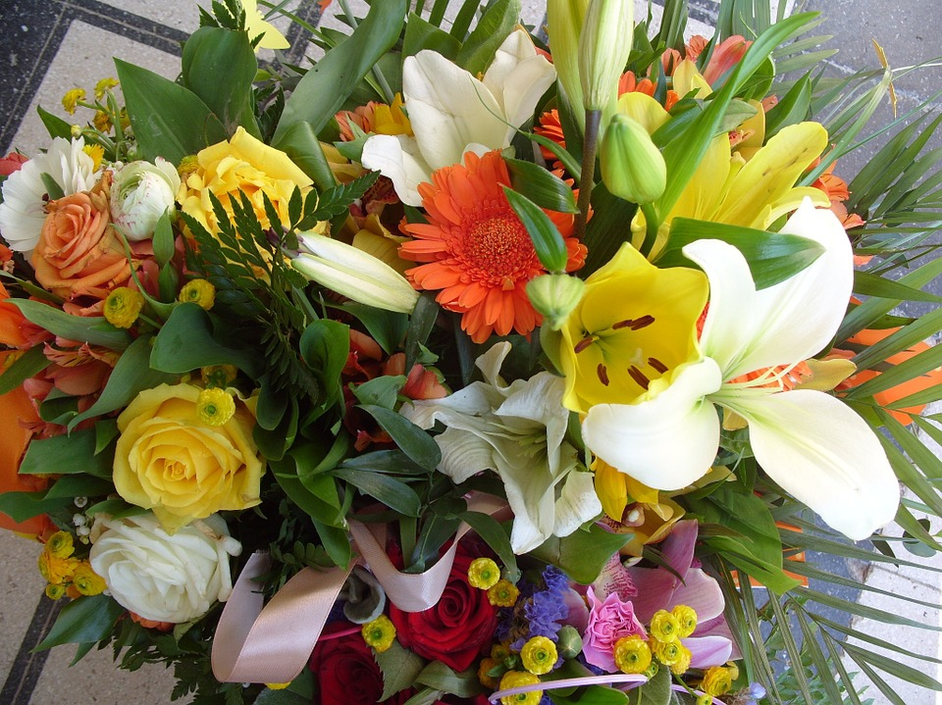
One hundred
We started talking about age. She told me it would be some time before I was her age. She would be 100 years old next week.
I reported the conversation to Depot Management.
On her birthday, they sent her a big bunch of flowers and $100 in taxi vouchers.
Notes:
https://pixabay.com/static/uploads/photo/2015/01/19/14/11/flower-604034_960_720.jpg

Slide 10

An Unusual Occupation
I was hailed by a well-dressed businessman wanting to go to the airport.
As well as being bigger jobs, paying more, jobs to or from the airport give the driver a good chance for a chat with the passenger.
“What do you do”, is often a good way to get the ball rolling.
Notes:
http://www.pngall.com/wp-content/uploads/2018/04/Businessman-PNG-Image.png

Slide 11
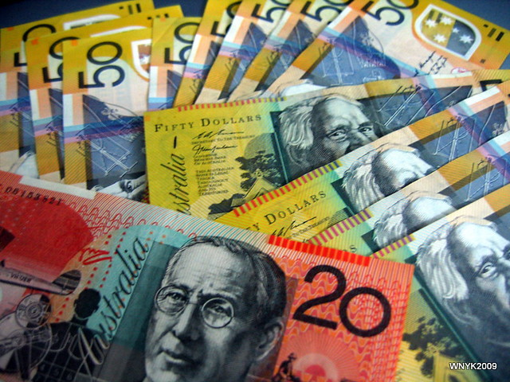
An Unusual
Occupation
“I'm a car spotter or broker”, he said. “I look around in car sales yards, newspaper ads, the internet, for cars that are for sale, and which I know can be sold for more somewhere else, perhaps interstate, perhaps just in a different dealership."
“Then I ring the second dealer, tell him about the car, and if he is interested, put the seller and the second dealer in touch with each other. Then I send them both an invoice for $250.”
Notes:
https://www.flickr.com/photos/williamnyk/3598113750

Slide 12

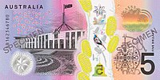


Quick Quiz – Who’s on the Banknotes?
1
2
Hint: She cuts a regal figure
Hint: The house on the hill
3
4
Hint: The man from Snowy River
Hint: Journalist (Canberra suburb of Gilmore named for her)
Notes:
https://en.wikipedia.org/wiki/Australian_five-dollar_note
https://en.wikipedia.org/wiki/Australian_five-dollar_note
https://en.wikipedia.org/wiki/Australian_ten-dollar_note
https://en.wikipedia.org/wiki/Australian_ten-dollar_note

Slide 13




Quick Quiz – Who’s on the Banknotes?
4
5
Hint: Convict turned business-woman
Hint: The flying doctor
6
7
Hint: First Aboriginal author to be published
Hint: First Australian woman elected to parliament (in WA)
Notes:
https://en.wikipedia.org/wiki/Australian_twenty-dollar_note
2. https://en.wikipedia.org/wiki/Australian_twenty-dollar_note
3. https://en.wikipedia.org/wiki/Australian_fifty-dollar_note
4. https://en.wikipedia.org/wiki/Australian_fifty-dollar_note

Slide 14


Quick Quiz – Who’s on the Banknotes?
9
Hint: Famous opera singer….
has had more farewell concerts than….
10
Hint: Military commander and engineer (Hint: has a university and a freeway named after him)
Rotary Club of Canterbury: Let’s Stay Connected Project
Notes:
https://en.wikipedia.org/wiki/Australian_one-hundred-dollar_note
https://en.wikipedia.org/wiki/Australian_one-hundred-dollar_note

Slide 15
Answers to ‘Who’s on the Banknotes?’
Note | Person Featured
$5 | Queen Elizabeth II
 | Parliament House
$10 | Banjo Paterson
 | Dame Mary Gilmore
$20 | Mary Reibey
 | Reverend John Flynn
Note | Person Featured
$50 | David Unaipon
 | Edith Cowan
$100 | Dame Nellie Melba
 | Sir John Monash
Notes:
http://www.thecud.com/live/sites/default/files/tonysmithoct3.jpg
The ‘Floating Concert Hall’: Music on the Manly Ferry
Tony Smith

