Slide 1

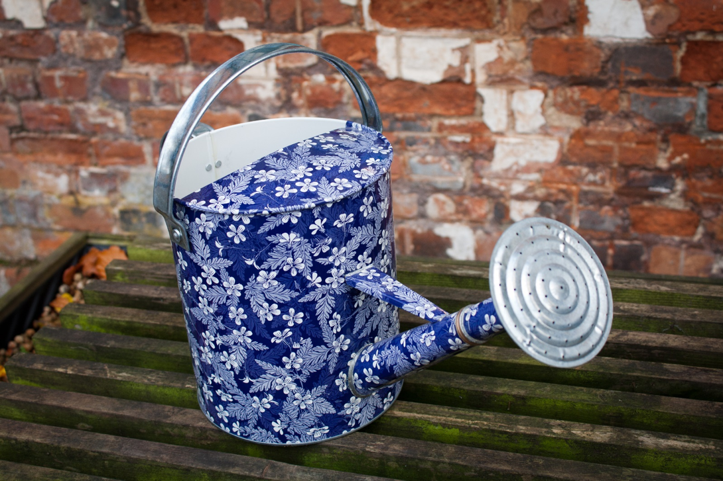
In Our
Garden TITLE
Notes:
https://upload.wikimedia.org/wikipedia/commons/4/49/Decorative_Watering_Can_(6320010953).jpg

Slide 2
Hello!
My name is Rosemary and I live in Melbourne, Australia and I am a member of the Rotary Club of Canterbury.
There are lots of things we grow in our garden. It is a lot of work, but we enjoy it very much.
Enjoy seeing our garden. I hope it reminds you of sights and smells, the feel of soil in your hands and the joy of growing your own food and flowers.
Rosemary
Notes:
Author’s own photograph

Slide 3
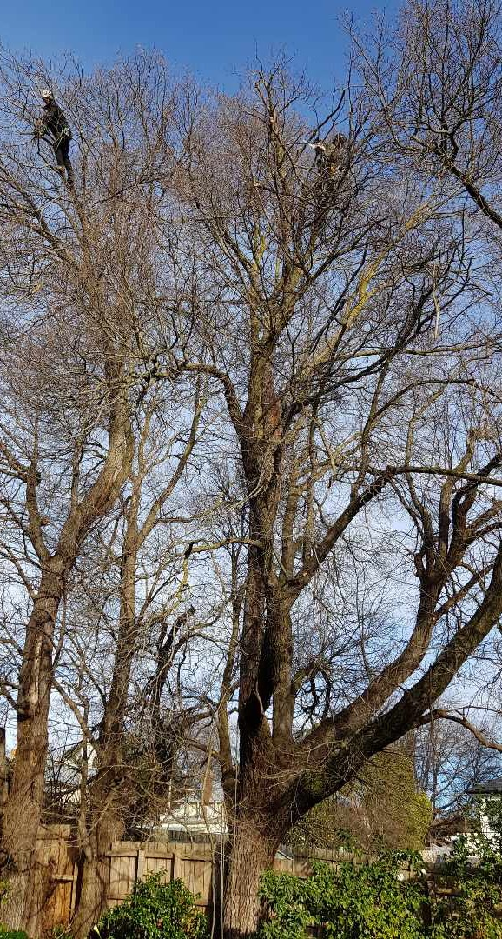
Our Big Elms
We have flowers and vegetables in our garden and some big elm trees in the back yard.
Last year we had the trees pruned.
You can see the men with the chainsaw, very high up in the tree.
Notes:
Author’s own photograph

Slide 4
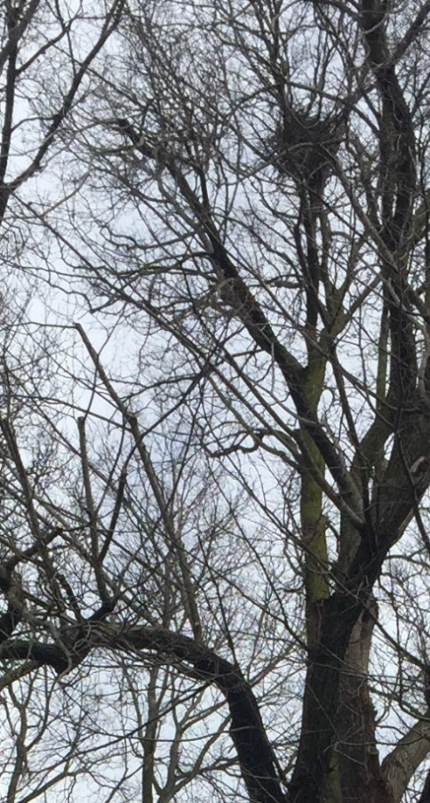
Our Big Elms
There was a big crow’s nest in the top of the tree.
The workmen were careful not to disturb the nest, but it fell down later.
Notes:
Author’s own photograph

Slide 5
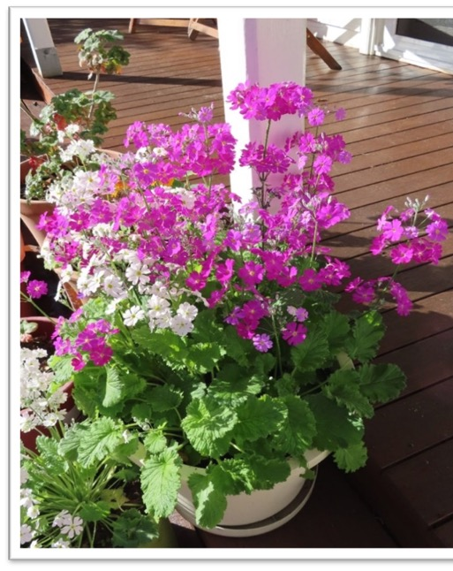
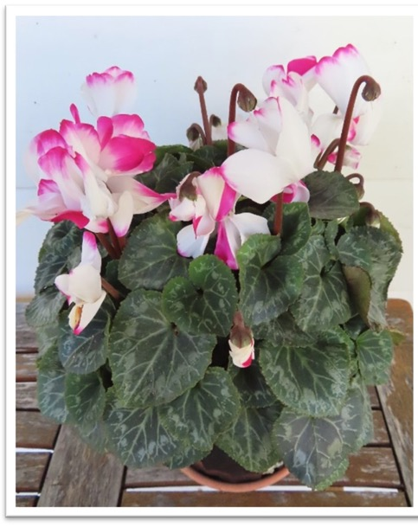
Our Flowers in Pots
We have lots of flowers in pots.
The pink and white primulas self-seeded.
This cyclamen was bought at a nursery.
Notes:
Author’s own photographs

Slide 6
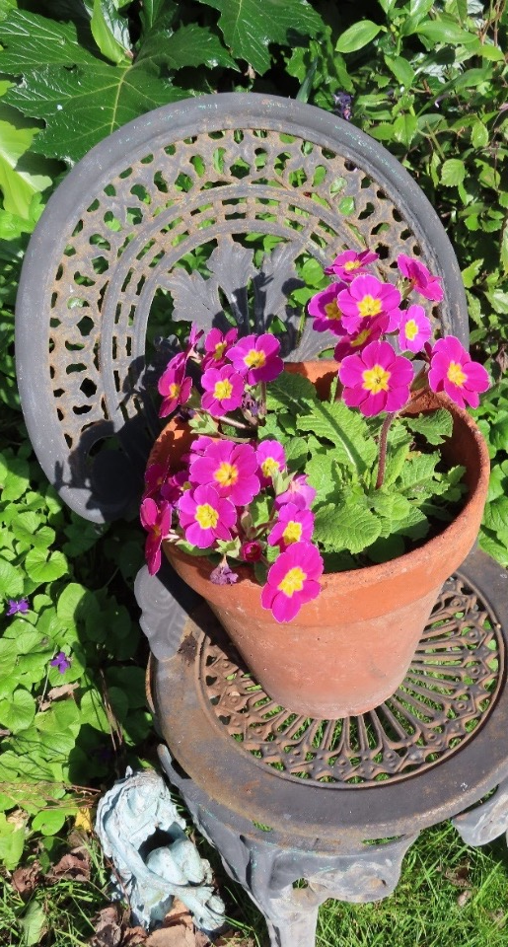
Our Flowers in Pots
This bright pink polyanthus has flowered for 3 years in a row.
The pot is sitting on a chair that used to be in my mother’s garden.
Notes:
Author’s own photograph

Slide 7
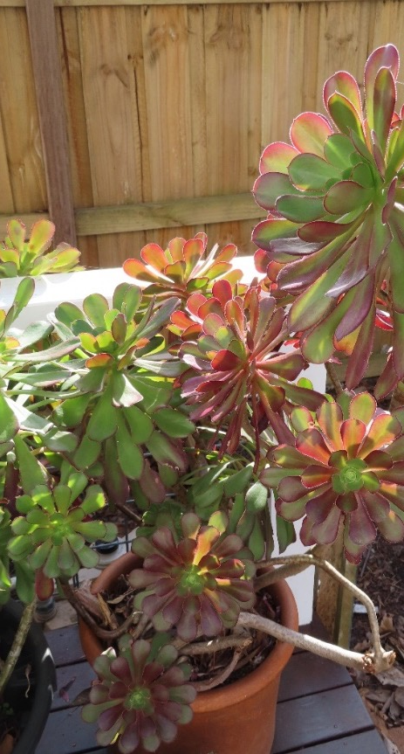
Our Flowers in Pots
These succulents don’t need much attention.
They are on a sunny deck where we often sit to have our lunch.
Notes:
Author’s own photograph

Slide 8
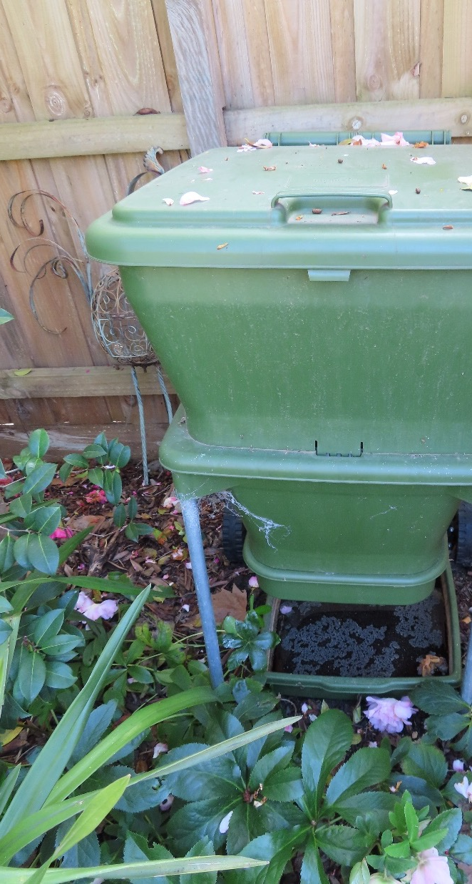
The Worm Farm
We have a worm farm that takes all our kitchen vegetable scraps.
It has a lot of worms that make lovely soil for our garden.
Notes:
Author’s own photograph

Slide 9
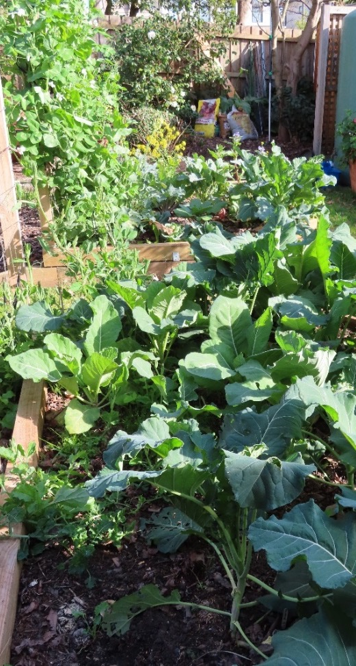
Our Vegetable Garden
Our vegetable patch has lots of vegetables.
We have a water tank on our shed to water the vegetables.
Notes:
Author’s own photograph

Slide 10
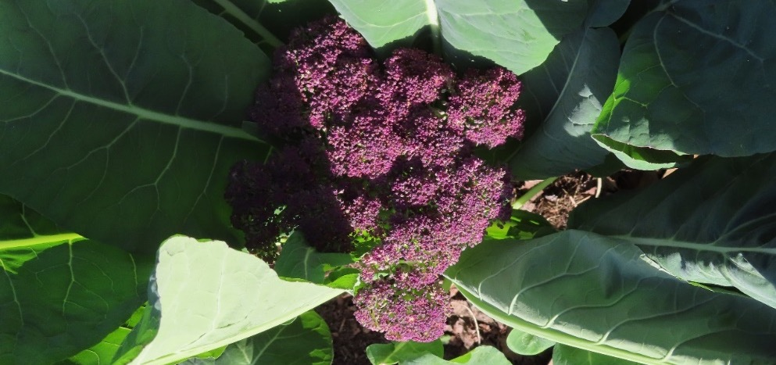
Our Vegetable Garden
In winter we grow purple broccoli.
Notes:
Author’s own photograph

Slide 11
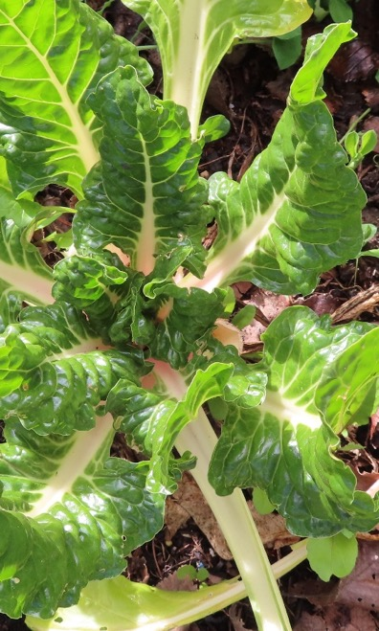
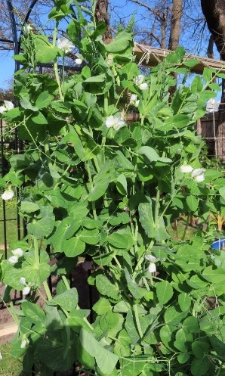
Our Vegetable Garden
In winter we grow snow peas….
… and silverbeet.
Notes:
Author’s own photographs

Slide 12
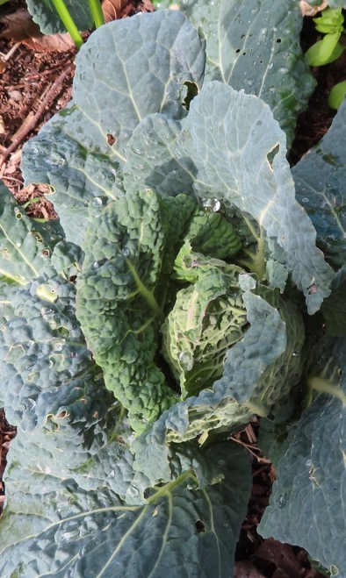
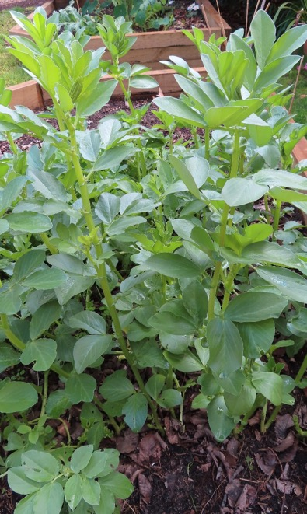
Our Vegetable Garden
We love cabbage…
… and broad beans.
Notes:
Author’s own photographs

Slide 13
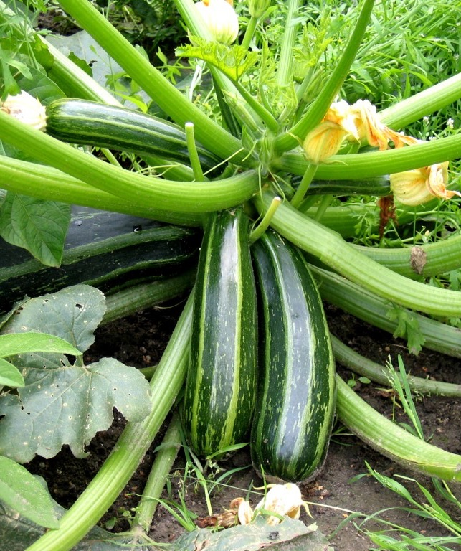
Our Vegetable Garden
In summer, we grow zucchini.
Notes:
https://qnholifield.files.wordpress.com/2014/08/growing-zucchini-how-to-grow-zucchini-summer-squash2-1024x768.jpg

Slide 14
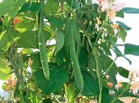
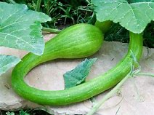
Our Vegetable Garden
In summer, we grow runner beans and tromboncino zucchini. These zucchini grow nearly a metre long.
Notes:
https://gardentabs.com/how-to-grow-pumpkins-successfully/
https://i.ebayimg.com/images/i/231257263412-0-1/s-l1000.jpg

Slide 15
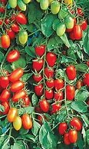
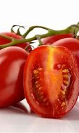
Our Vegetable Garden
In summer, I grow all sorts of tomatoes from seed.
There are tiny tomatoes for salad and ‘Italian’ tomatoes for cooking.
Notes:
https://parkseed.com/juliet-tomato-seeds/p/05345-PK-P1/
https://teplichniku.ru/pomidory/universalnyi-tomat-roma-kharakteristika-i-opisanie-sorta/

Slide 16
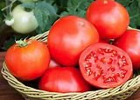
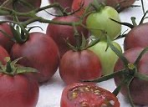
Our Vegetable Garden
We like to grow more unusual varieties of tomatoes like…
…big meaty ones and
…‘Black’ ones
Notes:
https://bonnieplants.com/product/bush-goliath-tomato/
https://www.ingegnoli.it/eng/pomodoro-black-cherry.html

Slide 17
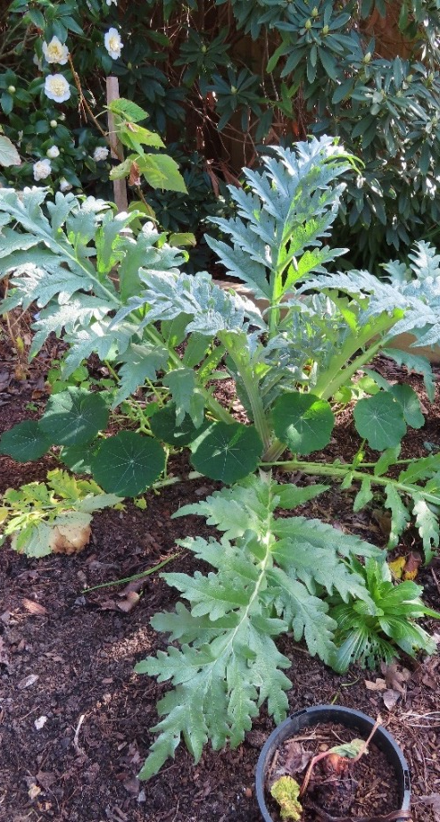
Our Vegetable Garden
We have artichokes.
Once my husband pulled out an artichoke plant because he thought it was a thistle.
Notes:
Author’s own photograph

Slide 18
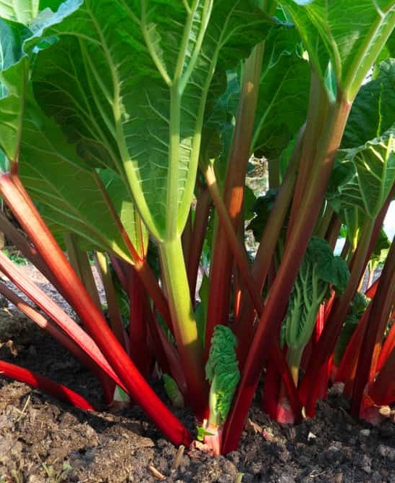
Our Vegetable Garden
We grow a lot of rhubarb.
My husband likes stewed rhubarb on his breakfast cereal.
Notes:
https://www.thedailygardener.com/wp-content/uploads/2019/07/growing-Rhubarb-600x900.jpg

Slide 19
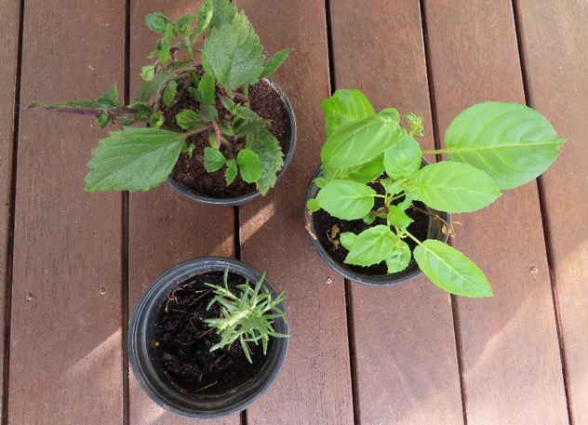
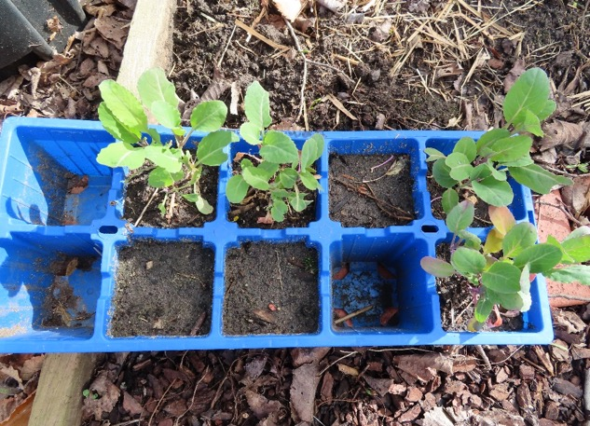
Grown from Cuttings
I grow a lot of plants from cuttings – rosemary and fuchsia and many others.
And a lot of our vegetables I grow from seed.
Notes:
Author’s own photographs

Slide 20
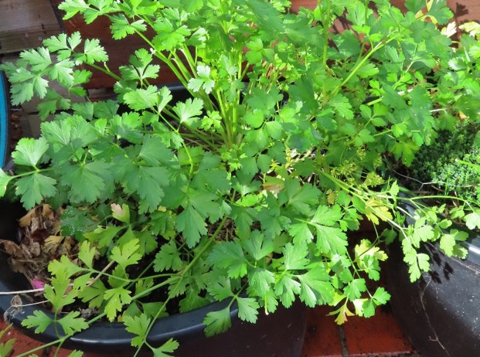
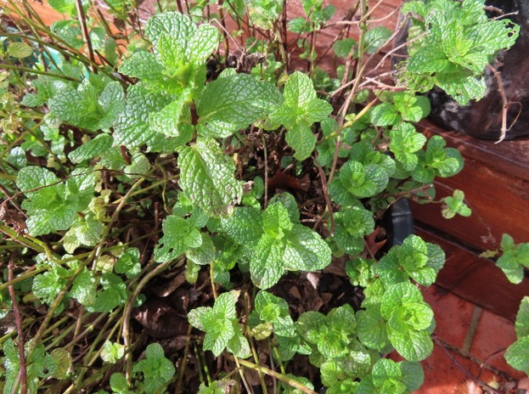
Growing Herbs
For cooking, we also have a lot of herbs in pots, like parsley and mint.
Notes:
Author’s own photographs

Slide 21
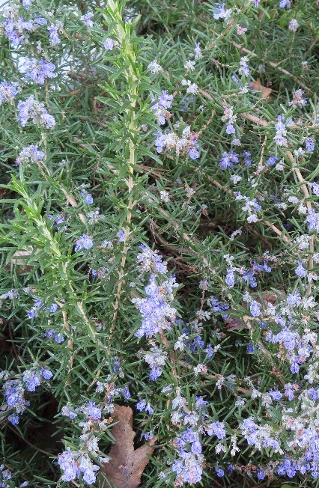
Growing Herbs
I like using rosemary in my cooking.
It goes especially well with lamb.
Notes:
Author’s own photograph

Slide 22
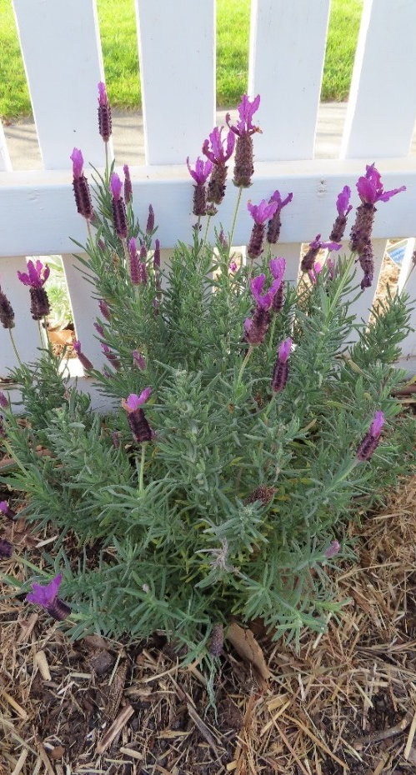
Plants for Bees and Butterflies
We have lots of plants to attract the bees and butterflies. The bees love lavender.
It smells lovely on a summer evening.
Notes:
Author’s own photograph

Slide 23
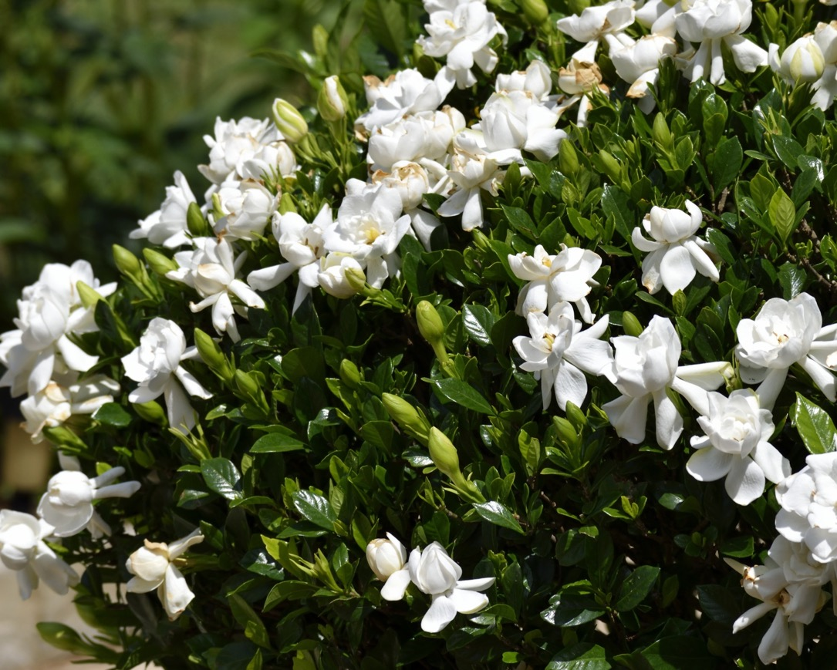
Plants for Bees and Butterflies
The gardenias smell beautiful.
Notes:
https://www.publicdomainpictures.net/pictures/180000/velka/gardenia-bush-flower.jpg

Slide 24
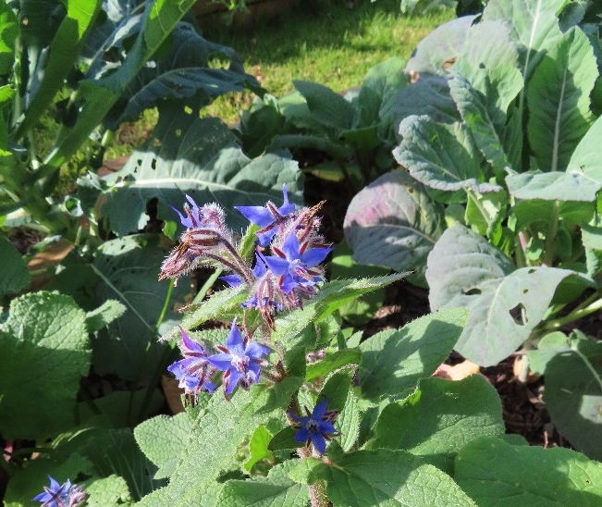
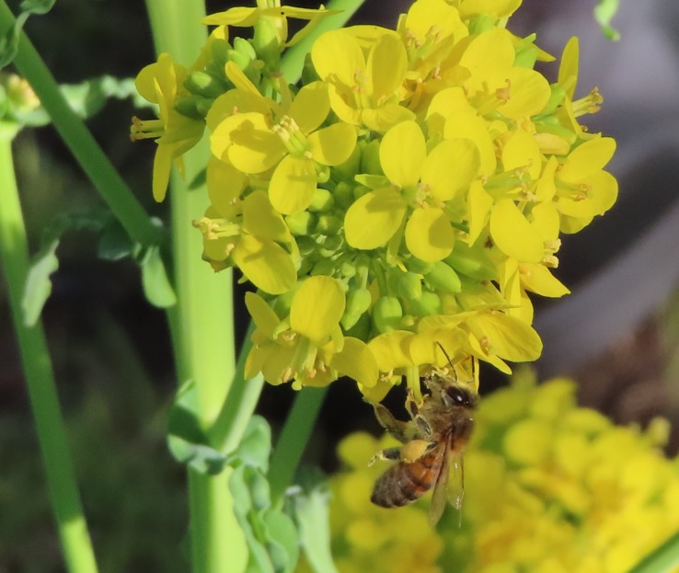
Plants for Bees and Butterflies
The borage is a bit prickly, but the bees don’t mind.
The bees love the flowers on the broccoli that went to seed.
Notes:
Author’s own photographs

Slide 25
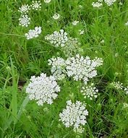
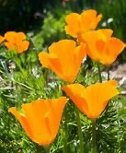
Plants for Bees and Butterflies
The bees love the Queen Anne’s Lace
… and they love the California poppies.
Notes:
Author’s own photographs

Slide 26
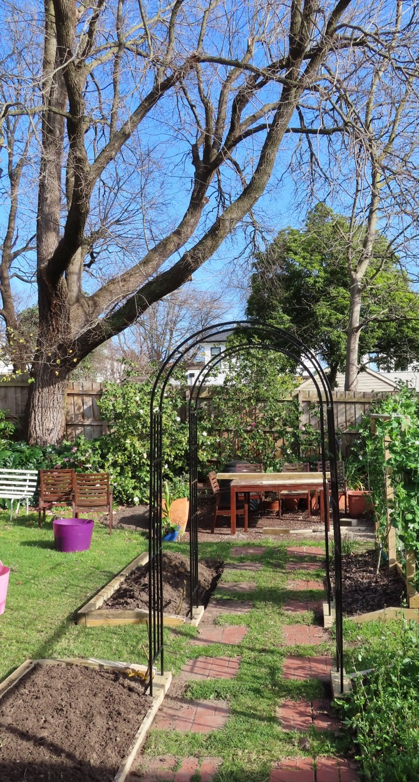
Our Roses
In the back garden we have made some new garden beds and planted some roses to grow over the arches.
Notes:
Author’s own photograph

Slide 27
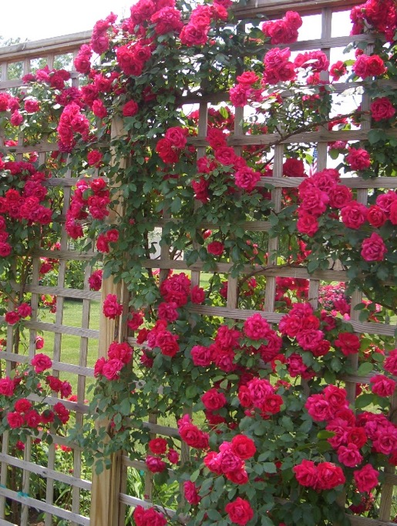
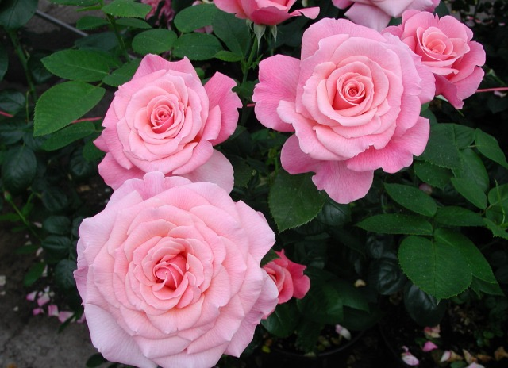
Our Roses
In summer in our garden there are lots of roses in many different colours.
Notes:
http://mygardentrellis.com/tips-on-planting-climbing-roses-on-a-rose-trellis/
https://nboldblog.files.wordpress.com/2013/02/tickled-pink-rose-bush.jpg?w=640&h=478

Slide 28

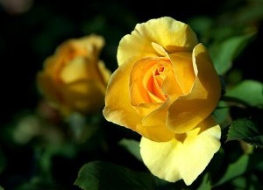
Our Roses
We have so many lovely roses.
The yellow rose is one of my favourites.
Notes:
https://www.publicdomainpictures.net/pictures/130000/t2/beautiful-bright-red-rose.jpg
https://pixnio.com/free-images/flora-plants/flowers/roses-flower-pictures/roses-in-national-park-300x225.jpg

Slide 29
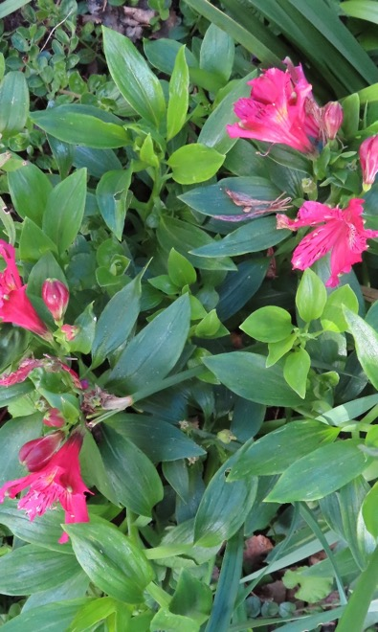
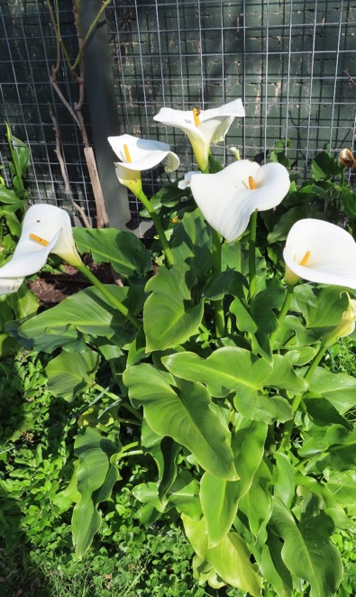
Our Winter Garden
Even in winter we have lots of flowers: alstroemerias and arum lilies.
Notes:
Author’s own photographs

Slide 30
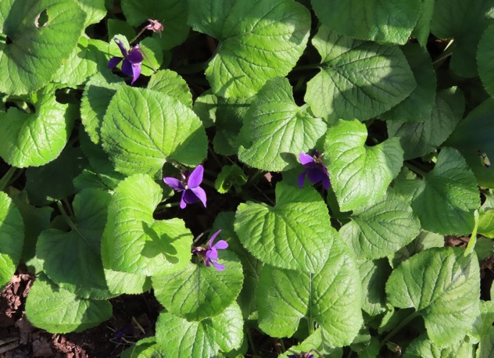
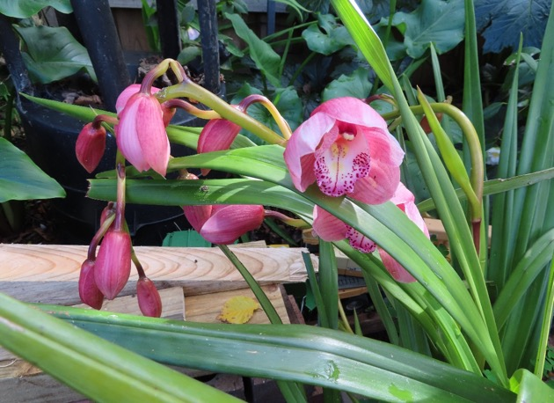
Our Winter Garden
In winter we see little violets poking their heads out of the foliage.
We also have several majestic orchids.
Notes:
Author’s own photographs

Slide 31
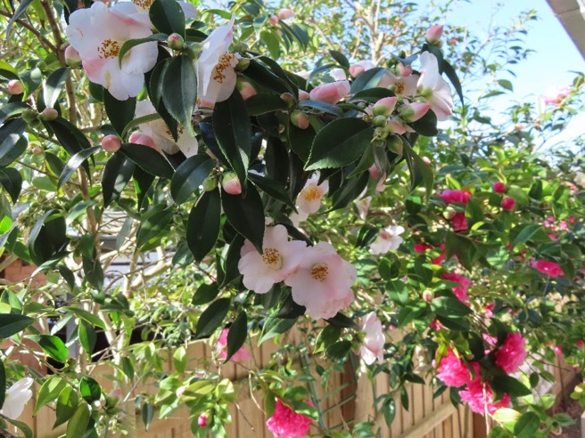
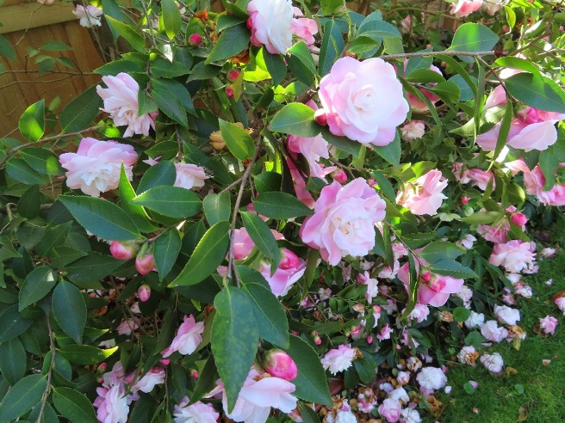
Our Winter Garden
There are lots of camellias in our winter garden. Some are light pink. Some are dark pink…
…and some are both dark and light shades of pink together.
Notes:
Author’s own photographs

Slide 32
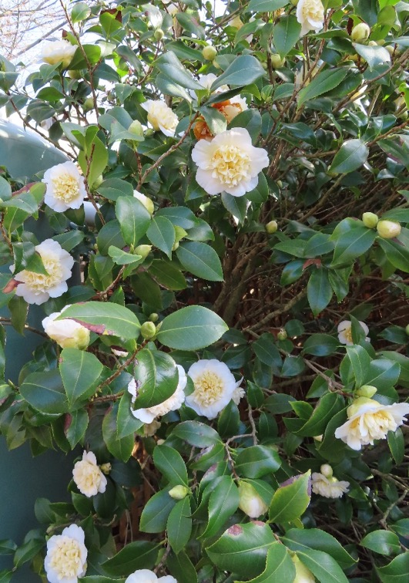
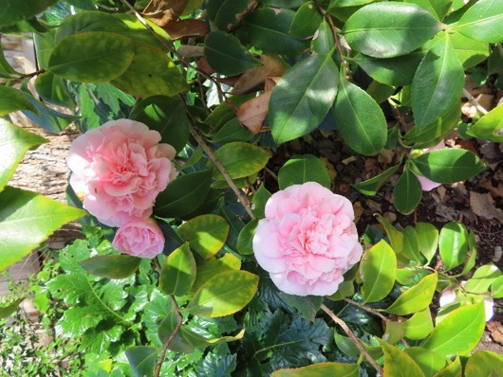
Our Winter Garden
We have white-flowered camellias and variegated camellias.
Notes:
Author’s own photographs

Slide 33
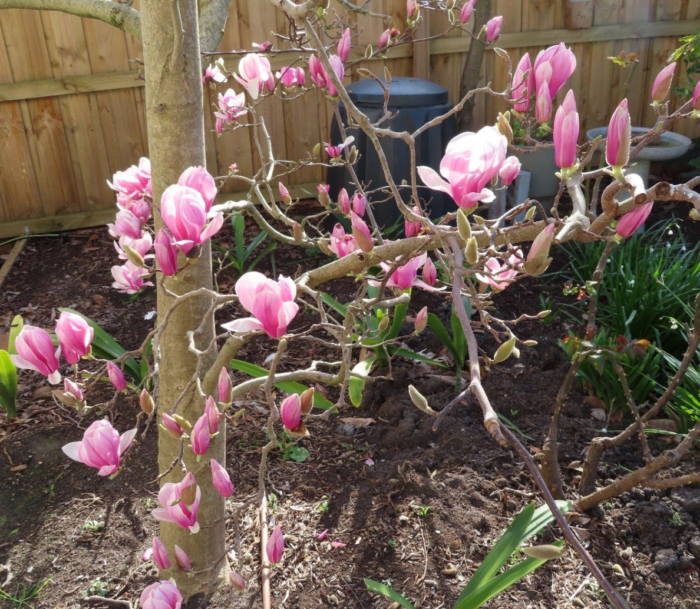
Our Winter Garden
The Magnolia almost hides the compost bin.
Notes:
Author’s own photographs

Slide 34
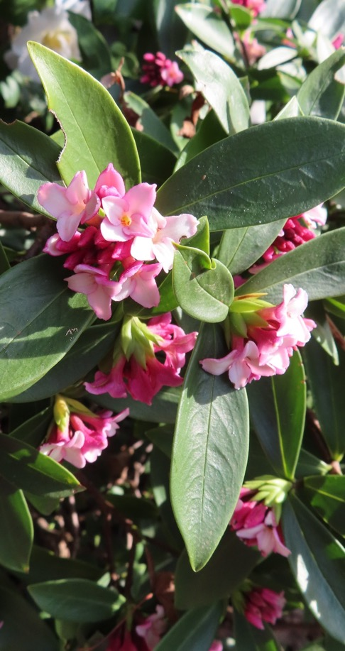
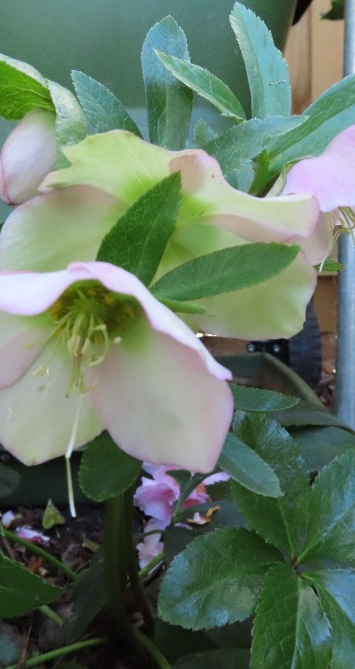
Our Winter Garden
The daphne has a delicious perfume, but it looks like insects have been feasting on the leaves.
The hellebores are delicate shades of pink.
Notes:
Author’s own photographs

Slide 35
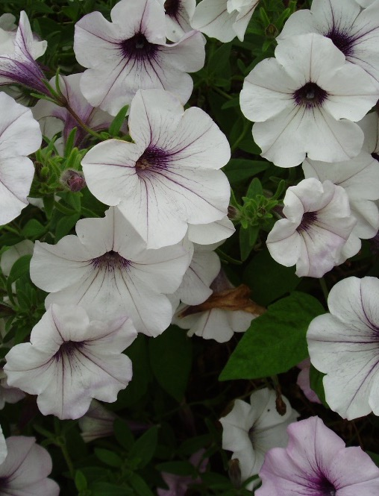


Petunias
We grow petunias in pots.
Notes:
Author’s own photographs

Slide 36

My Favourite Dahlia
We grow dahlias in many pretty colours.
Somehow, dahlias remind me of the head of a lion with a fuzzy mane.
Notes:
Author’s own photographs

Slide 37

The Rotary Club of Canterbury “Let’s Stay Connected Project” has been developed as a response to an identified need within the Aged Care sector.
At times when it’s difficult to connect in person with family and friends, the Rotary Club of Canterbury has pleasure in offering you this booklet, designed to promote conversation, recollection and engagement for those who are in isolation and without their usual social activities.
The booklets have been designed for people in an aged care residence, village or at home to read by themselves, or to have a family or staff member share the booklet with them.
You can download this and other booklets from the Rotary Club of Canterbury website (www.canterburyrotary.org).
Source references for this book are held at the Rotary Club of Canterbury. Contact president@caterburyrotary.org for further details.
Material in this book was reproduced in accordance with Section 113F of the Copyright Act (1968).

