Slide 1

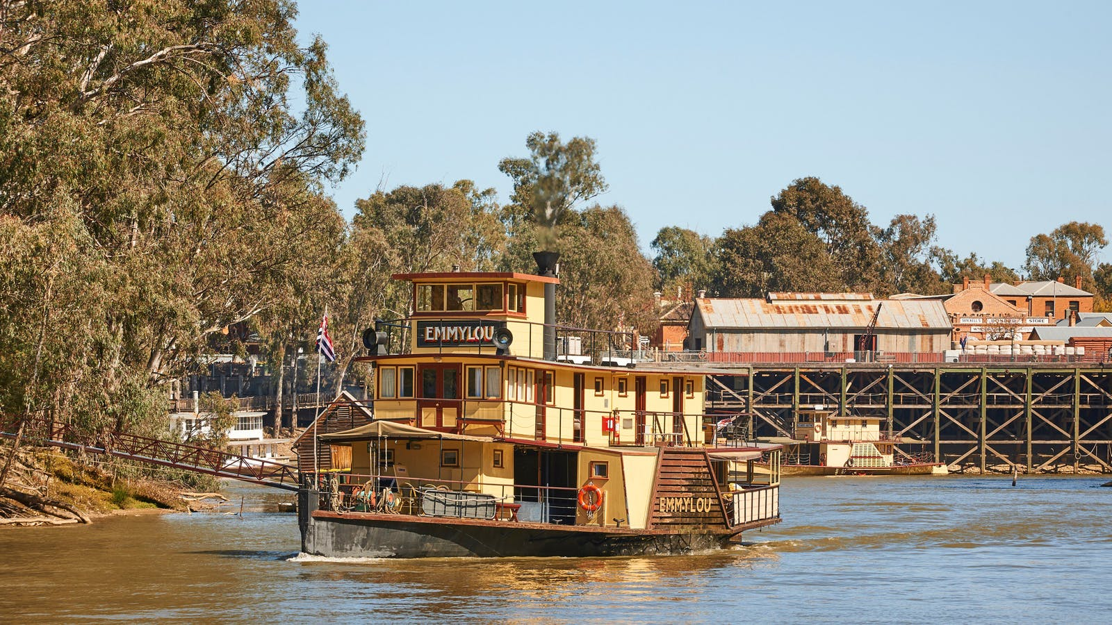
Growing up in a country town
Notes:
https://www.visitvictoria.com/regions/the-murray/things-to-do/tours/cruises-and-boat-tours/murray-river-paddlesteamers-echuca

Slide 2
The Rotary Club of Canterbury “Let’s Stay Connected Project” has been developed as a response to an identified need within the Aged Care sector.
At times when it’s difficult to connect in person with family and friends, the Rotary Club of Canterbury has pleasure in offering you this booklet, designed to promote conversation, recollection and engagement for those who are in isolation and without their usual social activities.
The booklets have been designed for people in an aged care residence, village or at home to read by themselves, or to have a family or staff member share the booklet with them.
You can download this and other booklets from the Rotary Club of Canterbury website (www.canterburyrotary.org).
Source references for this book are held at the Rotary Club of Canterbury. Contact president@caterburyrotary.org for further details.
Material in this book was reproduced in accordance with Section 113F of the Copyright Act (1968).
Notes:
https://en.wikipedia.org/wiki/Echuca

Slide 3
Hello
My name is Anne and I’m a member of the Rotary Club of Canterbury in Melbourne, Australia.
I’ve written this book based on my memories of growing up in a country town in the state of Victoria.
I hope you enjoy my story and it prompts you to recall happy moments from your childhood. I really enjoyed preparing it.
Kindest regards
Anne
Notes:
https://en.wikipedia.org/wiki/Echuca

Slide 4
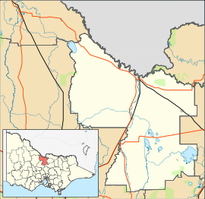
Where is Echuca?
Echuca is situated just over 200 kilometres north of Melbourne, on the Murray River.
Notes:
https://en.wikipedia.org/wiki/Echuca

Slide 5
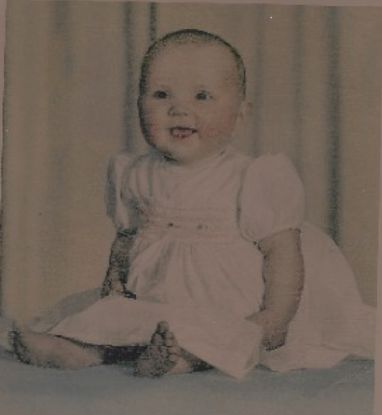
A Post War Baby
Following the horrors suffered by Australia’s population during WW2 Australia’s birth rate rose.
I was among the early ‘baby boomers’, being born in 1946 in Echuca.
I was named Anne and I am the eldest of a family of four children – three girls and a boy.
Notes:
Photo supplied by author

Slide 6
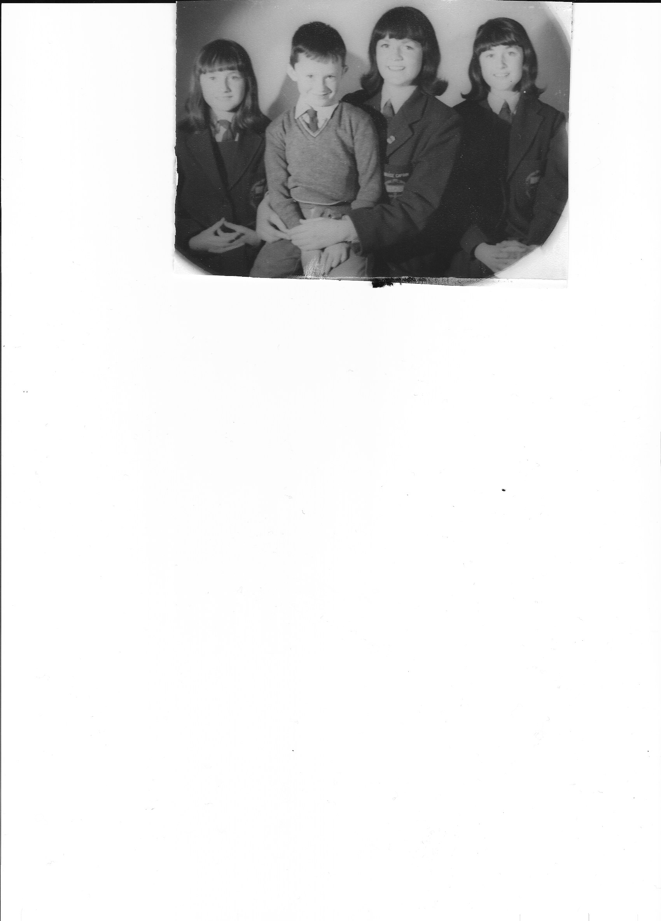
My Siblings
I have two sisters, Caryl and Ailsa and a brother Bryan. There is a total of ten years separating us.
Notes:
Photo supplied by author

Slide 7
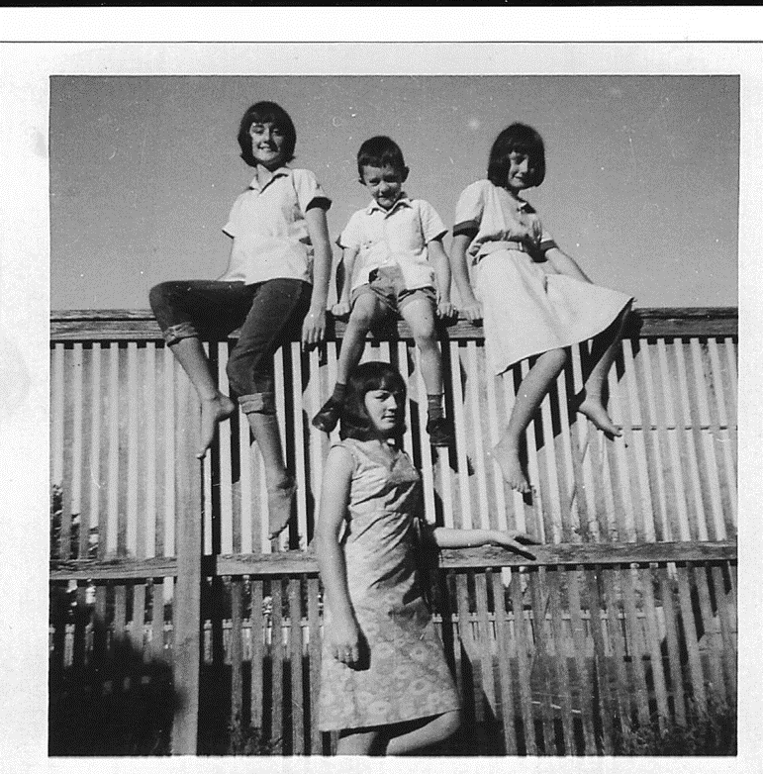
My Siblings
We loved to get into mischief, especially climbing the back fence.
Notes:
Photo supplied by author

Slide 8
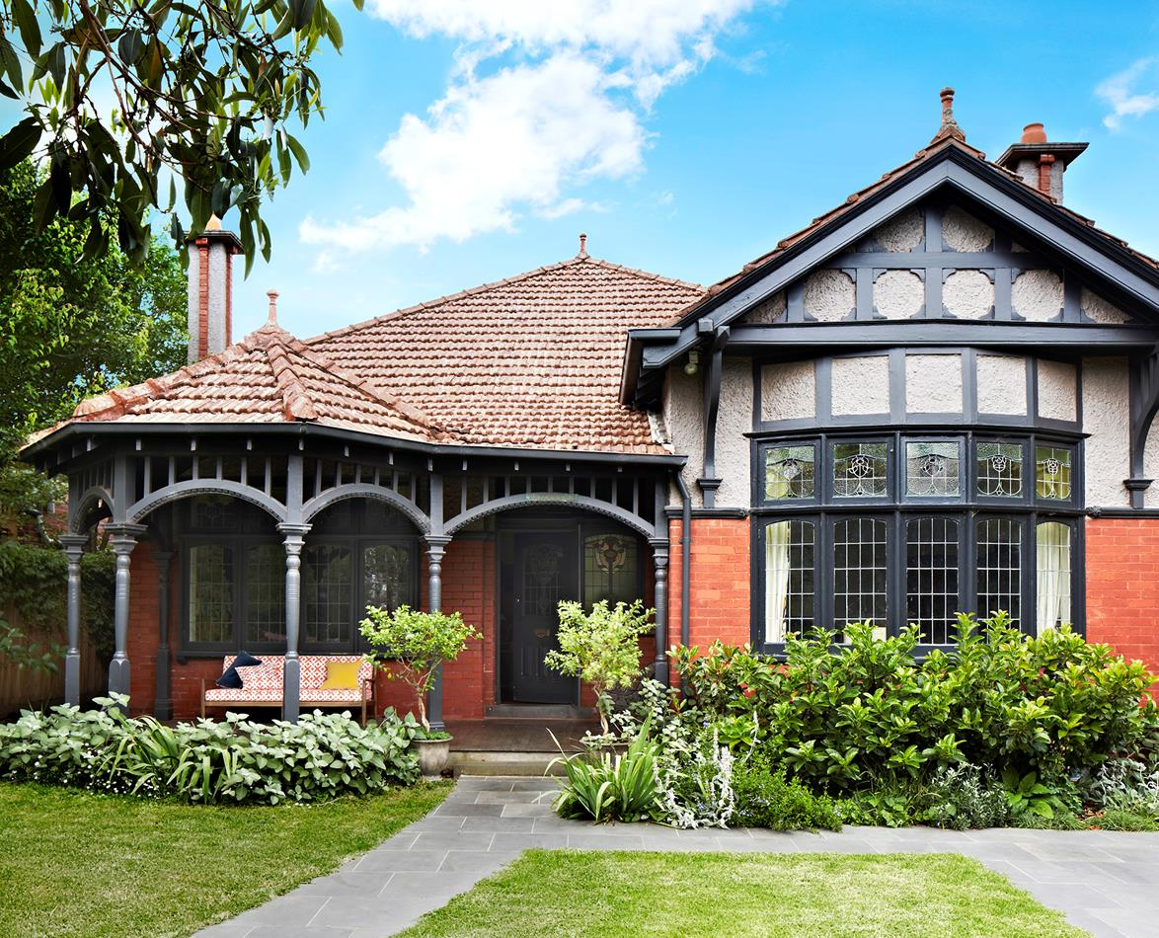
Home
We were lucky enough to grow up in a large Victorian home, with a return verandah, which went some way to shielding us from the harsh summer sun (not so warm in winter though).
The cellar was a feature, though it did flood when the nearby river, at the end of the side street, did likewise.
Notes:
https://www.homestolove.com.au/gallery-georgies-elegant-federation-house-renovation-1692

Slide 9
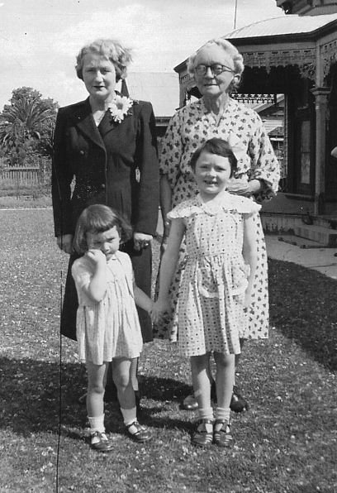
An Extended Family
My Dad, Mum and I initially shared the house with my paternal grandmother and one of dad’s younger sisters.
Nanna had a maid who came in everyday and her husband was the gardener and odd job man.
Later Dad’s sister married, and Nanna moved to live with one of her daughters in Melbourne.
Notes:
Photo supplied by author

Slide 10
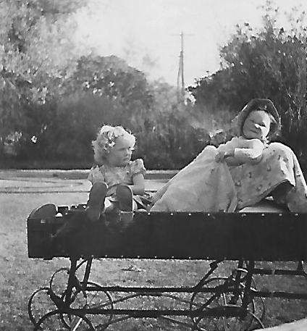
Hazy Memories
When I was thirteen months old my mother noticed I was walking with an uneven gait. Medical tests and x-rays revealed I had been born with a dislocated hip. (All newborn babies are now tested at birth and health centre visits for this).
I was placed in a “frog” plaster for 10 months, which was changed each six weeks and lived in a specially made extended pram.
I then wore calipers for a further three months. Later I had calipers fitted as I learned to walk and play again.
Notes:
Photo supplied by author

Slide 11
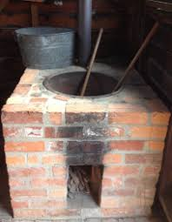
House Fittings
Down the back of the property were the former stables. As the property had been built in the late 1800’s, there was a carriage house with groom’s accommodation above. They were used as a woodshed in my younger days. Great hidey spots!
There were also large rose gardens which accommodated my grand father’s prize roses – sadly no one maintained them.
There were a few negatives too – an outside toilet, a copper for washing and a chip heater in the bathroom.
Notes:
https://sovereignhilledblog.com/2016/04/22/in-praise-of-washing-machines/

Slide 12
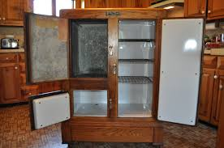
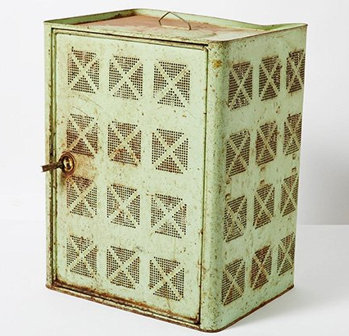
House Fittings
The ice chest and the safe with fly-wire protection were both in the large kitchen. Hot water for the dishes came from a small electric heater above the sink.
Notes:
https://blogs.sydneylivingmuseums.com.au/cook/curious-and-curiouser/meat-safe/
http://www.antiques.com/classified/1119271/Antique-Baldwin-Refrigerator-Co--Antique-Ice-Chest

Slide 13
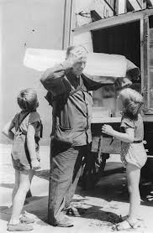
Tradesmen and Shopkeepers
The iceman came each day – he carried the blocks on his shoulder with an old sack for protection.
Notes:
https://www.wikiwand.com/en/Iceman_(occupation)

Slide 14
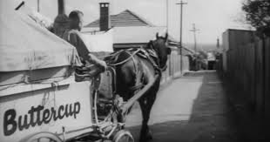
Tradesmen and Shopkeepers
The baker with his horse and cart came down the back lane. His loaves were in a basket and we could choose either a high tin or sandwich loaf.
Fresh milk was delivered daily the same way.
I used to love fresh bread with cold dripping from the roasting pan and lots of salt and pepper.
Notes:
https://startsat60.com/media/opinion/remember-when-fresh-bread-and-milk-were-delivered-to-your-door

Slide 15
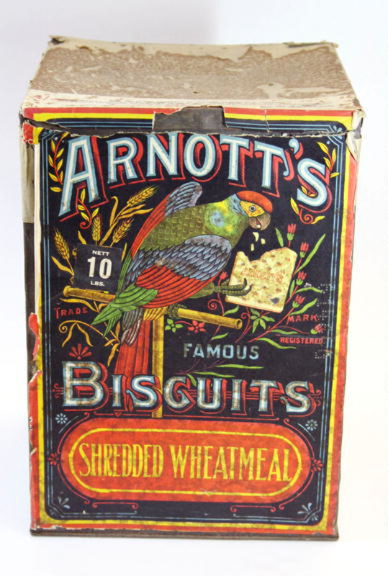
Tradesmen and Shopkeepers
The grocer would telephone each Thursday for my mother’s order and deliver it on the Friday.
My treat was three pence worth of broken biscuits.
Notes:
https://ehive.com/collections/4907/objects/507762/tin-arnotts-biscuits

Slide 16
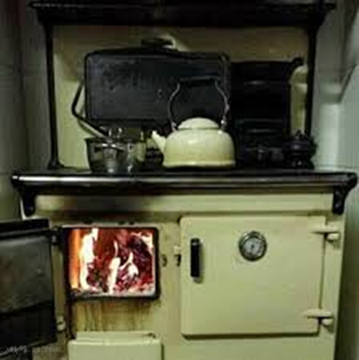
Tradesmen and Shopkeepers
Looking back, the number of grocery items was limited, but we did rely so much more on home baked goods.
Mum was a great cook, using the wood fired stove.
Notes:
https://www.google.com/search?q=olden+days+coal+stoves&rlz=1C1ASUT_enAU843AU843&sxsrf=ALeKk01iP6BPq3NzqNhGZ5RVxtdHNu1ZHw:1597804229995&tbm=isch&source=iu&ictx=1&fir=06DTEyhcvi2XwM%252Cjo6rcmLbiFzOeM%252C_&vet=1&usg=AI4_-kSC5xArVd0xKcyHJhSBIbQuol9dzA&sa=X&ved=2ahUKEwjYqLLMnKbrAhV_xzgGHZRmCbsQ9QEwB3oECAYQIw&biw=1366&bih=625#imgrc=AaSDDjRatu4BHM

Slide 17
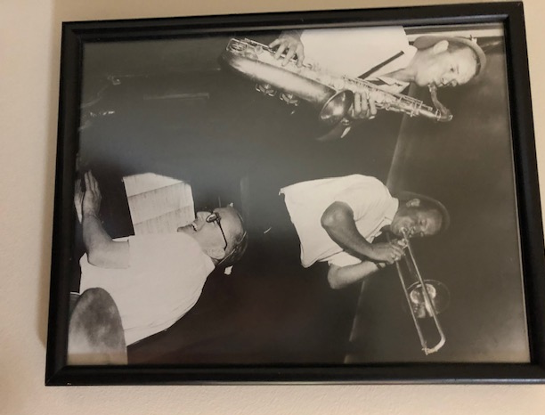
My Dad
My Dad had an accounting practice and walked or rode his bike to work each day.
He was an accomplished musician. His principal skill was at the piano, he also played the drums,
the guitar, the ukulele and the xylophone.
Dad also held several other roles: he was on the Hospital Board, the Echuca Racing Club, Echuca Athletic Committee and at the Catholic Church. He was a JP who sat on the bench each Tuesday morning.
He also had a very close relationship with the aboriginal settlement at Cumerugunga. Dad was a good man.
Notes:
Photo supplied by the author

Slide 18
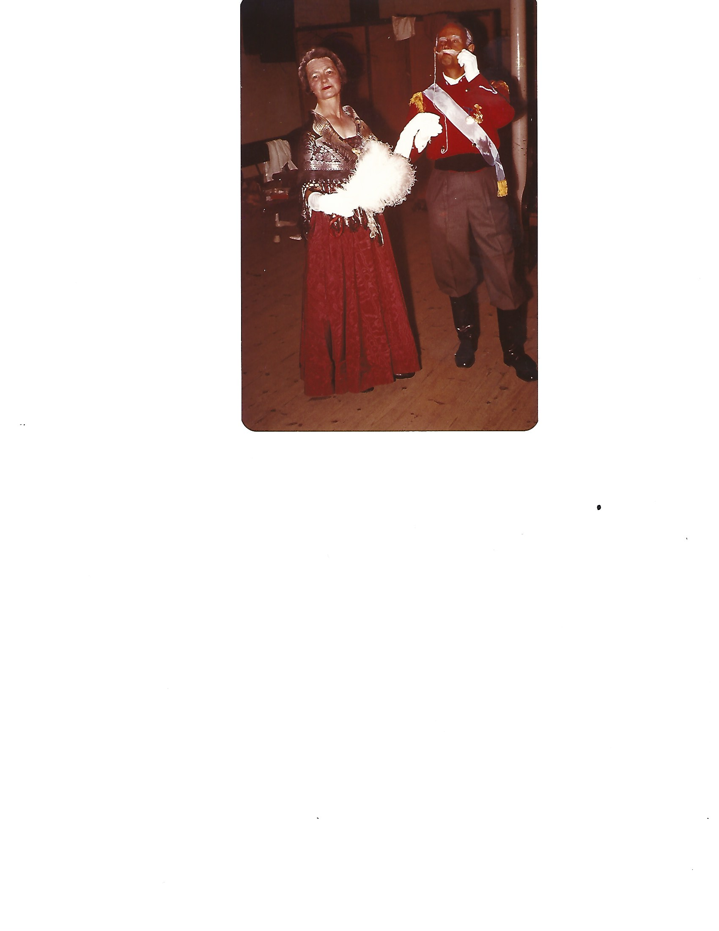
My Mum
Mum busied herself with household duties and roles on the Baby Health Centre Committee, the Catholic Women’s League and on school committees.
She reveled in depicting roles in the Echuca Drama Group. She frequently had the lead role in productions and won regional and
State awards for her performances. Public speaking, too, won her many awards.
Notes:
Photo supplied by the author

Slide 19
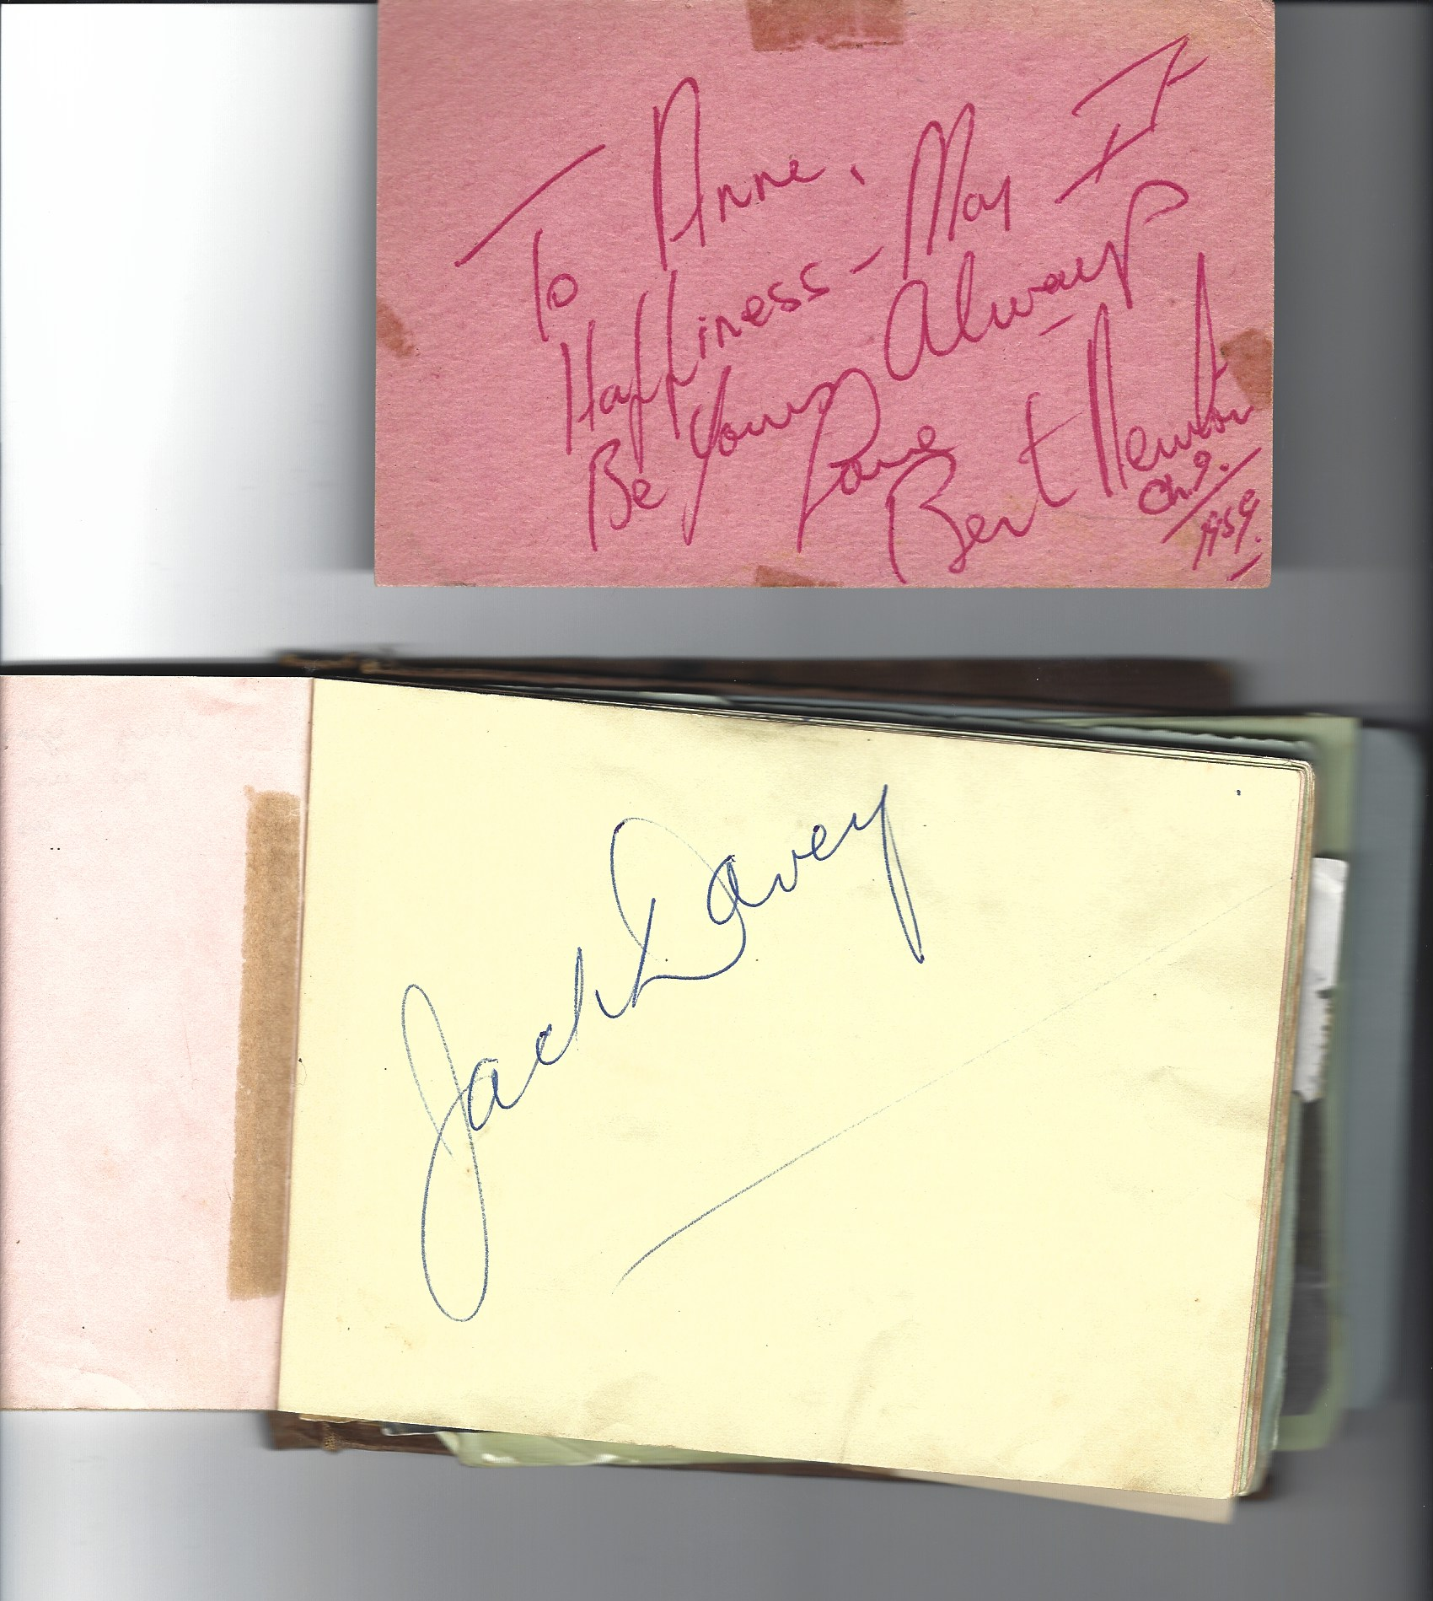
Autographs
Bert Newton and Jack Davey
I also have an autograph book from those days featuring famous vocalists who would tour country centres and sing with Dad’s band.
Notes:
Photos supplied by the author

Slide 20
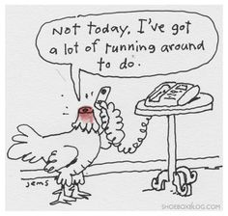
More Extended Family
Eventually the land at the back of the house was subdivided. One of Dad’s sisters, her husband and young son built a new home and came to live there. It was exciting as they kept chooks and had a dog.
Another memory is of headless chooks running around the lawn after being decapitated for human consumption, then having to pluck them.
Notes:
https://tcsblog.net/2016/01/running-around-like-a/

Slide 21
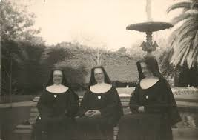
Schooldays 1951-1963
I attended the same school for the thirteen years of my education.
It was The Brigidine Convent called St Joseph’s College.
We were taught principally by nuns.
21
Notes:
Photos provided by the author

Slide 22
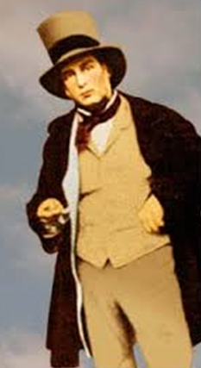
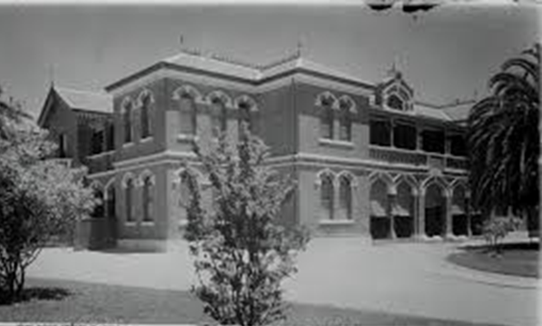
Schooldays 1951-1963
The main building was built by Henry Hopwood known as Echuca’s founder.
He operated a lucrative ferry business on the closest point of the Murray River to Melbourne.
Notes:
Photo of St Joseph's College supplied by the author.
https://www.boltonrevisited.org.uk/p-henry-hopwood.html

Slide 23
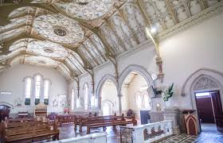
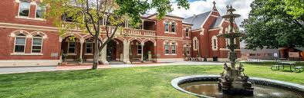
The Convent
Here is the Chapel at St Josephs and the front of the College.
The buildings and gardens were really beautiful.
Notes:
https://www.sje.vic.edu.au
https://www.sje.vic.edu.au/architecture/

Slide 24
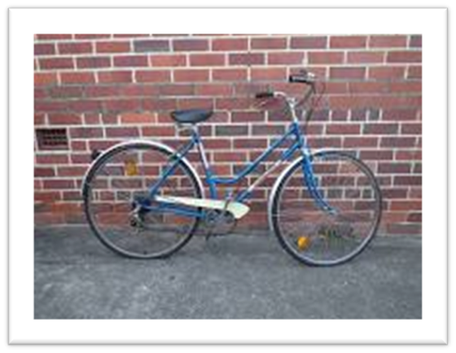
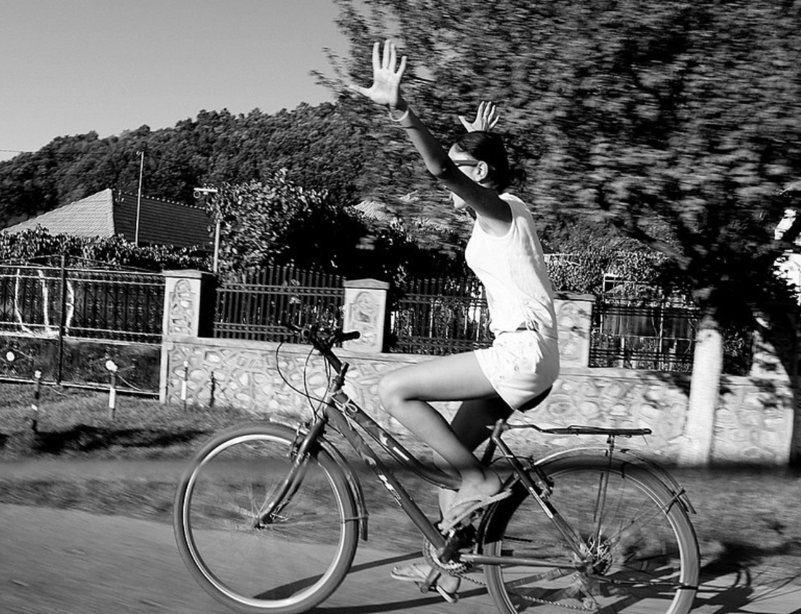

Schooldays
I walked or rode my bike, slightly over a mile, to school each day. Through primary school I rode home for lunch.
Lunch was always accompanied by the 1pm news from the ABC. Scary memories of the threat of the Korean War, agricultural news and omnipresent weather forecasts.
Notes:
https://www.abc.net.au/radio/centralvic/contact-us/
https://www.flickr.com/photos/free-stock/8425146207/in/photostream/
https://www.ebay.com.au/itm/Vintage-Malvern-Star-Bicycles-/282442553516

Slide 25
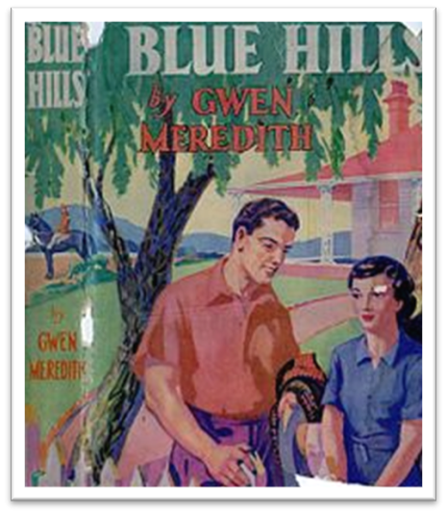
Schooldays
In the evening we listened to “Blue Hills” – a long running radio serial.
Blue Hills, created and written by Gwen Meredith, is an Australian radio serial about the lives of families, set in a fictional typical Australian country town called Tanimbla.
Notes:
https://en.wikipedia.org/wiki/Blue_Hills_(radio_serial)

Slide 26
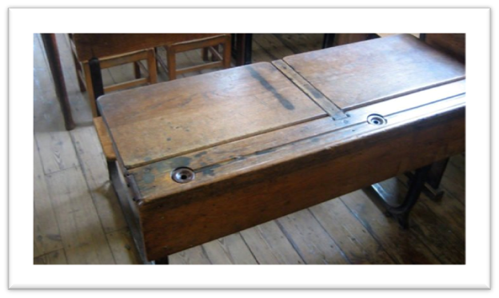
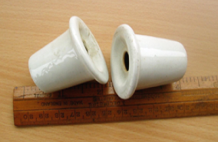
Schooldays
At school I started writing on a slate with chalk, then moved to pencil and paper and then nibbed pens dipped in inkwells.
One of my roles was to clean the inkwells from our desks, on a weekly basis.
26
We were often tormented on our way home (easily identified by our uniforms) by boys from the local school sledging us with “Catholics dogs look like frogs sitting on logs”.
Notes:
https://startsat60.com/media/opinion/nostalgia/old-school-desks-inkwell-remember
https://www.worthpoint.com/worthopedia/ceramic-school-desk-inkwells-1920s-1775227180

Slide 27
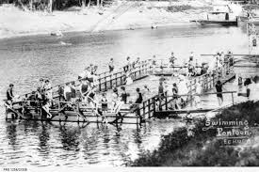
Schooldays
My schooldays were happy, and I enjoyed all aspects of my education.
We had a weekly elocution lesson from Miss Murray-Smith who travelled up each week on the train from Melbourne.
Sport was a good part of the curriculum and I loved athletics, playing on the school tennis courts and swimming lessons at the pontoon on the river.
27
Notes:
https://www.facebook.com/pg/LostEchucaMoama/photos/?tab=album&album_id=669870236364602

Slide 28
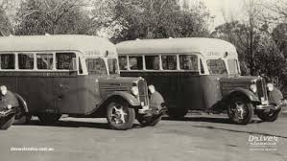
Schooldays
St Joseph’s College was also a boarding school and students who boarded came from Hay, Deniliquin, Cobram and much further afield.
Kids travelled by bus and train from other local townships such as Rochester, Gunbower, Lockington, Tongala, Kyabram and Mathoura.
As friendships developed over the years, we shared holidays at their homes and rode our bikes on weekends to the closer towns.
Notes:
https://www.driverbuslines.com.au/about-us/company-history

Slide 29
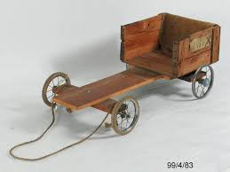
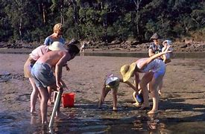
Recreation and Fun
These are some of the things I remember from my childhood:
billy-carting | dress-ups
hidey | bike riding
yabbying | mushrooming
swimming
We had to take salt to the sandbank to get rid of the leeches.
Notes:
https://collection.maas.museum/object/167251
http://sstb2007.blogspot.com/2012/11/pittwater-palm-beach-and-balmoral.html

Slide 30
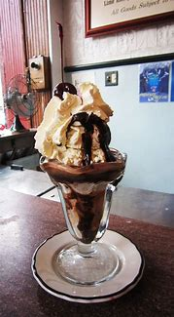
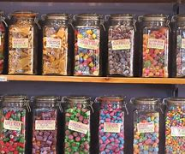
Recreation and Fun
Our favourite take-a-way food was sixpence worth of fish and chips after a hard day at the river!!!
I also loved having a chocolate sundae from the Tarax bar.
But my favourite treat was 3 pence worth of mixed lollies, including liquorice blocks – yum!!!
Notes:
https://www.freepngimg.com/food/grocery/ratings/page/13
https://i.pinimg.com/originals/94/d8/e7/94d8e7698757ff797db4acc41f67059b.jpg

Slide 31
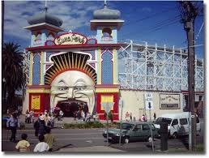
School Holidays
At least twice each year we travelled to Melbourne for fun-filled holidays and stayed with my grandparents
My grandmother was a school-teacher and my grandfather (a World War 1 Totally and Permanently Incapacitated veteran) worked at the munitions factory in Maribyrnong. We stayed with our Grandmother and Grandfather who lived in Maribyrnong.
We went to pantomimes and Luna Park in St Kilda.
Notes:
https://www.family-getaways-melbourne.com/luna-park-melbourne.html

Slide 32
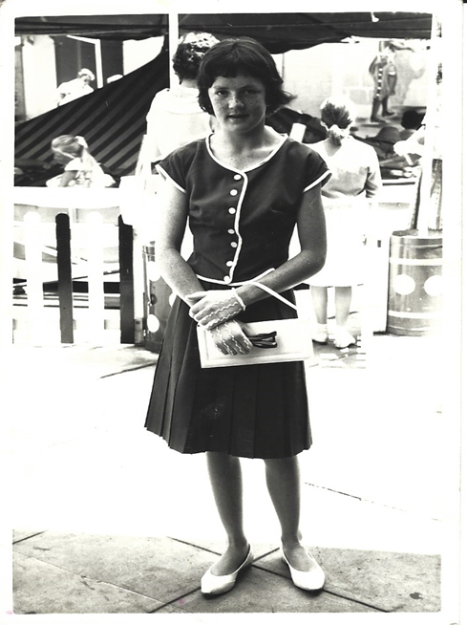
School Holidays
We had tram rides to the city, lunch at Russell St, Collins St or the Myer Mural Hall.
We saw the Christmas Carnival on the Myer rooftop.
My favourite time was when we bought beautiful new clothes.

Slide 33
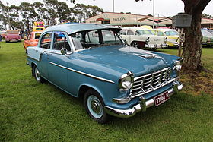
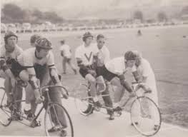
Teenage Years
We still rode our bikes everywhere. Our first car came in 1959 and was an FC Holden.
We played tennis and basketball, but swimming dominated. Tennis was played on the grass courts at Echuca.
The bike riding carnival and athletics all made weekends busy.
We went to Saturday night dances with the current rock tunes; the fun didn’t kick off until the pubs closed in Moama, across the border, at 10 o’clock.
Notes:
https://en.wikipedia.org/wiki/Holden_FC
Photo supplied by the author

Slide 34
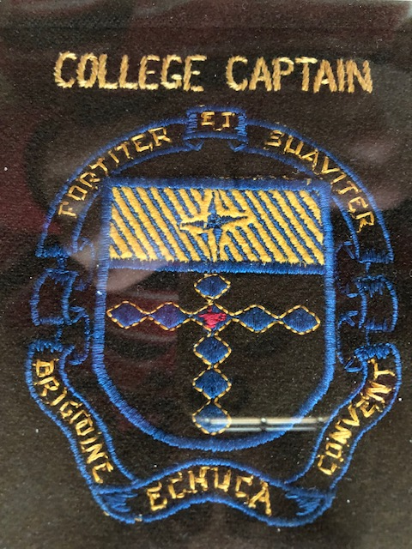
Final School Days
I was made a prefect and Captain of the School House “Kildare” in my Leaving year and School Captain in my Matriculation year.
School classes got smaller and smaller in those final years (by then we had become co-ed) and there were only ten of us in Matric.
Notes:
Photo supplied by the owner

Slide 35
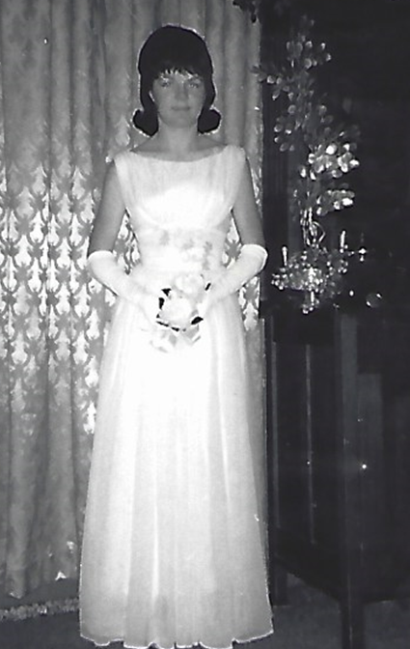
Final School Days
I was suspended twice in my senior years, once for wearing shorts in a Junior Olympics event.
The second time was for refusing to do PE, along with my girlfriends, on our debutante day. This was the completion of my secondary schooling and I loved my first formal dress.
I moved to Melbourne to continue my education and here I am over 70 years later.
Notes:
Photo supplied by the author

