Slide 1
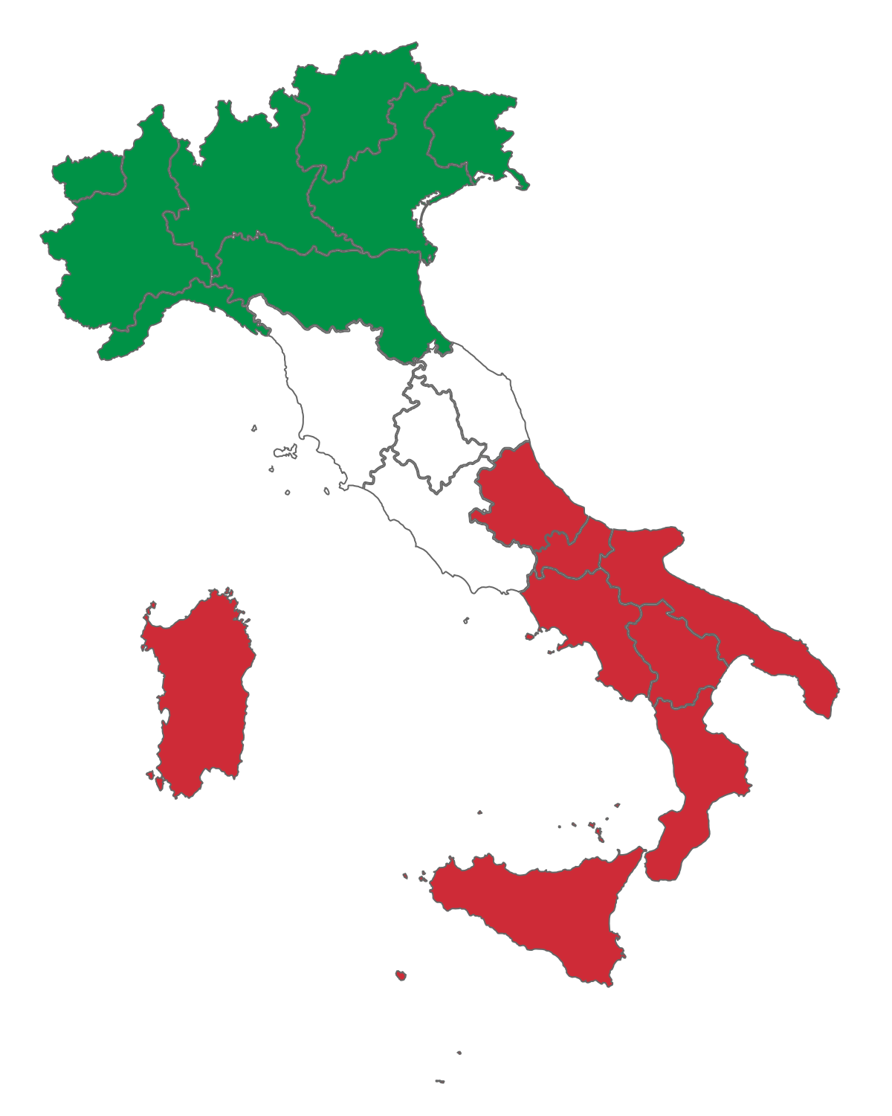
Bella Italia Festivals
Notes:
https://commons.wikimedia.org/wiki/File:Flag_map_of_Italy_with_regions.png

Slide 2
Hi
My name is Val and I’m a member of the Rotary Club of Canterbury.
It’s been fun researching some of the famous festivals in Italy for you. It’s reminded me of time spent in Italy.
Kind regards
Val

Slide 3
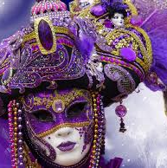
Carnevale in Venice
As the saying goes, “A Carnevale ogni scherzo vale”. When it’s carnival time, anything goes.
Notes:
https://www.worldtravelconnector.com/venetian-carnival/

Slide 4
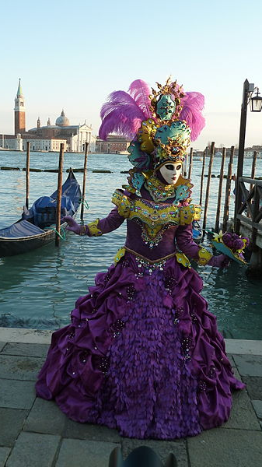
Carnevale in Venice
Carnevale is held in Venice in the weeks leading up to Easter. It finishes with a big final party the day before Ash Wednesday, on Shrove Tuesday.
Notes:
https://commons.wikimedia.org/wiki/File:Carnival_venice_2015_036.JPG

Slide 5
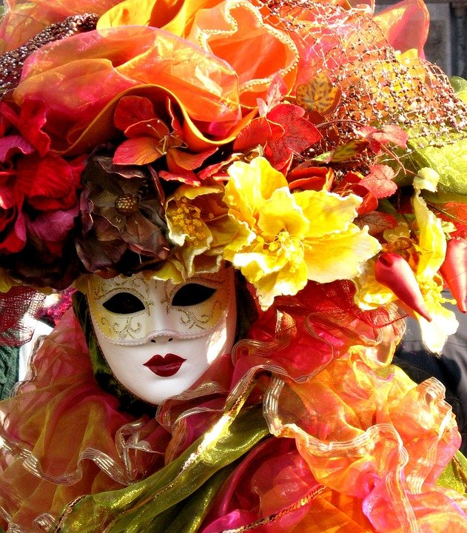
Carnevale in Venice
The festival is world-famous for its elaborate masks. There is a contest for “la maschera più bella” (the most beautiful mask) judged by a panel of international costume and fashion designers.
Notes:
https://cdn.pixabay.com/photo/2017/01/28/05/23/venice-2014734_960_720.jpg

Slide 6
Carnevale in Venice
In Italy, each region has its own Carnevale pastries deriving from the ancient Roman frictilia, prepared during spring festivals.
In the Veneto region the special pastries are crostoli, galani and frittelle.
Notes:
https://gianlucadotti.files.wordpress.com/2012/12/1024px-buc3b1uelos_-_juantiagues.jpg

Slide 7
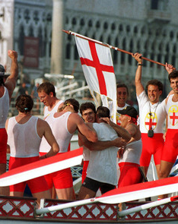
Palio delle Quattro Antiche Repubbliche Marinare
The Regatta of the Four Ancient Marine Republics festival is a sporting event recalling the rivalry of the famous Italian maritime republics: Amalfi, Pisa, Genoa and Venice.
Notes:
ttps://www.ilmugugnogenovese.it/regata-delle-repubbbliche-marinare-venezia-2019/

Slide 8
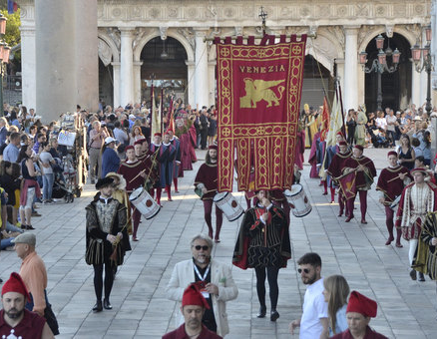
Palio delle Quattro Antiche
Repubbliche Marinare
The festival is held every year between the end of May and the beginning of July.
The regatta is preceded by an historical procession, through the streets of the organising city.
Notes:
https://www.ilgazzettino.it/nordest/venezia/palio_repubbliche_marinare_2019_venezia-4530836.html

Slide 9
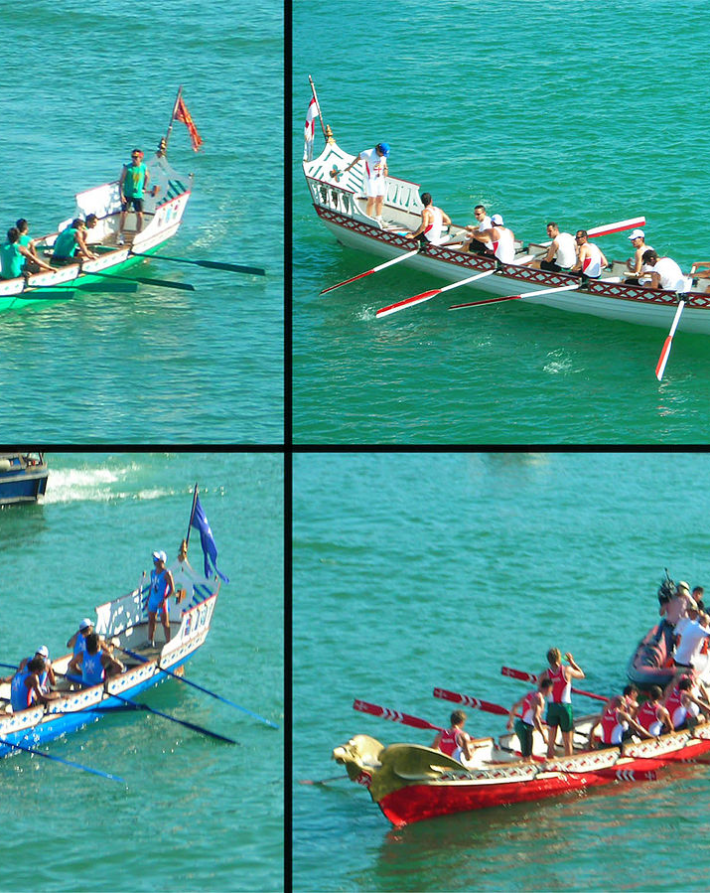
Palio delle Quattro Antiche Repubbliche Marinare
The festival is hosted in rotation between the four ancient rival maritime cities: Pisa, Venice, Amalfi, and Genoa.
Four rowing crews representing each of the republics compete against each other.
Notes:
https://en.wikipedia.org/wiki/Regatta_of_the_Historical_Marine_Republics

Slide 10
Palio delle Quattro Antiche
Repubbliche Marinare
These flags show the coat of arms of the four maritime republics (clockwise from the upper left): Venice, Genoa, Pisa, and Amalfi.
Notes:
https://en.wikipedia.org/wiki/Regatta_of_the_Historical_Marine_Republics

Slide 11
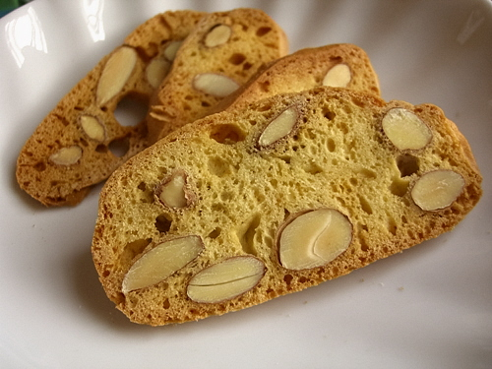
Palio delle Quattro Antiche
Repubbliche Marinare
If you’ve attended the Palio delle Quattro Antiche Repubbliche Marianare while in Pisa, then you may enjoy some biscotti after the boat race.
Notes:
https://farm3.static.flickr.com/2224/2214289848_d78ffb0175_o.jpg

Slide 12
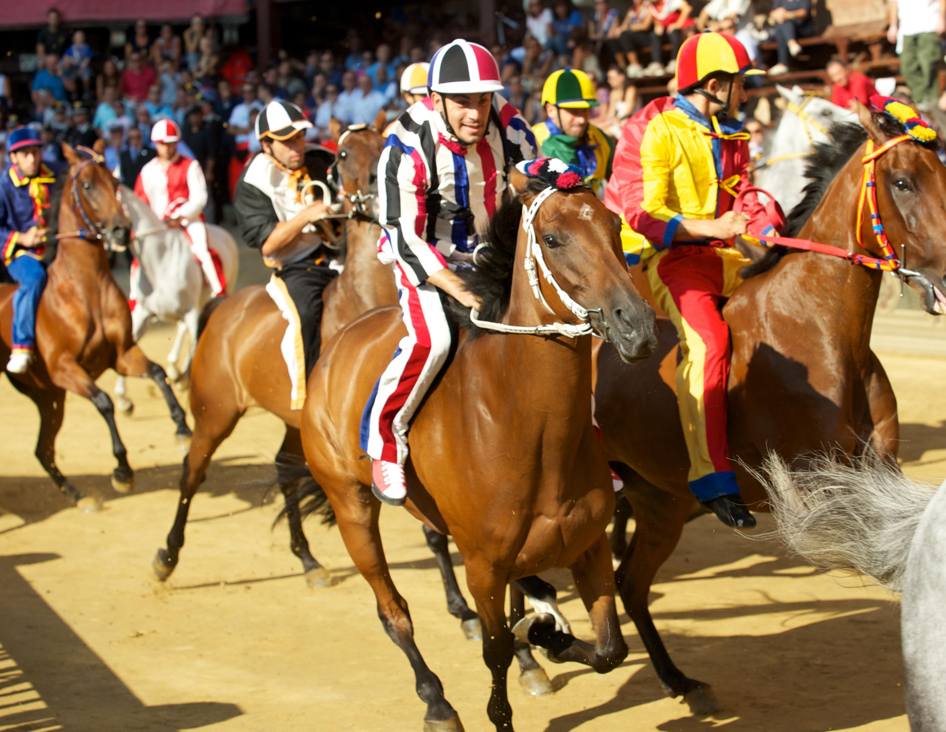
Il Palio di Siena
The Palio is a horse race in Siena, where the various "contrade" (city areas) challenge each other. Each Contrada has its own unique emblem and colours and represents an area of the city.
Notes:
https://upload.wikimedia.org/wikipedia/commons/0/0b/Palio_di_Siena_-_Assunta_2011_-_Istrice_2.jpg

Slide 13
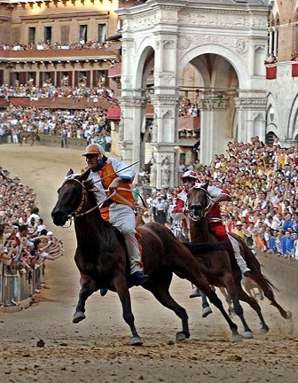
Il Palio di Siena
The Palio is held in Piazza del Campo, Siena’s main medieval, shell-shaped square.
It is held twice a year: in July (Palio of Provenzano) to honour the Madonna of Provenzano and in August (Palio of the Assumption) to honour the Virgin Mary's Assumption.
Notes:
https://i0.wp.com/www.labrujulaverde.com/wp-content/uploads/2010/07/i.telegraph.co_.uk_1.jpg?ssl=1

Slide 14
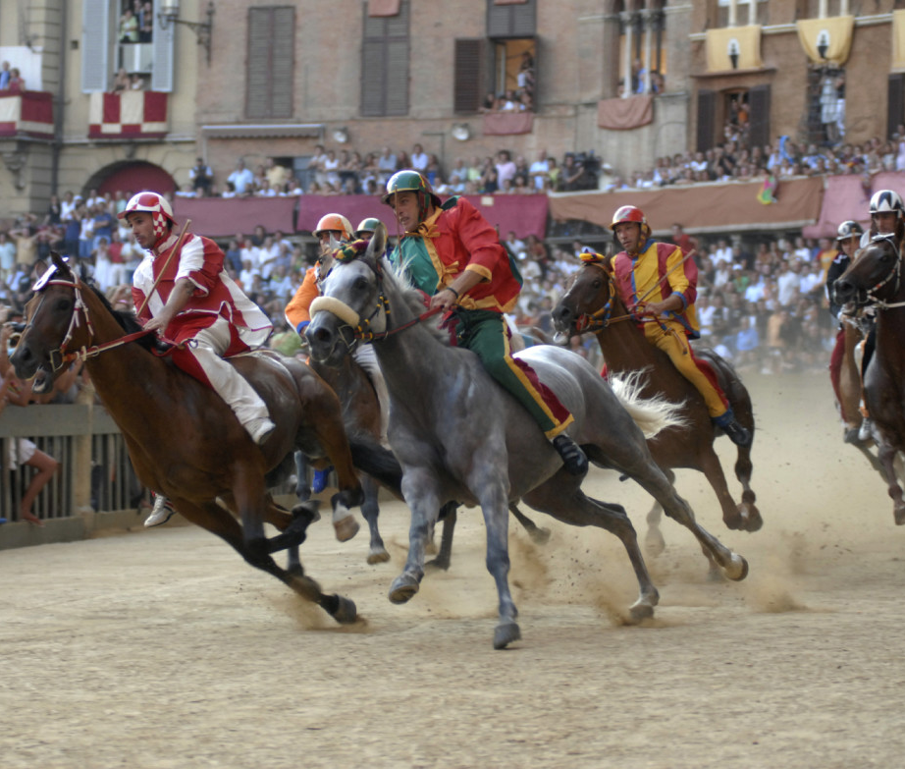
Il Palio di Siena
Bareback riders race the horses at full speed around the narrow track in the square.
It can be very dangerous for riders and spectators.
Notes:
http://www.sienanews.it/wp-content/uploads/2017/01/siena.06.jpg

Slide 15
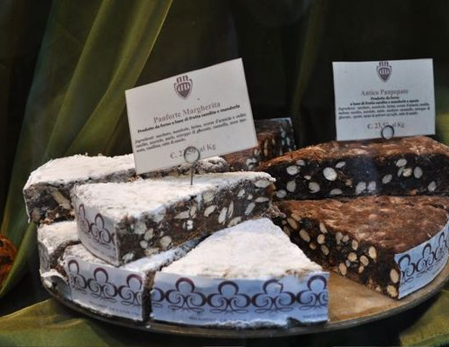
Il Palio di Siena
If you were visiting Siena for the Palio, you would need to try the local delicacy, panforte.
The original desert was composed of wheat flour, honey, spices, dried figs, jam, pine nuts and was flavored with pepper.
Notes:
https://briciole.typepad.com/.a/6a00d835508b1869e20120a6588211970c-600wi

Slide 16
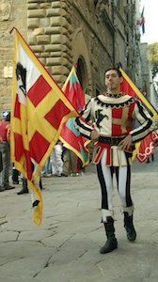
Flag Throwing in Tuscany
The tradition of flag throwing is thought to have arisen from medieval battle. The flag carrier was one of the most important soldiers on the field of battle, carrying of the symbol of the army.
If the flag carrier was overcome in battle, he would throw the flag to a comrade and so began the practice of hurling the banner high in the sky to land safely in the hands of another.
Notes:
https://www.italymagazine.com/featured-story/italian-institutions-flag-throwers

Slide 17
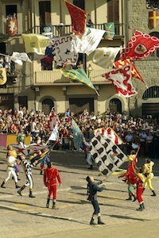
Flag Throwing in Tuscany
Flag throwing is often a major part of historical costume festivals that are one of the great attractions of Tuscany and, indeed, of all Italy.
The art of flag throwing dates back to medieval guilds. A guild's banner or flag was considered a symbol of purity, and as such it was not allowed to touch the ground.
Notes:
https://www.italymagazine.com/featured-story/italian-institutions-flag-throwers

Slide 18
Flag Throwing in Tuscany
The performers are known as “sbandieratori” and are usually young men, but more young women are taking part.
They dress in mediaeval costume and are usually accompanied by “tambura” (drummers) and sometimes “trombettieri” (trumpeters).

Slide 19
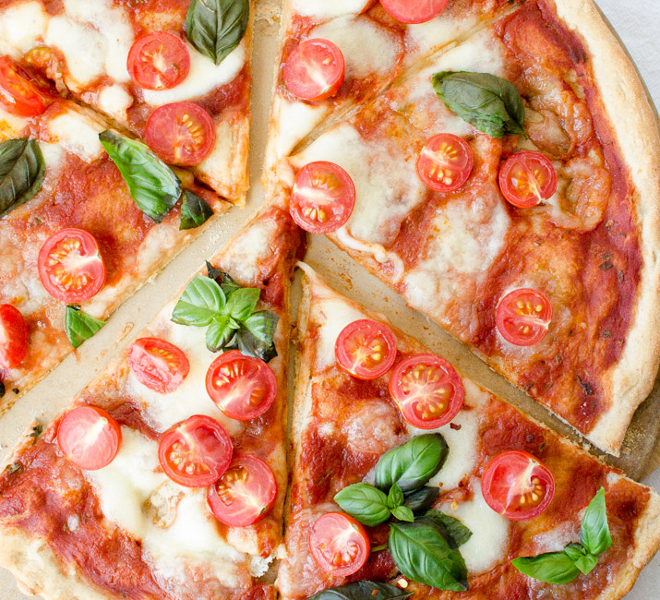
Festivals in Italy
What better way to end a presentation on festivals in Italy, than by having a large slice of pizza.
Enjoy!
Notes:
http://www.veryeatalian.com/wp-content/uploads/2015/03/Pizza-Margherita-with-Cherry-Tomatoes-veryEATalian-2.jpg

Slide 20
The Rotary Club of Canterbury “Let’s Stay Connected Project” has been developed as a response to an identified need within the Aged Care sector.
At times when it’s difficult to connect in person with family and friends, the Rotary Club of Canterbury has pleasure in offering you this booklet, designed to promote conversation, recollection and engagement for those who are in isolation and without their usual social activities.
The booklets have been designed for people in an aged care residence, village or at home to read by themselves, or to have a family or staff member share the booklet with them.
You can download this and other booklets from the Rotary Club of Canterbury website (www.canterburyrotary.org).
Source references for this book are held at the Rotary Club of Canterbury. Contact president@caterburyrotary.org for further details.
Material in this book was reproduced in accordance with Section 113F of the Copyright Act (1968).

