Slide 1
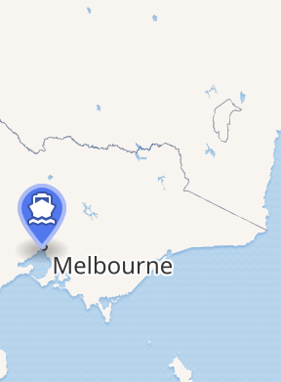

GROWING UP IN MELBOURNE
Notes:
https://en.wikipedia.org/wiki/Port_of_Melbourne#/map/0

Slide 2
The Rotary Club of Canterbury “Let’s Stay Connected Project” has been developed as a response to an identified need within the Aged Care sector.
At times when it’s difficult to connect in person with family and friends, the Rotary Club of Canterbury has pleasure in offering you this booklet, designed to promote conversation, recollection and engagement for those who are in isolation and without their usual social activities.
The booklets have been designed for people in an aged care residence, village or at home to read by themselves, or to have a family or staff member share the booklet with them.
You can download this and other booklets from the Rotary Club of Canterbury website (www.canterburyrotary.org).
Source references for this book are held at the Rotary Club of Canterbury. Contact president@caterburyrotary.org for further details.
Material in this book was reproduced in accordance with Section 113F of the Copyright Act (1968).

Slide 3
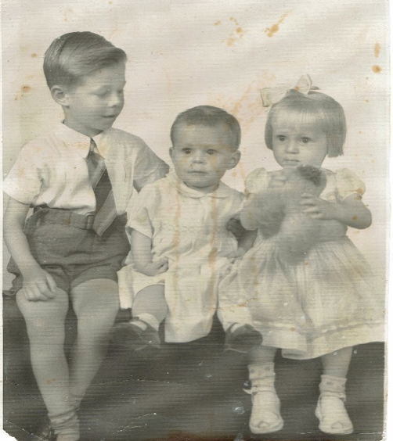
Growing up in Melbourne
Hi, My name is Val.
I know that we can’t meet but perhaps I can share some of my precious memories with you …. and help you to reflect on some of the good times of your childhood and life.
This is me as a toddler with my two brothers, Raymond and Jim.
Notes:
1. Photo Supplied by author

Slide 4
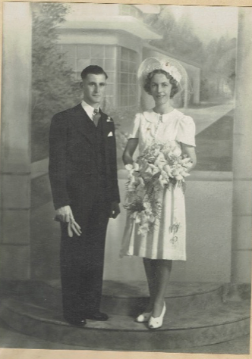
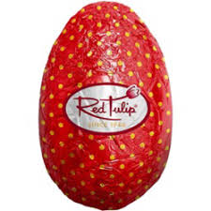
My Mum and Dad
My mother, Ruby, was a wonderful Mum. Her father died when she was 10 and she went to work in a paper bag factory when she was 14 to help her family. Mum always worked hard.
My father, Charlie, was a loving, hardworking Dad too. He started work early making chocolates at Besters . Later he worked at Red Tulip Chocolates, making Easter Eggs.
Easter was always fun at our house
Notes:
1. Photo supplied by author
2. https://www.google.com/imgres?imgurl=https%3A%2F%2Fwww.eastereggwarehouse.com.au%2Fwp-content%2Fuploads%2F2018%2F06%2FRed-Tulip-Hollow-Egg-50g.jpg&imgrefurl=https%3A%2F%2Fwww.eastereggwarehouse.com.au%2Fproduct%2Fred-tulip-hollow-egg-50g%2F&tbnid=ZrvIbo-IJbkF5M&vet=12ahUKEwiblsDU9M7rAhW-CrcAHZvZDgwQMygDegUIARC1AQ..i&docid=nDPducHCb-LuqM&w=709&h=886&q=red%20tulip%20easter%20eggs&ved=2ahUKEwiblsDU9M7rAhW-CrcAHZvZDgwQMygDegUIARC1AQ

Slide 5
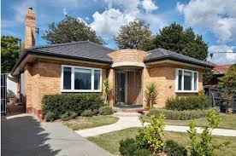
Growing up in Burwood.
My parents worked day and night to save up enough money to build a house in Highbury Road, Burwood. We were so proud of that house! ….
It was only a small 2 bedroom house and at first, my brothers slept in the dining room. Later Mum and Dad saved more money and bought a caravan. It was great! Ray and Jim slept in it during the year….. And we used it for holidays in the Summer.
We had good times and our parents taught us the importance of hard work.
Notes:
https://secretdesignstudio.com/render-brick-home-tribute-triple-fronted-blonde-brick-veneer-home/

Slide 6
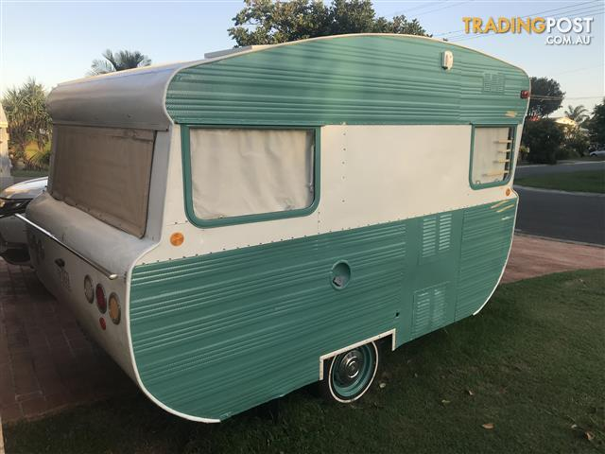
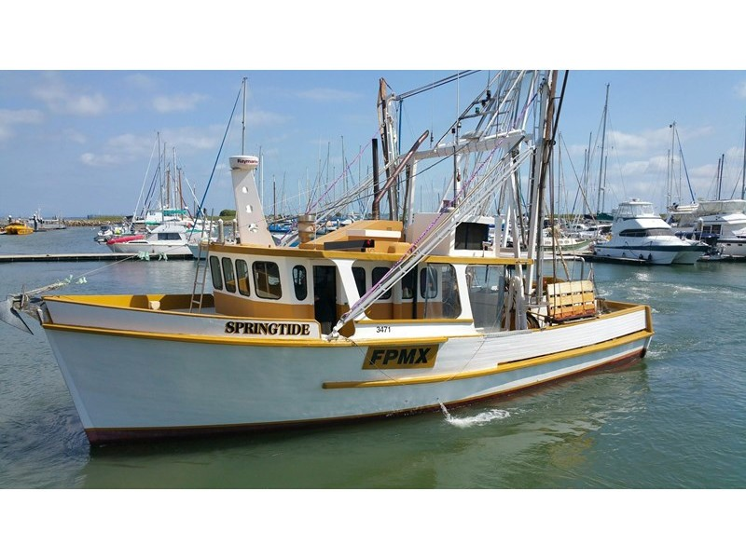
Holidays in the caravan
Our best holidays were in Eden, NSW. Our cousins lived there and our favourite uncle had a fishing trawler. We would go to the beach every day and sometimes our families would pack a picnic and we would all go fishing.
Once I had my birthday party on the boat. Great fun for a while, but we had to come home because we were seasick.
Notes:
https://www.google.com/url?sa=i&url=https%3A%2F%2Fwww.tradingpost.com.au%2FCaravans%2FCaravans-%2F1960-s-VINTAGE-VISCOUNT-10Ft-CARAVAN%2FRedlandBay%2FQLD%2FAdNumber%3D657CGT&psig=AOvVaw3lElkKt04X33KmSkcaKRT_&ust=1599288869959000&source=images&cd=vfe&ved=2ahUKEwjst5W59c7rAhXpBbcAHQ5IBcAQr4kDegUIARCnAQ
2. https://www.tradeaboat.com.au/details/2260-1983-trawler-timber
https://www.tradeaboat.com.au/storage/images/items/2257/01-l.jpg?ts=2019-09-24%2018:45:26
https://www.tradingpost.com.au/Caravans/Caravans-/1960-s-VINTAGE-VISCOUNT-10Ft-CARAVAN/Redland-Bay/QLD/AdNumber=657CGT

Slide 7
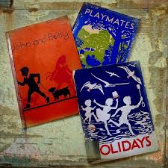
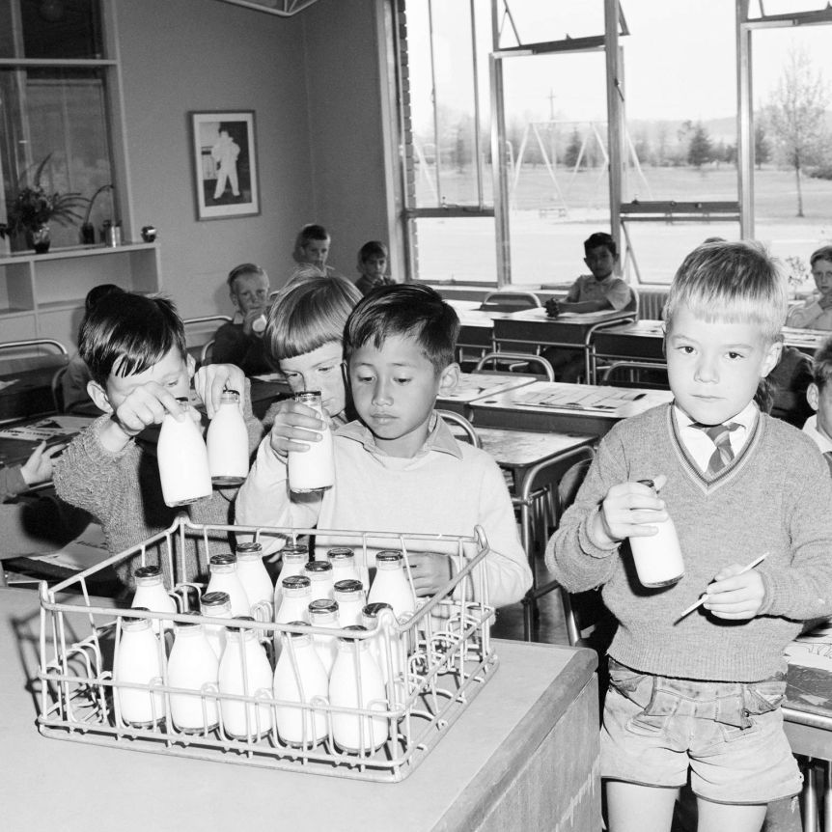
School Days
Remember our first readers?
I can remember being smacked by the teacher for writing my letters backwards.
That would not happen today.
And what about Playtime milk?
I loved the milk, but
sometimes it was left in the sun and was warm….Yukk!
Notes:
https://www.google.com/search?q=milk+in+schools+australia&rlz=1C1ASUT_enAU843AU843&sxsrf=ALeKk00dXvD8IZsnzLFNj2w67Oez-A7jZA:1597286536453&source=lnms&tbm=isch&sa=X&ved=2ahUKEwiHiPCElJfrAhUXzTgGHeNQAvUQ_AUoAXoECA0QAw&biw=1112&bih=615#imgrc=3HxC7rWZAR0rFM
https://encrypted-tbn0.gstatic.com/images?q=tbn%3AANd9GcRS3gjlvLUBw3-MZSKBOYLaok4zT5Sq_DQGgg&usqp=CAU

Slide 8
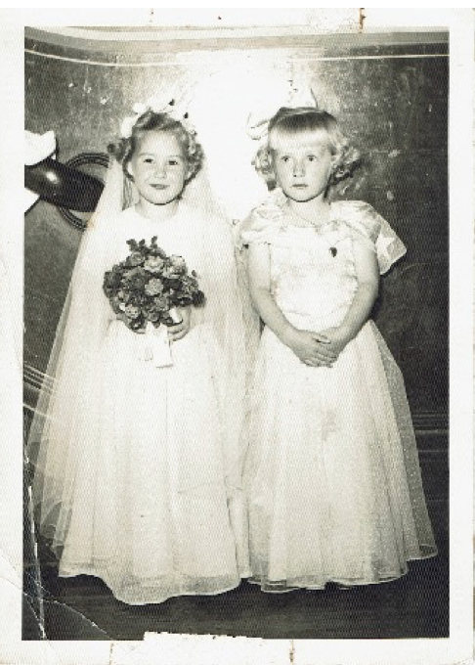
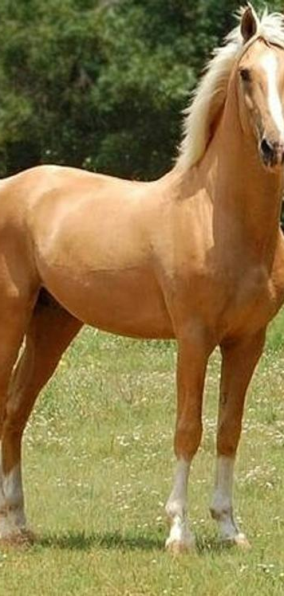
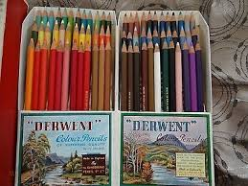
School Events
I clearly remember the school concert.
My best friend, Dorothy, was the bride and I was the bridesmaid.
I don’t look very happy about that, do I?
Later on in Primary School, my best friend Claire not only had a full set of 72 Derwent Pencils but she also had her own pony. Life can be disappointing sometimes!!! But Claire was nice.
Notes:
Photo supplied by the author
https://i.pinimg.com/originals/af/46/58/af4658dd02b3ce0c84f31ee221381cb2.jpg
https://www.worthpoint.com/worthopedia/vintage-derwent-coloured-pencils-521884671

Slide 9
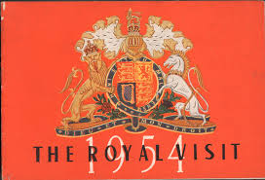
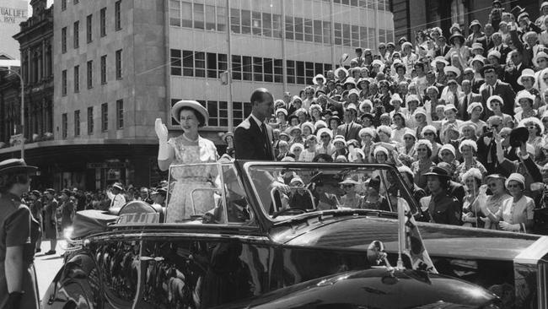
Special Events
In 1954 the Queen came to Melbourne. We lined the street and waved our flags as she drove by.
Notes:
https://cdn.newsapi.com.au/image/v1/7a043c864bb477428ed14508273fe519?width=650
https://www.flickr.com/photos/statelibraryqueensland/6868548847

Slide 10
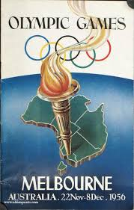
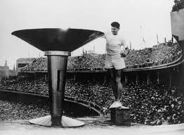
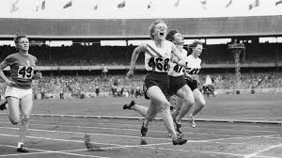
The Olympic Games
Then in 1956, the Olympic Games was held in Melbourne.
Ron Clark lit the Olympic Flame and
Betty Cuthbert won a Gold Medal.
Notes:
https://www.sportspages.com/shop/olympics_athletics/booklets/general_Olympics
https://www.smh.com.au/sport/athletics/clarke-ran-on-despite-burns-20150617-ghpuxf.html
https://en.wikipedia.org/wiki/Betty_Cuthbert

Slide 11

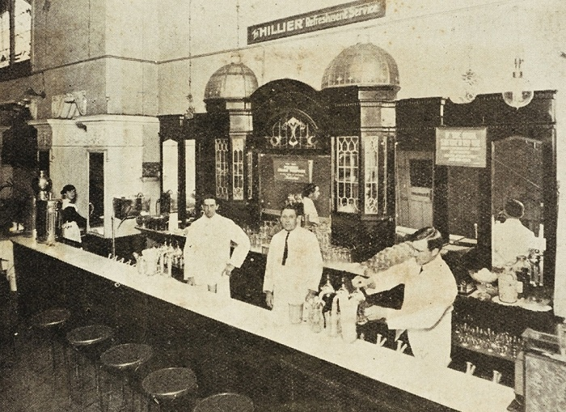
Other Special Times
For me, the highlight of a shopping trip to the city with my mother was our final stop. Ernest Hillier’s Café, beside the Regent Theatre, in Collins Street.
Ernest Hillier made Australia’s first chocolates in 1914.
Notes:
https://www.nbaa.com.au/award-nominees-date/1/2012-03-01
2. https://www.pinterest.com.au/pin/377528381237781500/?nic_v2=1a5f6n4id

Slide 12
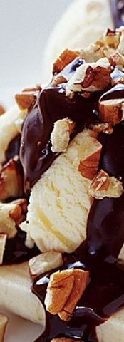
I fondly remember my favourite…..
A Chocolate Milkshake and a Banana Split, with chocolate sauce and peanuts.
I guess I didn’t eat dinner those nights.
Notes:
1. https://www.taste.com.au/recipes/homemade-chocolate-sauce/a2776d49-d317-45c1-9ae9-13cb149b6d44

Slide 13
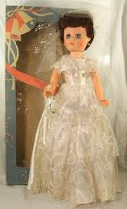
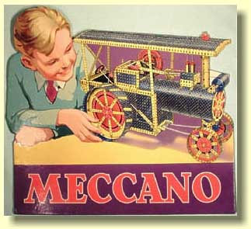
My Favourite Toys
In the 1950s, toys were very different. No ipads or computer games had been invented.
For girls it was bride dolls and for boys it was Meccano sets.
Notes:
https://www.worthpoint.com/worthopedia/vintage-sayco-bride-doll-1960s-vgc-416736419
https://alansmeccano.org/images/1937showcard.jpg
https://cdn.shopify.com/s/files/1/2347/2217/products/KHD002L1.jpg?v=1505097177

Slide 14
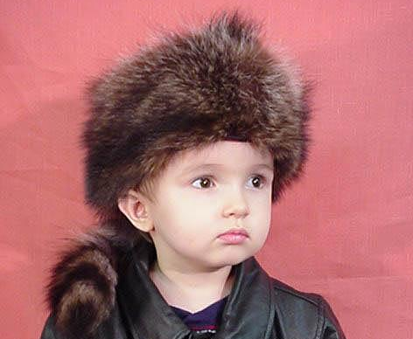
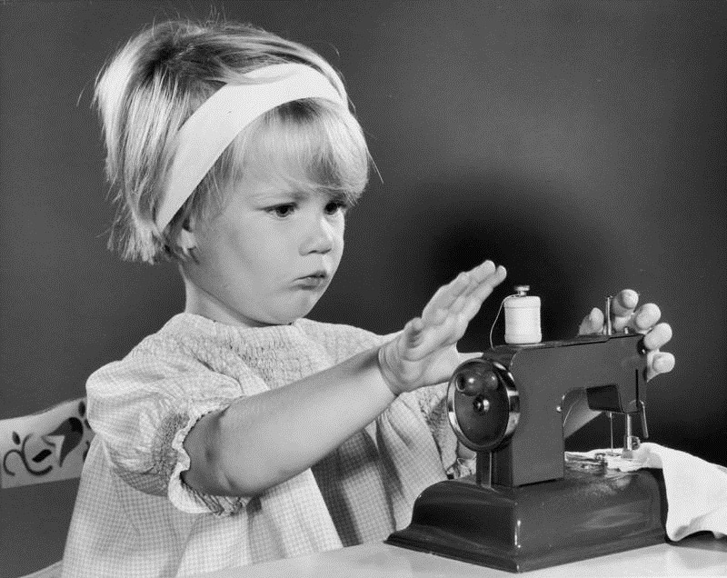
I remember that one year my brother and I found our Christmas gifts early and we played with them while our parents were out.
My brother had a Davey Crockett hat and a tennis racquet and I had a sewing machine. I don’t know if they ever found out.
Notes:
https://shekhmanfurs.com/products/davy-crockett-kids-hat
2https://countesslemonbalm.files.wordpress.com/2012/07/child-sewing-machine.jpg

Slide 15
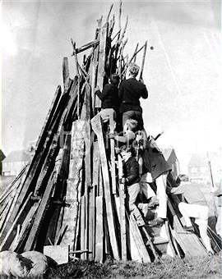
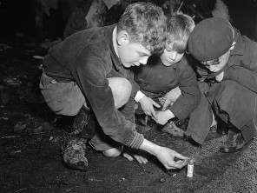
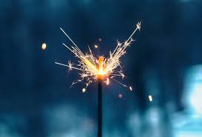
Cracker Night – Guy Fawkes
I remember when we would build a neighbourhood bonfire for cracker night. Our parents would allow us to light Tom Thumbs - small crackers…
But only the fathers got to light the spectacular ones!
I was always scared of crackers, but I LOVED sparklers!!!
Notes:
https://www.pinterest.com.au/pin/553731716671119296/?nic_v2=1a5f6n4id
https://www.flickr.com/photos/llgc/6302310729
https://encrypted-tbn0.gstatic.com/images?q=tbn%3AANd9GcTfApbvsFpSQvzFAcg4SJoyaGb140HIDIT7zQ&usqp=CAU

Slide 16
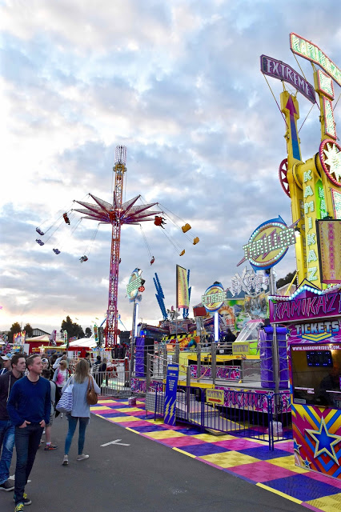
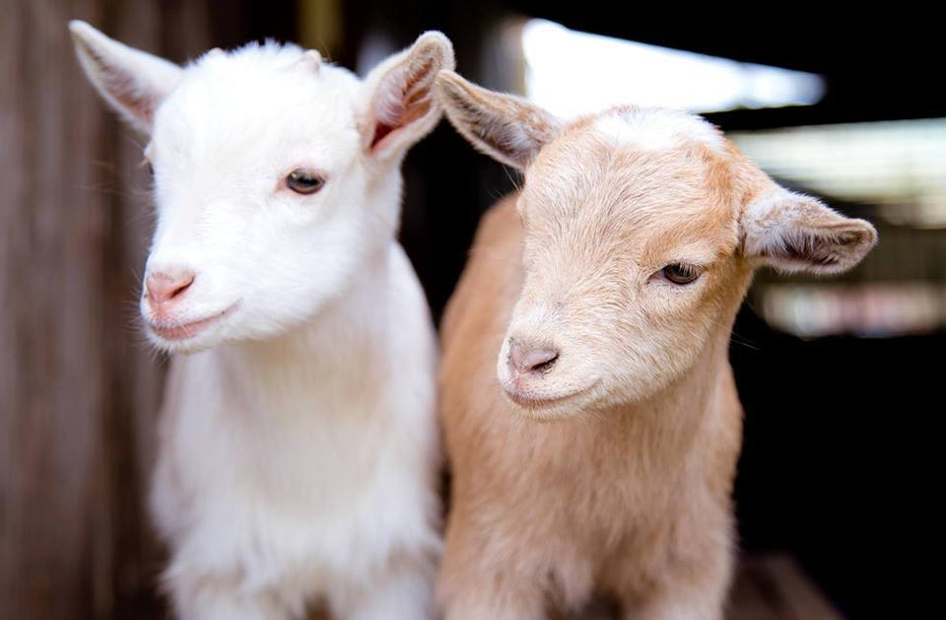

The Royal Melbourne Show
Do you remember the Royal Melbourne Show held at the Showgrounds? We loved the baby animals and the Cake Exhibitions, but the most exciting part was the Showbags.
We were always allocated an amount of money and had to decide how to spend it. Decisions, decisions!!
And someone always got lost!
Notes:
https://lv.foursquare.com/v/giants-stadium/4c416f23ff711b8d6afb1105?openPhotoId=5153a56be4b08abb6f4c4c8f
https://www.bensonstrading.com.au/showbags/
https://www.seattlemet.com/eat-and-drink/2016/08/baby-goats-are-coming-to-reuben-s-brews-next-week

Slide 17
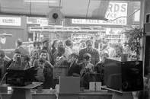
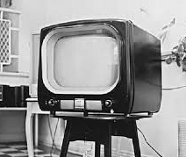
The Introduction of Television
Black-and-white television officially started in Australia in 1956. I can remember going to watch TV in the shop window in High Street, Thornbury.
And finally, we had the excitement of getting one at home.
Notes:
https://www.realestate.com.au/blog/images/550x350-fit,progressive/2013/07/1950stv.jpg
https://www.freetv.com.au/wp-content/uploads/2019/07/FACTS0030-1170x780.jpg
https://jamesrmacdonald.files.wordpress.com/2015/03/21st-april191.jpg

Slide 18

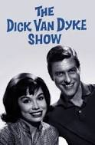
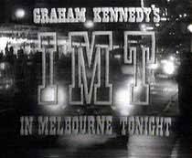
My Favourite TV Programs
Did you watch any of these?
Notes:
https://www.directv.com/tv/The-Dick-Van-Dyke-Show-bWpCcnI4V21qWWs9/The-Last-Chapter-VTVZbW1FNkJZenU4bnNZMVUyTzNZdz09
https://www.classicaustraliantv.com/homicide.htm
http://www.tvmem.com/OZST/tv/I/INMELBOU/INMELBOU.html

Slide 19
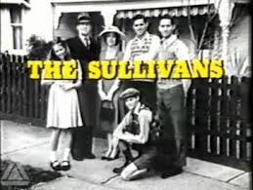
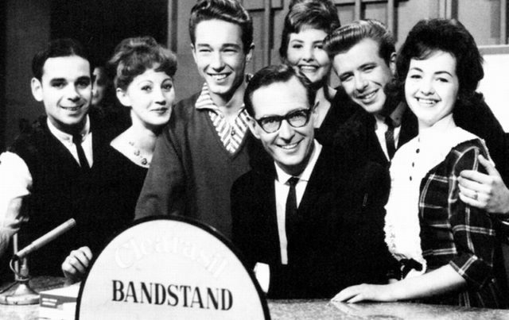
Or These? I loved Bandstand on Saturday nights with Brian Henderson as presenter.
Notes:
https://nostalgiacentral.com/television/tv-by-decade/tv-shows-1970s/sullivans/
https://nostalgiacentral.com/music/music-on-film-and-tv/bandstand-australia/

Slide 20
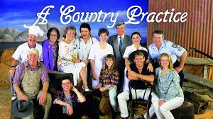
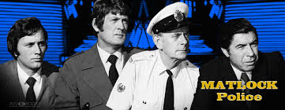
And in 1975, colour Tv arrived!
Notes:
1. https://7plus.com.au/link/Episode/CNP-229
2. https://www.atvtoday.co.uk/wp-content/uploads/2016/04/matlock2.jpg

Slide 21
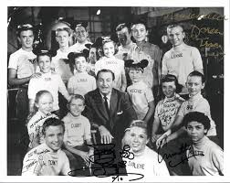


Some More Favourite Programs
Notes:
http://induced.info/?s=Original+Mickey+Mouse+Club+Home
https://www.amazon.com/Father-Knows-Best/dp/B075V7D5FX
https://classictvhistory.files.wordpress.com/2011/05/peyton-titles.png

Slide 22
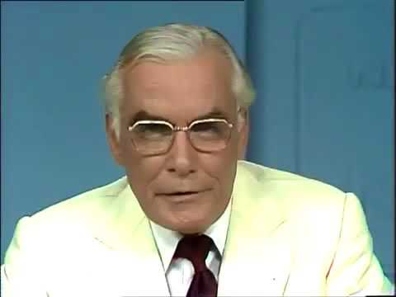
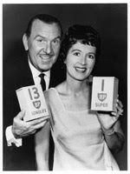
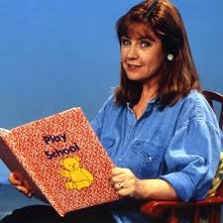
My Favourite Personalities
Bob and Dolly Dyer hosted “Pick A Box” quiz show
Sir Eric Pearce read the Channel 9 News
Noni Hazelhurst appeared on Play School
Notes:
https://www.youtube.com/watch?v=x5zdSk73AwI
https://www.bdb.co.za/shackle/articles/dolly_dyer.htm
https://celebrity.nine.com.au/tv/play-school-presenters-then-and-now/cb0adc10-d4e4-4640-af16-b26f49f2becf#16

Slide 23
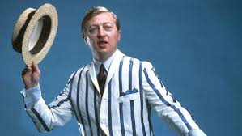
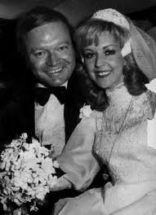
My Favourite Personalities
Graham Kennedy hosted In Melbourne Tonight.
Bert & Patty Newton appeared on many shows together and separately. Bert was Graham Kennedy’s “straight man” on IMT
Notes:
https://www.dailytelegraph.com.au/entertainment/sydney-confidential/the-daily-telegraph-reveals-the-worst-10-australian-tv-hosts-and-the-best-presenters-in-television/news-story/0291525a233a730c309b7190092efd05
https://www.theage.com.au/ftimages/2005/10/27/1130367986014.html

Slide 24
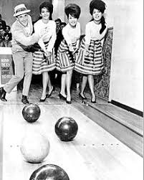
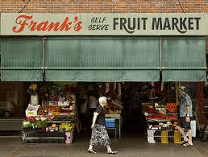
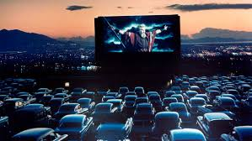
We Worked Hard…
Our parents encouraged us to work hard and live life to the full. At the age of 19 I decided that I wanted to go overseas with my friend, Ellen*. For 2 years we worked at 4 jobs …. One as a secretary … another at a ten pin bowling alley .. another at a drive in movie…. And also at the fruit shop on Saturday morning. Hard work, but fun!!!
* 50 years later, Ellen is still one of my best friends.
Notes:
https://upload.wikimedia.org/wikipedia/commons/thumb/d/d5/The_Ronettes_and_Murray_the_K.jpg/220px-The_Ronettes_and_Murray_the_K.jpg
https://www.domain.com.au/news/the-oldfashioned-underdeveloped-suburb-that-still-exists-in-sydneys-inner-west-20170123-gtr113/
https://www.smh.com.au/interactive/2014/OldShops/assets/images/slides/franks/13.jpg

Slide 25
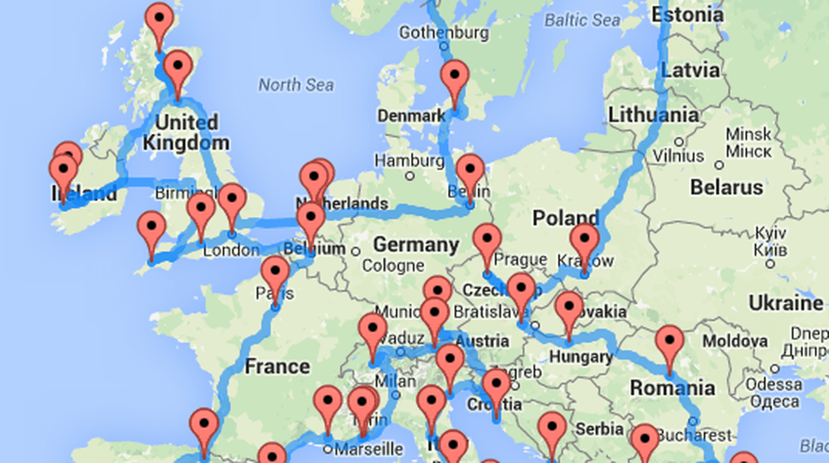
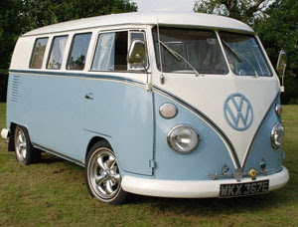
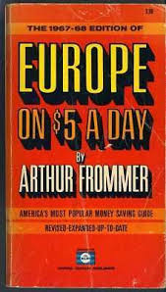
So after all that hard work…
Ellen and I headed overseas by ship, bought a Combi van (as all good Aussies do) and travelled around Europe…. Several times actually.
Notes:
https://www.travelettes.net/10-gorgeous-trailer-campers/
https://img.theculturetrip.com/1024x574/smart/wp-content/uploads/2017/02/europe-optimal-road-trip-2.png
https://media.nomadicmatt.com/florenceguide.jpg

Slide 26
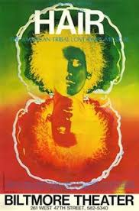
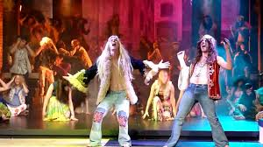

After several years, on our travels….
I met an Irishman called Patrick, from Tipperary. Our first date in London was to see the way out musical, Hair. It was a blast!
Several years later we married and 48 years later, we are still together having fun …. Most of the time!
Notes:
https://upload.wikimedia.org/wikipedia/en/b/b8/Hairposter.jpg
https://i.ytimg.com/vi/qA5d9VIF83E/maxresdefault.jpg
Photo provided by the author

Slide 27

We have two children and a wonderful granddaughter called Keira.
I hope you have enjoyed this journey through time with me and that it has brought back some happy memories for you too.
I wish we could meet so that I could hear your story….maybe one day. With love,
Val
Notes:
Photo provided by the Author

