Slide 1

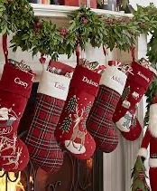
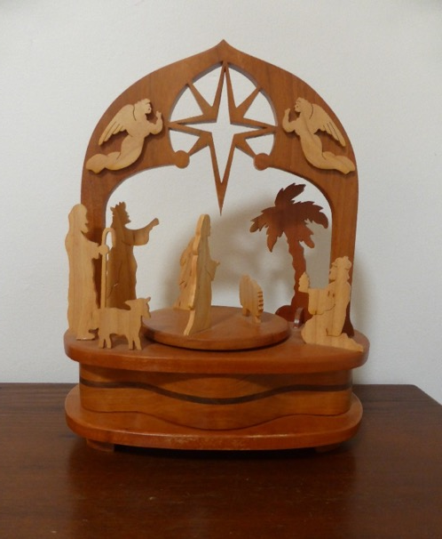
CHRISTMAS TRADITIONS by Carolyn
The Rotary Club of Canterbury Let’s Stay Connected Project
Notes:
1. https://www.potterybarnkids.com/products/luxe-velvet-stocking-collection/
2. Photo provided by the author

Slide 2
The Rotary Club of Canterbury “Let’s Stay Connected Project” has been developed as a response to an identified need within the Aged Care sector.
At times when it’s difficult to connect in person with family and friends, the Rotary Club of Canterbury has pleasure in offering you this booklet, designed to promote conversation, recollection and engagement for those who are in isolation and without their usual social activities.
The booklets have been designed for people in an aged care residence, village or at home to read by themselves, or to have a family or staff member share the booklet with them.
You can download this and other booklets from the Rotary Club of Canterbury website (www.canterburyrotary.org).
Source references for this book are held at the Rotary Club of Canterbury. Contact president@caterburyrotary.org for further details.
Material in this book was reproduced in accordance with Section 113F of the Copyright Act (1968).
The Rotary Club of Canterbury Let’s Stay Connected Project

Slide 3
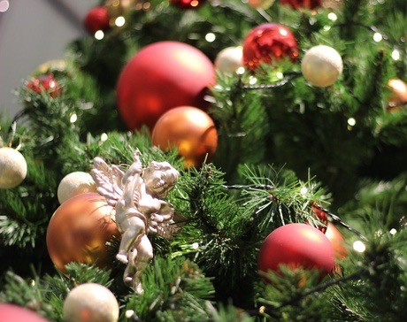
By Carolyn
I Love Christmas!
I love the traditions.
I love the family getting together to have a special lunch.
I love the spirit of giving.
I love the tree and the decorations.
I love the carols and music.
I love the food we only have at Christmas like the pudding.
I love the happiness that Christmas brings.
The Rotary Club of Canterbury Let’s Stay Connected Project
Notes:
"christmas tree ornament" by zaimoku_woodpile is licensed under CC BY 2.0

Slide 4
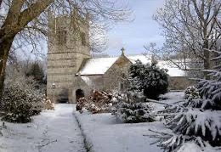
HAVE YOU EVER HAD A SNOWY CHRISTMAS?
When we lived in England, I loved trudging through the snow to the midnight service at our village church.
Afterwards, we would eat warm mince pies with our neighbours.
The Rotary Club of Canterbury Let’s Stay Connected Project
Notes:
1. http://www.bbc.co.uk/cornwall/content/images/2007/11/28/1_colanchurch_470x350.jpg

Slide 5
ORIGINS OF CHRISTMAS
The Church in Rome began celebrating the birth of Christ in 336AD during the reign of Emperor Constantine. Other Christian religions also celebrate on that date
Some Orthodox groups choose January 7th to celebrate Christmas.
This could be due to the date noted on the Julian calendar – January 7. However, we now use the Gregorian calendar.
The Rotary Club of Canterbury Let’s Stay Connected Project
Notes:
"Christian Christmas Nativity Scene" by johndillon77 is licensed under CC BY-SA 2.0

Slide 6

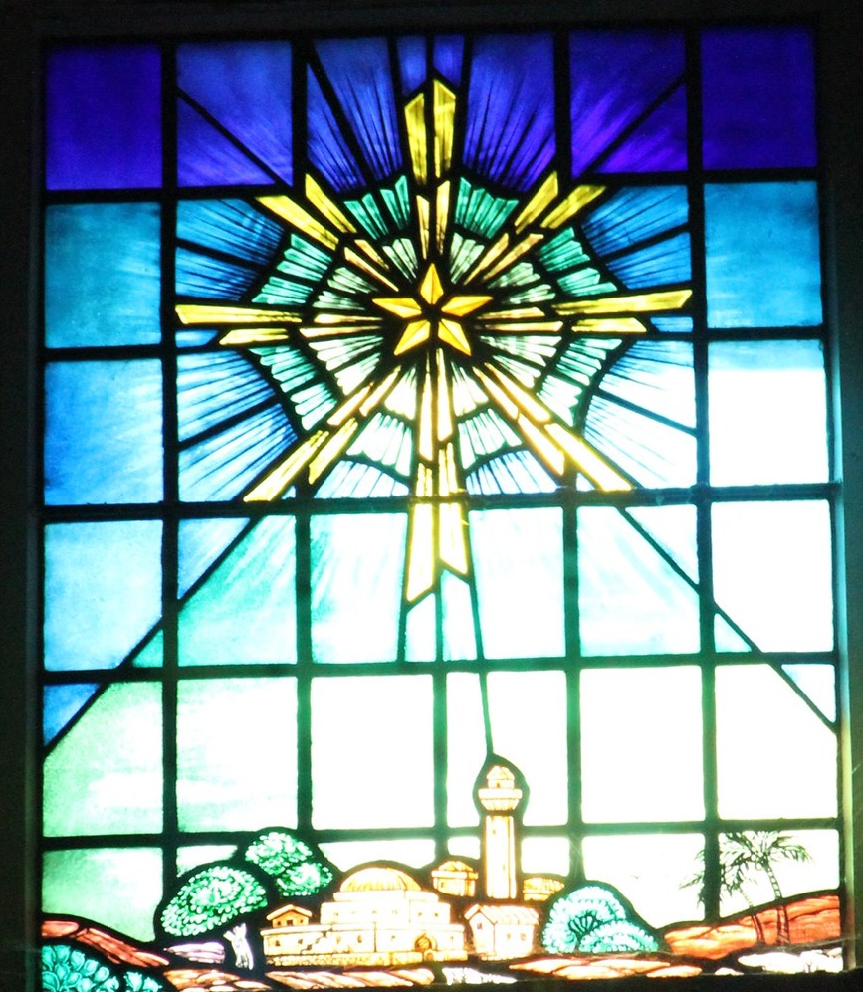
Biblical history
Whatever the exact date, records, as well as the Gospels, tell of the birth of the Christ child to Mary, in Bethlehem, around this time.
The shepherds and the wise men came to pay homage to the baby in the manger. This baby was seen as the new Saviour.
The Rotary Club of Canterbury Let’s Stay Connected Project
Notes:
"Christmas Star" by kahunapulej is licensed under CC BY-NC-SA 2.0

Slide 7
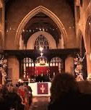
CHRISTMAS DAY TRADITIONS
Many religions hold a church service for Christmas.
The Rotary Club of Canterbury Let’s Stay Connected Project
Notes:
1. https://www.thegoodbook.com/media/blog_posts/carol.jpg

Slide 8

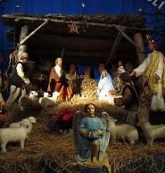
Some Christmas traditions
This nativity scene was in a village in France. I love seeing ones in Churches and in people’s front gardens. My wooden music box nativity, pictured on the front page, was made in Pennsylvania USA
The Rotary Club of Canterbury Let’s Stay Connected Project
Notes:
Photo supplied by the author

Slide 9
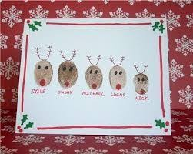
Christmas cards
Sending wishes on Christmas cards is going out of fashion. What a shame! I love cards, especially ones made by children.
This card has the names of each of the family members.
The Rotary Club of Canterbury Let’s Stay Connected Project
Notes:
Photo supplied by the author

Slide 10
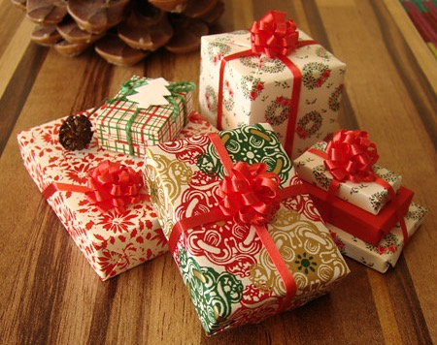
Christkindl or Kris Kringle.
Kris Kringle is derived from German for Christ child, sometimes spelled Christkindl. Nowadays, it often means we give a present to the name drawn from a hat. Kris Kringle presents can be good fun.
The Rotary Club of Canterbury Let’s Stay Connected Project
Notes:
"tiny cute Christmas gifts" by PetitPlat - Stephanie Kilgast is licensed under CC BY-NC-ND 2.0

Slide 11
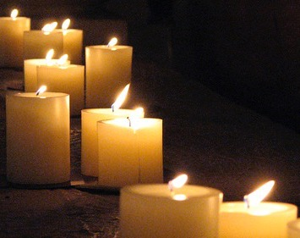
In England, we visited a Church for a Christkindl service - the Sunday before Christmas.
The 17th century Church was candlelit. Upon entering, the children were each given five things. An orange represented the world.
A candle was symbolic of giving light in the dark.
A red ribbon represented the blood of Christ.
Salt represented that which is essential for life.
Fruit and nuts symbolised food.
The Rotary Club of Canterbury Let’s Stay Connected Project

Slide 12
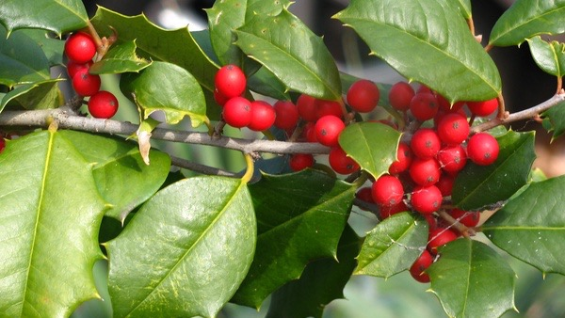
Holly and ivy
Holly symbolises the thorns of the garland Christ wore on the way to his crucifixion. Ivy represents the need to cling to God for support. Wreaths which we hang on the door began in Roman times and were for special occasions. They often have holly and ivy woven into them.
The Rotary Club of Canterbury Let’s Stay Connected Project
Notes:
"holly tree" by nannetteturner is licensed under CC BY 2.0

Slide 13
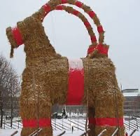
Traditions in other countries
In Sweden, Gavle or the Yule goat is based on a 19th Century tradition of men dressing as goats to give gifts to their families. The Gavle is burned at the end of the Christmas celebrations
Sweden
The Rotary Club of Canterbury Let’s Stay Connected Project
Notes:
Photo supplied by author

Slide 14
China
In China, muslin stockings are hung to receive gifts. These are called ‘Christmas old men.’ Santa is called ‘Lan Khoong-Khoong’ or Nice old Father.
The Christmas tree is decorated with red paper, paper flowers and lanterns to symbolise happiness.
The Rotary Club of Canterbury Let’s Stay Connected Project
Notes:
"'Paper' Lanterns" by partymonstrrrr is licensed under CC BY-NC-ND 2.0

Slide 15
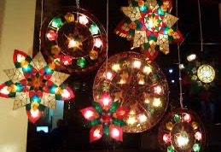
The Philippines
In the Philippines, the Festival of Lights symbolises Christ in our lives.
The Rotary Club of Canterbury Let’s Stay Connected Project
Notes:
Photo supplied by the author

Slide 16
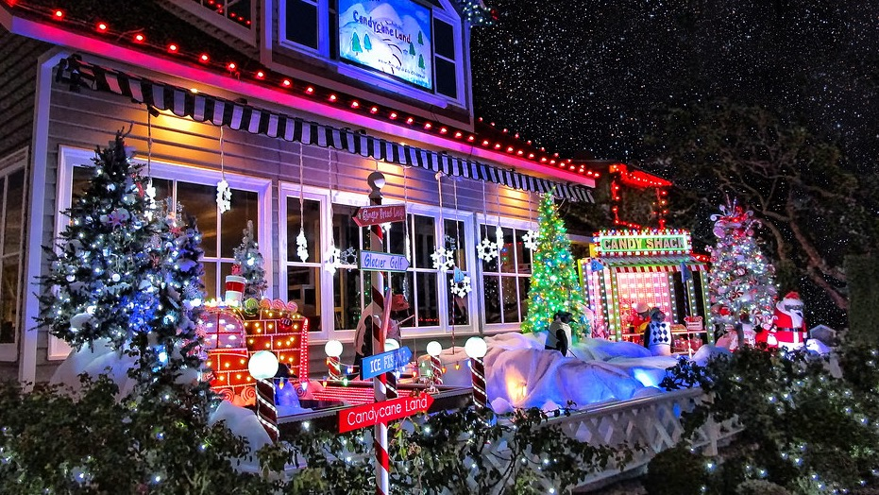
USA
In the USA, many people like to decorate the outside of their homes, too.
We have more of that happening here now.
The Rotary Club of Canterbury Let’s Stay Connected Project
Notes:
Photo supplied by the author

Slide 17
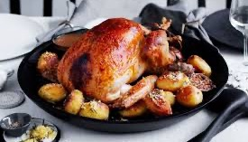

THERE IS ALWAYS A SPECIAL CHRISTMAS DINNER TO EAT
Traditionally, many Australians like to have a hot Christmas dinner, whatever the weather. This often includes a turkey and baked ham with cranberry sauce.
The Rotary Club of Canterbury Let’s Stay Connected Project
Notes:
https://www.delicious.com.au/recipes/collections/gallery/14-ways-with-ham-for-a-classic-christmas-this-year/jhgi2pqu?page=10
https://www.facebook.com/lugarnogourmetmeats/photos/a.309226105907930/1535667429930452/?type=3&theater

Slide 18
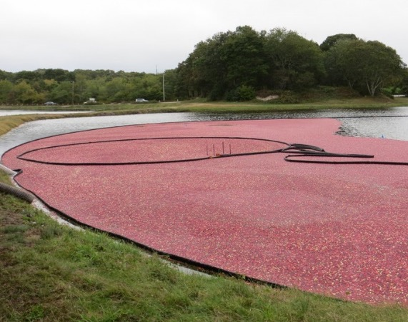
Cranberries
When we were in the USA, we saw cranberries being harvested. When the berries are ripe, the farmers flood the ponds in which the berries grow, then rake them into a pile. A machine scoops them up like a vacuum cleaner.
The Rotary Club of Canterbury Let’s Stay Connected Project
Notes:
Photo supplied by author

Slide 19
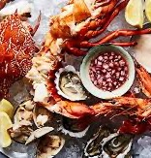
Seafood anyone?
Certainly, a cold Christmas lunch suits our weather better and is easier for the cook, usually, ‘Mum’.
When our extended family gets together, we have a cold buffet and everyone brings meats, seafood and salads. The work is shared and there is something for everybody’s taste.
The Rotary Club of Canterbury Let’s Stay Connected Project

Slide 20
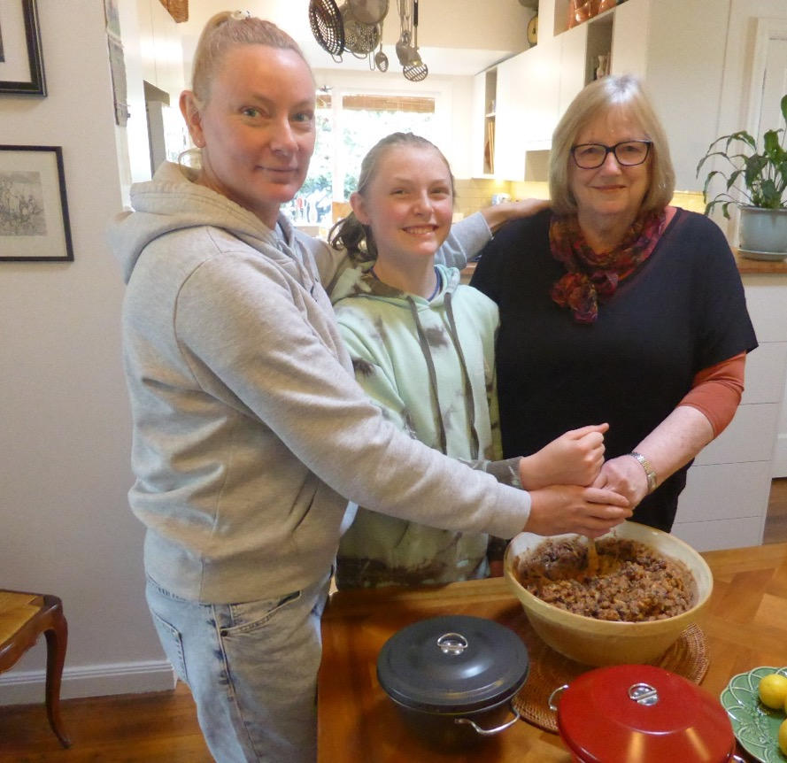
Christmas pudding
Every year I make several Christmas puddings. I am the pudding maker for our family. Below is a photo of me, my daughter Joanna and my granddaughter Eliza, stirring the pudding and making a wish.
The Rotary Club of Canterbury Let’s Stay Connected Project
Notes:
Photo supplied by author

Slide 21
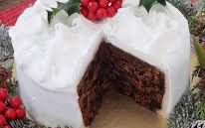

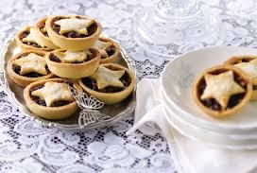
Sweet treats
No Christmas is right for me without mince pies. I love them. So does my husband .
Every year I make a Christmas cake. I used to ice them like this one because a dear relative loved it like this. It reminded her of home in England. Now I put almonds on top instead of icing. Originally the cakes were twelfth night cakes and eaten on the 5th January.
The Rotary Club of Canterbury Let’s Stay Connected Project
Notes:
Photos supplied by the author

Slide 22
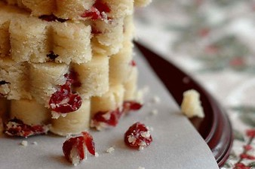
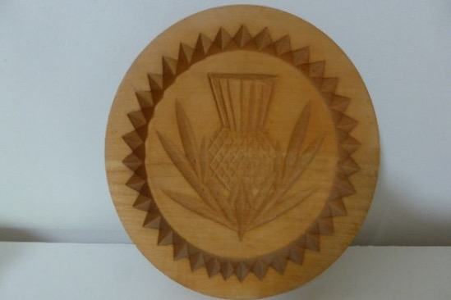
Scotland
I bought this shortbread mould in Scotland. Mostly I make shortbread biscuits in the usual way.
The Rotary Club of Canterbury Let’s Stay Connected Project
Notes:
"Dried Cranberry Shortbread Cookies" by Vita Arina is licensed under CC BY-NC 2.0
xPhoto supplied by author

Slide 23
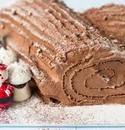
France
This chocolate cake is a French Bûche de Noel. In English we would call it a Yule Log. The mushrooms are made from meringue.
The Rotary Club of Canterbury Let’s Stay Connected Project
Notes:
Photo supplied by author

Slide 24
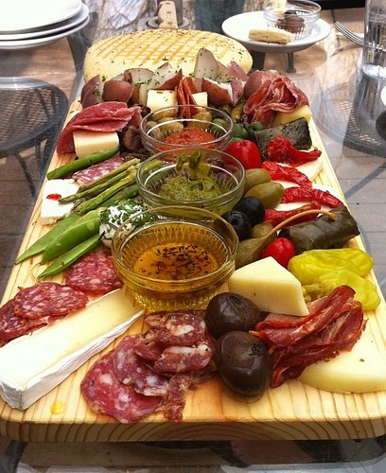
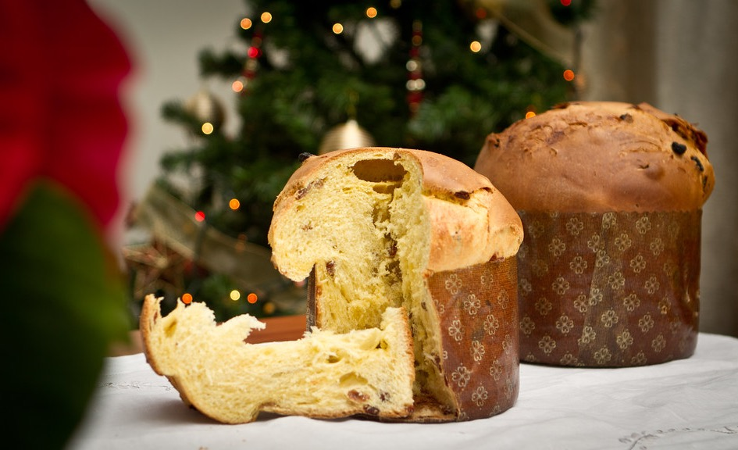
Italy
My daughter-in-law is Italian. For their Christmas dinner, they have an anti-pasti platter, then filled pasta like ravioli for an entrée, roast meat and vegetables then a dessert like Tiramisu. The meal lasts for hours. The traditional cake is Pannetone which is dipped in coffee.
The Rotary Club of Canterbury Let’s Stay Connected Project
Notes:
"Nicol-Ettone 2011 edition - IMG_2261" by Nicola since 1972 is licensed under CC BY 2.0
"The biggest antipasto in Colorado." by BuzzFarmers is licensed under CC BY 2.0

Slide 25
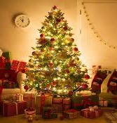
The Christmas tree and decorations
I love decorating the tree. My decorations are from my childhood, from my children’s childhood and one special one for each of my grandchildren. Mostly my ornaments are red and green. I like tradition!
The evergreen tree has been used to celebrate winter festivals since before Christian times.
The Rotary Club of Canterbury Let’s Stay Connected Project
Notes:
"christmas tree 2004" by scottfeldstein is licensed under CC BY 2.0

Slide 26
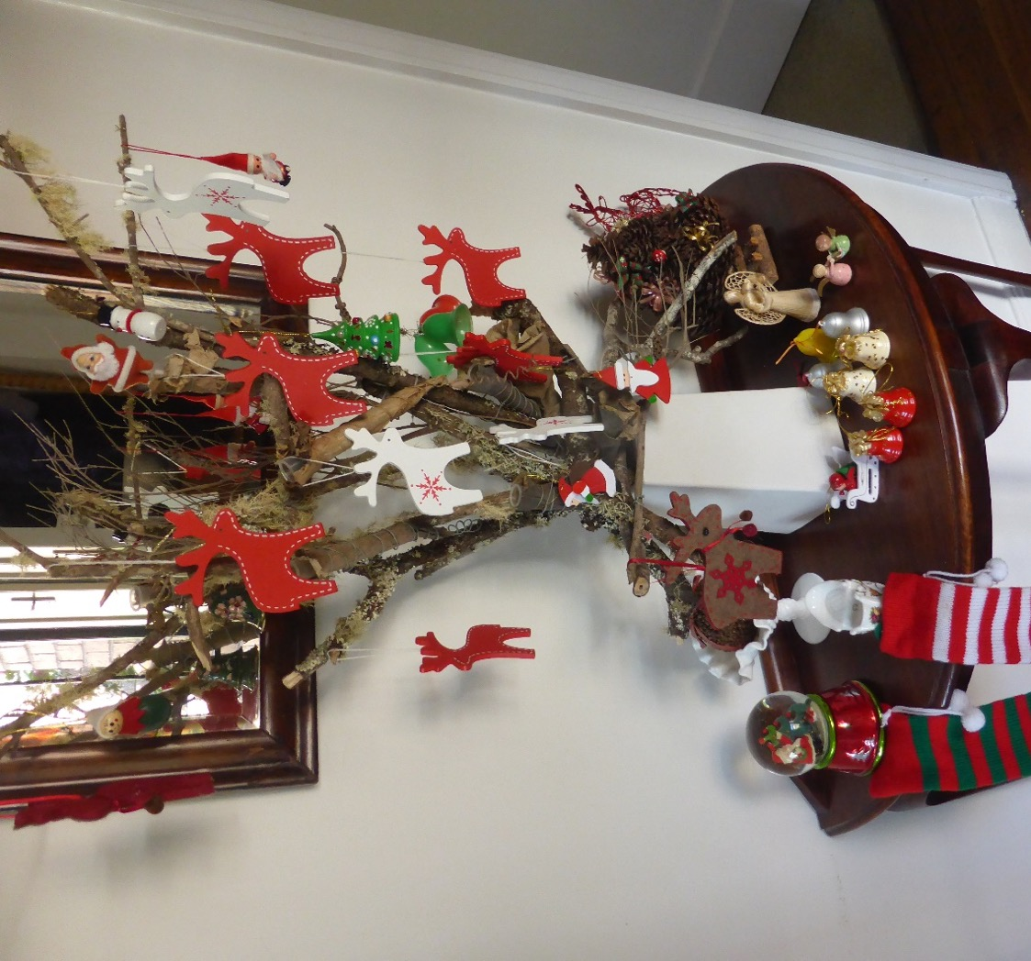
Some of my favourite decorations
The Rotary Club of Canterbury Let’s Stay Connected Project
Notes:
Photo supplied by author

Slide 27
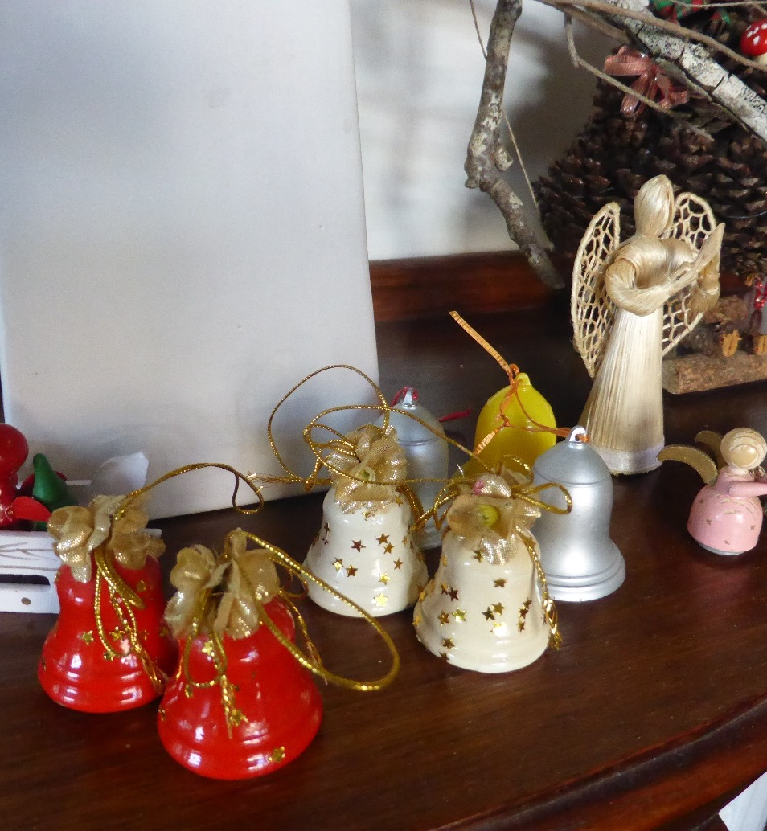
My special decorations
The snowdome, the stockings, the pinecone Christmas tree, the bells, the raffia angel and the wooden ornaments are from my children’s childhood. The tiny wooden angels on the right and the plain bells are from my own childhood. I treasure them.
The Rotary Club of Canterbury Let’s Stay Connected Project
Notes:
Photo supplied by the author

Slide 28
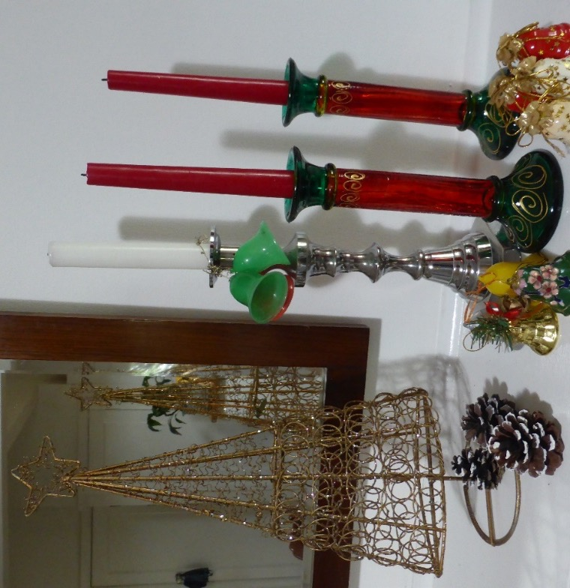
Candles and bells
I like to have lots of candles and white and dark red Christmas lilies in the house over Christmas.
Candles and bells have long been associated with Christmas. Candles originally lit churches and Christmas trees. An Austrian friend always lights candles on their tree before their traditional Christmas Eve dinner.
The Rotary Club of Canterbury Let’s Stay Connected Project
Notes:
Photo supplied by author

Slide 29
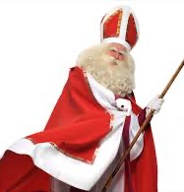
Santa, Father Christmas or Saint Nicholas
Turkey
In the 4th century, a rich man living in what is now Turkey, gave presents and money to the poor. He gave so much he was named Saint Nicholas. Saint Nicholas’ day is still celebrated on 6th November by some countries, especially in Europe.
The Rotary Club of Canterbury Let’s Stay Connected Project
Notes:
https://historydaily.org/santa-claus-father-christmas

Slide 30
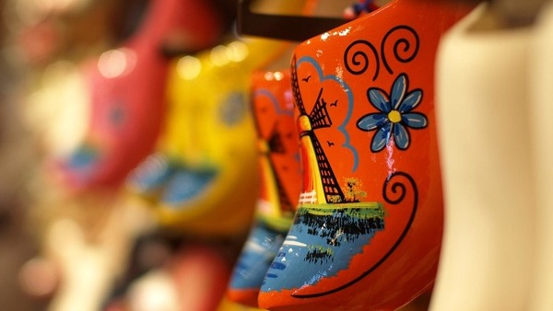
The Netherlands
Netherlands, children put out their clogs or shoes to receive gifts and sweets from St. Nick on the evening of the 5th November.
They also believe in leaving carrots and hay for St. Nick’s horse Sinterklaus.
Over time, Sinterklaus became Santa Klaus. Santa was the name adopted by USA as the many Dutch and German people migrated there.
The Rotary Club of Canterbury Let’s Stay Connected Project
Notes:
"Netherlands clogs" by Photography Love Travel is licensed under CC BY-SA 2.0

Slide 31
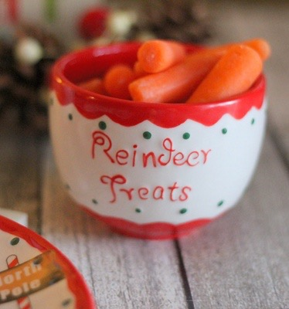
United Kingdom and France
In the United Kingdom, in the Middle Ages, Old Man Christmas or Father Christmas was more popular. He brought the children gifts on Christmas Eve. Children left carrots for the reindeer and a drink and biscuits for Father Christmas. In France, Father Christmas is called Pere Noel.
The Rotary Club of Canterbury Let’s Stay Connected Project
Notes:
"carrots for reindeer in a ceramic mug on a wood table next to a plate with pine cones in the background" by PersonalCreations.com is licensed under CC BY 2.0

Slide 32

Christmas gifts
The origins of gift giving go back to the three wise men bringing gifts to the Christ child in the manger. Their gifts were gold, frankincense and myrrh. Frankincense is an incense. Myrrh is scented oil. Gifts were also given by richer people to poorer people on Boxing Day.
The Rotary Club of Canterbury Let’s Stay Connected Project
Notes:
http://uzhgorod.in/en/news/2014/dekabr/uzhgorod_children_received_new_year_s_gifts_but_there_is_one_but

Slide 33
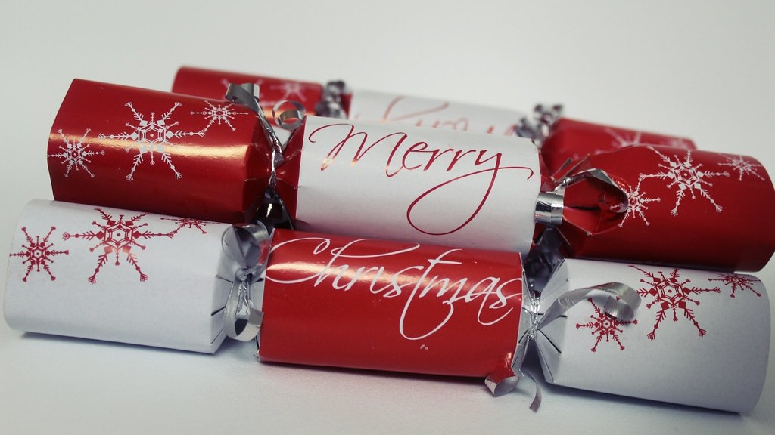
Christmas crackers or bon bons.
Tradition tells how a London sweet maker, called Tom Smith, invented crackers in 1847. He created them to promote his sweets, or bon bons.
Inspired by the crackling of his fire he inserted a snap. When two people pull the cracker, there is a mild bang. Inside the cracker is a paper crown, a corny joke and a small trinket.
Originally, Tom Smith included sweets, nuts and a poem.
The Rotary Club of Canterbury Let’s Stay Connected Project
Notes:
"merry christmas crackers" by athriftymrs.com is licensed under CC BY-SA 2.0

Slide 34
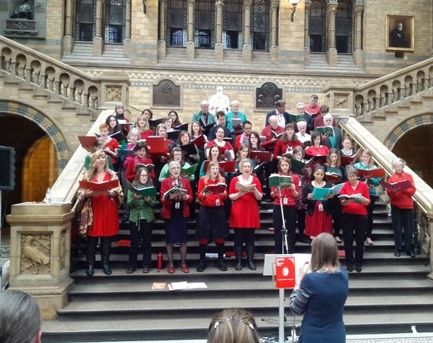
Carols and songs
On Christmas Eve we sometimes go to a midnight Carol service. The carols sung by the choir were beautiful.
My favourite carol is ‘Silent Night.’ That is the carol which plays on my wooden nativity music box on the front page.
The Rotary Club of Canterbury Let’s Stay Connected Project
Notes:
"File:A choir of Natural History Museum, Science Museum and Victoria and Albert Museum staff members sing carols in the central hall of the Natural History Museum 02.jpg" by John Cummings is licensed under CC BY-SA 3.0

Slide 35
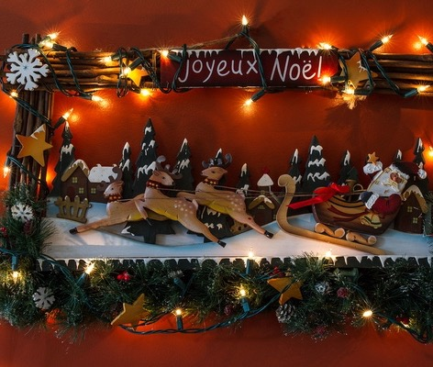
Merry Christmas
Whatever your traditions are, I wish you a very happy Christmas.
The Rotary Club of Canterbury Let’s Stay Connected Project
Notes:
"joyeux Noel! Mery Christmas!" by Y.O.T.O is licensed under CC BY-NC-SA 2.0

