Slide 1

Belle
Paris! – Part 1
Beautiful Paris – Part 1
Notes:
Author’s own photograph (of a postcard)

Slide 2
The Rotary Club of Canterbury “Let’s Stay Connected Project” has been developed as a response to an identified need within the Aged Care sector.
At times when it’s difficult to connect in person with family and friends, the Rotary Club of Canterbury has pleasure in offering you this booklet, designed to promote conversation, recollection and engagement for those who are in isolation and without their usual social activities.
The booklets have been designed for people in an aged care residence, village or at home to read by themselves, or to have a family or staff member share the booklet with them.
You can download this and other booklets from the Rotary Club of Canterbury website (www.canterburyrotary.org).
Source references for this book are held at the Rotary Club of Canterbury. Contact president@caterburyrotary.org for further details.
Material in this book was reproduced in accordance with Section 113F of the Copyright Act (1968).

Slide 3
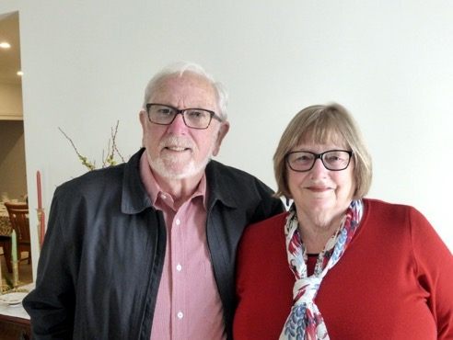
Je m’appelle Carolyn.
I’m a friend of the Rotary Club of Canterbury, Melbourne Australia.
My husband Roger and I have visited Paris several times. This booklet recounts just some of the different places we visited and the places we saw, stayed in, what we ate and explored.
I hope you enjoy my short stroll through some of my favourite Parisian memories.
Caroline and Roger
Notes:
Author’s own photograph

Slide 4
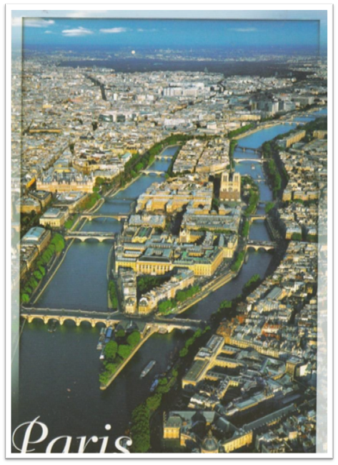
J’aime Paris!
I love Paris!
This photo shows the River Seine running either side of the Île de la Cité (island of the city).
Notes:
Author’s own photograph (of a postcard)

Slide 5
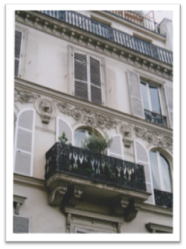
What makes Paris so beautiful?
Paris has an architectural unity.
Baron Haussmann was commissioned by Napoleon Bonaparte to rebuild Paris in the mid-nineteenth century. He built wide boulevards, squares, parks and gardens. The buildings were mostly of three to five storeys.
Lots of stone is used in the buildings.
Pretty ironwork decorates the balconies.
Notes:
Author’s own photograph

Slide 6
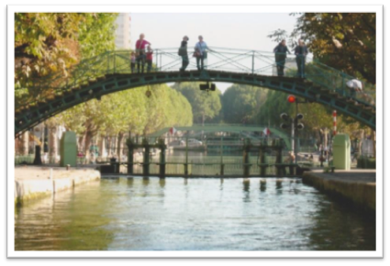
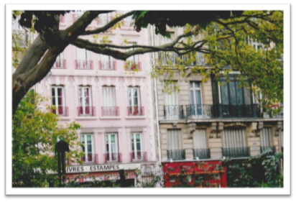
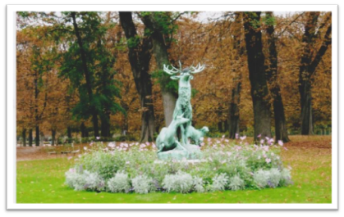
What makes Paris so beautiful?
Dotted around Paris are lovely apartments, bridges, canals and sculptures. Here are three photos I love.
Notes:
Author’s own photographs

Slide 7
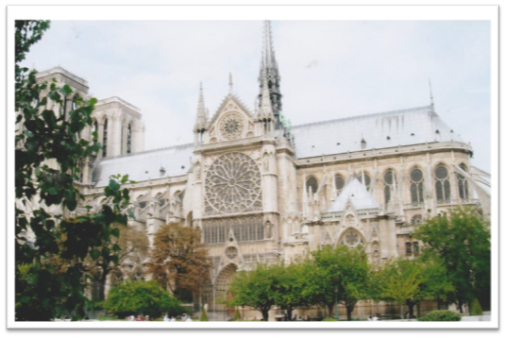
Notre Dame Cathedral
Most of the famous buildings and monuments are along the River Seine.
Notre Dame is one of the most famous Gothic cathedrals of the Middle Ages. This photo is taken from the River Seine before the great fire of 2019.
Notes:
Author’s own photograph

Slide 8
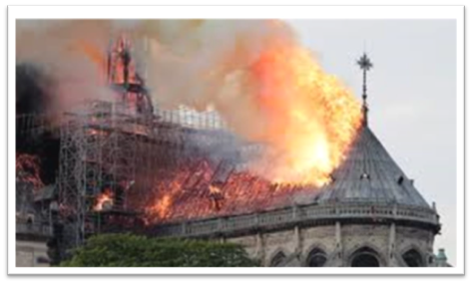
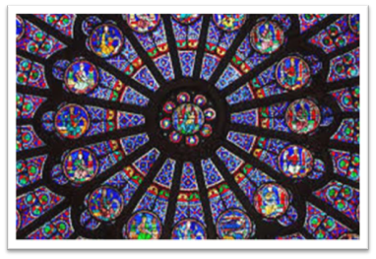
Notre Dame Cathedral
The fire destroyed the 92-metre high spire, much of the roof and the interior.
This photo shows one of the beautiful rose windows that was saved.
Notes:
Author’s own photographs

Slide 9
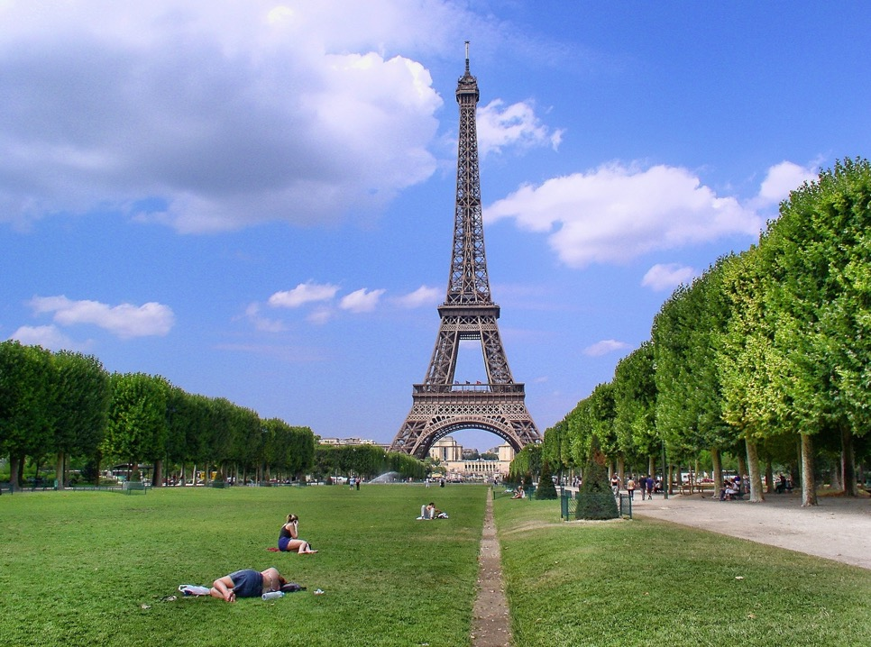
The Eiffel Tower
The Eiffel Tower was built for the 1889 World Fair to mark the 200th anniversary of the French Revolution.
Notes:
https://get.pxhere.com/photo/eiffel-tower-paris-monument-tower-symbol-park-landmark-memorial-field-of-mars-1064341.jpg

Slide 10
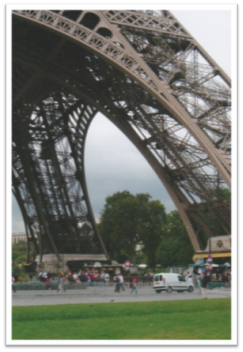
The Eiffel Tower
The Eiffel Tower is 300 metres tall and 125 metres wide. It took two years to build.
The designer was Gustav Eiffel and his iron girder design was not universally liked when it was built.
Notes:
Author’s own photograph

Slide 11
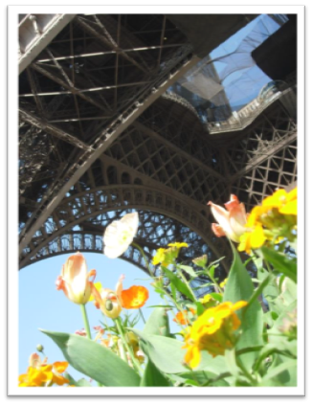
The Eiffel Tower
In 1982 our family watched the final of the Tour de France bicycle race from the first level of the Eiffel Tower. We didn’t know it was on and were there by happy chance.
There are flowers, parks, gardens, trees all through Paris. These add to the beauty and soften the stone and iron used so extensively. I love the contrast between the colour of the flowers and the grey ironwork.
Notes:
Author’s own photograph

Slide 12
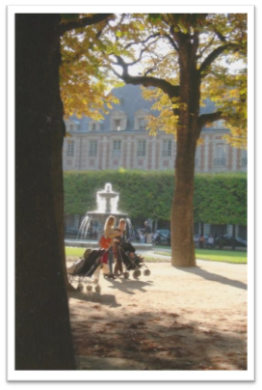
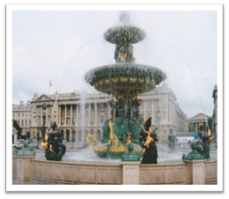
The Gardens of Paris
Some of my favourite gardens, fountains and squares (called ‘place’) are Place des Voges, (left) and the Place de Concorde (right).
The Place de Concorde was built in the late 1790s. It was originally a place of public executions.
Sprawled over 20 acres (8 hectares), it has beautiful fountains and sculptures. It separates the famous Champs-Elysees from the Jardin de Tuileries.
Notes:
Author’s own photographs

Slide 13
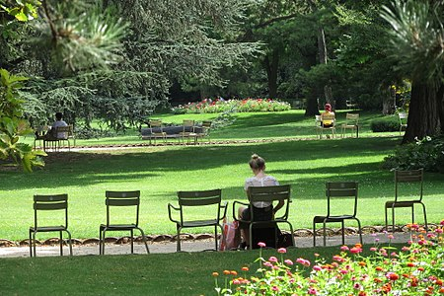
The Gardens of Paris
The Jardin du Palais Royal is small and is surrounded by lovely buildings.
You are not allowed to walk on the grass!
Notes:
https://en.wikipedia.org/wiki/Jardin_du_Luxembourg
https://en.wikipedia.org/wiki/Jardin_du_Luxembourg

Slide 14
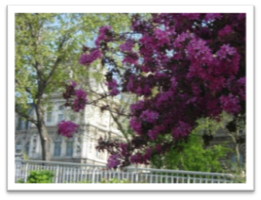
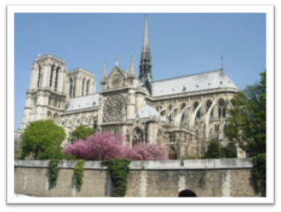
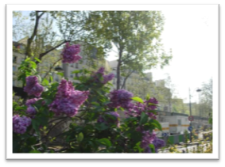
The Gardens of Paris
Sometimes, during our walks along the Seine we would come across glorious purple lilacs and blossom trees.
Notes:
Author’s own photographs

Slide 15
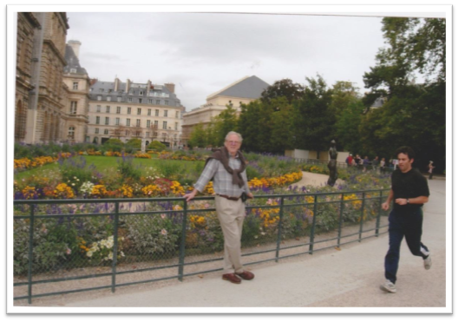
The Gardens of Paris
The Luxemburg Gardens are always full of people walking, sitting or having ‘le picnic’. In fine weather, children play with sailboats. The gardens are a wonderful large space, right in the heart of Paris.
My rather crooked photo shows my husband in front of one of the flower gardens in the Luxembourg Gardens.
Notes:
Author’s own photograph

Slide 16
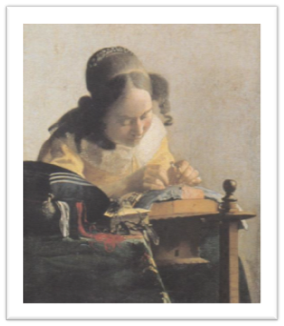
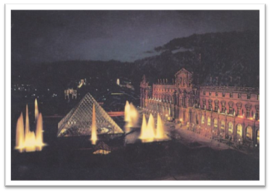
Museums and Galleries
Paris has many wonderful galleries and museums. Le Louvre is the most famous. This photo, taken at night, shows the fountains and the glass Pyramid very well.
One of my favourite paintings is ‘The Dressmaker’, by Johannes Vermeer.
Notes:
Author’s own photographs

Slide 17
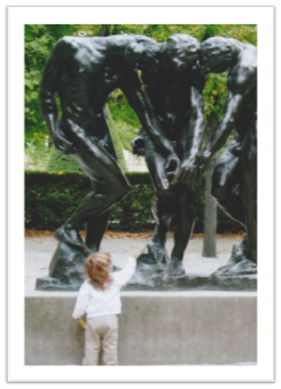
Museums and Galleries
We like the photo of the little girl touching the feet of one of the Auguste Rodin sculptures in his sculpture park.
Notes:
Author’s own photograph

Slide 18
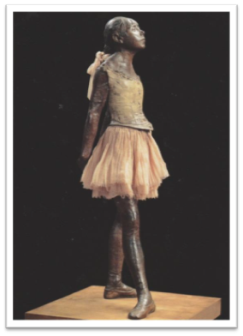
Museums and Galleries
I love the sculptures by Edward Degas.
This one, called ‘Petite Danseuse’, is in the Musée D’Orsay. This museum houses many Impressionist paintings amongst many other works.
Notes:
Author’s own photograph

Slide 19
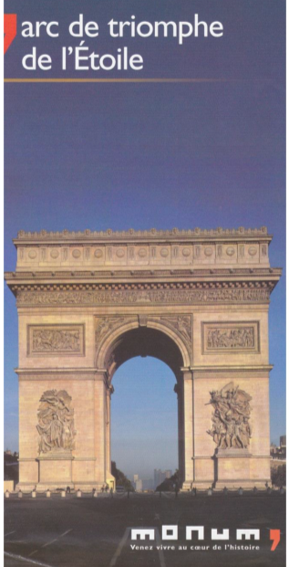
Arc de Triomphe
We cannot forget to include the Arc de Triomphe.
It was built by Napoleon in 1806 and later dedicated by Louis-Philippe as a triumphal arch to the glory of the armies of the revolution.
It is at the head of the world renowned, cobbled boulevard, the Champs Elysée, which you can just see through the arch.
Notes:
Author’s own photograph (of a postcard)

Slide 20
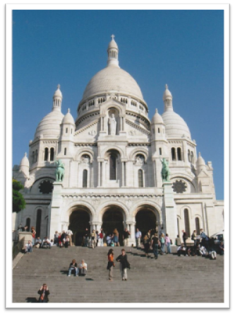
Churches
Apart from Notre Dame Cathedral, Paris has many other fine churches.
Sacre Coeur Basilica built in 1910 is well recognized. It is a landmark in Paris, high on the hill in Montmartre. It is made of white travertine stone. It stands out against the blue sky. To reach the basilica, you walk up huge flights of steps. My knees hurt!
Just below the steps are many artists painting local scenes for the ‘touristes’.
Notes:
Author’s own photograph

Slide 21
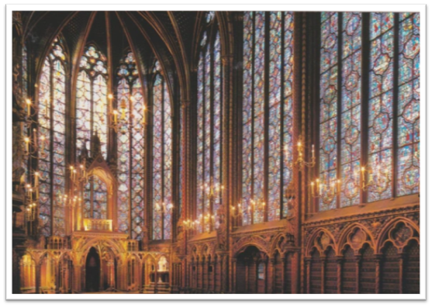
Churches
One of our favourite churches is a small chapel, named Sainte Chapelle. It is on the Ile de la Cite.
The church was built in 1248 as a royal chapel. There are 1113 stained glass windows which sparkle like jewels.
Notes:
Author’s own photograph

Slide 22
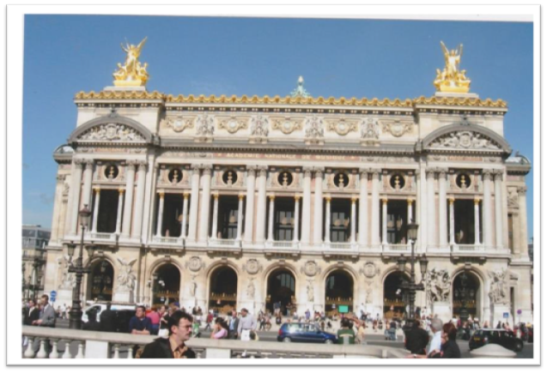
Palais Garnier
One evening we went to the famous opera house called Palais Garnier.
It is sometimes compared to a wedding cake.
Notes:
Author’s own photograph

Slide 23
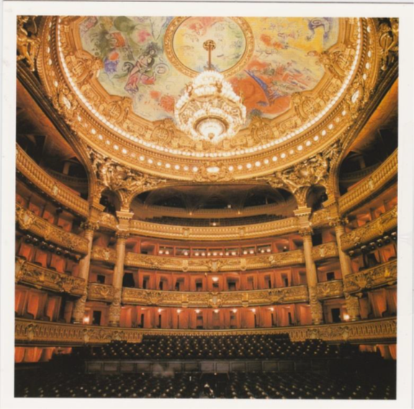
Palais Garnier
The interior of the Palais Garnier is a riot of gold and red. We saw a ballet there.
Notes:
Author’s own photograph

Slide 24
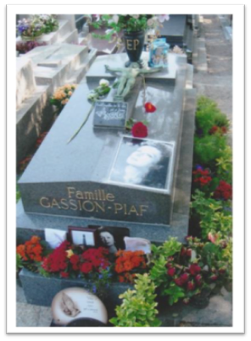
Père Lachaise Cemetery
Another interesting place to visit is Père Lachaise Cemetery. I sought the grave of Edith Piaf, known as ‘the Little Sparrow’. Someone leaves red roses on her grave every day.
Edith was the French ‘chanteuse’ who sang the famous song, ‘Je ne regrette rien’.
Notes:
Author’s own photograph

Slide 25
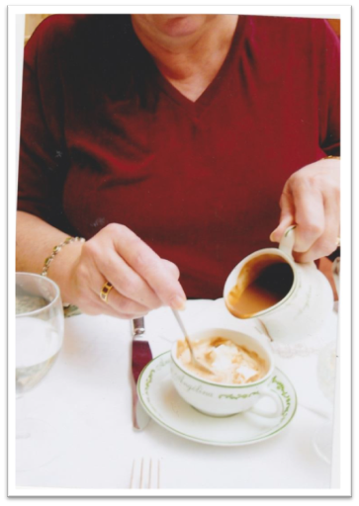
Cafés in Paris
One of my favourite things in Paris is to have hot chocolate at ‘Angelinas’, a famous cafe. This one is very rich and chocolatey. Yum!
Each morning we would buy our baguette at the local boulangerie and have it with beautiful butter and jam for breakfast.
Notes:
Author’s own photograph

Slide 26
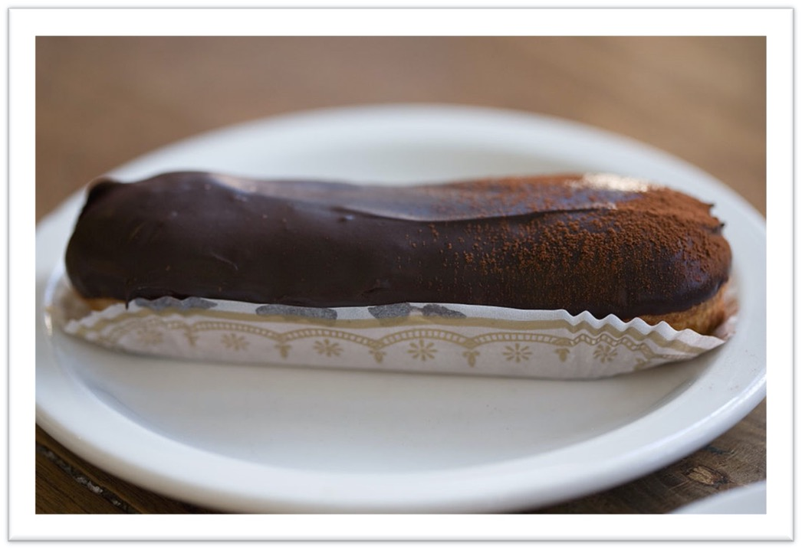
Cafés in Paris
Each day, wherever we went, we bought a chocolate éclair. We LOVE éclairs – when they are made by French pastry cooks. We also loved to eat crêpes and omelettes.
Notes:
https://en.wikipedia.org/wiki/%C3%89clair#/media/File:Eclair_1120005560.jpg

Slide 27
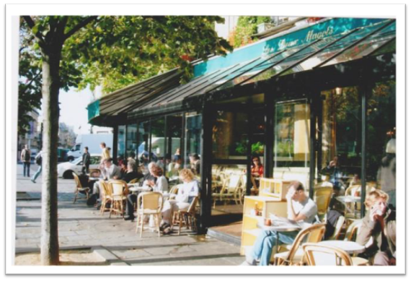
Cafés in Paris
Les Deux Magots (the two stout men) pictured here, is a cafe which was frequented by writers like Jean Paul Sartre, Simone de Beauvoir, Ernest Hemingway and artists like Picasso.
It was the haunt of the literary and intellectual elite.
Now it is mostly frequented by tourists and is rather expensive!
Notes:
Author’s own photograph

Slide 28
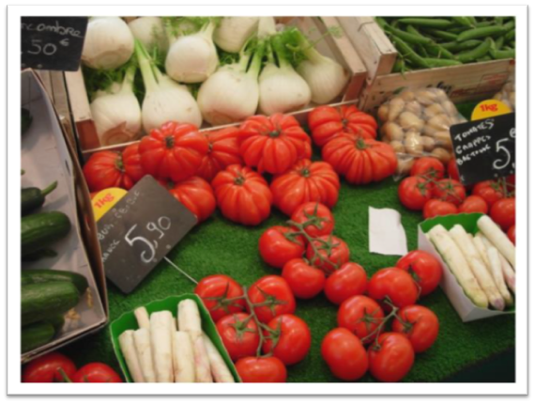
Markets
I love cooking and we visit markets whenever we travel.
This photo shows white asparagus which has a delicate flavour.
We don’t see white asparagus much in Australia.
Notes:
Author’s own photograph

Slide 29
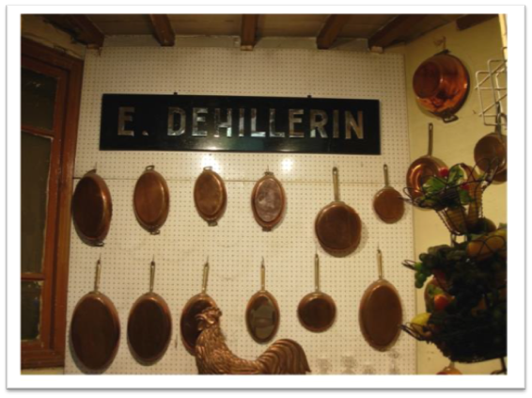
A Specialist Shop
Paris has a shop famous for kitchen ware including copper pans.
I bought a tiny copper pot which I use when I want only a small amount of a sauce.
Au revoir. À bientôt!
Goodbye. See you later!
Notes:
Author’s own photograph

