Slide 1
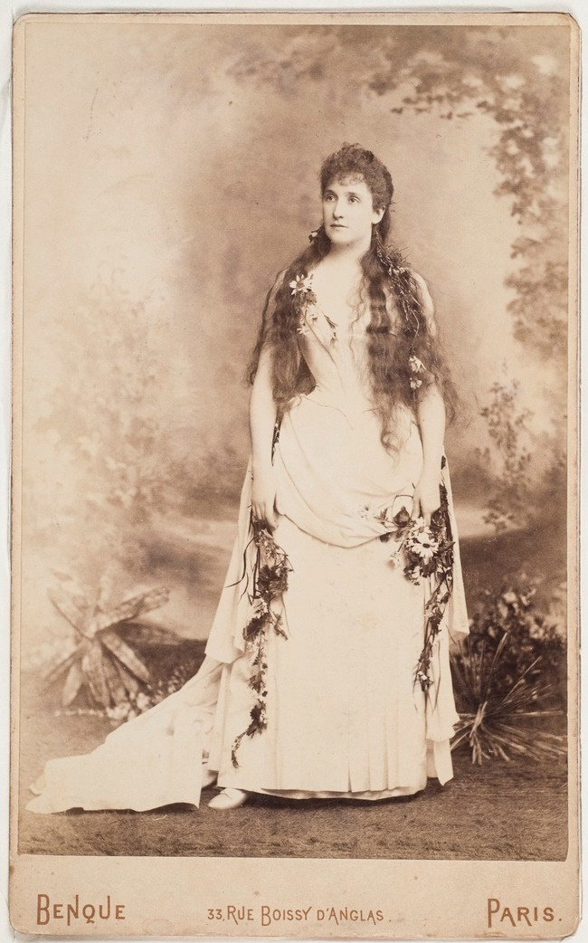

Australian Opera Singers
Notes:
https://statelibrarynsw.tumblr.com/post/119313194963/famous-australian-soprano-dame-nellie-melba-was

Slide 2
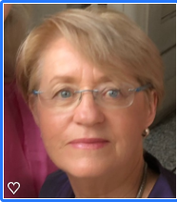
Hi
My name is Val and I’m a member of the Rotary Club of Canterbury in Melbourne, Australia.
It’s been fun researching the story of so many famous Australian opera singers for you. I’ve learnt such a lot.
Regards
Val
Notes:
Author’s own photo

Slide 3
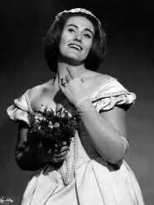
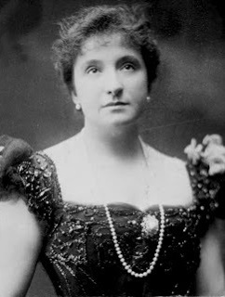
Australian Opera Singers
Australia has a long history of opera singers, possibly the most famous being Dame Nellie Melba and Dame Joan Sutherland
Australia has had a whole alphabet of operatic singers, both male and female.
Dame Joan Sutherland (left) and
Dame Nellie Melba (right)
Notes:
1. https://www.britannica.com/biography/Joan-Sutherland
2. https://d2kdkfqxnvpuu9.cloudfront.net/images/big/67661.jpg?1386697312

Slide 4
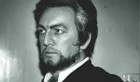
Robert Allman
Robert Joseph Edward Allman (1927-2013) was a bass baritone who sang at the Royal Opera and Covent Garden. He became a principal artist with the Australian Opera in 1965.
4
Notes:
1. http://www.theoperablog.com/obituary-robert-allman-obe-am/
2. http://www.theoperablog.com/obituary-robert-allman-obe-am/

Slide 5
Marie Angel
Marie Angel (1953) is a contemporary soprano opera singer but also sings standard repertoire.
She is one of today’s most thrilling dramatic sopranos and is known for the versatility of her voice, her stage presence and her extraordinary ability to move audiences.
Notes:
https://www.discogs.com/fr/artist/1038046-Marie-Angel
https://mubi.com/cast/marie-angel

Slide 6
Florence Austral
Florence Austral (1892-1968) was born Florence Mary Wilson but adopted the professional surname Austral in 1921 in honour of her homeland of Australia. She was an operatic soprano renowned for her interpretation of the most demanding Wagnerian female roles.
During the mid-1920s she made the first of more than 100 recordings for HMV. In her later years with declining health, she taught singing at the Newcastle Conservatorium.
Notes:
https://en.wikipedia.org/wiki/Florence_Austral
https://www.nma.gov.au/exhibitions/glorious-days/music-films/florence-austral

Slide 7
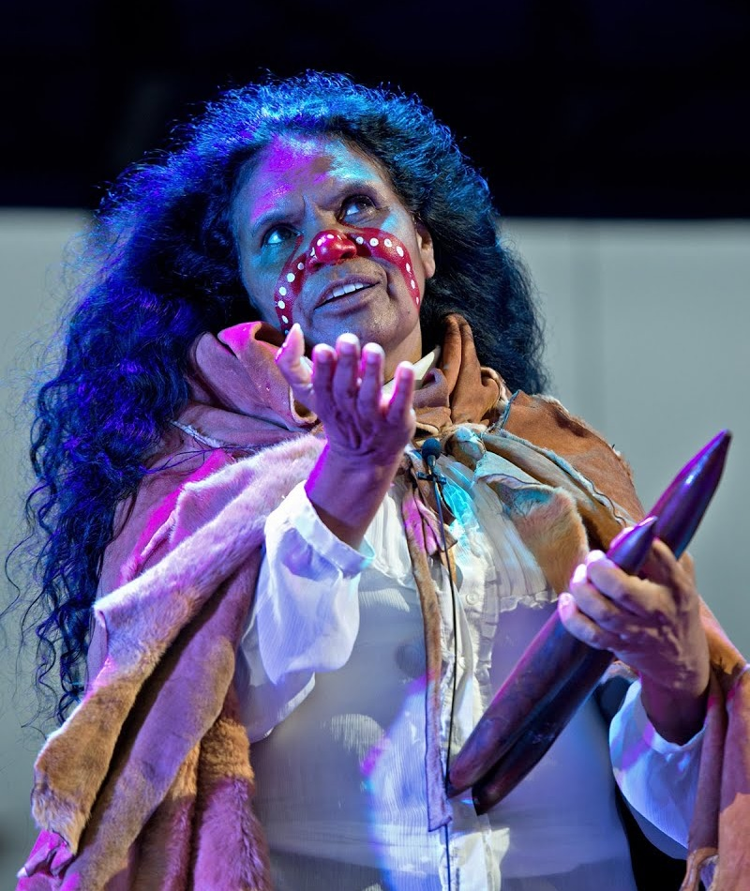
Maroochy Barambah
Maroochy Barambah (born Yvette Isaacs in the 1950s) is an Aboriginal mezzo-soprano. As a tribute to her Aboriginality she took the names Maroochy (meaning "black swan") and Barambah (meaning "source of the western wind").
Her most famous performance was in “Black River” at the Sydney Opera House.
Notes:
1. https://artsandculture.google.com/entity/maroochy-barambah/m04ybjx1

Slide 8
John Brownlee
John Brownlee (1900-1969) was a baritone who won a singing contest even though he had had no singing lessons.
Nellie Melba saw him at a performance of The Messiah and encouraged him. He debuted in the performance of La Boheme where Melba made her farewell appearance.
Brownlee as Sharpless in Puccini's Madama Butterfly (left).
Notes:
https://en.wikipedia.org/wiki/John_Brownlee_(baritone)
http://forgottenoperasingers.blogspot.com/2016/10/john-brownlee-baritone-geelong-victoria.html

Slide 9
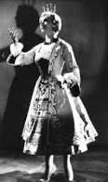
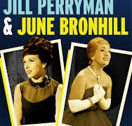
June Bronhill
June Bronhill (1929-2005) was a coloratura soprano, performer and actress. Born June Gough, she changed her name to reflect the town of her birth – Broken Hill.
June sang light opera musicals at the West End theatres and towards the end of her career she played a role in the TV comedy Are You Being Served.
June as Vilja in The Merry Widow (right).
Notes:
https://i.ytimg.com/vi/6o9ejz73PZ0/maxresdefault.jpg
https://i.ebayimg.com/images/g/wr8AAOSw6n5Xqq2m/s-l300.jpg
https://www.youtube.com/watch?v=AjdwkJIPetk

Slide 10
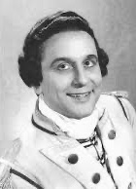
John Cameron
John Cameron (1918-2002) was a baritone who won a national singing competition along with Joan Sutherland in 1948.
He performed with the Elizabethan Opera Company between 1949 and 1974, preferring modern operas such as Diary of a Mad Man and Cadillac.
In his role in Lilac Time by Schubert (left).
Cameron (above and on left) as Point, in Yeomen of the Guard
But only Georges represented international fashion and style in Melbourne
Notes:
http://www.operascotland.org/person/1712/John-Cameron
https://en.wikipedia.org/wiki/John_Cameron_(singer)

Slide 11
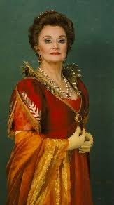
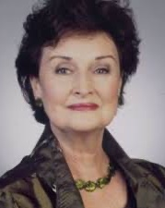
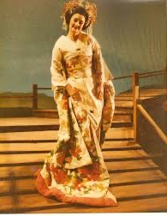
Joan Carden AO OBE (1937) is an Australian operatic soprano. She was an understudy for June Bronhill in The Merry Widow in 1960.
Her debut, with Opera Australia, was in 1971 as Liù in Puccini’s Turandot. She has been described as "a worthy successor to Dame Nellie Melba and Dame Joan Sutherland“.
As Countess Almaviva in The Marriage of Figaro (left) and as Madame Butterfly (right).
Joan Carden
Notes:
https://sydneyuniversitygraduatechoir.com.au/joan-carden-2/
https://alchetron.com/Joan-Carden
https://sydneyuniversitygraduatechoir.com.au/joan-carden-2/

Slide 12
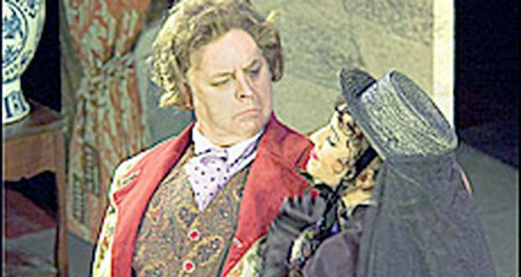
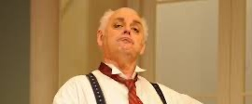
Conal Coad
Conal Coad is known for his dramatic interpretations of the bass repertoire. He performs with the New Zealand Opera Company and Opera Australia. Coad has performed many Benjamin Britten roles such as Bottom in A Midsummer Night’s Dream in Valencia, Spain, Timur in the Handa Opera at the Sydney Harbour production of Turandot.
He is shown in the role of Don Pasquale in two different performances – above below at the Kerikeri Centre.
But only Georges represented international fashion and style in Melbourne
Notes:
https://www.nzherald.co.nz/lifestyle/news/article.cfm?c_id=6&objectid=10394390
http://elissablake.blogspot.com/2013/07/conal-coad.html

Slide 13
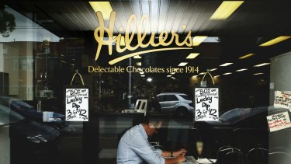
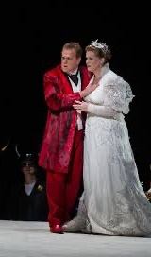
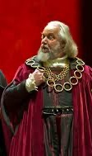
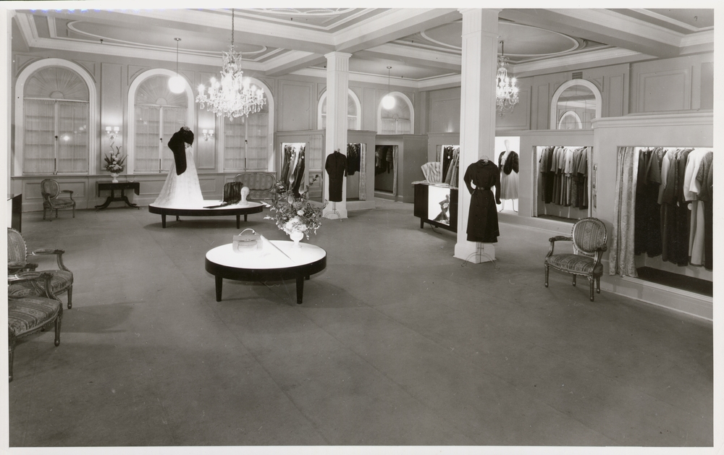
Peter Coleman-Wright
Peter Coleman-Wright (1958) is a baritone and has performed many traditional roles with the English National Opera. In 2002, he won the Helpmann Award for Best Male Actor in a Musical for his role in Sweeney Todd: The Demon Barber of Fleet Street.
He is shown as Gunther in Gutterdamerung (left) and as Beckmesser in Die Meistersinger (right).
But only Georges represented international fashion and style in Melbourne
Notes:
http://www.roh.org.uk/people/peter-coleman-wright
https://www.flickr.com/photos/royaloperahouse/6537516865/

Slide 14
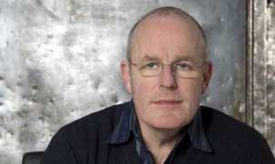
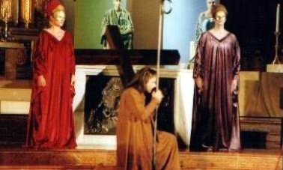
Martin Cooke
Martin Cooke (1955) is a baritone and is the first Australian to become a member of the Bavarian State Opera Chorus.
He is seen here as St Peter in Il Lutto dell'Universo – The Mourning of the Universe.
Notes:
http://www.operafolks.com/Cooke/multimedia.html
http://www.operafolks.com/Cooke/englishcv.html

Slide 15
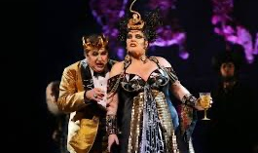
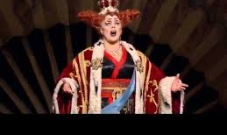
Jacqueline Dark
Jacqueline Lisa Dark was born in Ballarat and trained as a mezzo-soprano at the Victorian College of the Arts.
Dark has played most of the major classical female roles: Donna Elvira – Don Giovanni, Marcellina – Marriage of Figaro, Maddalena – Rigoletto, Emilia- Otello, Flora – La Traviata, Suzuki – Madam Butterfly, Carmen – Carmen.
Jacqueline as Herodias in Salome (below) and as Katisha, singing “Alone Yet Alive” from The Mikado (below).
15
Notes:
http://soundslikesydney.com.au/news/the-dark-side-of-mothering-herodias-in-salome/9484.html
https://www.youtube.com/watch?v=bBZX4taI0IU

Slide 16
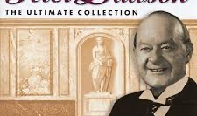
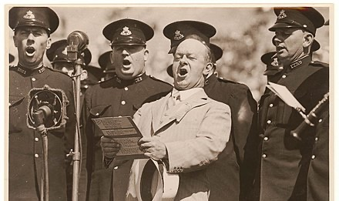
Peter Dawson
Peter Dawson (1882-1961) born in Adelaide, was a baritone and song writer. While Dawson didn’t perform operas, he was known for his technically excellent vocal abilities through his renditions of operatic arias, oratorio solos and rousing ballads.
In 1984, Dawson was chosen by the Guinness Book of Recorded Sound as one of the top 10 singers on disc of all time.
In 2007, Peter Dawson's 1931 recording of Along the Road to Gundagai was added to the National Film and Sound Archive's Sounds of Australia registry.
16
Notes:
https://open.spotify.com/album/4yv73YQBFpyURH6vLJMHqg?highlight=spotify:track:2Gx3YgDhlc11mW5AvoswFN
https://en.wikipedia.org/wiki/Peter_Dawson_(bass-baritone)

Slide 17
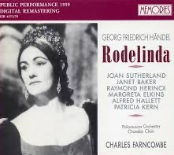
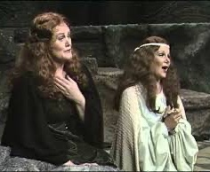
Margreta Elkins
Margreta Elkins (1930-2009), a mezzo-soprano, sang on many of the world’s opera stages and with Maria Callas and Joan Sutherland.
Callas had heard Elkins in rehearsal and chose her to sing Alisa for the EMI recording of Lucia di Lammermoor.
Margreta is seen here (below left) with Joan Sutherland in Vincenzo Bellini’s Norma.
Notes:
https://rateyourmusic.com/release/album/the-philomusica-of-london-chandos-choir-charles-farncombe-joan-sutherland-janet-baker-raimund-herincx-margreta-elkins-alfred-hallett-patricia-kern/rodelinda/
https://www.youtube.com/watch?v=GN75XDDm_DI
https://greatsingersofthepast.wordpress.com/2017/10/18/margreta-elkins-mezzo-soprano/

Slide 18
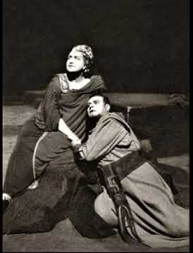
Sylvia Fisher
Sylvia Fisher AM (1910-1996) was an operatic soprano, especially distinguished in German opera.
She also appeared as soloist with the leading choral societies and orchestras, and at music festivals under the batons of the most famous conductors.
Notes:
https://www.discogs.com/artist/1347074-Sylvia-Fisher
https://www.youtube.com/watch?v=sXqNHJvQujE

Slide 19
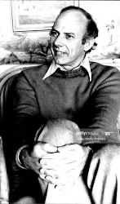
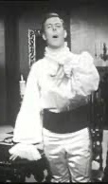
Clifford Grant
Clifford Grant (1930) is a bass singer. He had his debut at the Royal Opera House in The Marriage of Figaro, in the role of Doctor Bartolo.
Grant participated in numerous recordings of operas, such as: Norma, Esclarmonde, the collection of all late Italian operas by Mozart, Lucia di Lammermoor, Tosca, Rigoletto, and Wagner's Ring cycle.
Notes:
1. https://www.gettyimages.no/detail/news-photo/mr-clifford-grant-who-is-in-australian-to-sing-in-the-news-photo/1078793420
2. https://www.youtube.com/watch?v=US5fxBsXFk0

Slide 20
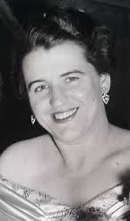
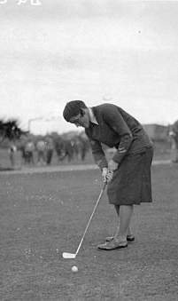
Dame Joan Hammond
Joan Hilda Hood Hammond, DBE, CMG (1912-1996) was an Australian operatic soprano, singing coach and champion golfer. What a combination!
Her final performance was at the funeral of Lady Gowrie, at St George's Chapel, Windsor Castle. Hammond was the first woman ever granted royal permission to sing in that chapel.
Notes:
1. https://www.discogs.com/artist/1434565-Joan-Hammond
2. https://en.wikipedia.org/wiki/Joan_Hammond#

Slide 21
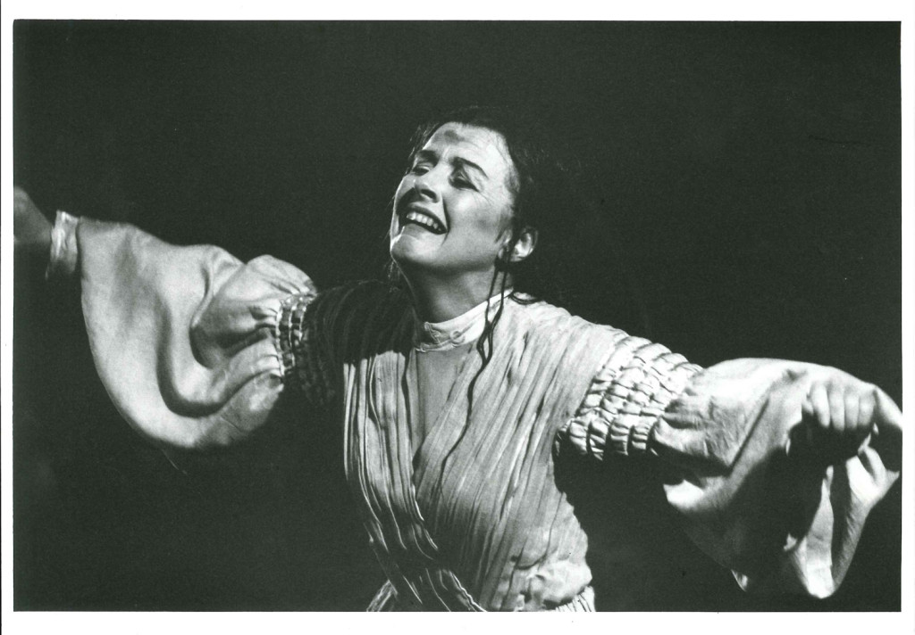
Eilene Hannan
Eilene Hannan AM (1946-2014) was an operatic soprano with an international reputation. She was particularly associated with opera sung in English, although she also sang in other languages.
On the right she is shown in the title role of Janacek’s Katya Kabanova in 1995.
Notes:
http://www.theoperablog.com/eilene-hannan-passes-away-aged-67/
http://www.theoperablog.com/eilene-hannan-passes-away-aged-67/

Slide 22
David Hansen
David Hansen (1981) is a counter tenor, the highest register for the male singing voice. He studied at the Sydney Conservatorium of Music.
He made his European debut in 2004 at the Aix-en-Provence Festival in Purcell’s Dido and Aeneas.
Hansen is pictured here as Farinelli in Broschi’s Merope which was performed for the first time in 287 years at Alte Musik in Berlin.
But only Georges represented international fashion and style in Melbourne
Notes:
https://www.youtube.com/watch?v=3hyI2apSMKo
https://twitter.com/guywhosingshigh

Slide 23
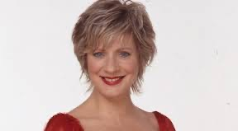
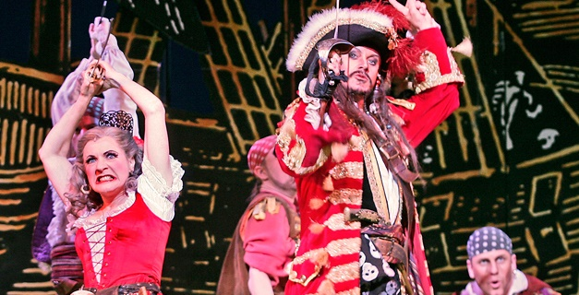
Suzanne Johnstone
Suzanne Johnstone (1958), a mezzo-soprano, was born in Murrumbeena! She had singing lessons with Joan Hammond.
Along with Judi Connelli she won the 1999 ARIA Award for Best Original Cast or Show Album for their album Perfect Strangers.
Suzanne above in The Pirates of Penzance.
Notes:
https://opera.org.au/artists/suzanne-Johnston
https://opera.org.au/artists/suzanne-johnston

Slide 24
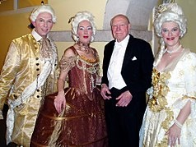
Glenn Kesby
Glenn Kesby (1970) is a counter tenor specialising in Baroque music. Glenn made his professional singing debut at the 25th Handel Festival in Karlsruhe, Germany, where he played Adelberto in Ottone.
Glenn (left) is shown with the cast of 2005 Baroque Encounter production of Handel's Parnasso.
Notes:
1. https://en.wikipedia.org/wiki/Glenn_Kesby

Slide 25
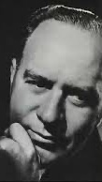
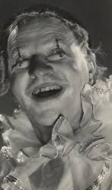
Arnold Matters
Arnold Matters AO (1901-1990) was a baritone who performed with Saddler’s Wells in the 1930s and 40s.
He started a career as an accountant, but after winning the Sun Aria prize, Dame Nellie Melba invited him to join her touring company. He was a great success.
Notes:
https://www.youtube.com/watch?v=c0E8rPu-u-k
https://www.discogs.com/artist/3623445-Arnold-Matters

Slide 26
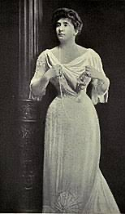
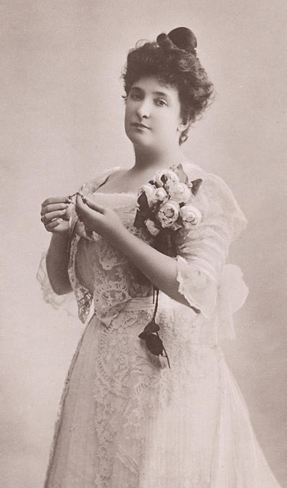
Dame Nellie Melba
Dame Nellie Melba (1861-1931) was born Helen Porter Mitchell. She was an operatic lyric soprano who took the professional name ‘Melba’ after her hometown of Melbourne.
Dame Nellie studied singing in Melbourne but became famous once she went to Paris.
Melba made her Covent Garden début in May 1888, in the title role in Lucia di Lammermoor.
Notes:
1. https://en.wikipedia.org/wiki/Nellie_Melba
2. https://en.wikipedia.org/wiki/Nellie_Melba

Slide 27
Dame Nellie Melba
Notes:
https://www.telegraph.co.uk/culture/tvandradio/downton-abbey/10242588/Nellie-Melba-the-greatest-diva-from-Down-Under.html
https://www.melbaoperatrust.com.au/about/attachment/about-dame-nellie-melba/

Slide 28
Dame Nellie Melba
She was an active fundraiser for the war effort, singing for charities.
Dame Nellie returned to Australia many times during the 20th century and sang up until the last months of her life. She actively supported up and coming singers.
Melba is pictured here as Desdemona.
She is commemorated on the $100 note.
But only Georges represented international fashion and style in Melbourne
Notes:
https://cv.vic.gov.au/stories/creative-life/dame-nellie-melba/signed-photograph-of-nellie-melba-as-desdemona-in-otello-1924/
https://en.wikipedia.org/wiki/Australian_one-hundred-dollar_note

Slide 29
Eva Mylott
Eva Mylott (1875-1920) was born in New South Wales and was a contralto.
Dame Nellie Melba helped Eva by sending her to Melba’s own Parisian singing coach.
Eva appeared at the Metropolitan Opera with Nellie Melba in 1914.
Eva Mylott was the paternal grandmother of Mel Gibson.
Notes:
http://www.turosshead.org/Pages/EvaMylott.htm
https://en.wikipedia.org/wiki/Eva_Mylott

Slide 30
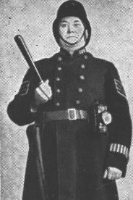
John Ralston
John Ralston (1882-1933) was a baritone (or perhaps bass-baritone) singer noted for his work in musical comedies and Gilbert and Sullivan operas.
While travelling with the Lilliputian Opera Company in the early 1900s, he was discovered by JC Williamson, with whose Light Opera Company he remained the rest of his life.
Ralston is shown here as The Sergeant in Trial By Jury.
Notes:
1. https://en.wikipedia.org/wiki/John_Ralston_(baritone)

Slide 31
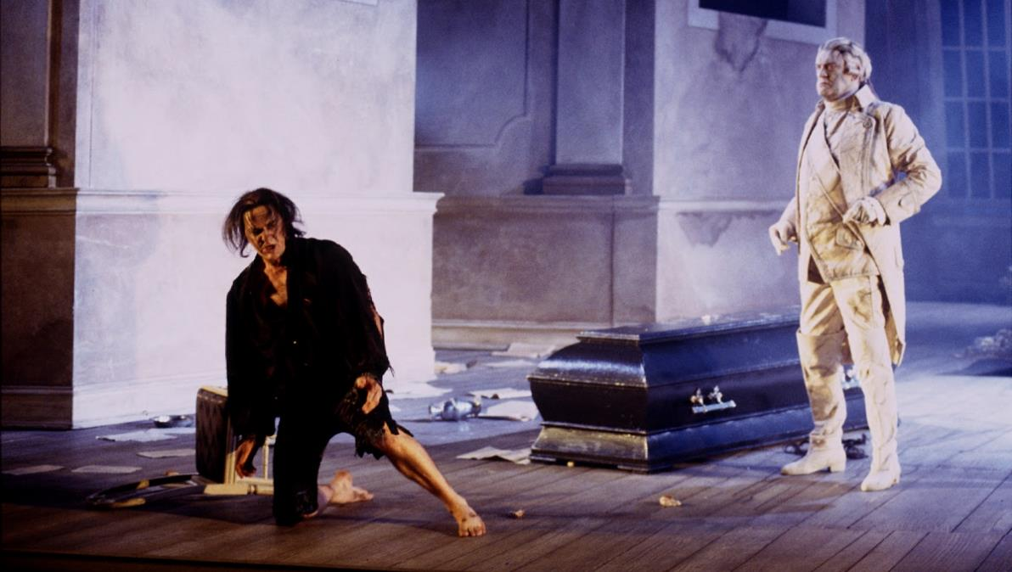
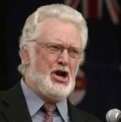
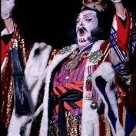
Donald Shanks
Donald Robert Shanks, AO, OBE (1940-2011) was a bass-baritone who sang over 65 principal roles with Opera Australia and other companies in Australia and overseas.
He joined the Elizabethan Theatre Trust Opera Company in 1964, aged 23.
He was also a talented Wagnerian singer.
Notes:
https://www.smh.com.au/national/choirboy-start-for-operas-high-priest-20110513-1em78.html
https://artsandculture.google.com/asset/stephen-bennett-and-donald-shanks-in-don-giovanni-opera-australia/7AH-z72BW-RzhQ?hl=en
https://www.limelightmagazine.com.au/wp-content/uploads/2014/08/DonaldShanks.jpg

Slide 32
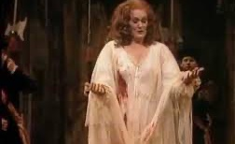
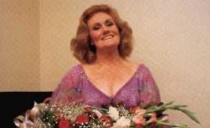
Dame Joan Sutherland
Dame Joan Sutherland (1926-2010) was taught piano and voice by her mother until she was 19.
In 1951 she won Australia’s most prestigious singing award: the Sun Aria.
She joined the Covent Garden company where she made her debut on 28 October 1952, as the First Lady in Die Zauberflote.
In 1959, after a long apprenticeship, she appeared in Lucia di Lammermoor which launched her career.
Her vast repertoire and magnificent voice earned her the nickname “La Stupenda”.
Notes:
https://www.youtube.com/watch?v=LdE_z1DNtig
https://www.youtube.com/watch?v=r9wWBK5VgxA

Slide 33
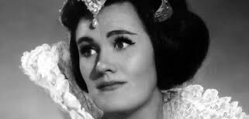
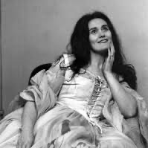
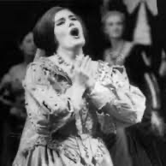
Dame Joan Sutherland
Notes:
https://talesoftessitura.wordpress.com/2018/01/05/my-favourite-opera-singers-joan-sutherland/
https://www.lyricopera.org/about-lyric-opera/legends-of-lyric/dame-joan-sutherland/
https://www.youtube.com/watch?v=zwBUPYkRFBM

Slide 34
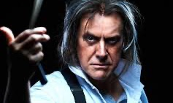
Anthony Warlow
Anthony Warlow, AM (1961) is an opera and musical theatre performer, noted for his character acting and considerable vocal range. He is a classically trained lyric baritone.
Warlow's roles with Opera Australia range from Papageno in The Magic Flute to Ko-Ko in The Mikado, though it is in his role as The Phantom in The Phantom of the Opera that caused him to become so well-known.
Notes:
https://opera.org.au/artists/anthony-warlow
https://www.stagewhispers.com.au/news/anthony-warlow-and-gina-riley-sweeney-todd

Slide 35
Anthony Warlow
As the Wizard in The Wizard of Oz (left).
The role as Dr Zhivago was created specially for Warlow (top right).
As the Phantom in The Phantom of the Opera (bottom right).
Notes:
https://www.dailytelegraph.com.au/entertainment/arts/wizard-of-oz-star-anthony-warlow-on-why-he-never-stops-learning/news-story/916449a00f7e9a19a1f1cb9f80429bc9
https://www.heraldsun.com.au/entertainment/confidential/doctor-zhivago-was-made-for-anthony-warlow-and-now-it-heads-to-broadway/news-story/2854283d824e0029162895c5b2ac319e
https://www.abc.net.au/news/2007-10-23/anthony-warlow-and-ana-marina-perform-during-the/707128?nw=0

Slide 36
I hope you have enjoyed this musical journey through time.
Notes:
http://www.rpac.com.au/pages/performances.aspx?PerfID=516
https://classicsdirect.com.au/from-melb-to-sutherland/

Slide 37
The Rotary Club of Canterbury “Let’s Stay Connected Project” has been developed as a response to an identified need within the Aged Care sector.
At times when it’s difficult to connect in person with family and friends, the Rotary Club of Canterbury has pleasure in offering you this booklet, designed to promote conversation, recollection and engagement for those who are in isolation and without their usual social activities.
The booklets have been designed for people in an aged care residence, village or at home to read by themselves, or to have a family or staff member share the booklet with them.
You can download this and other booklets from the Rotary Club of Canterbury website (www.canterburyrotary.org).
Source references for this book are held at the Rotary Club of Canterbury. Contact president@caterburyrotary.org for further details.
Material in this book was reproduced in accordance with Section 113F of the Copyright Act (1968).

