Slide 1

Belle
Paris!
Beautiful Paris
Notes:
Author’s own photograph (of a postcard)

Slide 2

The Rotary Club of Canterbury “Let’s Stay Connected Project” has been developed as a response to an identified need within the Aged Care sector.
At times when it’s difficult to connect in person with family and friends, the Rotary Club of Canterbury has pleasure in offering you this booklet, designed to promote conversation, recollection and engagement for those who are in isolation and without their usual social activities.
The booklets have been designed for people in an aged care residence, village or at home to read by themselves, or to have a family or staff member share the booklet with them.
You can download this and other booklets from the Rotary Club of Canterbury website (www.canterburyrotary.org).
Source references for this book are held at the Rotary Club of Canterbury. Contact president@caterburyrotary.org for further details.
Material in this book was reproduced in accordance with Section 113F of the Copyright Act (1968).

Slide 3
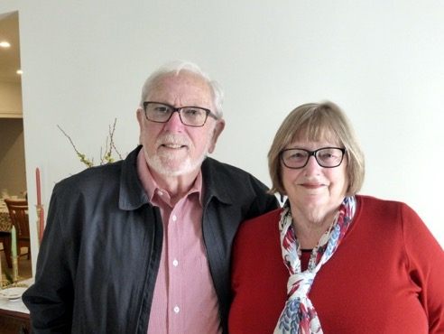
Je m’appelle Carolyn.
I’m a friend of the Rotary Club of Canterbury, Melbourne Australia.
My husband Roger and I have visited Paris several times. This booklet recounts just some of the different places we visited and the places we saw, stayed in, what we ate and explored.
I hope you enjoy my short stroll through some of my favourite Parisian memories.
Caroline and Roger
Notes:
Author’s own photograph

Slide 4
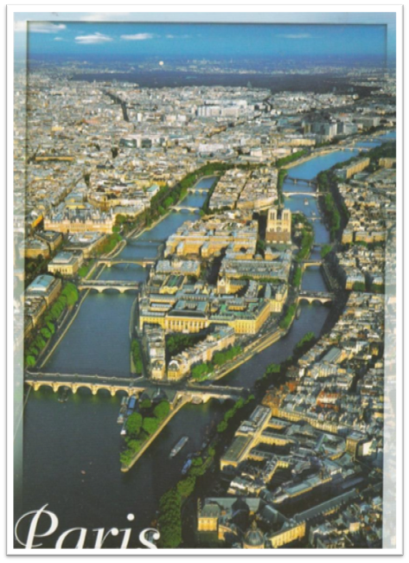
J’aime Paris!
I love Paris!
This photo shows the River Seine running either side of the Île de la Cité (island of the city).
Notes:
Author’s own photograph (of a postcard)

Slide 5
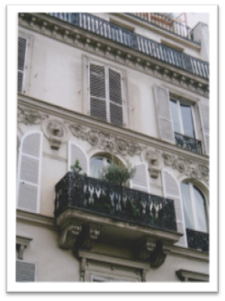
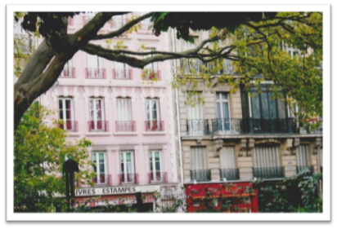
What makes Paris so beautiful?
The buildings of Paris are mostly of three to five storeys, built of stone. Pretty ironwork is used to decorate the balconies.
Notes:
Author’s own photograph

Slide 6
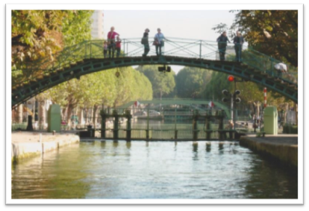
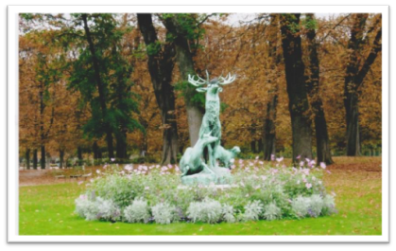
What makes Paris so beautiful?
Paris has wide boulevards, squares, parks and gardens.
Dotted around Paris are quaint bridges, canals and lovely sculptures.
Notes:
Author’s own photographs

Slide 7
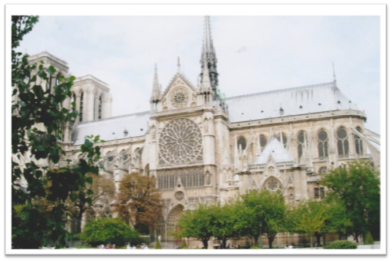
Notre Dame Cathedral
Notre Dame is a famous Gothic cathedral of the Middle Ages.
This photo was taken from the River Seine before the great fire of 2019.
Notes:
Author’s own photograph

Slide 8
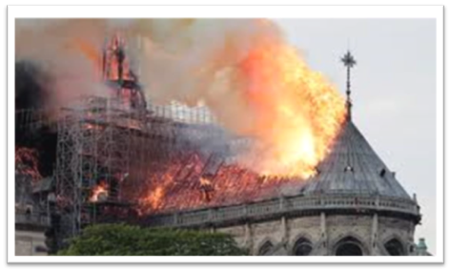
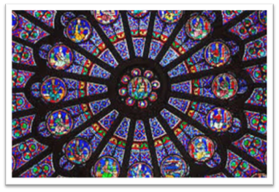
Notre Dame Cathedral
The fire destroyed the 92-metre high spire, much of the roof and the interior.
This photo shows one of the beautiful rose windows that was saved.
Notes:
Author’s own photographs

Slide 9
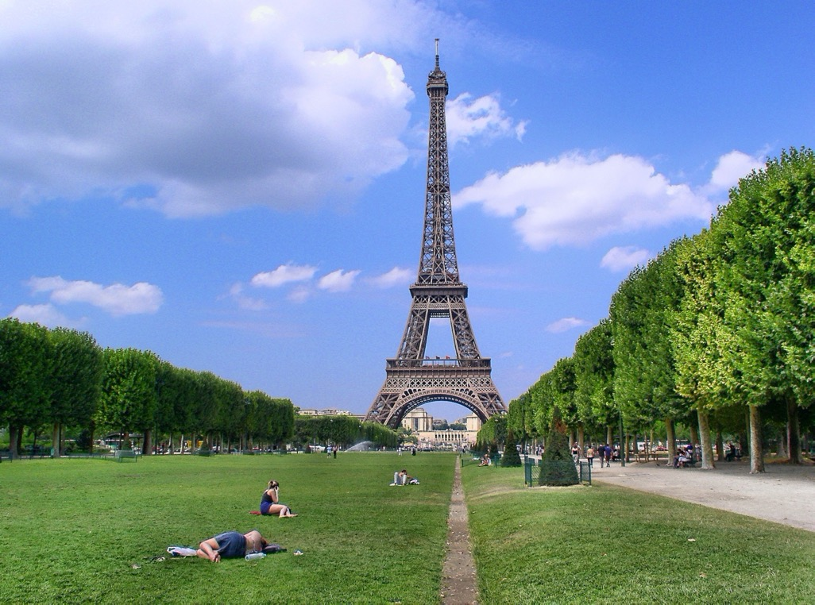
The Eiffel Tower
The Eiffel Tower was built for the 1889 World Fair to mark the 200th anniversary of the French Revolution.
Notes:
https://get.pxhere.com/photo/eiffel-tower-paris-monument-tower-symbol-park-landmark-memorial-field-of-mars-1064341.jpg

Slide 10
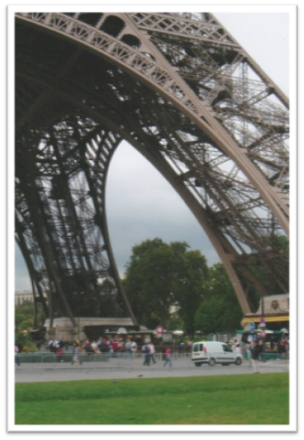
The Eiffel Tower
The Eiffel Tower is 300 metres tall and 125 metres wide. It took two years to build.
The designer was Gustav Eiffel and his iron girder design was not universally liked when it was built.
Notes:
Author’s own photograph

Slide 11
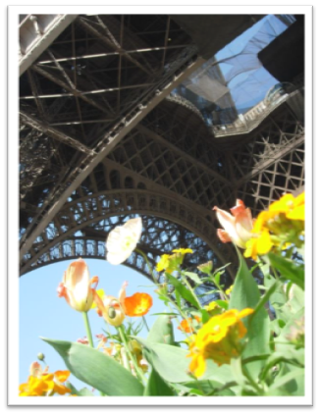
The Eiffel Tower
In 1982 our family watched the end of the Tour de France bicycle race from the Eiffel Tower. We didn’t know it was on and were there by happy chance.
I love the contrast in this photo between the colour of the flowers and the grey ironwork.
Notes:
Author’s own photograph

Slide 12
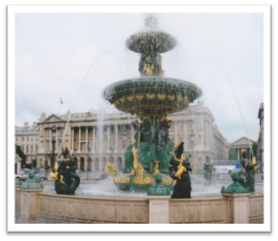
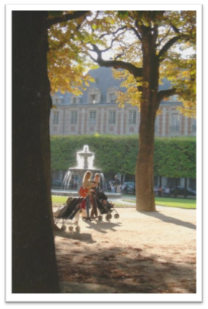
The Gardens of Paris
Some of my favourite gardens, fountains and squares (‘place’) are Place de Concorde (right) and Place des Voges (left).
Built in the 1790s, the Place de Concorde was originally for public executions.
Notes:
Author’s own photographs

Slide 13
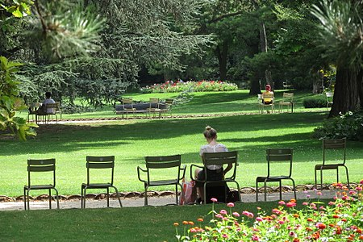
The Gardens of Paris
The Jardin du Palais Royal is a small garden.
You are not allowed to walk on the grass!
Notes:
https://en.wikipedia.org/wiki/Jardin_du_Luxembourg
https://en.wikipedia.org/wiki/Jardin_du_Luxembourg

Slide 14
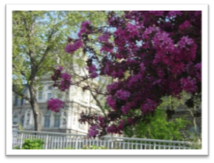
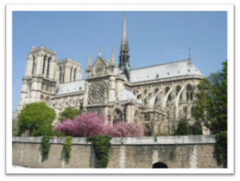
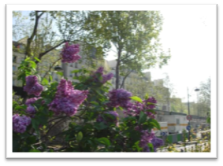
The Gardens of Paris
Sometimes during our walks we would come across glorious purple lilacs and blossom trees.
Notes:
Author’s own photographs

Slide 15
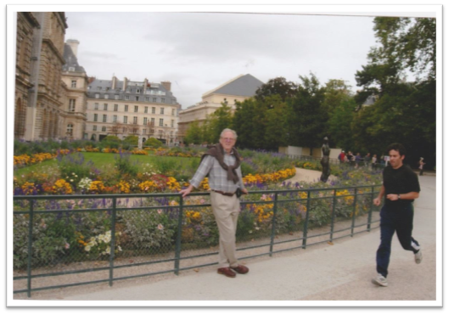
The Gardens of Paris
The Luxemburg Gardens, in the heart of Paris, are always full of people walking, sitting or having ‘le picnic’.
This is my husband in front of one of the flower gardens in the Luxembourg Gardens.
Notes:
Author’s own photograph

Slide 16
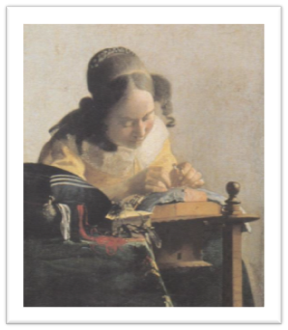
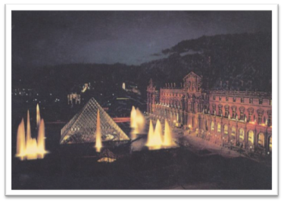
Museums and Galleries
Le Louvre is the most famous Paris gallery. This photo, taken at night, shows the fountains and the glass Pyramid very well.
This is my favourite painting, ‘The Dressmaker’, by Johannes Vermeer.
Notes:
Author’s own photographs

Slide 17
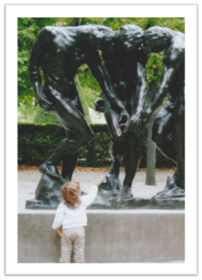
Museums and Galleries
We like the photo of the little girl touching the feet of one of the Auguste Rodin sculptures in his sculpture park.
Notes:
Author’s own photograph

Slide 18
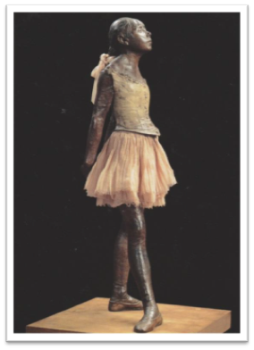
Museums and Galleries
This sculpture by Edward Degas is called ‘Petite Danseuse’.
It is in the Musée D’Orsay which houses many Impressionist paintings and other works of art.
Notes:
Author’s own photograph

Slide 19
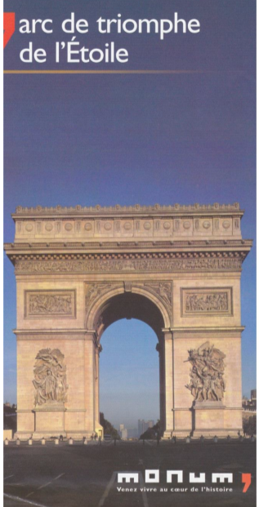
Arc de Triomphe
The Arc de Triomphe was built by Napoleon in 1806.
It is at the head of the world renowned, cobbled boulevard, the Champs Elysée, which you can just see through the arch.
Notes:
Author’s own photograph (of a postcard)

Slide 20
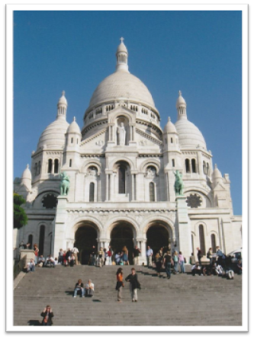
Churches
Sacre Coeur Basilica, built in 1910, is a well recognized landmark in Paris, high on the hill in Montmartre.
It is made of white travertine stone which stands out against the blue sky. To reach the basilica, you walk up huge flights of steps.
Notes:
Author’s own photograph

Slide 21
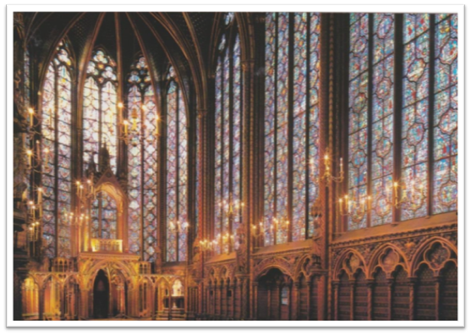
Churches
Sainte Chapelle was built in 1248 as a small royal chapel.
There are 1113 stained glass windows which sparkle like jewels.
Notes:
Author’s own photograph

Slide 22
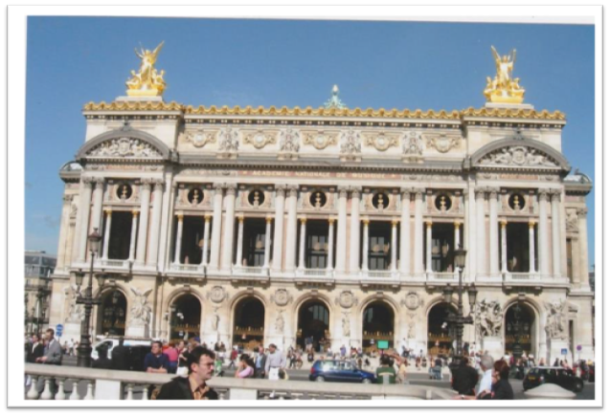
Palais Garnier
One evening we went to the famous opera house called Palais Garnier. It is sometimes compared to a wedding cake.
Notes:
Author’s own photograph

Slide 23
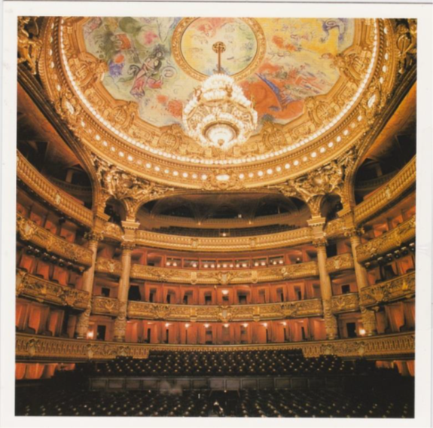
Palais Garnier
The interior of the Palais Garnier is a riot of gold and red. We saw a ballet there.
Notes:
Author’s own photograph

Slide 24
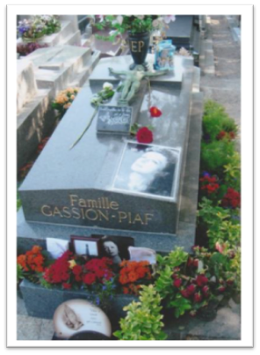
Père Lachaise Cemetery
Père Lachaise Cemetery contains the grave of Edith Piaf, known as ‘the Little Sparrow’, who was famous for singing ‘Je ne regrette rien’.
Someone leaves red roses on her grave every day.
Notes:
Author’s own photograph

Slide 25
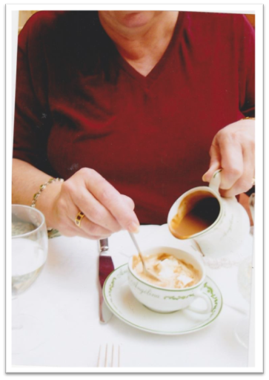
Cafés in Paris
One of my favourite things in Paris is to have hot chocolate at ‘Angelinas’, a famous cafe.
This one is very rich and chocolatey. Yum!
Notes:
Author’s own photograph

Slide 26
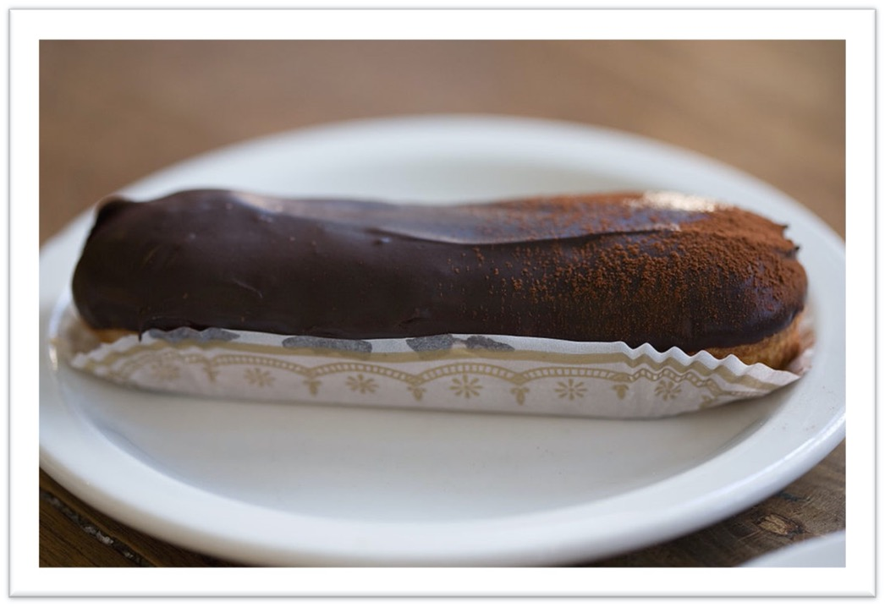
Cafés in Paris
Each day, wherever we went, we bought a chocolate éclair.
We LOVE éclairs – when they are made by French pastry cooks.
Notes:
https://en.wikipedia.org/wiki/%C3%89clair#/media/File:Eclair_1120005560.jpg

Slide 27
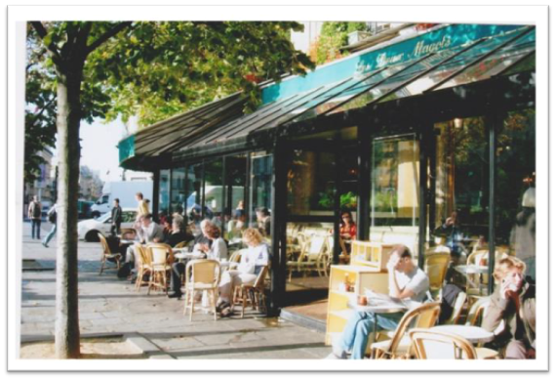
Cafés in Paris
Les Deux Magots (the two stout men) pictured here, is a cafe which was the haunt of the literary and intellectual elite in the 1900s.
Now it is mostly frequented by tourists and is rather expensive!
Notes:
Author’s own photograph

Slide 28
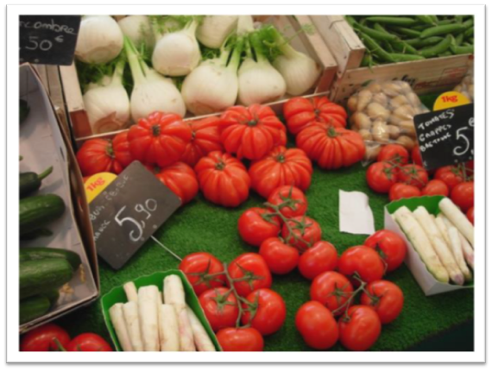
Markets
I love cooking and we visit markets whenever we travel.
This photo shows white asparagus which has a delicate flavour.
Notes:
Author’s own photograph

Slide 29
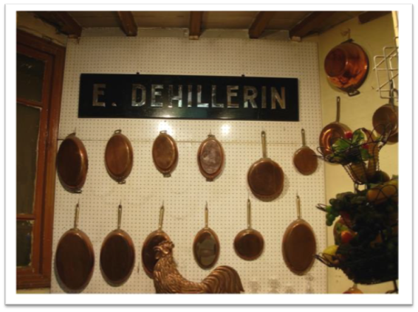
A Specialist Shop
Paris has a shop famous for kitchen ware including copper pans.
I bought a tiny copper pot which I use when I want only a small amount of a sauce.
Au revoir. À bientôt!
Goodbye. See you later!
Notes:
Author’s own photograph

