Slide 1

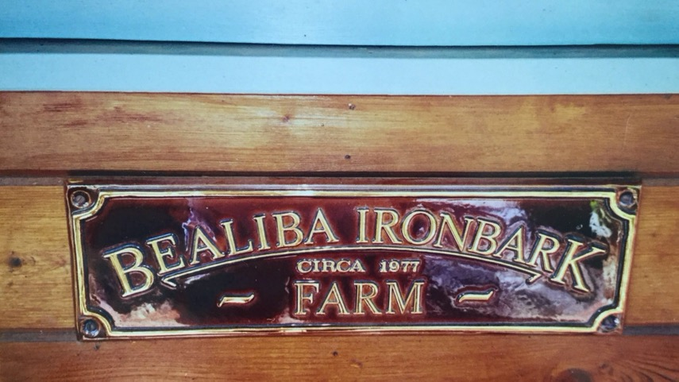
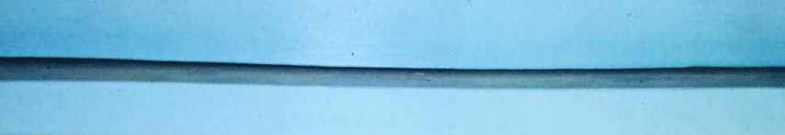
My Victorian Farm
By David Shave
Rotary Club of Canterbury: Let's Stay Connected Project

Slide 2
The Rotary Club of Canterbury “Let’s Stay Connected Project” has been developed as a response to an identified need within the Aged Care sector.
At times when it’s difficult to connect in person with family and friends, the Rotary Club of Canterbury has pleasure in offering you this booklet, designed to promote conversation, recollection and engagement for those who are in isolation and without their usual social activities.
The booklets have been designed for people in an aged care residence, village or at home to read by themselves, or to have a family or staff member share the booklet with them.
You can download this and other booklets from the Rotary Club of Canterbury website (www.canterburyrotary.org.
Source references for this book are held at the Rotary Club of Canterbury. Contact president@caterburyrotary.org for further details.
Material in this book was reproduced in accordance with Section 113F of the Copyright Act (1968).

Slide 3

BUYING A FARM
Hello, my name is David.
From a very early age, I always wanted to be a farmer.
Due to a lack of post-secondary education and a frequent shortage of the required funds, it was years before I could fulfil my passion.
However, at age 40, I became aware of available land next to a large property on which I had jackarooed. I managed to gather the funds to purchase 250 acres at a location called Emu, some 90 miles west of Bendigo and 20 miles east of St Arnaud.
It was given the august name “Bealiba Ironbark Farm”.
Please enjoy this story.
David
Notes:
1. Photo from the personal collection of the author.

Slide 4
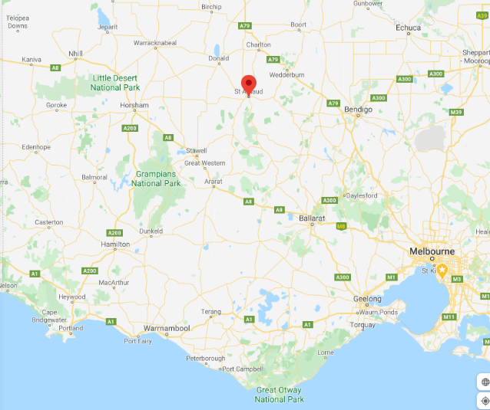
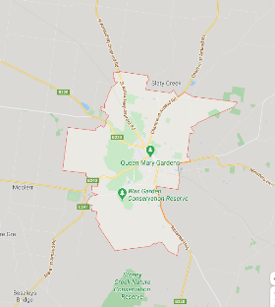
This map shows St Arnaud.
You may have driven through the town on the Sunraysia highway.
The inset is Bealiba Ironbark Farm.
Notes:
Caravan Picture: https://yandex.com/images/search?pos=0&url=https%3A%2F%2Ftemp-ca.s3.amazonaws.com%2Fcdn-files%2Fris_ss47803459sst1598610930.png%3FX-Amz-Content-Sha256%3DUNSIGNED-PAYLOAD%26X-Amz-Algorithm%3DAWS4-HMAC-SHA256%26X-Amz-Credential%3DAKIAIDCPACSZZCN62NGQ%252F20200828%252Fus-east-1%252Fs3%252Faws4_request%26X-Amz-Date%3D20200828T103531Z%26X-Amz-SignedHeaders%3Dhost%26X-Amz-Expires%3D300%26X-Amz-Signature%3D5559da2f680418a52f7e0d1ad243555e296188463d3c467de6dd619110810c05&img_url=https%3A%2F%2Fstatic.dezeen.com%2Fuploads%2F2016%2F11%2Fdojo-wheels-caravan-transport-mobile-office-interior-design-five-am-belgium-architizer-a-awards-2016_dezeen_sq.jpg&rpt=imagelike&source=collections
2. Google maps
https://www.google.com/search?q=caravan&rlz=1C1CHBF_en-GBAU907AU907&sxsrf=ALeKk02f9tetfC16gbB2UCumzRAKydFiQg:1598161753594&source=lnms&tbm=I
Maps: Google Maps, St Arnaud and Emu

Slide 5
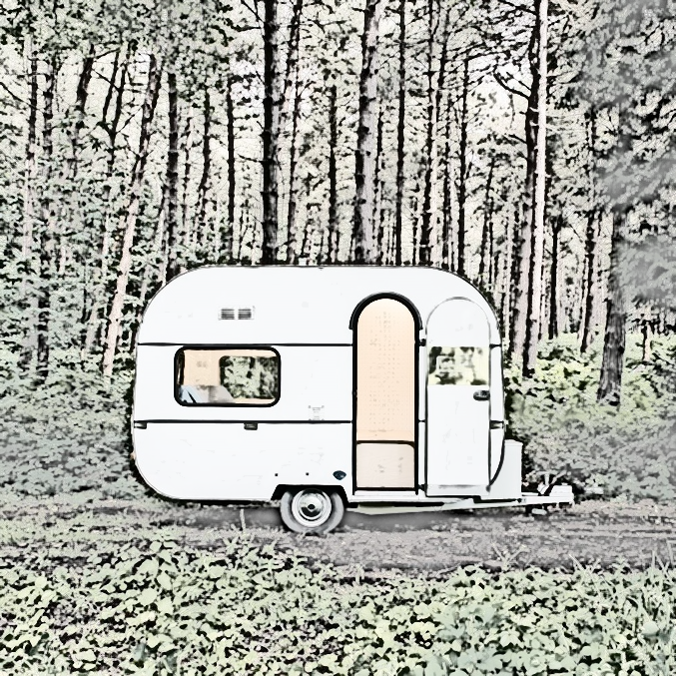
Early Days
In order to visit the farm, which was a 3 hour drive from Melbourne, I acquired a small caravan. Progressively, with second hand materials, I constructed what was little more than a camp with no electricity or other creature comforts.

Slide 6
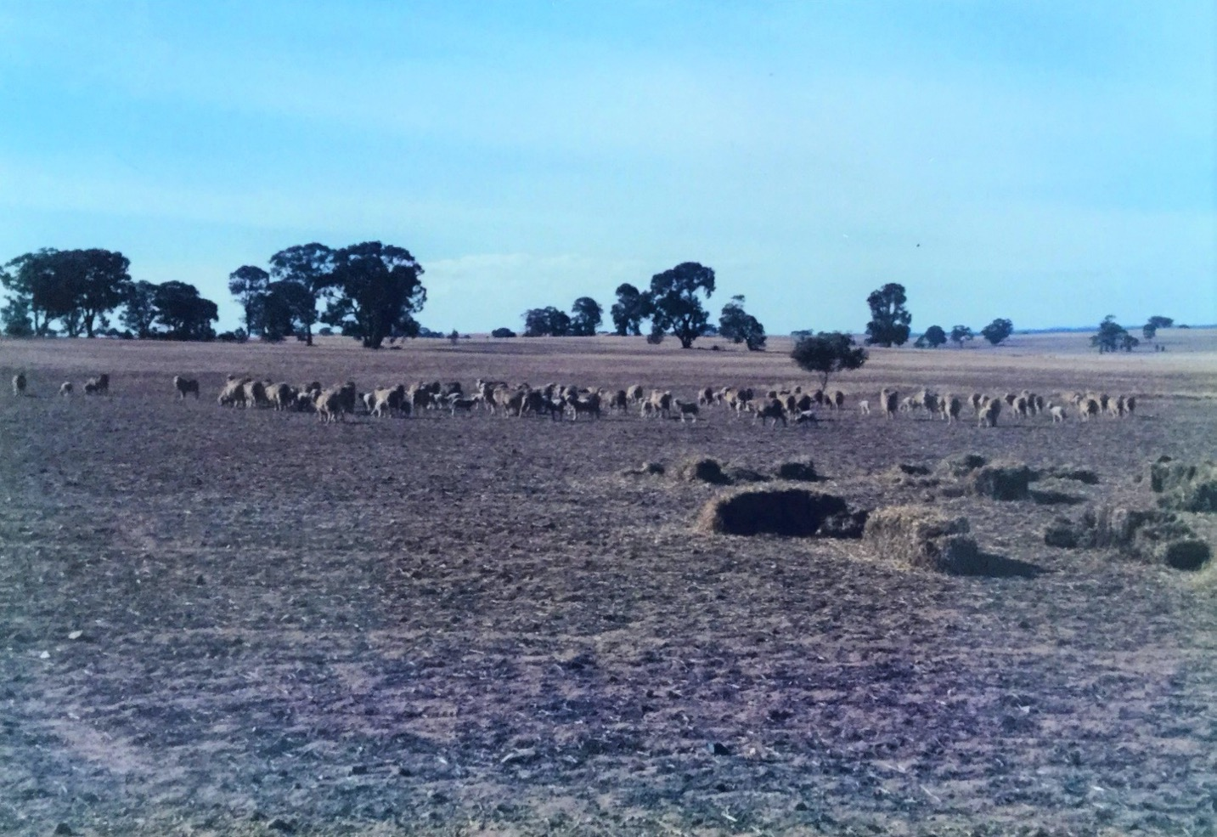
Times of Drought
The drought of 1984-5 was somewhat of a disaster for the small flock of sheep I had developed.
The photo shows how I attempted to keep the sheep fed, because there was absolutely no grass.
Notes:
Photo is from the author's personal collection

Slide 7
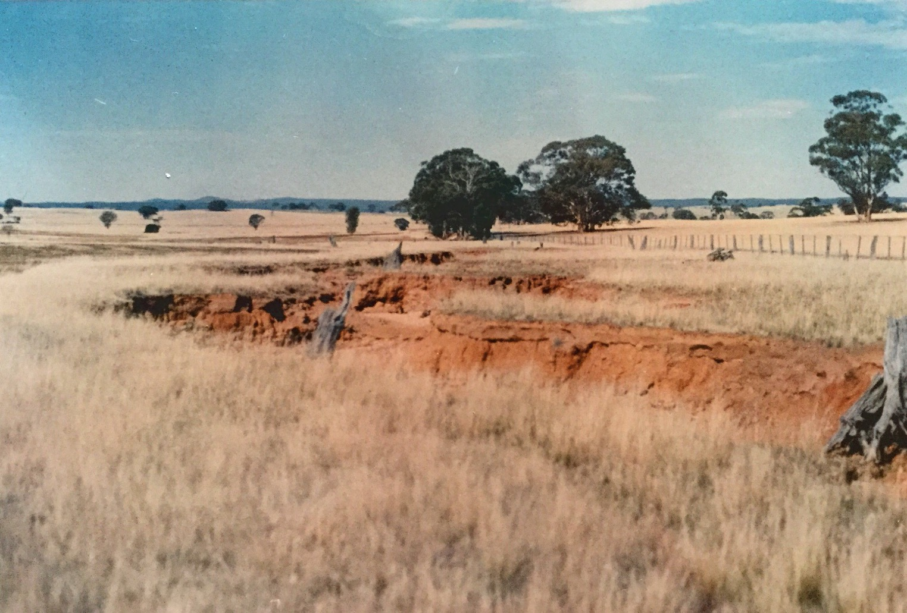
Dealing With Erosion
When I first occupied the farm, there was considerable erosion, as shown.
It took some years before I was able to have the erosion controlled. The photo shows just one of the major scars.
Notes:
Photo is from the author's personal collection

Slide 8
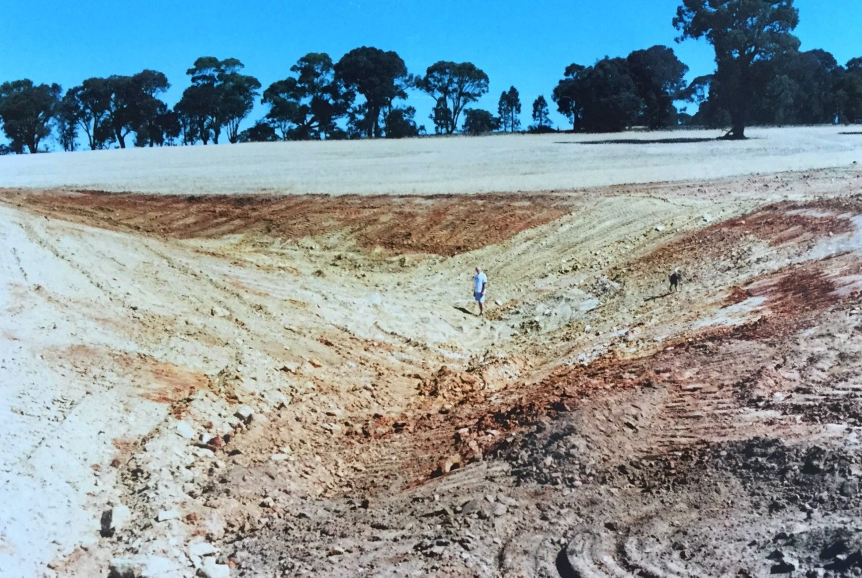
Construction of a Dam
Fortunately, my neighbour had a bulldozer which he loved operating and was really competent in constructing dams.
The picture shows one of the larger dams at about 20 feet at its deepest.
Notes:
Photo is from the author's personal collection

Slide 9
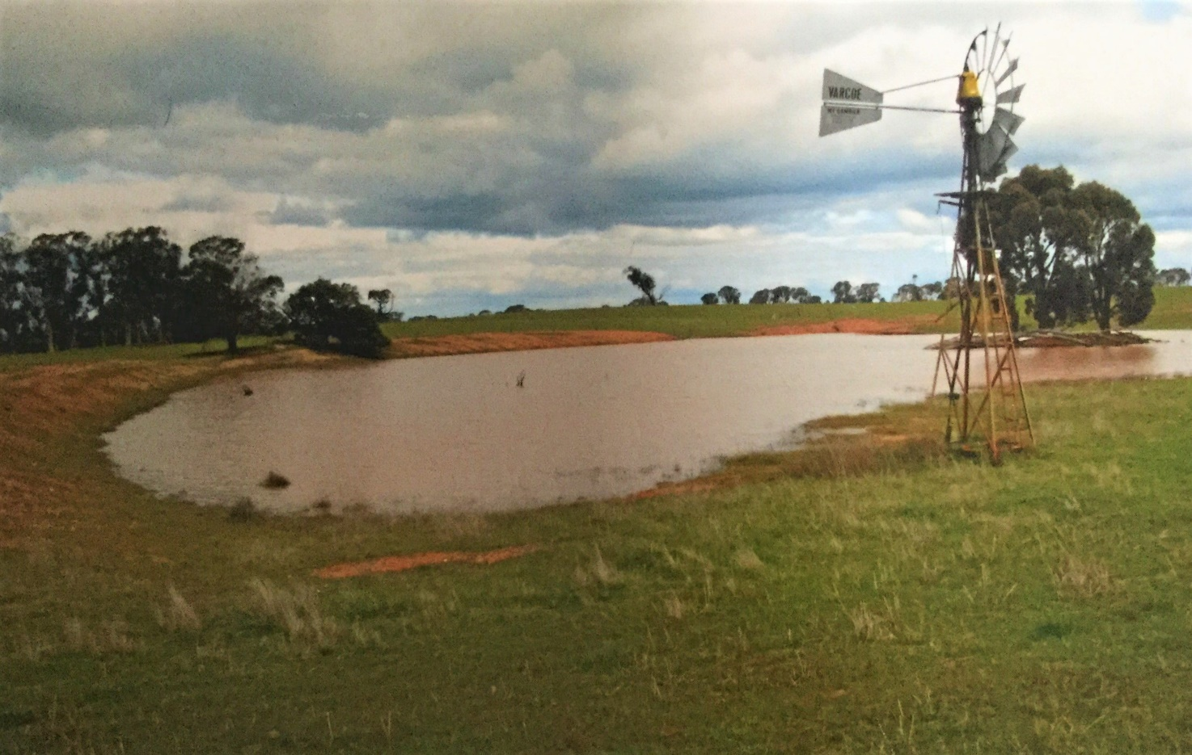
Completed Dam
Fortunately, soon after completion, there was substantial rain.
The photo shows the big dam full. The windmill was used to pump water up to a smaller dam, adjacent to what became a more permanent home, to water the emerging garden of more than 1 acre. What an amazing sense of achievement!
Notes:
Photo is from the author's personal collection

Slide 10
Food for Thought
Can you imagine the attention required to water a large garden:
using a petrol driven pump which needed refuelling every 2 hours and was
some 500 metres from the house
the difficulty was that the water held particles of red soil; and when irrigation was used, the soil around plants became rock hard.
Notes:
"Silver Princess" by Tatters ✾ is licensed under CC BY 2.0

Slide 11
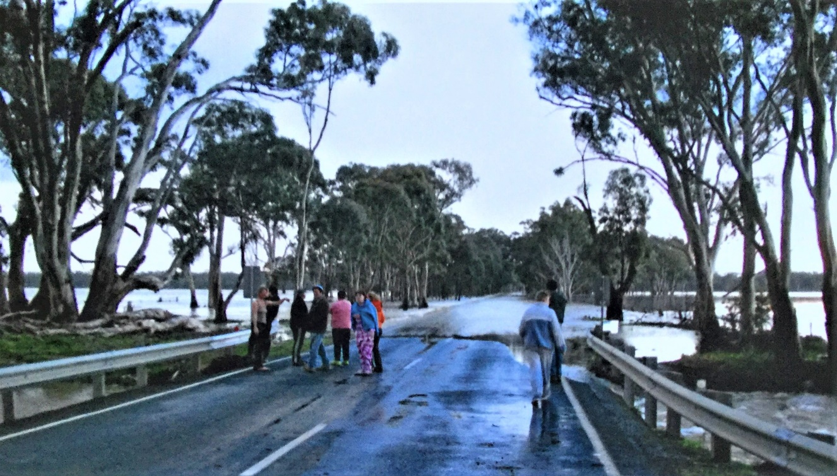
The Vagaries of Flood
The average annual rainfall was 16 inches, ranging from 8 inches in a drought year, to 23 inches in a really good year.
On 3 occasions in the last 20 years there were floods. The photo shows the main road between St Arnaud and Bendigo completely impassable. This picture was taken some 3 kilometres from the Avoca River.
Notes:
Photo is from the author's personal collection

Slide 12
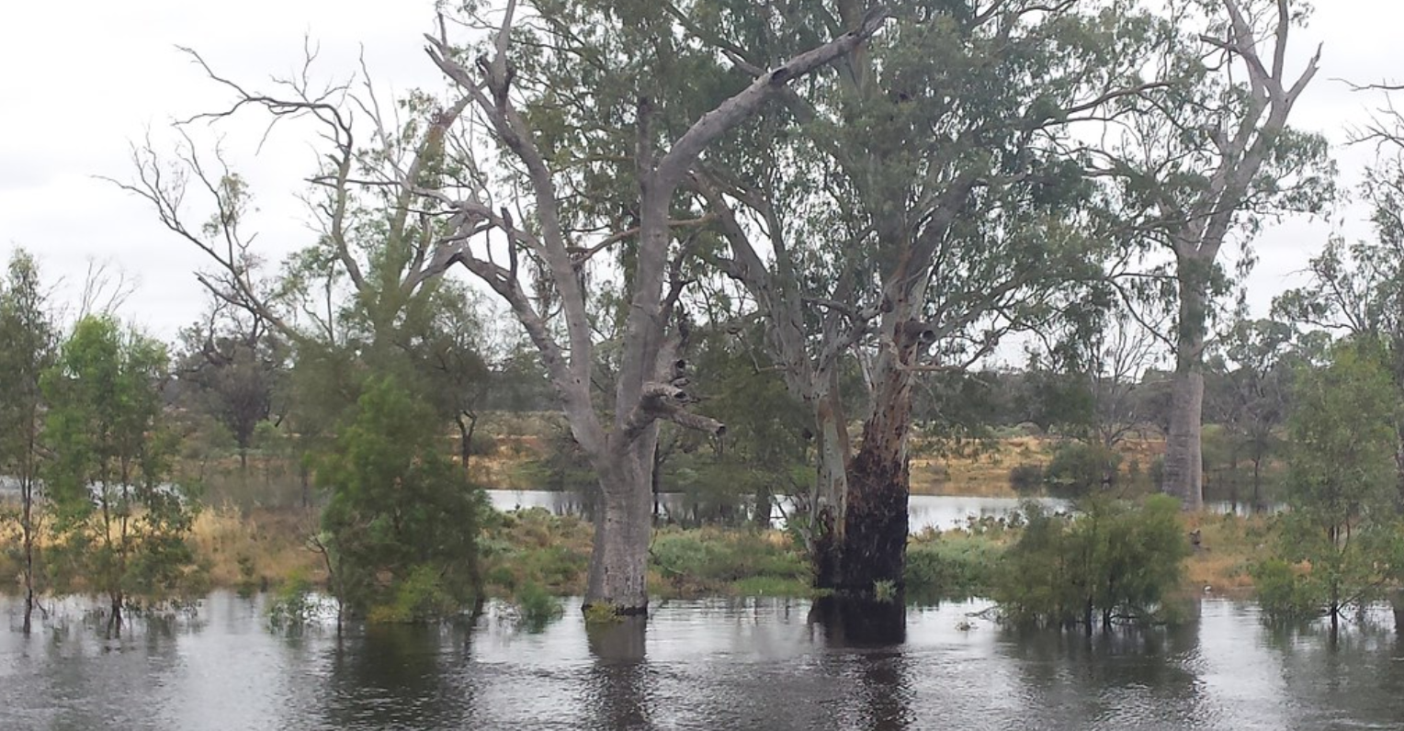
Caught by Floods - 1
On one trip, it took 6 hours to travel to the farm. The usual road was cut in 4 places, so we had to travel through Wedderburn.
We navigated through 2 stretches of more than 1 foot of flood water, and we arrived home about a half an hour before the flooding have prevented us from getting home at all!
Notes:
"Murray River in Flood, Australia" by water.alternatives is licensed under CC BY-NC 2.0

Slide 13
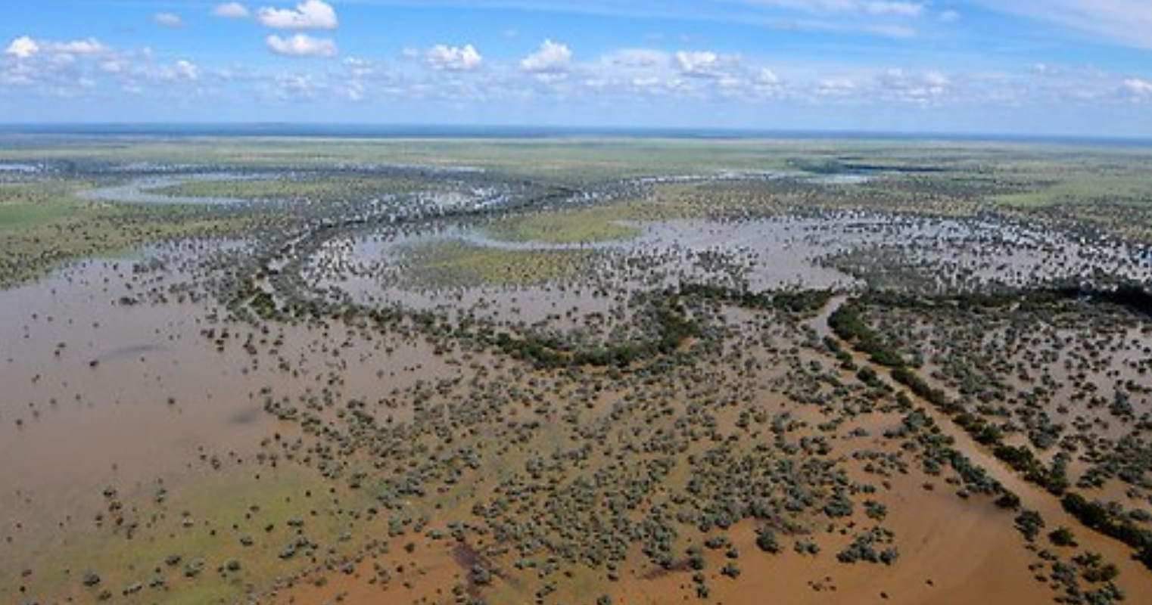
Caught by Floods - 2
On another occasion, having just made it into Bendigo for a Bachelor and Spinsters ball, my road was cut off by one of the floods. It took me 3 days to eventually get home, to where I was jackarooing.
I slept in my car in my dinner suit!
Notes:
"Upper-Darling River in flood, Australia" by water.alternatives is licensed under CC BY-NC 2.0

Slide 14
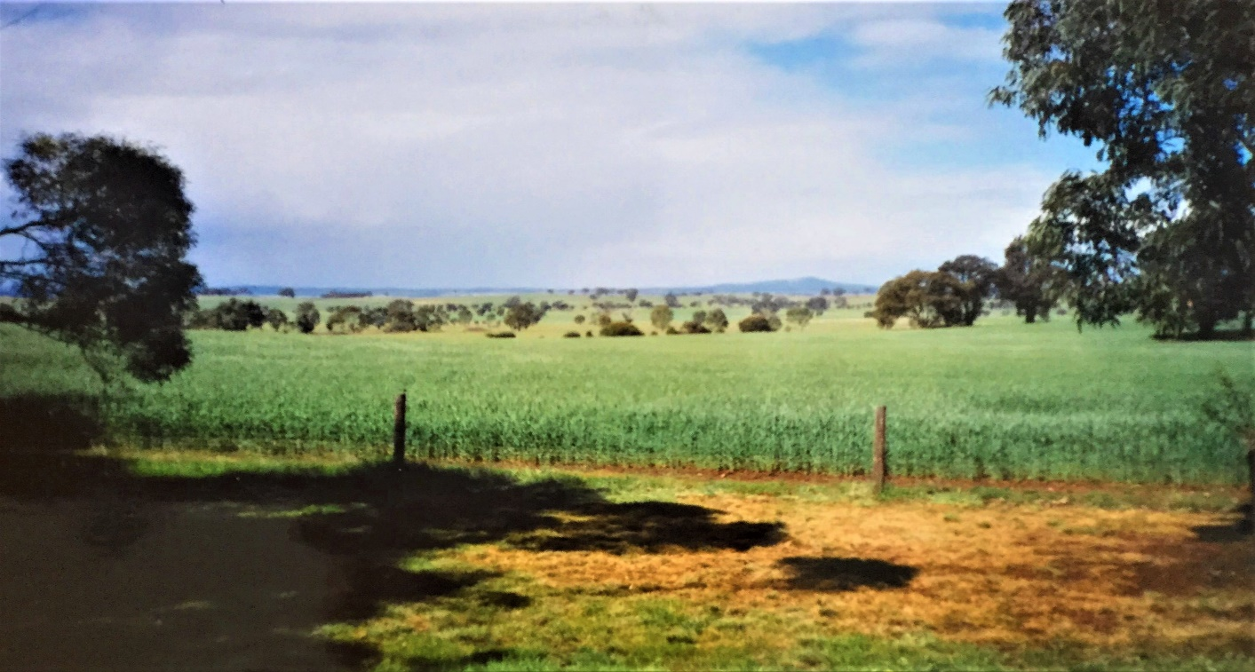
Planting Crops
The soil at the farm was not anything like river flats. It was very stony in the quartz gold country, however it was arable.
The photo shows the type of crops which can be grown, given the rain in a good season. This crop was triticale and, even though it wasn’t the best of seasons, it was one of the best crops in the district.
Notes:
Photo is from the author's personal collection

Slide 15
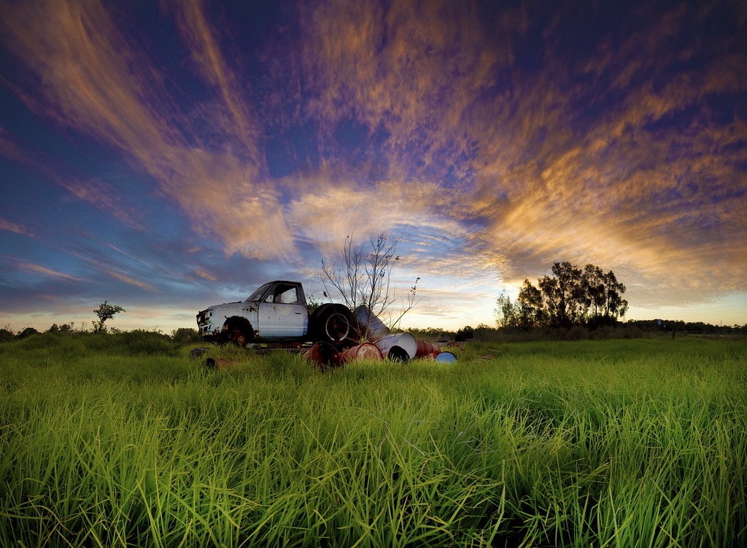
Leasing Land
It did not take long to realise it was not viable to have sheep or crops on such a small holding with no equipment of our own.
Fortunately, during the last 30 years, of our 42 years of occupation, the land was leased to a succession of local farmers. This allowed me to concentrate on the development of the garden. It also gave us a small income from the lease which covered the major outgoings and I had every second weekend to work in the garden.
Notes:
"Green, Green Grass" by Garry - www.visionandimagination.com is licensed under CC BY-NC-SA 2.0

Slide 16
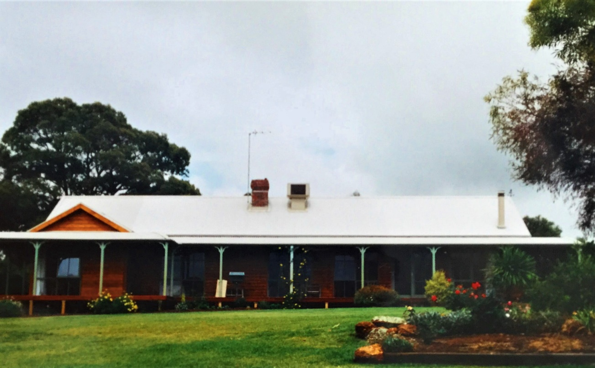
Building the farm homestead
Eventually, we were able to build a proper house – a country style 3 bedroom timber home was selected. In the early 90’s a 2-bedroom extension was added
Most weekends were devoted to the development of the garden.
This photo was taken about 1989. The (front) of the house faces east.
Notes:
Photo is from the author's personal collection

Slide 17
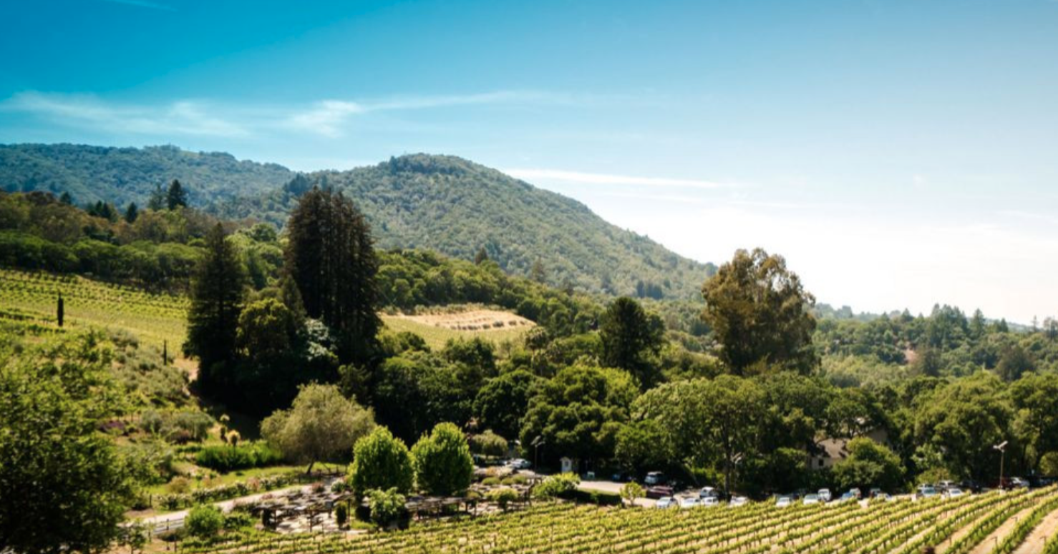
Facing East
We loved sitting on the veranda and relaxing, drinking in a “million dollar view” that included Mt Moliagul.
In the colder months, we enjoyed the open fire at one end of the living room.
Notes:
https://winecraft.com/australia/victoria/pyrenees/winery/mount-moliagul

Slide 18
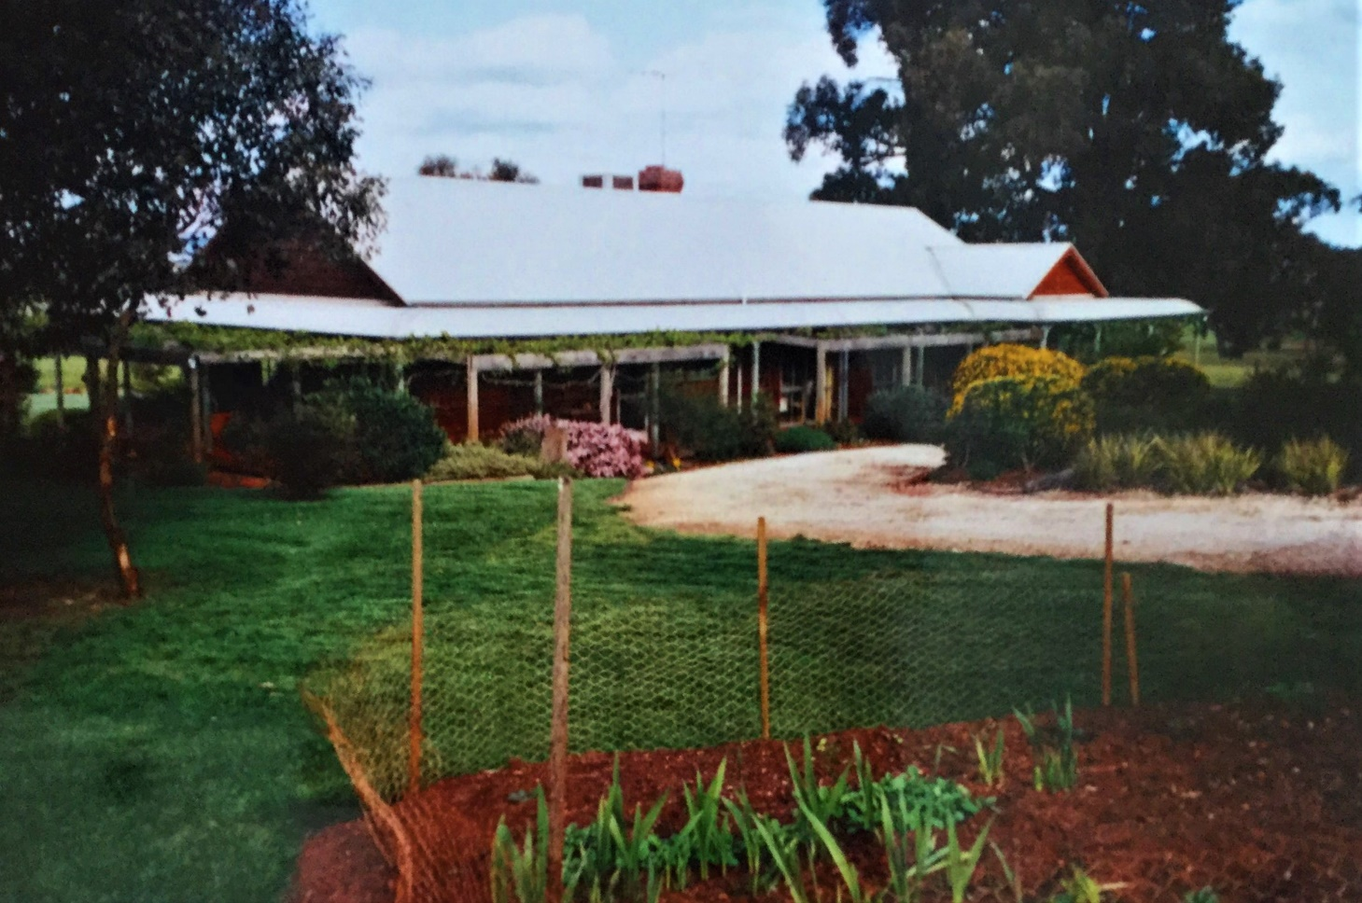
Rear view of the house
The“ rear” view of the house faced west. This was the main entrance.
You can see the amount of work that went into planting and landscaping the beautiful gardens.
Notes:
Photo is from the author's personal collection

Slide 19
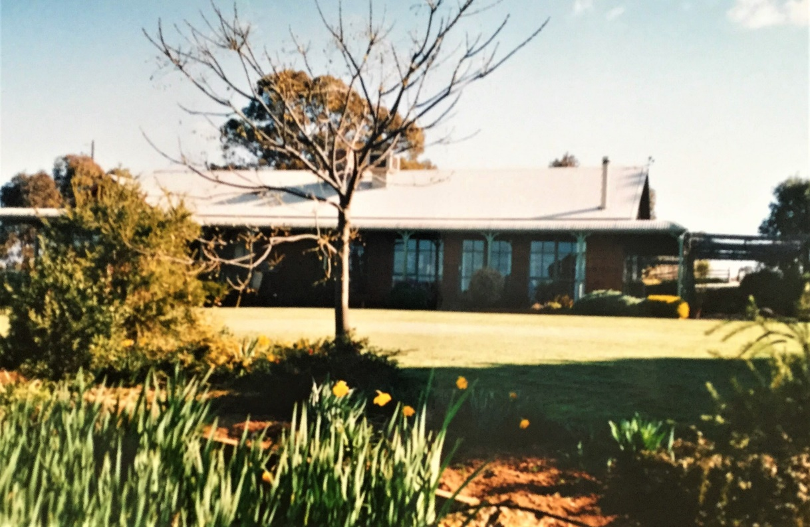
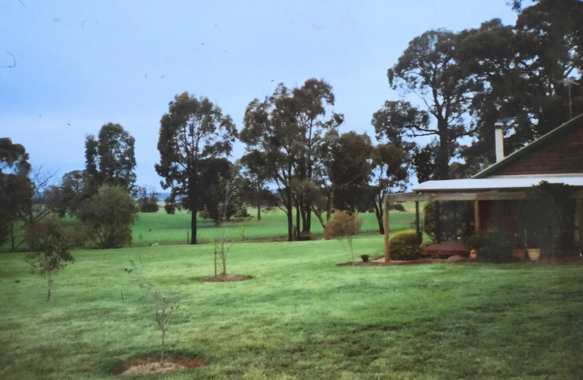
The Property In Its Prime
In its prime, the garden was well-established and embellished with mature trees.
Notes:
Photo is from the author's personal collection
Photo is from the author's personal collection

Slide 20
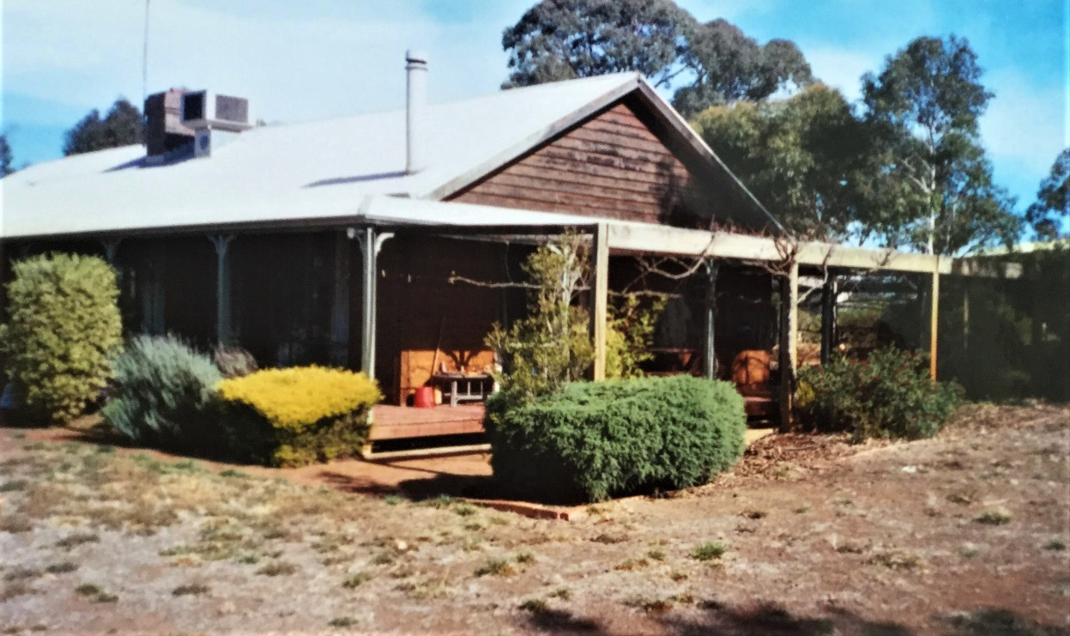
More Drought
Life is never simple on a farm. Another serious drought occurred in the mid 90’s .This photo shows what happened.
Quite a number of shrubs, plants, and ornamental grapes, sundry roses, flowers, and a vegetable garden also died. Very sad when one considers the amount of time spent creating something quite wonderful.
Notes:
Photo is from the author's personal collection

Slide 21
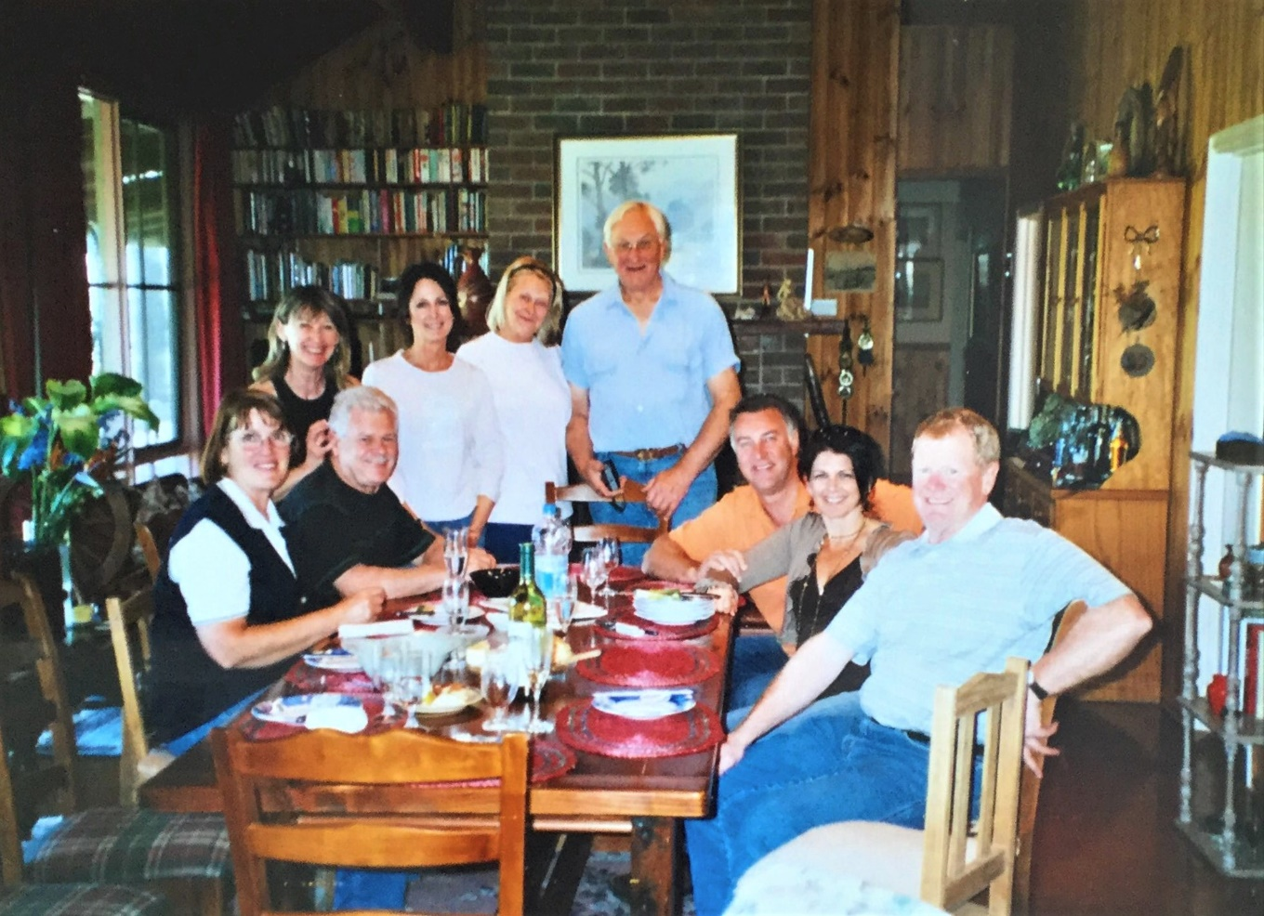
The End of the Farming Era
We enjoyed many social occasions with family and friends over the years.
This story ended in August 2019 when we had to sell the farm.
In many ways, this was the hardest part of our 42 years of farming.
It was an exciting and rewarding country life and I am so pleased to have lived it for the time that I did.
Notes:
Photo is from the author's personal collection

Slide 22

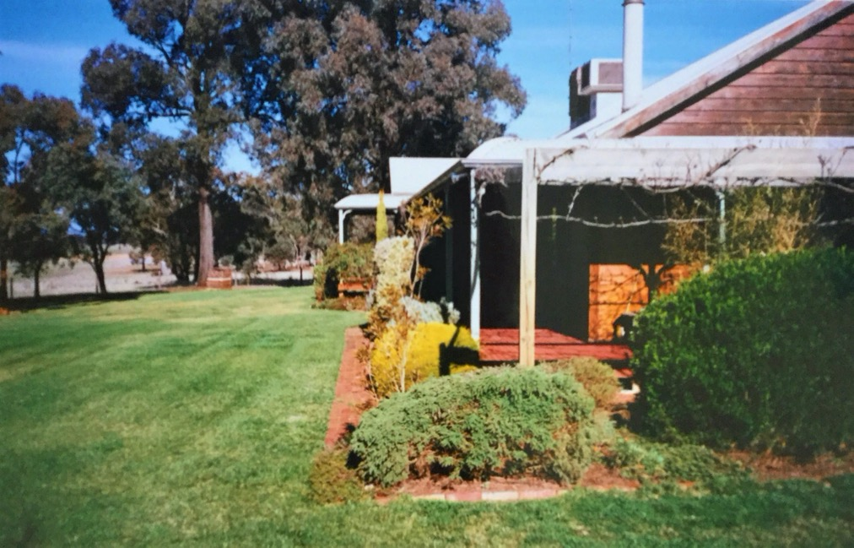
Thank you for sharing this story
Wishing you well and hope you are keeping safe.
David Shave
Rotary Club of Canterbury
Notes:
Photo is from the author's personal collection

