Slide 1
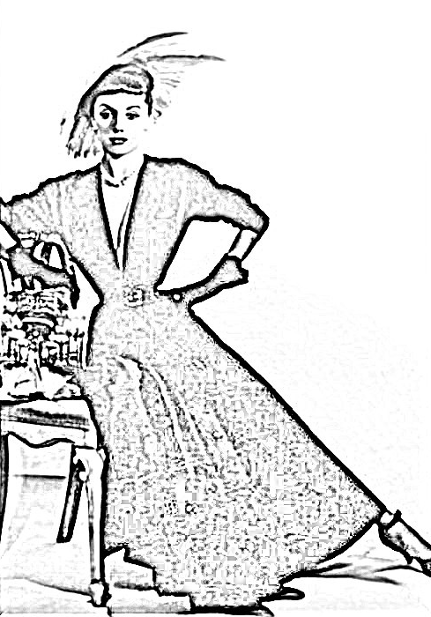

Melbourne:
City of Fashion
Notes:
https://cv.vic.gov.au/stories/creative-life/athol-shmith/no-title-fashion-illustration-model-patricia-tuckwell/
NB: this image was put through a photo to sketch application to produce this

Slide 2
The Rotary Club of Canterbury “Let’s Stay Connected Project” has been developed as a response to an identified need within the Aged Care sector.
At times when it’s difficult to connect in person with family and friends, the Rotary Club of Canterbury has pleasure in offering you this booklet, designed to promote conversation, recollection and engagement for those who are in isolation and without their usual social activities.
The booklets have been designed for people in an aged care residence, village or at home to read by themselves, or to have a family or staff member share the booklet with them.
You can download this and other booklets from the Rotary Club of Canterbury website (www.canterburyrotary.org).
Source references for this book are held at the Rotary Club of Canterbury. Contact president@caterburyrotary.org for further details.
Material in this book was reproduced in accordance with Section 113F of the Copyright Act (1968).

Slide 3

Hi,
My name is Val Cunniffe and I am a member of the Rotary Club of Canterbury, in Melbourne, Australia.
I wrote "Melbourne: City of Fashion" because as a small child I remember visits to the city with my mother. They were always so exciting and we always ended up in Collins Street, looking at the shops and going for a special afternoon tea. It all felt so glamorous and I felt so special! When I showed the pictures of the fashions to my granddaughter she was shocked that our dresses were so short, colours so vibrant and our hairstyles so "out there". It was fun to remember and to share memories.
Val
Notes:
Author’s own photo

Slide 4
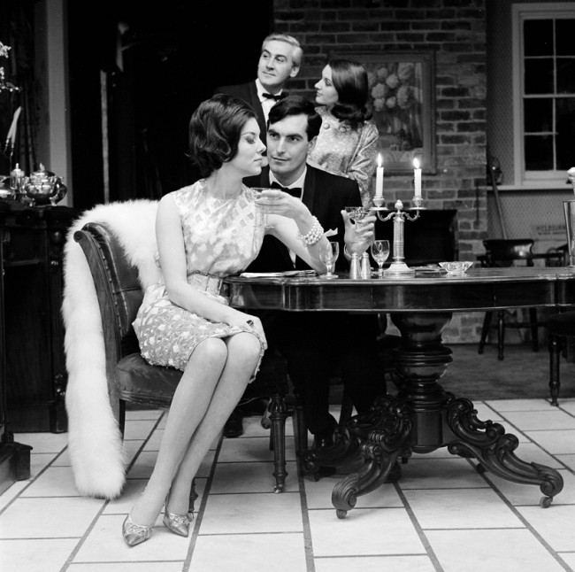
THE CITY OF FASHION
Melbourne has long been touted as the fashion capital of Australia; known for its sophistication and culture.
Melbourne is more than just a pretty face. History shows Melbourne has led the fashion pack from very early on.
Notes:
https://www.slv.vic.gov.au/sites/default/files/styles/gallery_large/public/31.%20Photograph%20for%20Holeproof%20advertisement%2C%20Henry%20Talbot.jpg?itok=VwjUwHTJ

Slide 5
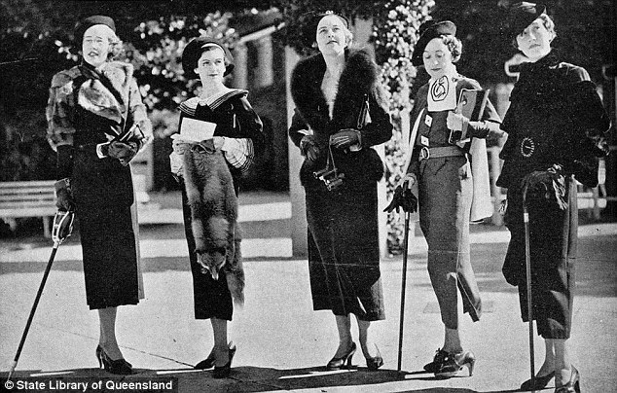
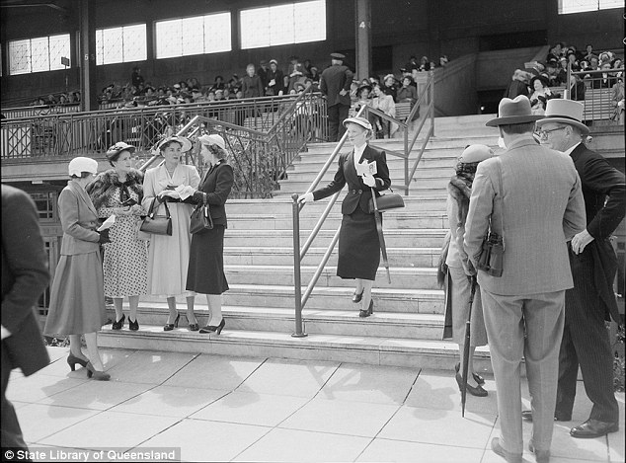
Melbourne Fashions in the 30s
Melbourne Cup Fashions in the early 50s
Notes:
https://commons.wikimedia.org/w/index.php?search=race+day+fashions&title=Special%3ASearch&go=Go&ns0=1&ns6=1&ns12=1&ns14=1&ns100=1&ns106=1#/media/File:StateLibQld_2_206817_Mannequins_modelling_race_day_fashions_at_Ascot,_Brisbane,_1935.jpg
https://i.dailymail.co.uk/i/pix/2015/05/08/04/2853EA7300000578-3071525-A_day_at_the_races_Women_gossiping_in_their_finest_at_the_Melbou-a-117_1431057525806.jpg

Slide 6
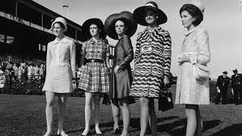
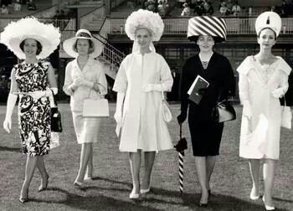
Melbourne Fashions in the 60s
In 1962 in a bid to attract more women to the male dominated racetrack, the Victoria Racing Club introduced the “Fashions on the Field” competition. It has been a feature of Melbourne racing ever since.
Notes:
https://www.google.com/search?q=Fashions+on+the+field+in+the+60s&rlz=1C1ASUT_enAU843AU843&sxsrf=ALeKk03JG4azN0xB9xPItAnoVpvyfNTcJA:1597831393157&tbm=isch&source=iu&ictx=1&fir=WTO9TXMfdpzg_M%252CiYAVrr1BWjZ6WM%252C_&vet=1&usg=AI4_-kRUJO82mFEujOltPrGcNJxovFPlKQ&sa=X&ved=2ahUKEwj1kObkgafrAhVe7nMBHYLvAjMQ9QEwCHoECAoQKQ&cshid=1597831449853197&biw=1366&bih=625#imgrc=q7wYaEjFb8aV1M
https://www.standard.net.au/story/1880832/gallery-historical-photos-at-flemington-racecourse/

Slide 7
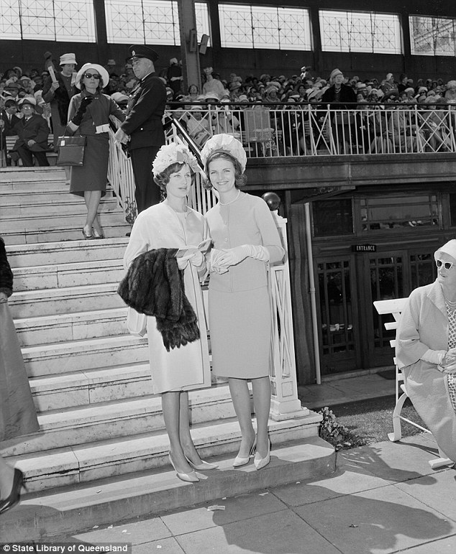
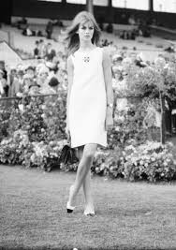
The Place to be seen
Jan Taylor
Miss Australia 1961
At the Melbourne Cup
Jean Shrimpton
UK model in the
“Dress that shocked the Nation”
5 inches above the knee
No stockings
No gloves
“I fear that Melbourne is not ready for me yet.”
Notes:
https://www.dailymail.co.uk/femail/article-3071525/The-evolution-Australian-Race-Day-fashion-Black-white-pictures-archives-reveal-glory-days-fashions-field.html
https://en.wikipedia.org/wiki/White_shift_dress_of_Jean_Shrimpton

Slide 8
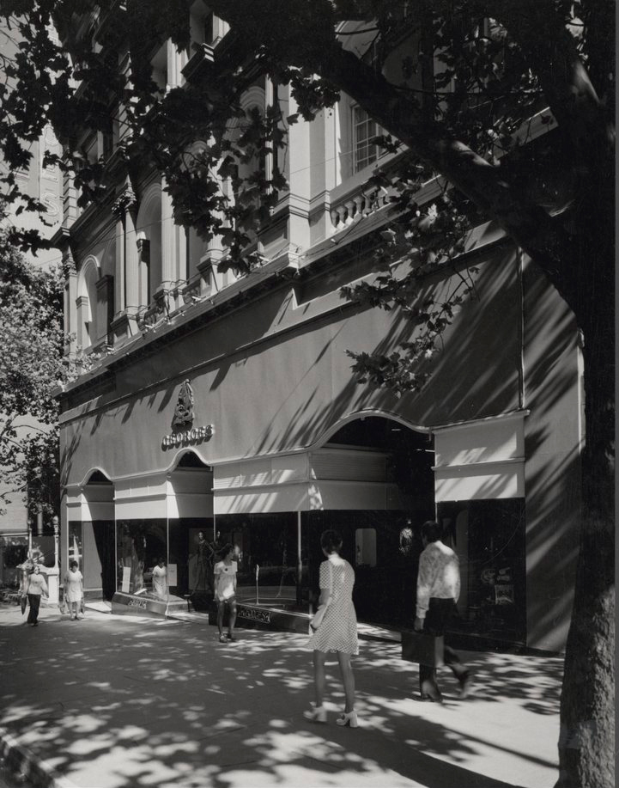
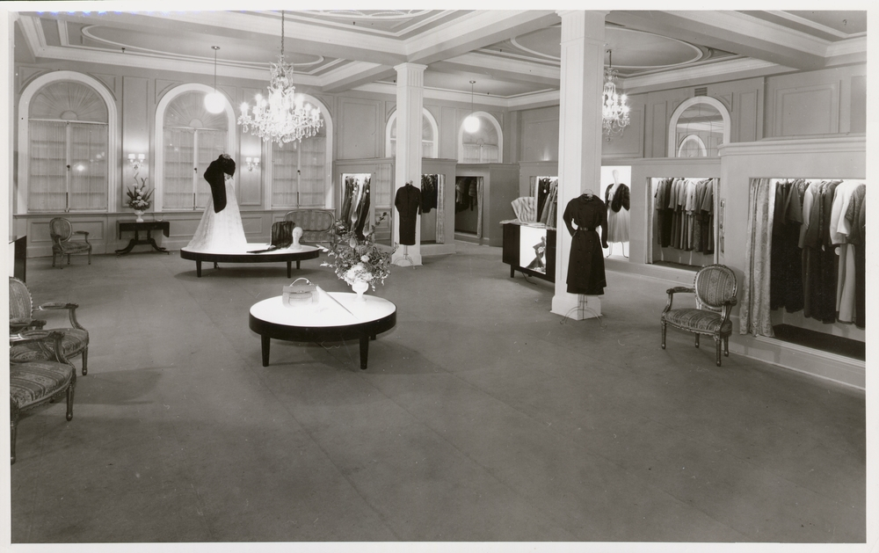
Other Places to be seen - Georges
Georges was always the heart of elegance.
But in the 1950s and ’60s there others too.
Remember Ball & Welch, Buckley & Nunn, Foy & Gibson?
And more recently, who now remembers Daimaru in its former Melbourne Central home?
But only Georges represented international fashion and style in Melbourne. Established by brothers Willie and
Harley George in
1880 and moving to its ‘Paris end of Collins Street’ location in 1889, evolved into one of the most exclusive department stores in Melbourne.
Notes:
https://blogs.slv.vic.gov.au/our-stories/melbournes-lost-department-stores/
https://blogs.slv.vic.gov.au/our-stories/melbournes-lost-department-stores/

Slide 9
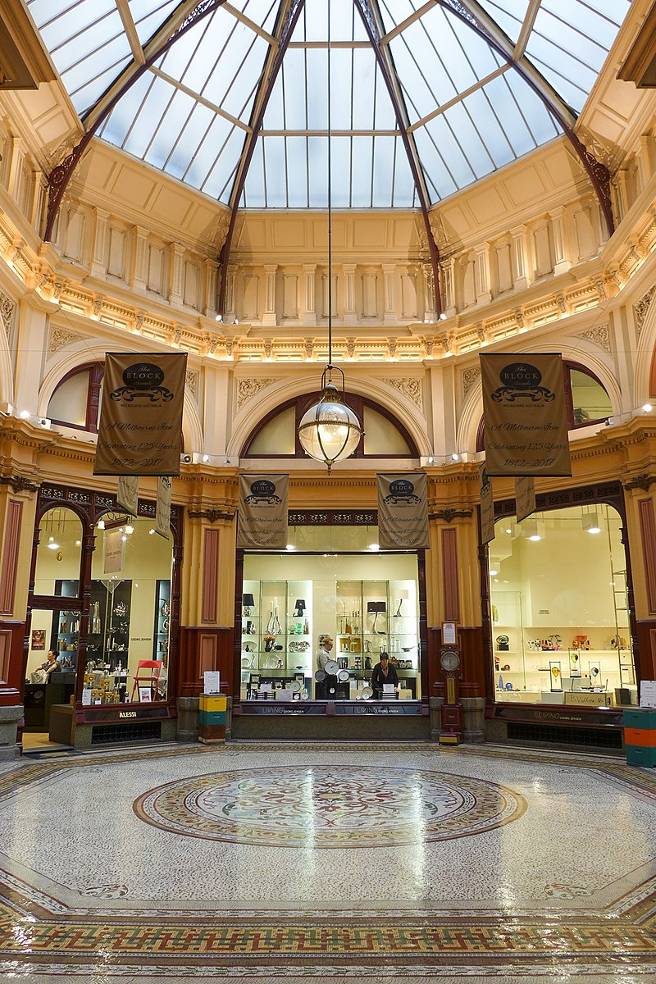
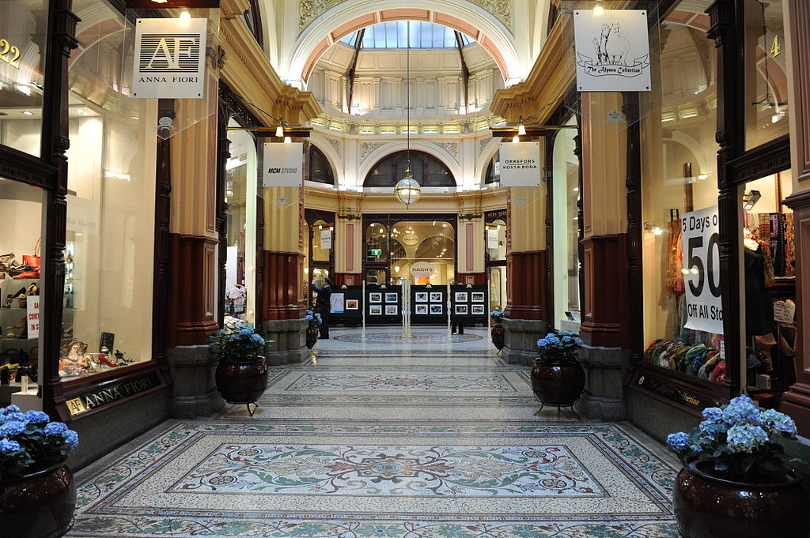
Other Places….. Block Arcade
Melbourne's impressive Block Arcade was constructed in 1891 and is as much a popular shopping precinct today as when it was built.
Modelled after the Galleria Vittorio Emanuele in Milan, Melbourne’s
Block Arcade is a ‘place to shop and be seen.’
The Block Arcade opened with 15 milliners, three lace shops, a photographer
and Hopetoun Tea
Rooms. The Tea Room was bought for 18 pounds and remains open for business today.
Notes:
https://en.wikipedia.org/wiki/Block_Arcade,_Melbourne#/media/File:The_Block_Arcade_interior,_Melbourne.jpg
https://en.wikipedia.org/wiki/Block_Arcade,_Melbourne#/media/File:The_Block_Arcade_Central_atrium_201708.jpg

Slide 10
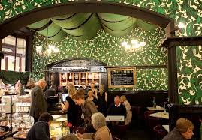
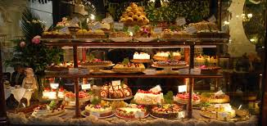
Other Places….. Block Arcade
A trip to the Block Arcade is never complete without the decadence of
High Tea at the Hopetoun Tea Rooms.
Full of old-world charm, it was known to draw queues – both for its extensive menu of English teas, herbal infusions and more exotic blends, and for its extravagant window displays of cakes, tarts and muffins.
Notes:
https://www.broadsheet.com.au/melbourne/food-and-drink/article/128-year-old-melbourne-institution-hopetoun-tea-rooms-sale
https://en.wikipedia.org/wiki/Block_Arcade,_Melbourne#/media/File:Tea_rooms_store_front_in_Collins_Street,_Melbourne.jpg

Slide 11

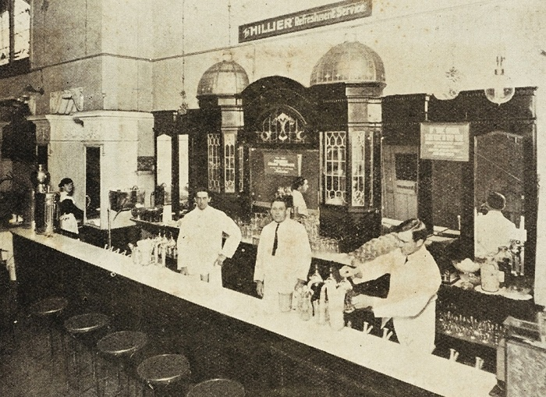
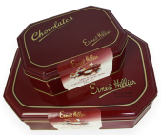
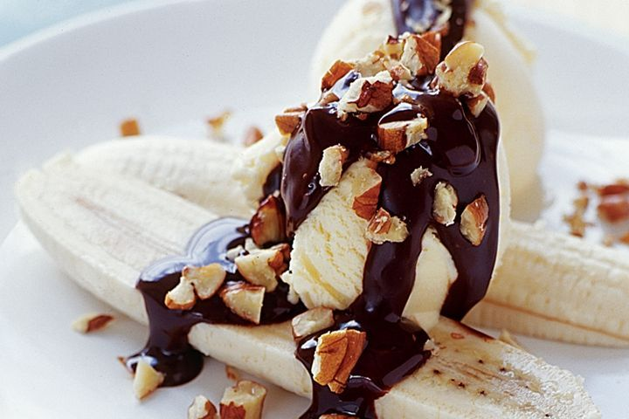
Other Places….. Hilliers
Ernest Hillier made Australia’s first chocolates in 1916.
For me, the highlight of a shopping trip to the city with my mother was our final stop. Ernest Hilliers Café, beside the Regent Theatre in Collins Street. I remember fondly my favourite…..
a Banana Split, with chocolate sauce and peanuts.
Notes:
https://pbs.twimg.com/profile_images/2752471739/5b059b32a42a276aec33b5b5d15f27dc_400x400.jpeg
https://australianfoodtimeline.com.au/earnest-hillier/
https://australianfoodtimeline.com.au/earnest-hillier/
https://www.taste.com.au/recipes/banana-split/3b01b775-2be2-4a15-9326-0ca09178b1eb

Slide 12
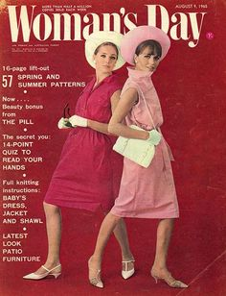
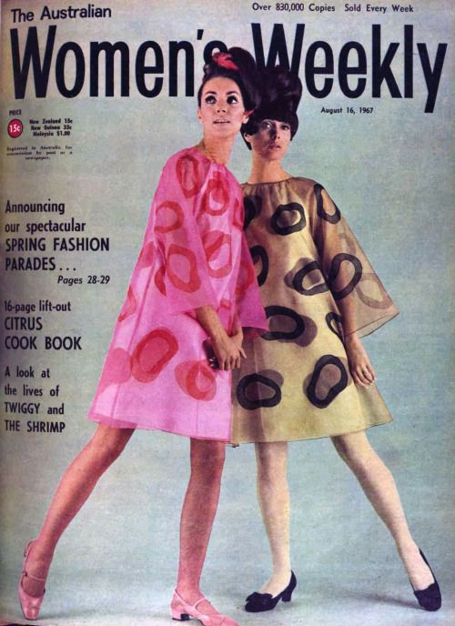
Popular Fashion Magazines
For many years, Women’s Weekly was the premier magazine in Australia. It was started in 1933 by Frank Packer as a weekly publication.
Notes:
https://likesoldclothes.tumblr.com/post/79147047960/womans-day-australia-august-9-1965
https://theswinginsixties.tumblr.com/post/74370085678/designer-fashion-music-shopping-internet-clothes-beauty

Slide 13
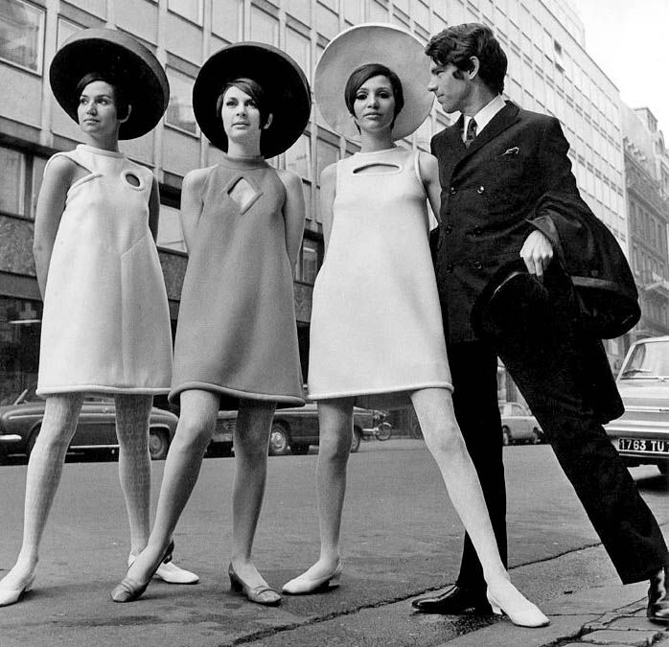
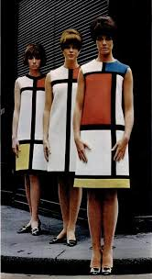
Iconic designers
Pierre Cardin
Pierre was already a trained tailor by the age of fourteen. He began his couture career at Christian Dior.
Yves St Laurent
In tribute to the Dutch artist Piet Mondrian, this jersey shift dress — devoted to the artist’s geometric works — caused a sensation when shown as part of the fall/winter 1965 haute couture show.
Notes:
https://blog.colettehq.com/inspiration/pierre-cardin-geometric-guru
https://snapfashion.wordpress.com/tag/mondrian-dress-ysl/

Slide 14
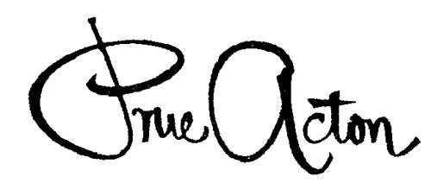
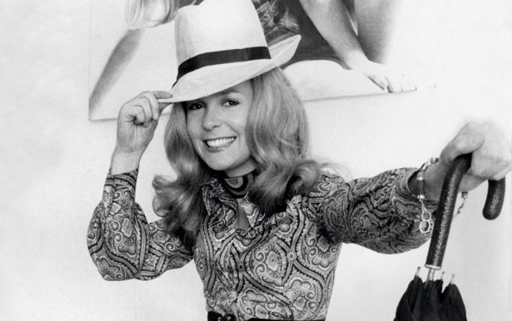
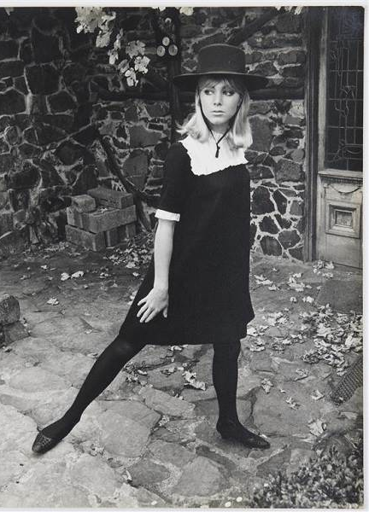
Prue Acton
Fashion and business entrepreneur Prue Acton established her signature label in the 1960s. She was one of the new wave of designers who was shaping the new youth fashion industry.
In 1963, aged 21, she established her fashion design business in Flinders Lane. It turned over 350 designs a year and sold an average of 1,000 dresses a week through 80 outlets in Australia and New Zealand. She developed her own range of cosmetics.
Notes:
https://www.smh.com.au/entertainment/art-and-design/design-of-a-lifetime-prue-acton-exhibition-opens-at-bayside-arts-and-cultural-centre-20160212-gms88y.html
https://www.art-almanac.com.au/new-look-1960s-fashion-melbourne/prueacton-medium/

Slide 15
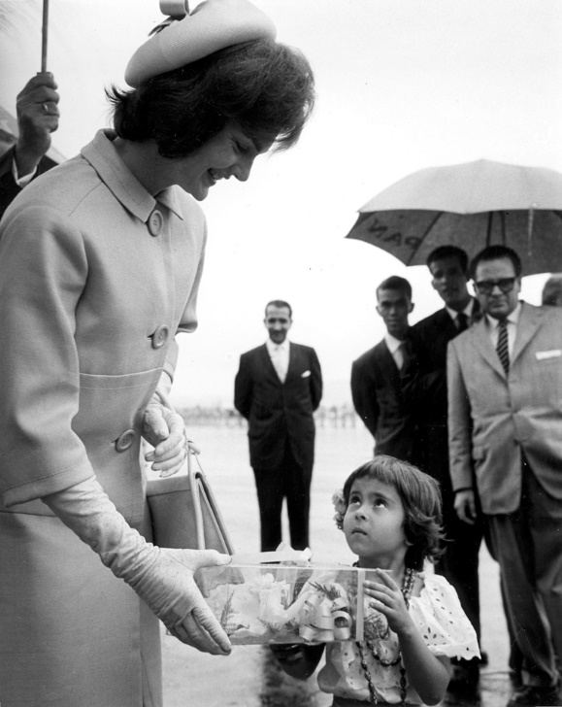
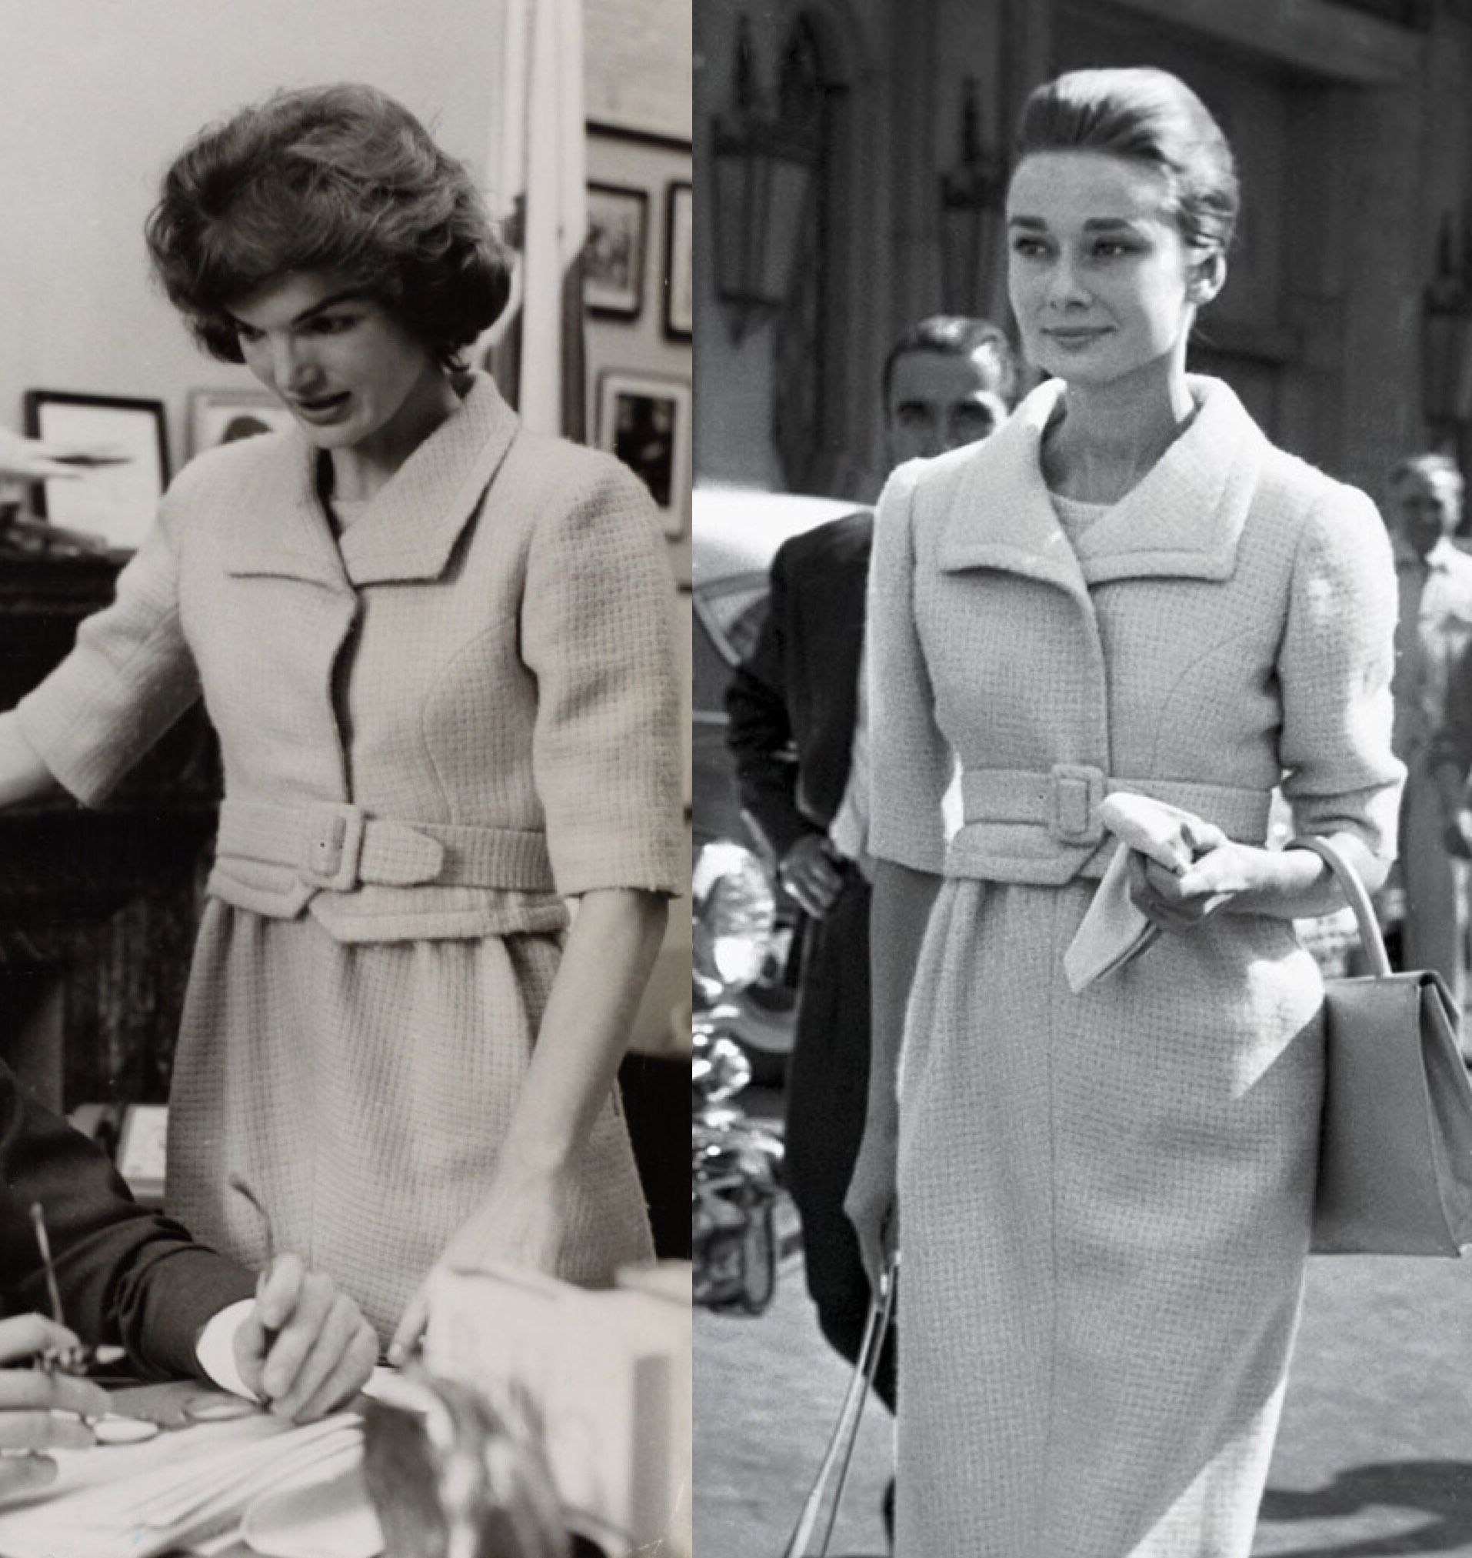
The most stylish women….
Jacqueline Kennedy
Fashion Icon and
First Lady of the United States of America, 1961
Jacqueline Kennedy and Audrey Hepburn wearing Givenchy
Notes:
https://commons.wikimedia.org/wiki/File:JKO_606P.jpg
https://www.google.com/search?q=jacqueline+kennedy+wears+givenchy&rlz=1C1ASUT_enAU843AU843&sxsrf=ALeKk024DO97zMeNDCK0c6l4d-vrQvU0gA:1598070510669&tbm=isch&source=iu&ictx=1&fir=VmEyVhuQNjRIkM%252CiZ2YSBV42uHfTM%252C_&vet=1&usg=AI4_-kSnJKS5krW5-2ovkkI-DnSVyv7EPw&sa=X&ved=2ahUKEwjI3fTI_K3rAhUiILcAHS_DBzcQ9QEwAHoECAoQEQ#imgrc=VmEyVhuQNjRIkM

Slide 16
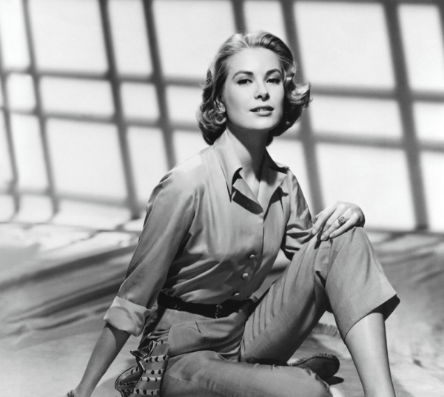
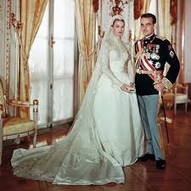
The most stylish women….
Grace Kelly
The American actress who, after starring in several significant films in the early to mid-1950s, became Princess of Monaco by marrying Prince Rainier III in April 1956.
And who can forget the elegance of that gown.
Notes:
https://www.firstforwomen.com/posts/entertainment/grace-kelly-diet-170264
https://www.glamour.com/story/never-before-seen-photos-grace-kelly-prince-rainier-of-monaco-wedding

Slide 17
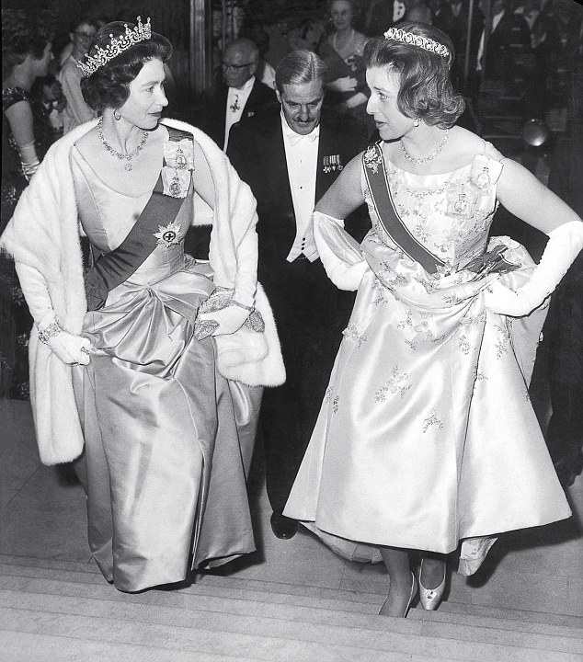
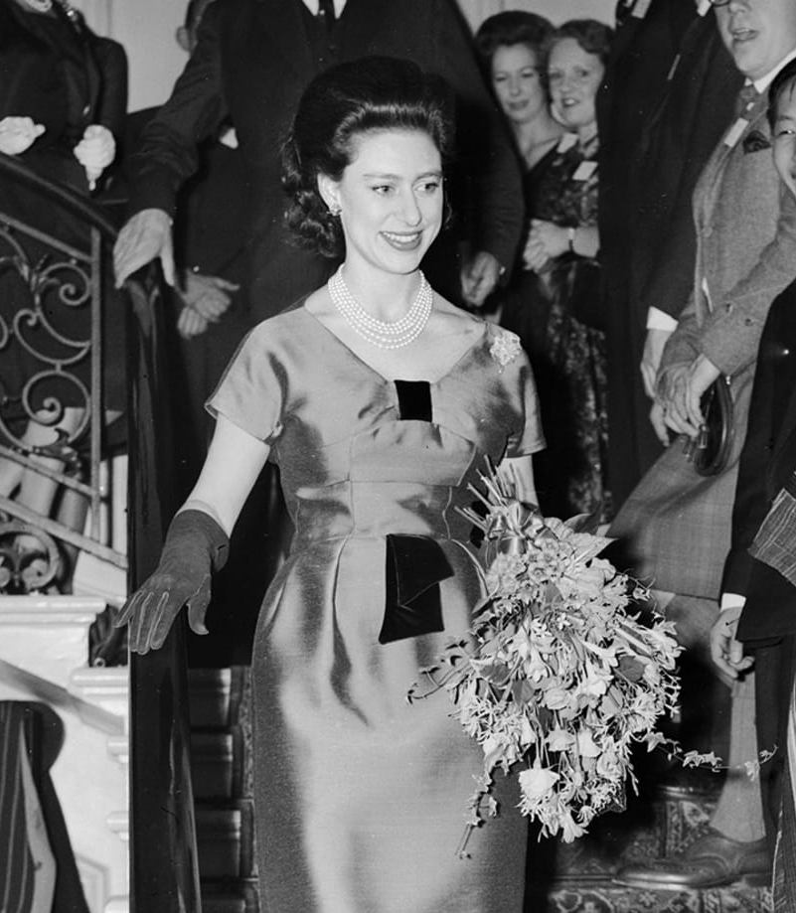
Let’s not forget the Royals….
Princess Alexandra is the first cousin and a close confidante of The Queen.
They have demonstrated poise and style over the years.
But who can forget Princess Margaret, who took Royal style…. and scandal… to another level.
Notes:
https://www.dailymail.co.uk/femail/article-6576865/Palace-denies-Princess-Alexandra-stepping-public-duties.html
https://www.biography.com/news/princess-margaret-worst-party-guest

Slide 18
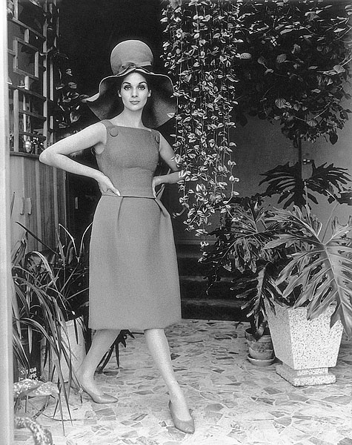
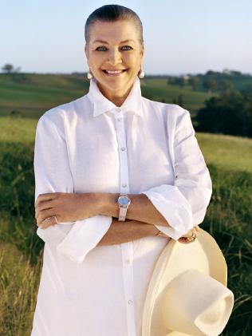
Australian models of the 60s
Maggie Tabberer
Her name has been synonymous with fashion and style in this country for more than 60 years.
From model to editor, television host, fashion designer and retailer, Tabberer has done the lot.
Notes:
https://nga.gov.au/exhibition/karshshmith/detail.cfm?IRN=66837&BioArtistIRN=12439&mystartrow=25&realstartrow=25
https://cdn.newsapi.com.au/image/v1/ccc640808b26aff4f0345d44d0db2b17?width=316

Slide 19
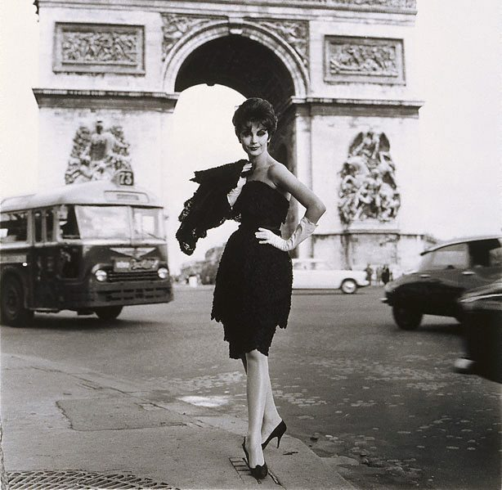
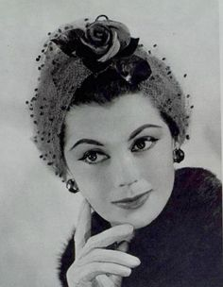
Australian Models….
Jean Newington
Jean wearing a Nina Ricci design in Paris.
Sadly in later years Jean became a hoarder and lived a lonely life in Sydney.
Notes:
https://www.artgallery.nsw.gov.au/collection/works/359.1991/?tab=shop
https://www.thmotion.com/product_info.php?c=satin%20turban%20the%20evie%201920s%20glamour

Slide 20
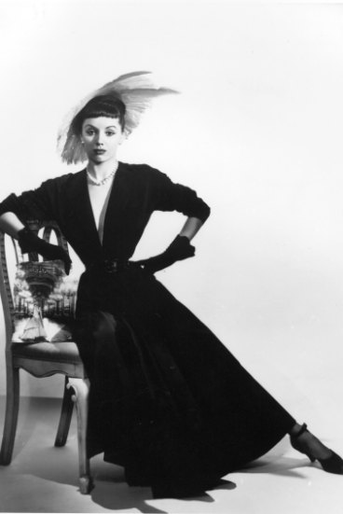
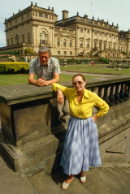
Australian Models….
Bambi Smith
This Australian Model became the Countess of Harewood.
Here she is photographed by Athol Shmith in Melbourne in
the 60s.
The Dowager Countess of Harewood was an Australian model and violinist. She caused a scandal when she gave birth to the Earl of Harewood's son while he was still married.
Notes:
https://cv.vic.gov.au/stories/creative-life/athol-shmith/no-title-fashion-illustration-model-patricia-tuckwell/
https://www.thetimes.co.uk/article/the-dowager-countess-of-harewood-obituary-9p2smq53s

Slide 21
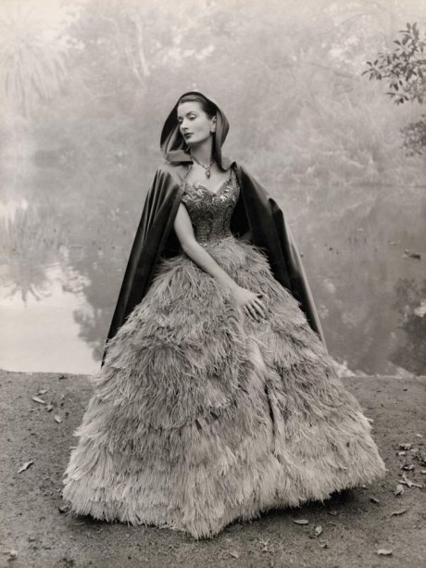
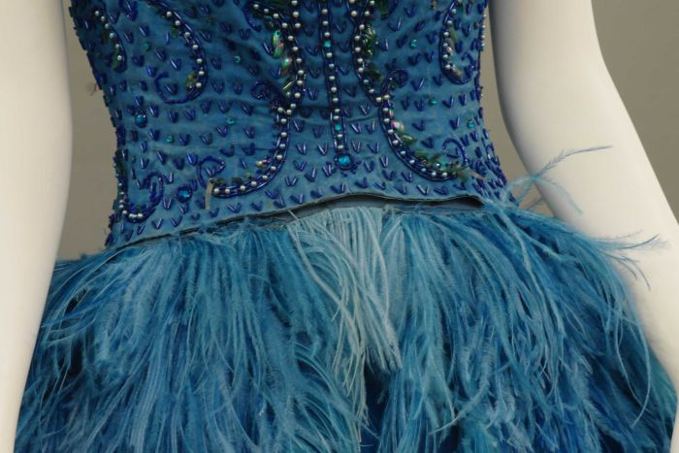
The Ostrich Feather Dress
The model wearing this amazing creation is Ann Chapman, a big name in the industry at the time.
This elaborate royal blue hand-dyed ostrich feather dress, studded with sequins, beads and diamantes is now housed in the National Gallery of Victoria.
The original owner was Australian Annette Klooger, a successful international singer and television presenter. She bought the dress from La Petite, a salon in Melbourne on Collins Street.
Notes:
https://www.abc.net.au/news/2016-03-01/dress-in-glamorous-black-and-white-photograph-from-1960s-found/7177712?nw=0
https://www.abc.net.au/news/2016-03-01/dress-in-glamorous-black-and-white-photograph-from-1960s-found/7177712?nw=0

Slide 22
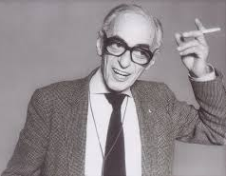
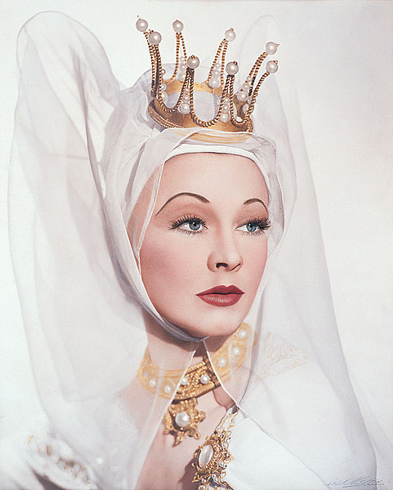
Fashion Photographer
Athol Shmith
Australian studio portrait and fashion photographer and photography educator in his home city of Melbourne.
He contributed to the promotion of international photography within Australia as much as to the fostering of Australian photography to the world.
Athol Shmith was charming and witty and it is said that “he treated his models like princesses”.
Perhaps his portrait of Vivien Leigh bears testament to that statement.
Notes:
https://www.portrait.gov.au/portraits/1999.57/athol-shmith
https://nga.gov.au/exhibition/karshshmith/detail.cfm?IRN=54204&BioArtistIRN=12439&mystartrow=13&realstartrow=13

Slide 23
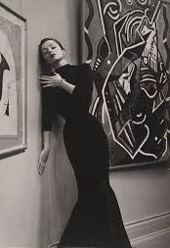
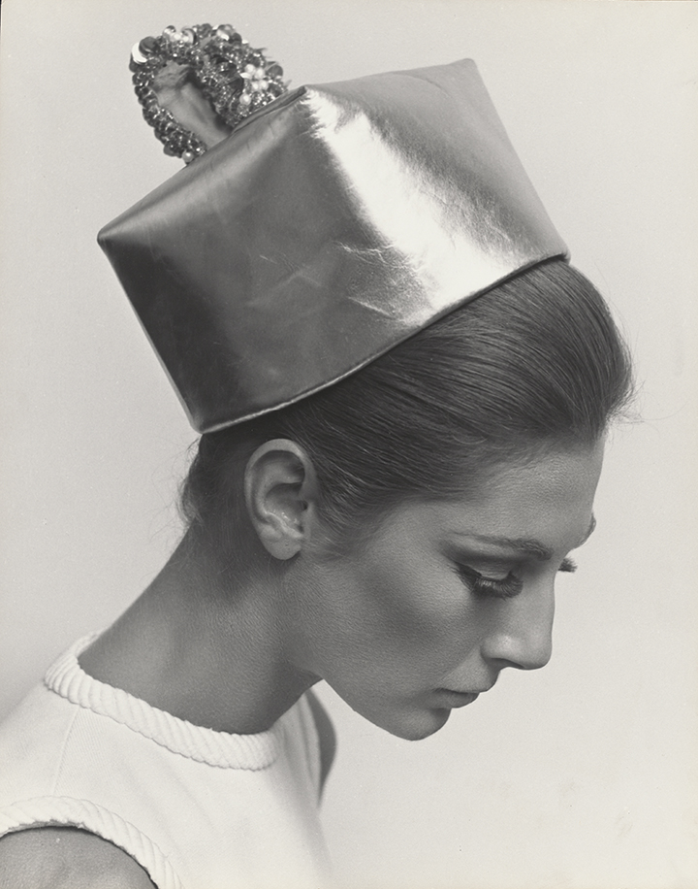
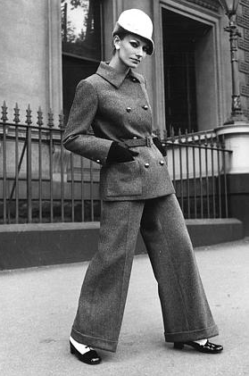
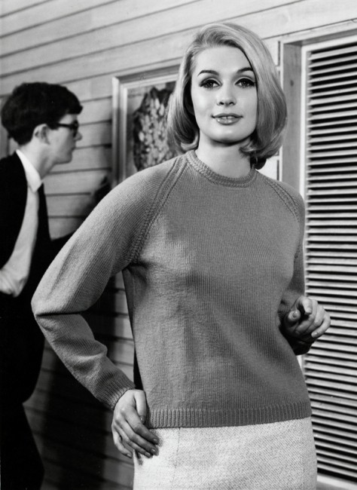
Fashion Photographer… Athol Shmith
From high fashion, hats, trouser suits .. and even Paton’s knitting patterns.
Notes:
https://www.abc.net.au/news/2016-12-12/athol-shmith-fashion-photographs-on-display-at-national-library/8099622?pfm=ms
https://www.artgallery.nsw.gov.au/collection/works/?artist_id=shmith-athol
http://melbournehub.blogspot.com/2014/06/photo-essay-take-look-back-at-everyday_9640.html
https://www.broadsheet.com.au/melbourne/art-and-design/entries-modern-tomorrow-closing-soon

Slide 24
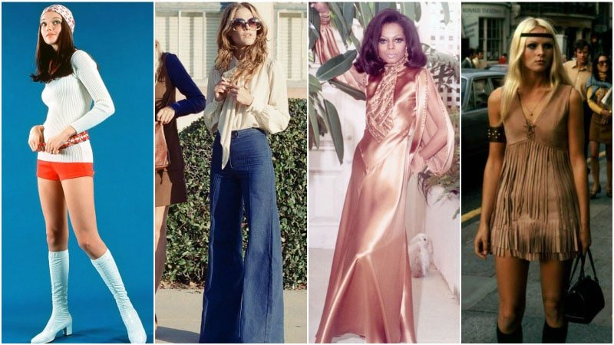
Fashion in the 70s
The 1970s are one of the most revisited decades when it comes to fashion, and they continue to influence modern style.
Thanks to the era’s whimsical uniqueness and freedom of expression, the ’70s and its style are something to which both designers and fashion-lovers are continuously drawn.
From hippy and glam rock to disco and bohemian, the decade encapsulates numerous iconic styles that are still wearable today.
Notes:
https://www.thetrendspotter.net/70s-fashion-trend/

Slide 25
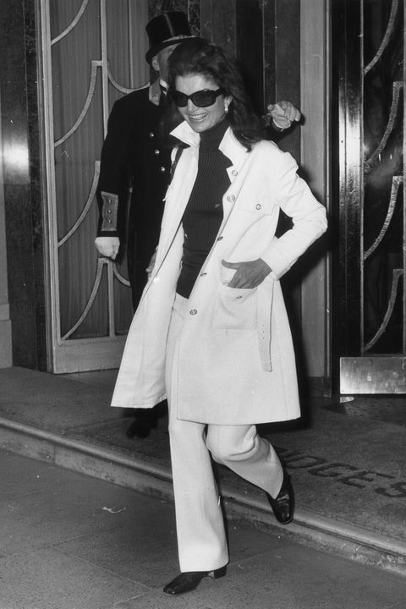
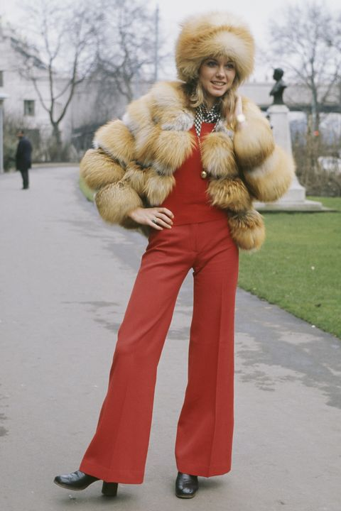
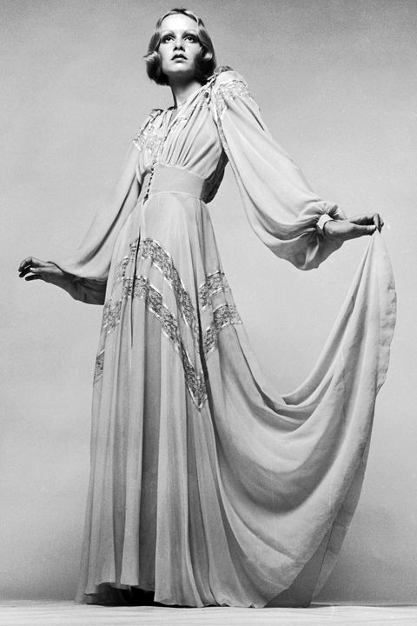
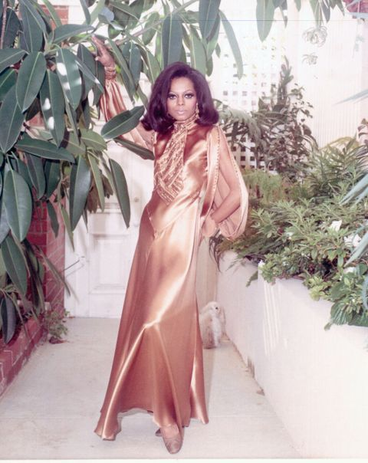
Style icons of the 70s
Olivia Newton John
Jacqueline Kennedy Onassis
Diana Ross (Supremes)
Twiggy
Notes:
https://www.telegraph.co.uk/films/jackie/true-fashion-icon-jackie-kennedy/
https://www.crfashionbook.com/culture/a23337615/olivia-newton-john-fashion-line/
https://www.elle.com/fashion/celebrity-style/g27315/70s-fashion-in-photos/
https://www.essence.com/fashion/diana-ross-iconic-style/

Slide 26
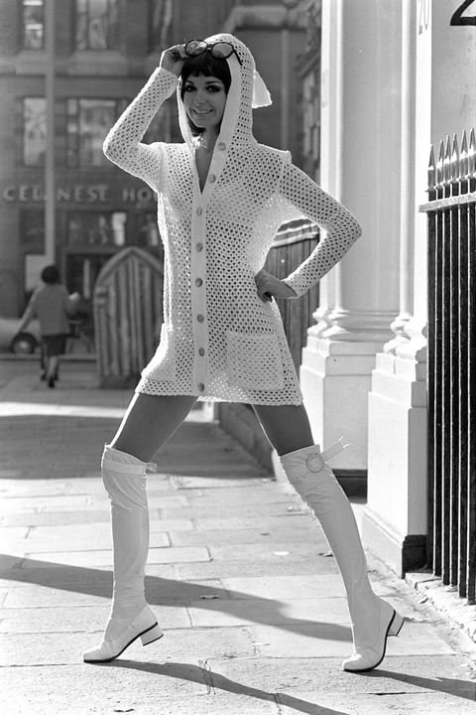



What were you wearing in the 70s?
Notes:
http://www.townandcountrymag.com/style/fashion-trends/news/g1760/70s-fashion-in-photos/
https://www.elle.com/fashion/trend-reports/g28520318/70s-fashion-style-trends/
https://www.harpersbazaar.com/fashion/trends/g6495/70s-fashion-in-photos/
https://www.harpersbazaar.com.sg/gallery/year-born-fashion-trends-90-80/

Slide 27




What were you wearing in the 70s?
Notes:
https://www.townandcountrymag.com/style/fashion-trends/news/g2069/100-years-of-style/
https://www.retrospace.org/2011/01/bad-fashion-18-colors-of-seventies.html
https://www.harpersbazaar.com/fashion/trends/g6495/70s-fashion-in-photos/
https://www.clbxg.com/Disco-Themed-Dresses/

Slide 28



Fashion in the 80s
This was a decade of bold style, colours, and silhouettes — and heaps of permed hair. Trends spanned ripped tights and biker jackets to polished oversized blazers and poof skirts. Style icons ranged from Joan Jett to Joan Collins. It was one of the most eclectic decades in fashion.
Princess Diana also emerged as a style icon.
Notes:
https://www.simplyeighties.com/80s-fashion.php
https://www.thesun.co.uk/tvandshowbiz/10086818/the-crown-emma-corrin-princess-diana/
https://www.townandcountrymag.com/style/fashion-trends/g28074440/princess-diana-royal-ascot-style-photos/

Slide 29


Changes in the 80s
So many 'statements' were being made in the 80s, and sometimes all in one outfit. Note the dress with the statement houndstooth print (including shoulder pads) and the more flattering simple black skirt (with the statement flower).
Additional statements:
BIG hair and earrings.
How many perms can you fit at one table?
It was also the time for eating fondue.
How many perms can you seat at one table?
Notes:
https://www.whowhatwear.com.au/best-80s-fashion-moments/slide2
https://www.whowhatwear.com.au/best-80s-fashion-moments

Slide 30


Changes in hair and makeup too!
Remember Lucille Ball in the 1950s, That gorgeous shocking red hair.
I wonder if it was her natural colour?
Notes:
https://vintagedancer.com/1950s/1950s-hairstyles/
https://www.rebelsmarket.com/blog/posts/1950s-hairstyles-most-popular-hairstyles-of-the-1950s

Slide 31




Hairstyles of the 70s
Notes:
https://www.hairstylesupdate.com/the-30-best-70s-hairstyles/
https://abcnews.go.com/Entertainment/loved-confidants-remember-farrah-fawcetts-final-days-worst/story?id=63061673
https://sassmystyle.com/70s-hairstyles
https://clickamericana.com/topics/beauty-fashion/how-to-create-5-different-classic-70s-hairstyles-plus-check-out-8-more-retro-dos

Slide 32




Then came the 80s
The perms! The wigs!!
The earrings!!!
And finally some sense.
Notes:
https://peruecken-online.com/GFW386-24AB17
https://www.allure.com/gallery/80s-hairstyles-trends
https://andrewbrentcall.blogspot.com/2018/12/80s-hairstyle-short-hair.html
https://www.short-haircut.com/best-stacked-short-hairstyles-pictures.html

Slide 33

We’ve come a long way
Notes:
https://upload.wikimedia.org/wikipedia/commons/thumb/b/be/StateLibQld_2_206817_Mannequins_modelling_race_day_fashions_at_Ascot%2C_Brisbane%2C_1935.jpg/120px-StateLibQld_2_206817_Mannequins_modelling_race_day_fashions_at_Ascot%2C_Brisbane%2C_1935.jpg
https://www.wafashionsonthefield.com.au/2019-20-calendar/

Slide 34

Thank you for taking this journey through time.
It has been fun to compile and I hope it has been enjoyable for you too.
Notes:
https://www.amazon.com/How-Fashion-Designer-Lesley-Ware/dp/1465467610

