Slide 1


IN OUR GARDEN
Notes:
http://www.supercoloring.com/coloring-pages/flowers-bouquet

Slide 2
The Rotary Club of Canterbury “Let’s Stay Connected Project” has been developed as a response to an identified need within the Aged Care sector.
At times when it’s difficult to connect in person with family and friends, the Rotary Club of Canterbury has pleasure in offering you this booklet, designed to promote conversation, recollection and engagement for those who are in isolation and without their usual social activities.
The booklets have been designed for people in an aged care residence, village or at home to read by themselves, or to have a family or staff member share the booklet with them.
You can download this and other booklets from the Rotary Club of Canterbury website (www.canterburyrotary.org).
Source references for this book are held at the Rotary Club of Canterbury. Contact president@caterburyrotary.org for further details.
Material in this book was reproduced in accordance with Section 113F of the Copyright Act (1968).

Slide 3
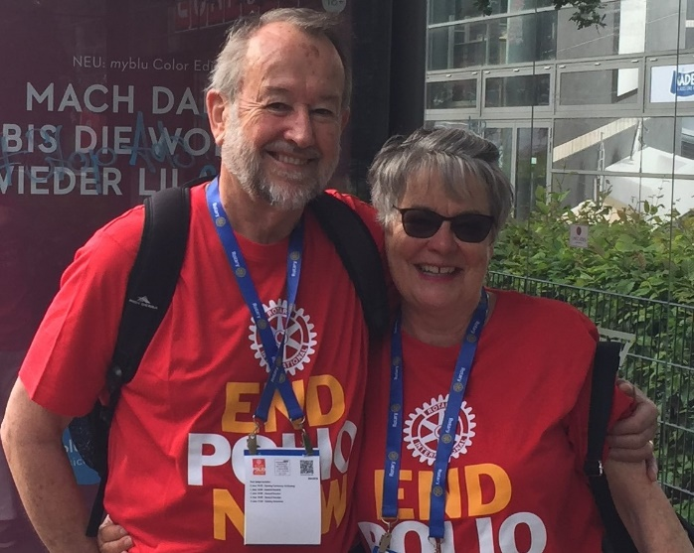
We’re Rosemary and Ted
We’re members of the
Rotary Club of Canterbury
and we invite you
to wander through
our garden.

Slide 4
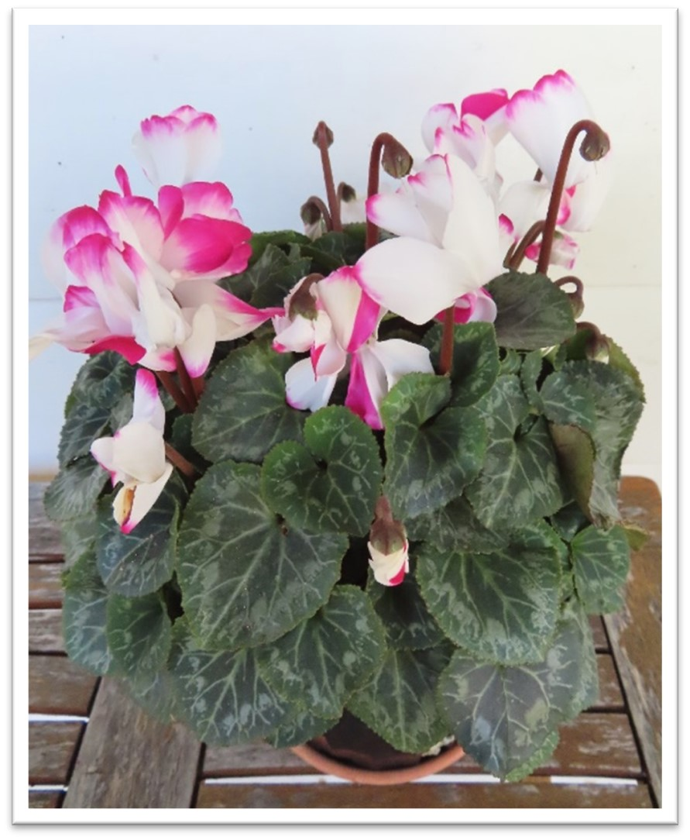
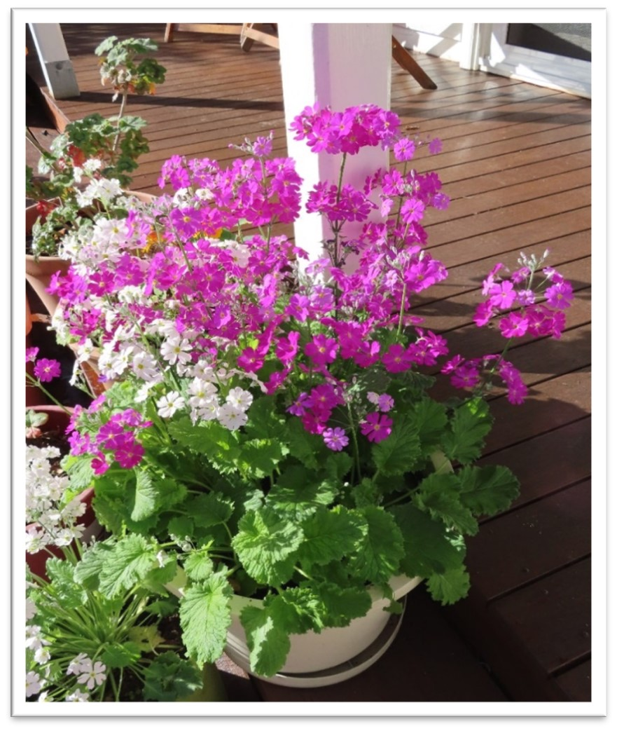
Pot Plants
We have lots of flowers in pots.
Notes:
Author’s own photographs

Slide 5
Pot Plants – Cyclamen
We buy our cyclamen at florists and garden centres.
Cyclamens are native to woodlands and can be found in many parts of the world.
Notes:
Author’s own photograph

Slide 6
Pot Plants – Primulas
These primulas were self-seeded in our garden.
Primulas belong to the primrose family and are native to woodlands. They can be found in many parts of the world, including Ethiopia and Papua New Guinea.
Notes:
Author’s own photograph

Slide 7

Other flowers in our garden – Poppies
The poppy is a symbol of remembrance.
In the First World War, poppies were a common sight, especially on the Western Front.
Notes:
http://www.supercoloring.com/coloring-pages/flowers/poppies

Slide 8
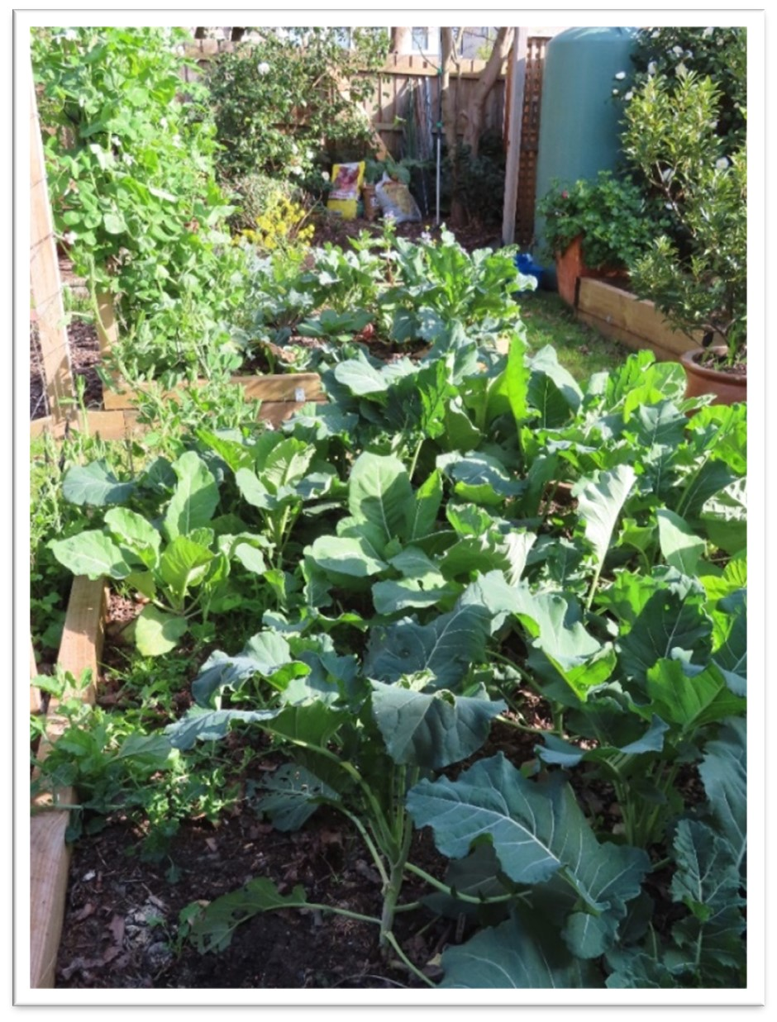
Vegetables in
our garden
Our vegetable patch has lots of vegetables.
We have a water tank by our shed to water the vegetables.
Notes:
Author’s own photograph

Slide 9
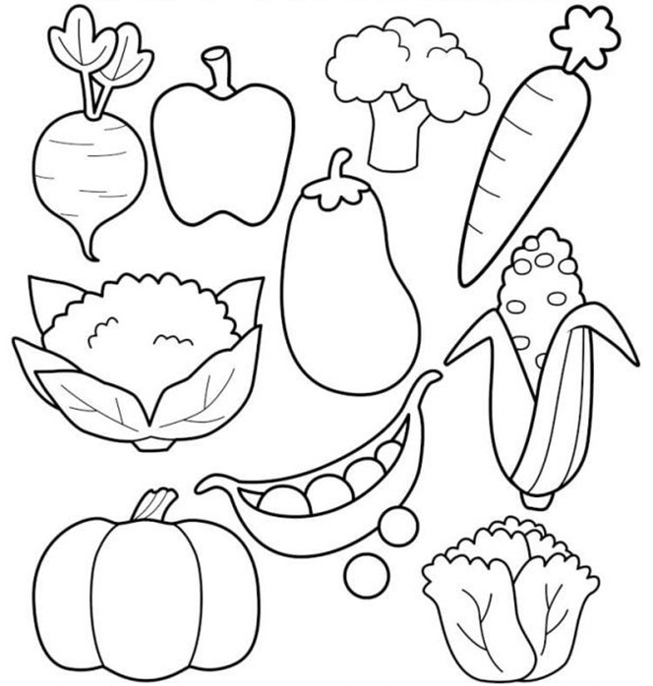
Vegetables for you to colour
Notes:
https://www.google.com/search?rlz=1C1ASUT_enAU843AU843&sxsrf=ALeKk03XXla58hh1O0uv8cIh2kj4blUeog:1597125424008&source=univ&tbm=isch&q=free+colouring+pages+for+kids+vegetables&sa=X&ved=2ahUKEwjfzrzsu5LrAhWCF3IKHf1pCicQ7Al6BAgKECE&biw=1112&bih=615#imgrc=o7bd091KPLyekM

Slide 10
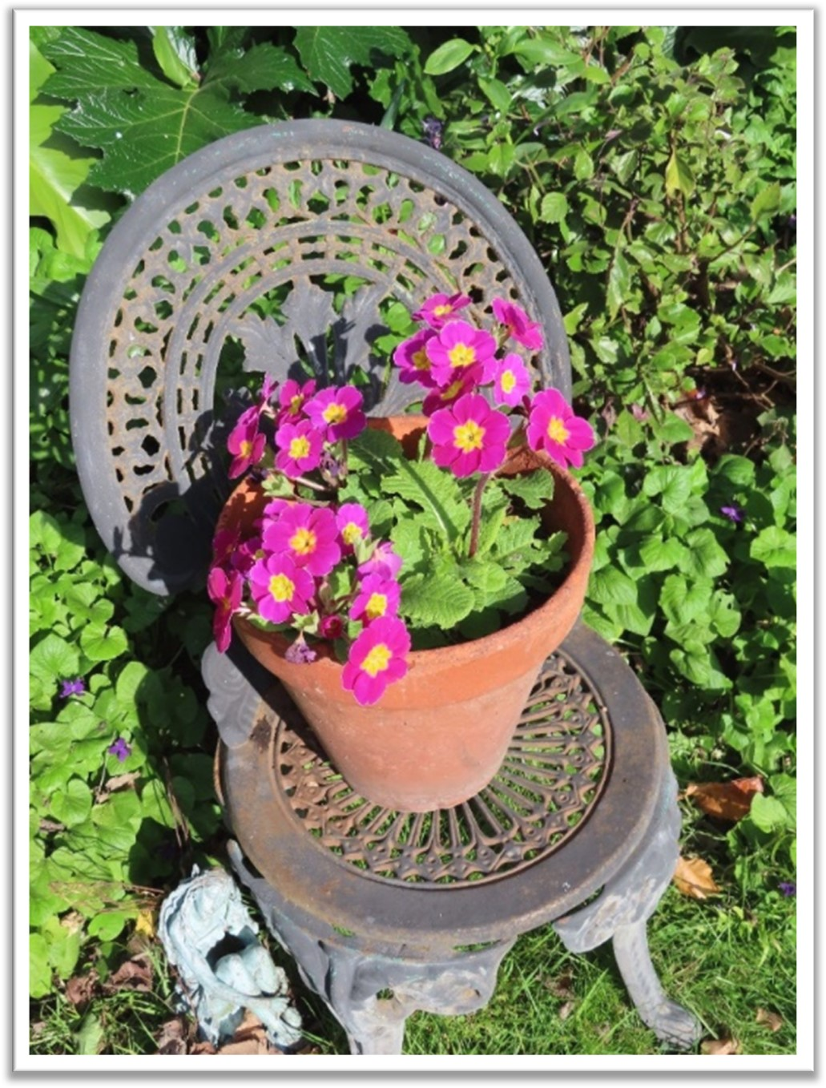
Flowers in pots
This bright pink polyanthus has flowered for three years in a row.
The pot is sitting on a chair that used to be in my mother’s garden.
Notes:
Author’s own photograph

Slide 11

Flowers for you to colour
Notes:
http://www.oogazone.com/2019/top-flower-drawings-vector-cdr/

