Slide 1

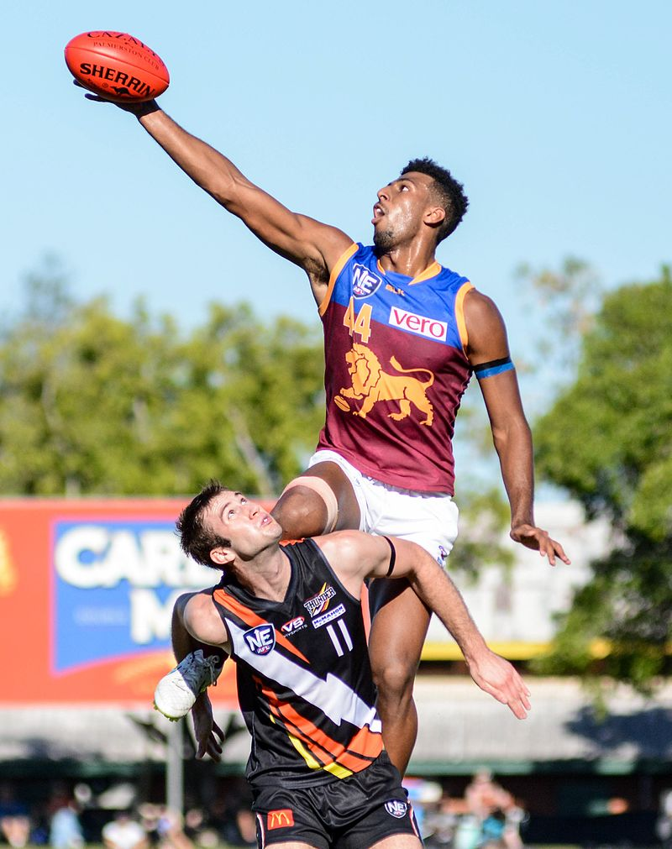
Australian Rules Football:
History and Legends
Notes:
https://en.wikipedia.org/wiki/Australian_rules_football#/media/File:Archie_Smith.jpg

Slide 2
Hi
My name is Sue.
I am a friend of a member of the Rotary Club of Canterbury in Melbourne, Australia.
I researched and wrote this booklet for those of you who enjoy Australian Rules Football and would like to read a short history of the game and the legendary footballers who played it.
Hope you enjoy it!
Sue

Slide 3
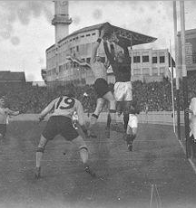
Football History
Initially known as Melbourne or Victorian rules football, the game was invented in Melbourne in the late 1850s.
The game was a combination of various football rules that were used in English public (independent) schools.
Notes:
https://en.wikipedia.org/wiki/Names_of_Australian_rules_football

Slide 4
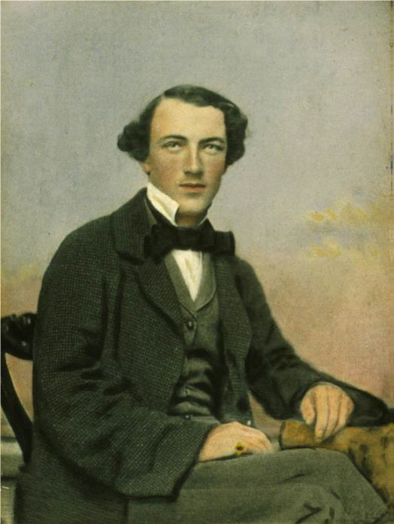
How Football Started in Melbourne
Tom Wills (pictured) had a letter published in July 1858, calling for “a foot-ball club, or other athletic pursuits to keep cricketers fit during winter”.
An experimental match was played on the Richmond Paddock on 31 July 1858.
Notes:
https://www.wikidata.org/wiki/Q3530930

Slide 5
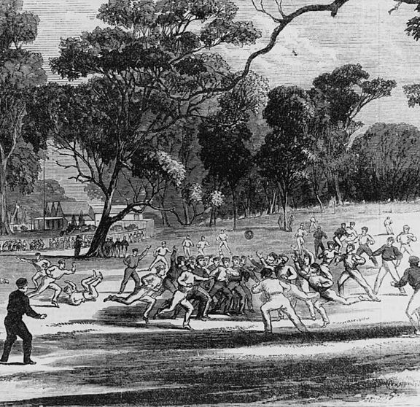
An Early Match
In August 1858, a famous match between Melbourne Grammar School and Scotch College was played.
The two teams played to ‘agreed rules’ which were not recorded, though we know each side fielded 40 players.
Notes:
https://upload.wikimedia.org/wikipedia/commons/thumb/a/a9/Australianfootball1866.jpg/220px-Australianfootball1866.jpg

Slide 6
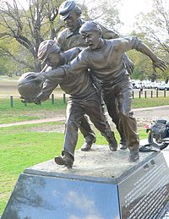
An Early Match
This first match between the two private schools is so famous in the football world that a statue commemorating this game can be found in the park around the MCG.
Notes:
https://upload.wikimedia.org/wikipedia/commons/thumb/c/ce/Tom_wills_statue.jpg/200px-Tom_wills_statue.jpg

Slide 7
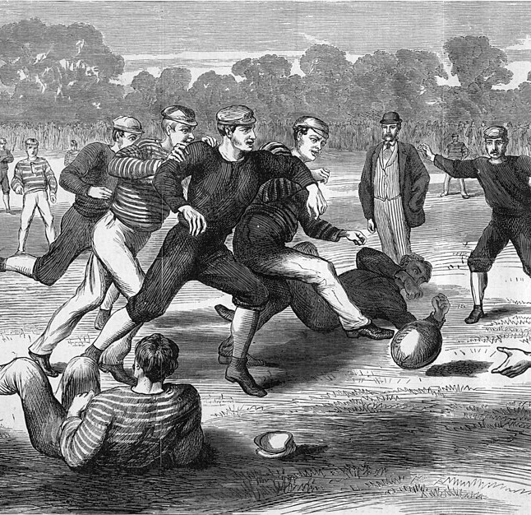
Development of Rules – Season 1
In May 1859, the Melbourne Football Club organised a game to start the season.
Two issues arose during the game: spectators encroaching on the field and the players all played to different rules.
A match in 1874
Notes:
https://commons.wikimedia.org/wiki/Category:1874_in_Australian_rules_football#/media/File:Australian_Football_Yarra_Park_1874.jpg

Slide 8
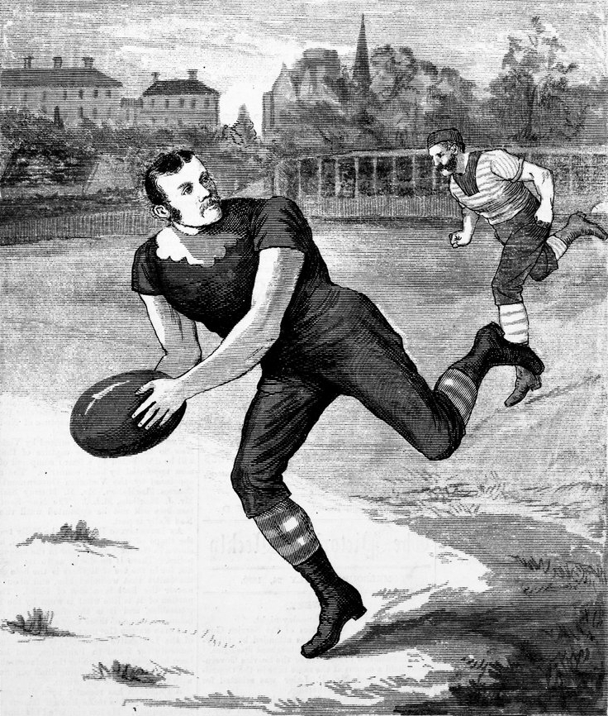
Development of Rules – Season 1
In this first game, there were players who wanted to kick and catch the ball. Others who did not want any hands used, and yet others who wanted to hold the ball and run.
Following that game, it was decided that Australian football needed its own rules.
Notes:
https://commons.wikimedia.org/wiki/Category:1880_in_Australian_rules_football#/media/File:Carlton_Footballer_George_Coulthard.jpg

Slide 9
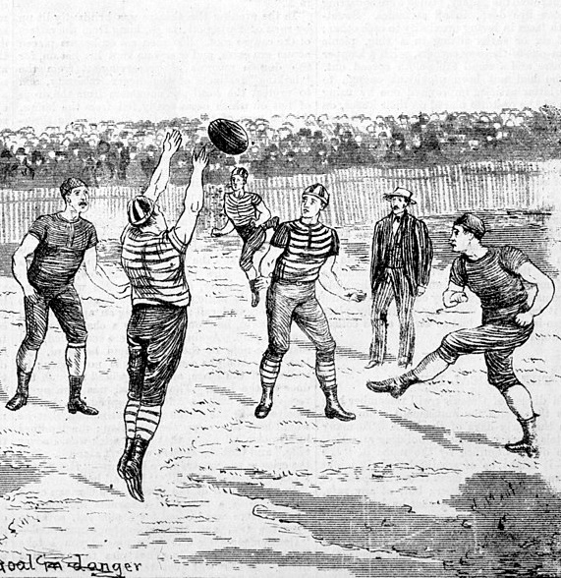
Development of Rules – Season 1
The initial rules were not immediately adopted by other clubs so rules would need to be agreed by the two teams before the game.
In 1860, a common set of rules "Victorian Rules of Football" were agreed.
Notes:
https://commons.wikimedia.org/wiki/Category:1880_in_Australian_rules_football#/media/File:Geelong_Melbourne_1880.jpg

Slide 10
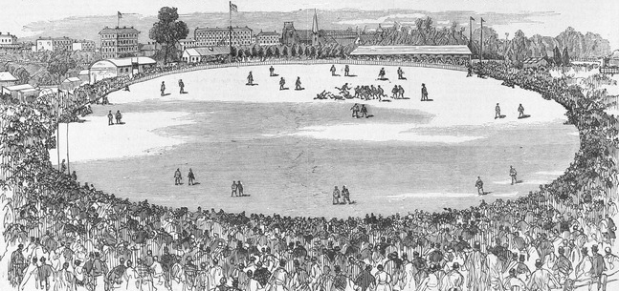
Development of Rules – Season 1
To stop spectators coming onto the field the Melbourne Football Club asked the Melbourne Cricket Club if their ground could be used.
An engraving of an early football match, 1879
Notes:
https://commons.wikimedia.org/wiki/Category:1879_in_Australian_rules_football#/media/File:Intercolonial_Football_Match_1879.jpg

Slide 11
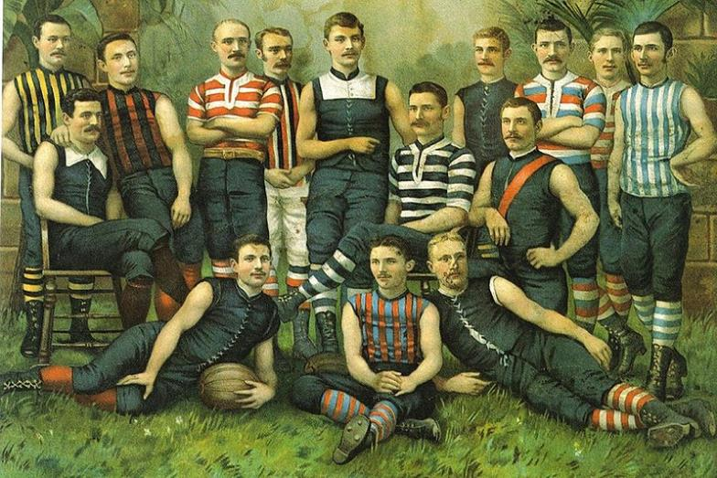
The First Football Clubs
Many current teams dating back to the beginnings of the game are part of the Australian Football League today.
Notes:
https://commons.wikimedia.org/wiki/Category:1885_in_Australian_rules_football#/media/File:Australian_rules_players.jpg

Slide 12
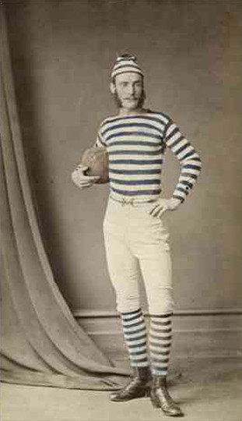
The First Football Clubs
The first inter-colony match was played before the end of the 1870s between Victoria and South Australia.
The photo shows a South Australian footballer in uniform, circa 1870.
Notes:
https://adelaidia.history.sa.gov.au/sites/default/files/styles/gallery_full_crop/public/images/teaser/b7437_mod.jpg?itok=bMJL9xll

Slide 13
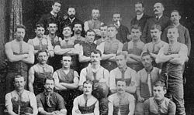
The Development of Football
Victorian Football Association (VFA)
The Victorian Football Association (VFA) was established in 1877 and had an initial membership of 10 senior clubs.
The Carlton football team were the first VFA club to premier in 1877.
Notes:
https://en.wikipedia.org/wiki/History_of_Australian_rules_football_in_Victoria_(1859%E2%80%931900)#:~:text=The%20Victorian%20Football%20Association%20(VFA,VJFA%20had%20its%20own%20administration.

Slide 14
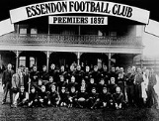
The Development of Football
Victorian Football League (VFL)
In 1896, the six strongest VFA clubs formed a breakaway competition, the Victorian Football League (VFL).
Its inaugural season was in 1897.
The first VFL club to premier was Essendon in 1897.
Notes:
https://en.wikipedia.org/wiki/Australian_Football_League#Background_and_founding

Slide 15
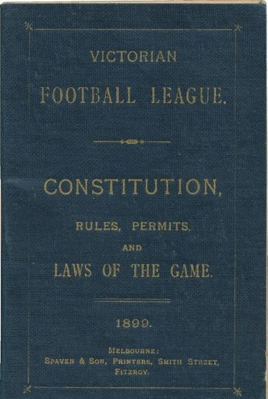
The Development of Football
Victorian Football League (VFL)
The VFL introduced many of the features in football today such as an annual finals tournament; and the modern scoring system of six points awarded for a goal, and one point for a behind.
In 1908, the League expanded to ten teams and by 1925, there were 12 teams.
Notes:
https://www.carters.com.au/index.cfm/item/945818-victorian-football-league-constitution-rules-permits-and-laws-of/

Slide 16

The Development of Football
Australian Football League (AFL)
During the 1980s, there was a push to have more interstate teams and develop a national competition.
The league changed its name to the Australian Football League (AFL) following the 1989 season and by 2012 there were with 18 member clubs.
Notes:
https://en.wikipedia.org/wiki/Australian_Football_League

Slide 17
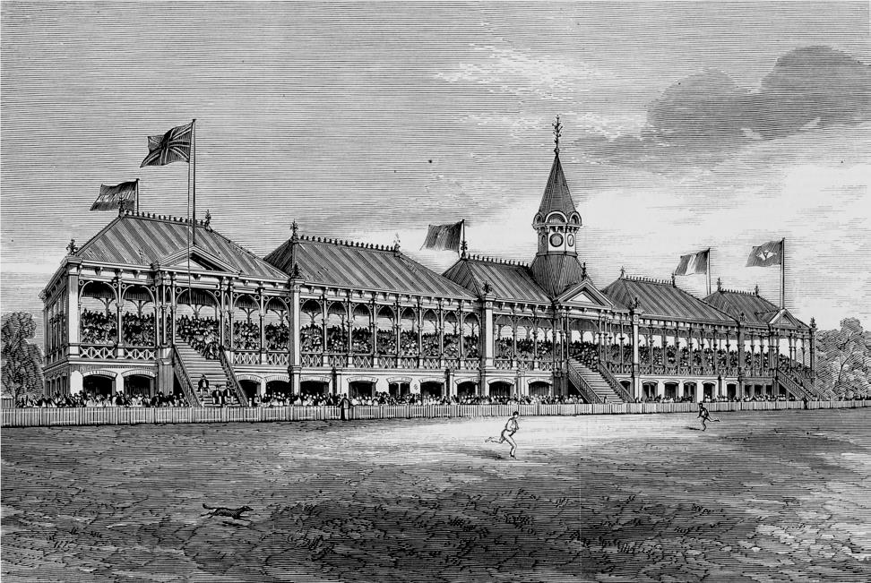
The Melbourne Cricket Ground (MCG)
The MCG was established in 1853, less than 20 years after the founding of Melbourne.
The MCG has been the home of Australian football since 1859.
Notes:
https://commons.wikimedia.org/wiki/File:MCG_grandstand.jpg

Slide 18
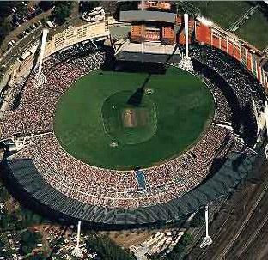
The Melbourne Cricket Ground (MCG)
Up to 100,000 fans can be accommodated in the MCG to watch the AFL Grand Final.
Notes:
https://en.wikipedia.org/wiki/Melbourne_Cricket_Ground

Slide 19
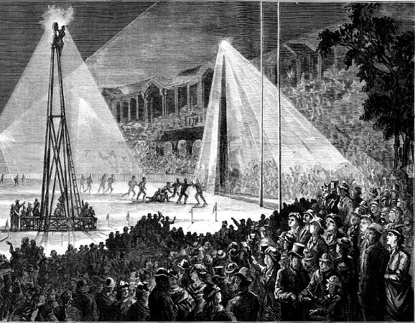
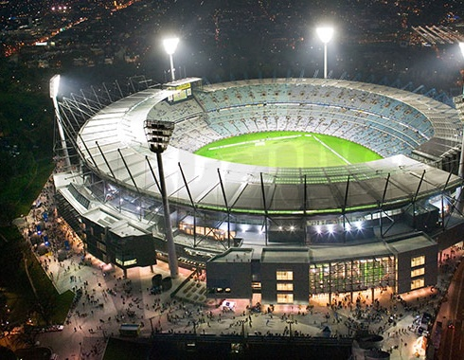
The MCG under Lights
The first night football match occurred in August 1879 at the MCG using electric light from batteries.
No batteries in use nowadays!
Notes:
https://commons.wikimedia.org/wiki/Category:1879_in_Australian_rules_football#/media/File:Football_electric_lighting_MCG_1879.jpg
https://www.australiansolarquotes.com.au/wp-content/uploads/2017/10/MCG.jpg

Slide 20
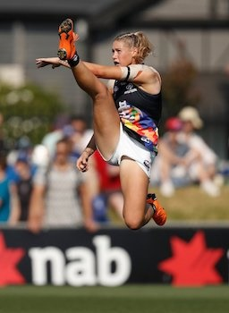
AFL Women’s (AFLW)
AFL Women’s (AFLW) is Australian Rules Football for female players. The first season began in 2017 with 8 teams, expanding to 14 by 2020.
Tayla Harris is pictured here showing style as athletic as any male players.
Notes:
https://en.wikipedia.org/wiki/Tayla_Harris

Slide 21
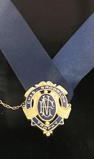
Awards and Medals
– The Brownlow
The First Brownlow Medal (pictured here) was awarded in 1924. It is awarded to the best and fairest player in the AFL during the season, as determined by the field umpires after each game.
Four players have each won the Brownlow three times.
Notes:
https://en.wikipedia.org/wiki/Brownlow_Medal

Slide 22

Awards and Medals
– The Norm Smith Medal
The Norm Smith Medal is presented to the player judged the best on ground in the Grand Final.
The award was named in honour of Norm Smith, a former player and six-time premiership coach for Melbourne.
Notes:
https://commons.wikimedia.org/wiki/Category:Norm_Smith#/media/File:Australian_rules_footballer_Norm_Smith.jpg

Slide 23
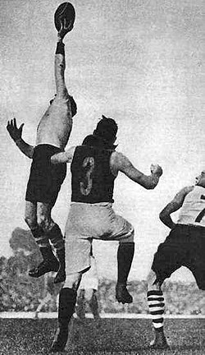
Up there Cazaly
Roy Cazaly was a South Melbourne ruckman known for his amazing leap. Fellow players used to call "Up there, Cazaly!" when he flew for the ball.
The phrase was later immortalised in the 1979 song “Up There Cazaly” which has become an unofficial anthem of the AFL.
Notes:
https://commons.wikimedia.org/wiki/Category:Roy_Cazaly

Slide 24
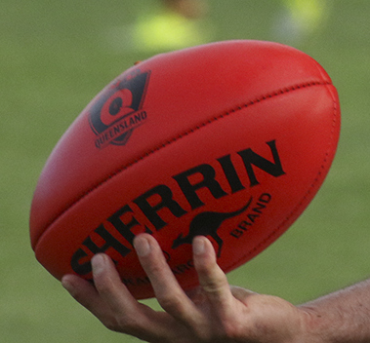
AFL Legends
The Australian Football Hall of Fame was established in 1996 to recognise the contributions made to the sport by players and others. Candidates are considered on the basis of their ability, integrity, sportsmanship and character.
The Legends category is reserved for those who are deemed to have had a significant impact on the game of Australian rules football.
Notes:
https://en.wikipedia.org/wiki/Australian_rules_football#/media/File:Sherrin_Kangaroo_Brand.jpg

Slide 25
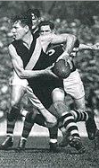
AFL Legend
– Jack Dyer
Jack was a Richmond ruckman who played from 1931-1949, a total of 19 seasons, 312 games and 443 goals.
After a particularly difficult game in 1935, a newspaper cartoonist pictured Dyer as a pirate. A journalist nicknamed him ‘Captain Blood’, after the Errol Flynn film Captain Blood.
Notes:
https://en.wikipedia.org/wiki/Richmond_Football_Club

Slide 26
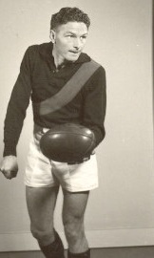
AFL Legend
– Bill Hutchinson
William Hutchison "Hutchy", played with Essendon from 1942-1957. He captained Essendon from 1951 to 1957, and played in Essendon's premiership sides in 1942, 1946, 1949 and 1950.
He was awarded the Brownlow Medal twice and is considered one of the finest rovers ever.
Notes:
https://en.wikipedia.org/wiki/Bill_Hutchison

Slide 27
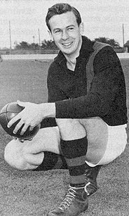
AFL Legend
– John Coleman
John Coleman played for Essendon from 1949-1954. In a short playing career, Coleman has the second highest goal average in history, kicking 537 goals in only 98 matches.
Coleman was known for his high-flying spectacular marks. A knee injury ended his playing career at age 25.
Notes:
https://en.wikipedia.org/wiki/John_Coleman_(Australian_footballer)

Slide 28
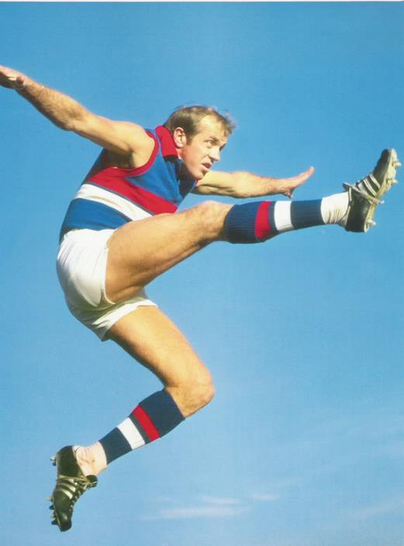
AFL Legend
– Ted Whitten
Ted Whitten "Mr Football" was admired for his ability, showmanship and larrikin streak. He played for Footscray, captaining the team from 1957-1970.
He was one of few football players who could play any position on the field and was regarded by his contemporaries as the most talented player of his era.
Notes:
https://australianfootball.com/players/player/ted%2Bwhitten/8030

Slide 29
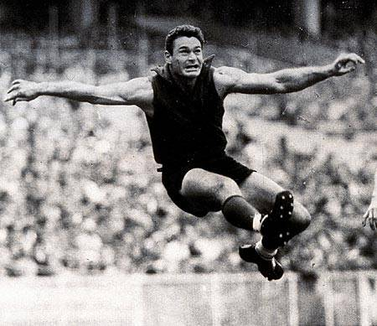
AFL Legend
– Ron Barassi
Ron Barassi played for Melbourne from 1953-1964 and for Carlton from 1965-1969. He played in six VFL Premierships: 1955, 1956, 1957, 1959, 1960 and 1964.
His great playing style, coaching career, clean record and passion for the game caused him to be the first player to be inaugurated into the Australian Football Hall of Fame as a "Legend".
Notes:
https://australianfootball.com/players/player/ron%2Bbarassi/16019

Slide 30
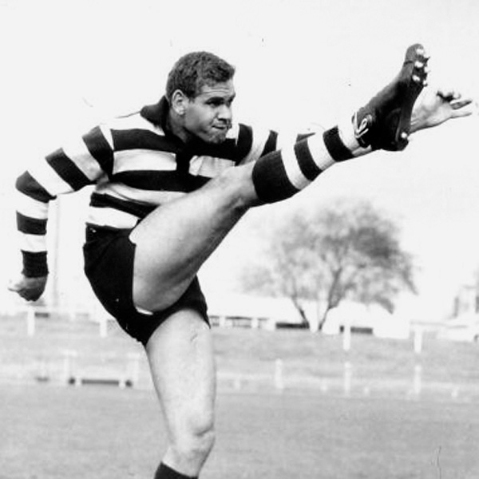
AFL Legend
– Graham (Polly) Farmer
Polly Farmer started his football career in Perth in 1953 as a ruckman. He was recruited to play for Geelong where he captained the team for three seasons before returning to Western Australia.
He is an AFL Legend and is included among the Indigenous Team of the Century players.
Notes:
https://wais.org.au/other/hoc_detail.php?id=79

Slide 31
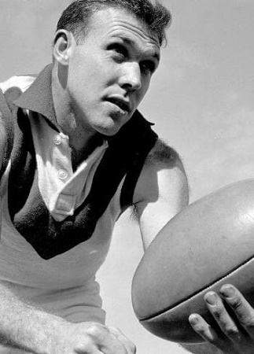
AFL Legend
– Bob Skilton
Bob Skilton was a South Melbourne rover who captained the team for eleven years. He is one of only four players to have won the Brownlow Medal three times.
One of his greatest assets was the ability to kick with both feet.
Notes:
https://afllegends.com.au/2019/01/04/bob-skilton/

Slide 32
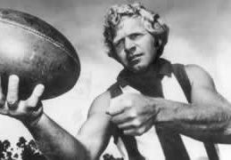
AFL Legend
– Barry Cable
Barry Cable played over 400 games between 1962 and 1975 at senior level in the VFL and the Western Australian Football League (WAFL). He was awarded the Sandover Medal (equivalent to the Brownlow) three times.
He has been judged one of the greatest rovers in the sport's history.
Notes:
https://www.aflfreebets.com/wp-content/uploads/barry-cable-320x180.jpg

Slide 33
The Rotary Club of Canterbury “Let’s Stay Connected Project” has been developed as a response to an identified need within the Aged Care sector.
At times when it’s difficult to connect in person with family and friends, the Rotary Club of Canterbury has pleasure in offering you this booklet, designed to promote conversation, recollection and engagement for those who are in isolation and without their usual social activities.
The booklets have been designed for people in an aged care residence, village or at home to read by themselves, or to have a family or staff member share the booklet with them.
You can download this and other booklets from the Rotary Club of Canterbury website (www.canterburyrotary.org).
Source references for this book are held at the Rotary Club of Canterbury. Contact president@caterburyrotary.org for further details.
Material in this book was reproduced in accordance with Section 113F of the Copyright Act (1968).

